Slide 1
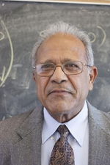
Stellar Limits on Light Scalars [Some recent (and not-so-recent) work with Rabi]
Bhupal Dev
Washington University in St. Louis
Rabi-Fest
University of Maryland, College Park
October 21, 2022

Slide 2
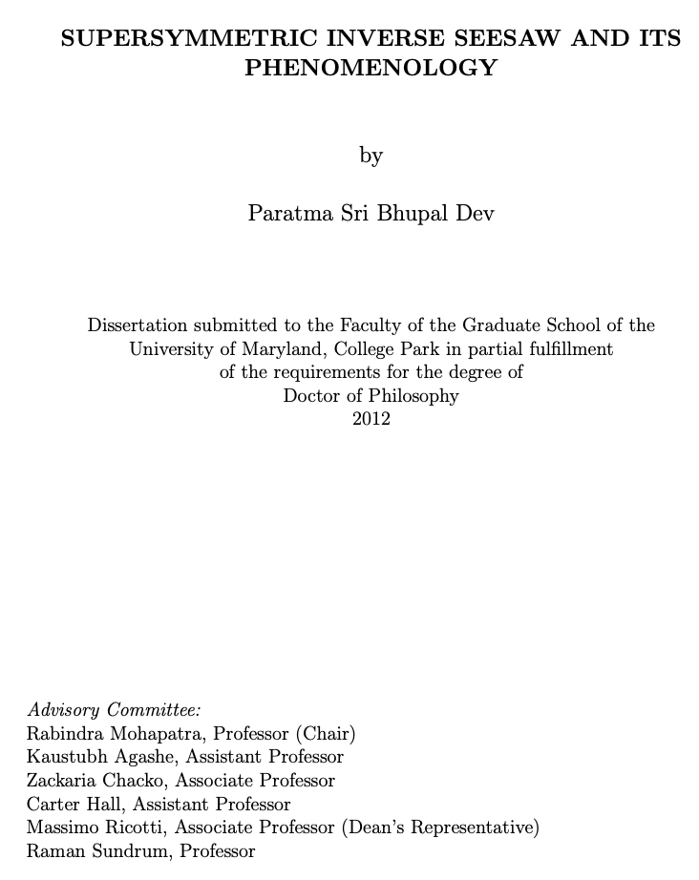
Honor and Privilege to be Rabi’s student (2007-12)
Post-Sphaleron Baryogenesis and Neutron-antineutron oscillation: Babu, BD, Mohapatra, 0811.3411 (PRD ‘09). Set the foundation for 1303.6918 (PRD ‘13) – paper that Yuri loves so much.
Supersymmetric SO(10) GUT Phenomenology
BD, Mohapatra, 0910.3924 (PRD ‘10) – one of my most cited papers
BD, Mohapatra, 1003.6102 (PRD ‘10)
BD, Mohapatra, Severson, 1107.2378 (PRD ‘11)
BD, Dutta, Mohapatra, Severson, 1202.4012 (PRD ‘12)
Leptogenesis: Blanchet, BD, Mohapatra, 1010.1471 (PRD ‘10)
Dark Matter: An, BD, Cai, Mohapatra, 1110.1366 (PRL ‘12)
– one of Haipeng’s favorites (see Xiangdong’s talk)
Higgs Physics: BD, Franceschini, Mohapatra, 1207.2756 (PRD ‘12)
-- my first experience with PYTHIA/Delphes
Collider Physics: Chen, BD, 1112.6419 (PRD ‘12)
-- my first independent paper (with a TASI-mate)

Slide 3
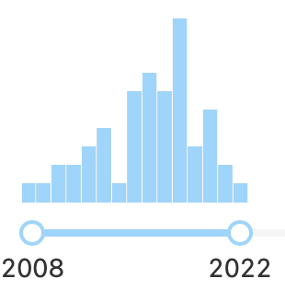
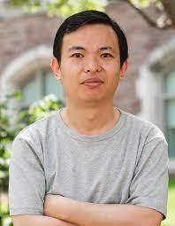
My collaboration with Rabi has continued ever since
Will limit the rest of my talk to a couple of recent papers with Rabi and some follow-up work on astrophysical limits on light BSM physics.
BD, Mohapatra, Zhang, Revisiting supernova constraints on a light CP-even scalar, 2005.00490 (JCAP ‘20)
BD, Mohapatra, Zhang, Stellar limits on light CP-even scalar, 2010.01124 (JCAP ‘21)
BD, Harris, Fortin, Sinha, Zhang, Light scalars in neutron star mergers, 2111.05852 (JCAP ‘22)
Balaji, BD, Silk, Zhang, Improved stellar limits on a light CP-even scalar, 2205.01669
And ongoing work
Yongchao Zhang
(former Rabi/Xiangdong student, our postdoc (2017-20).
Now Professor at Southeast Univ

Slide 4
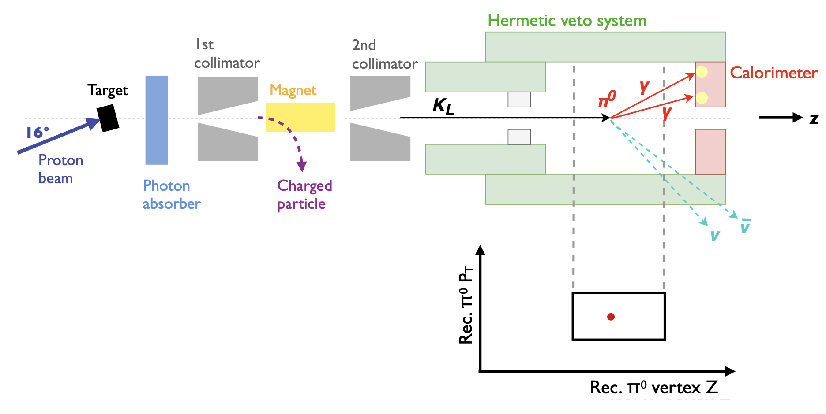
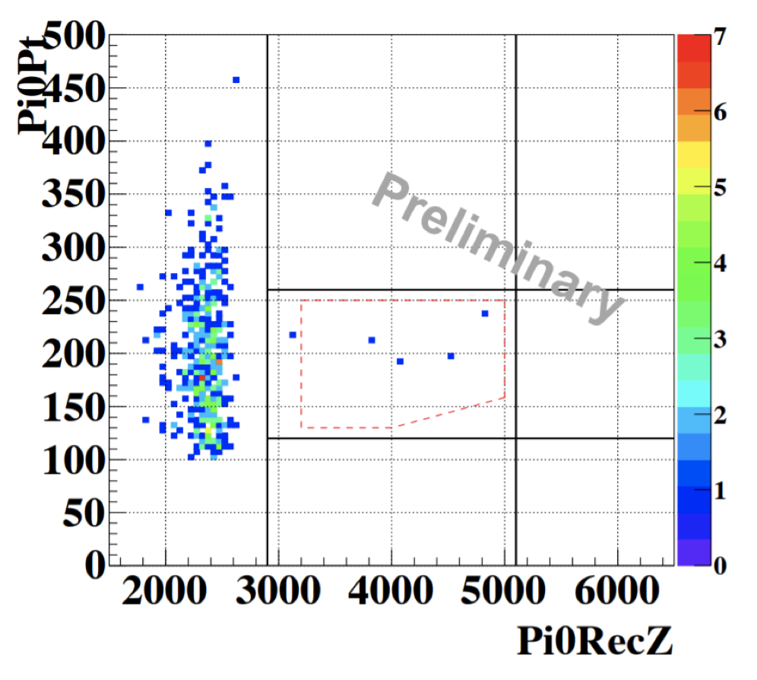
This series of works started with something completely different: KOTO Anomaly
3 events in the signal region vs SM expectation of 0.10±0.02.
Talk by Sinohara KAON 2019
New Physics?

Slide 5
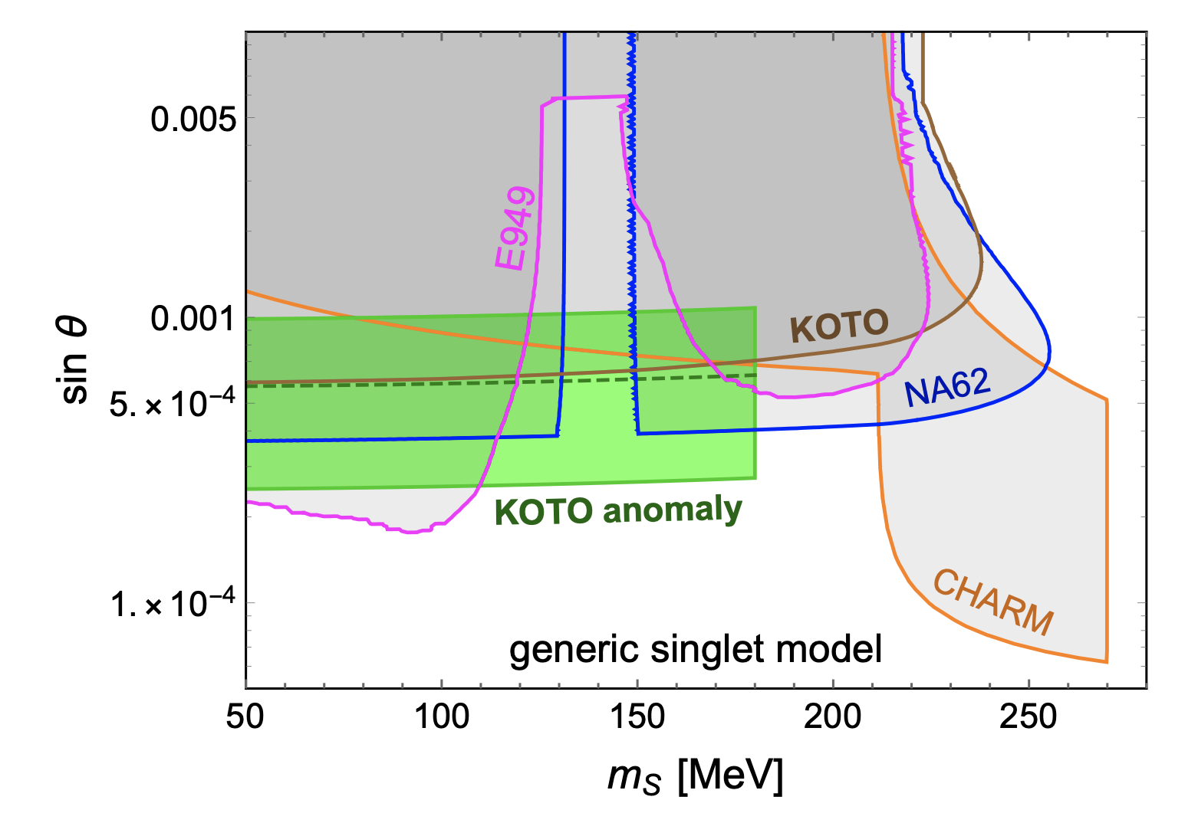
Light CP-even Scalar
Not
What about the supernova constraint?
Soon realized that nobody had done a full calculation of SN1987A bound on CP-even scalar.
The existing literature just used the NN
bremsstrahlung amplitude for CP-odd axions.
Isizuka, Yoshimura (PTEP ‘90);
Arndt, Fox, hep-ph/0207098 (JHEP ‘03);
Diener, Burgess, 1302.6486 (JHEP ‘13);
Krnjaic, 1512.04119 (PRD ‘16)
BD, Mohapatra, Zhang, 1911.12334 (PRD ‘20)

Slide 6
But there are two crucial differences between CP-even and CP-odd Cases!
BD, Mohapatra, Zhang, 2005.00490 (JCAP ‘20)
Coupling to pion mediator is important.
Absent in the CP-odd case.

Slide 7
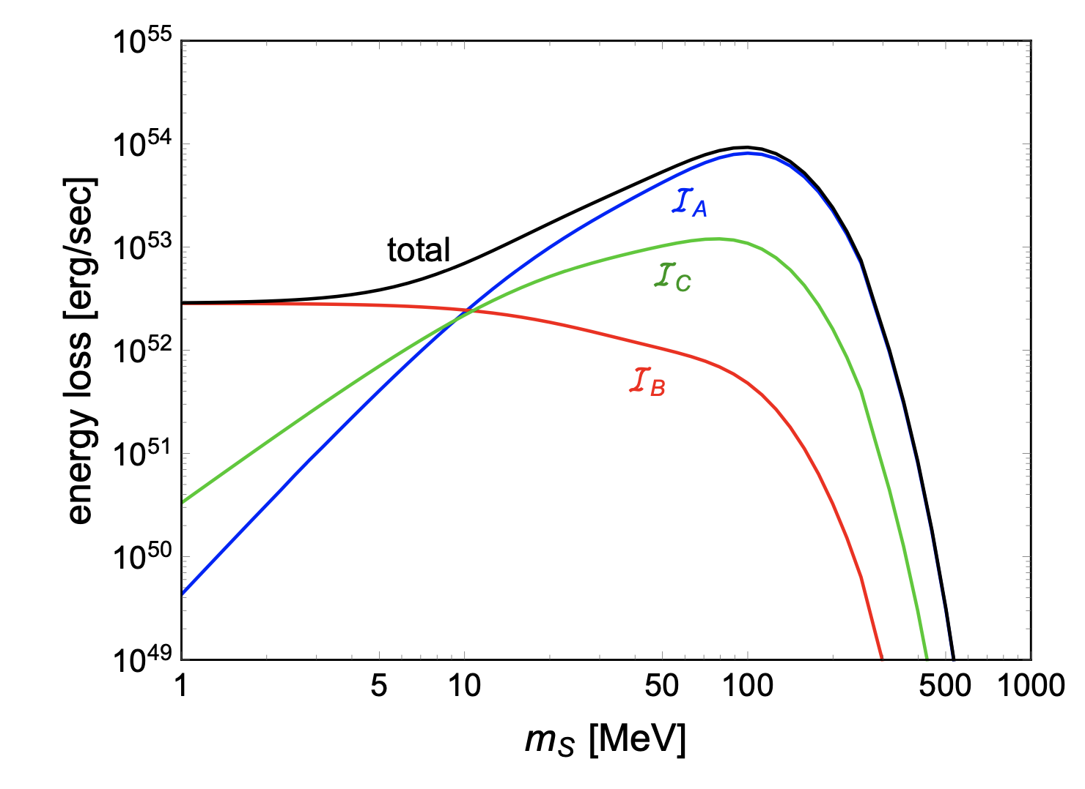
Comparison of Different Contributions

Slide 8
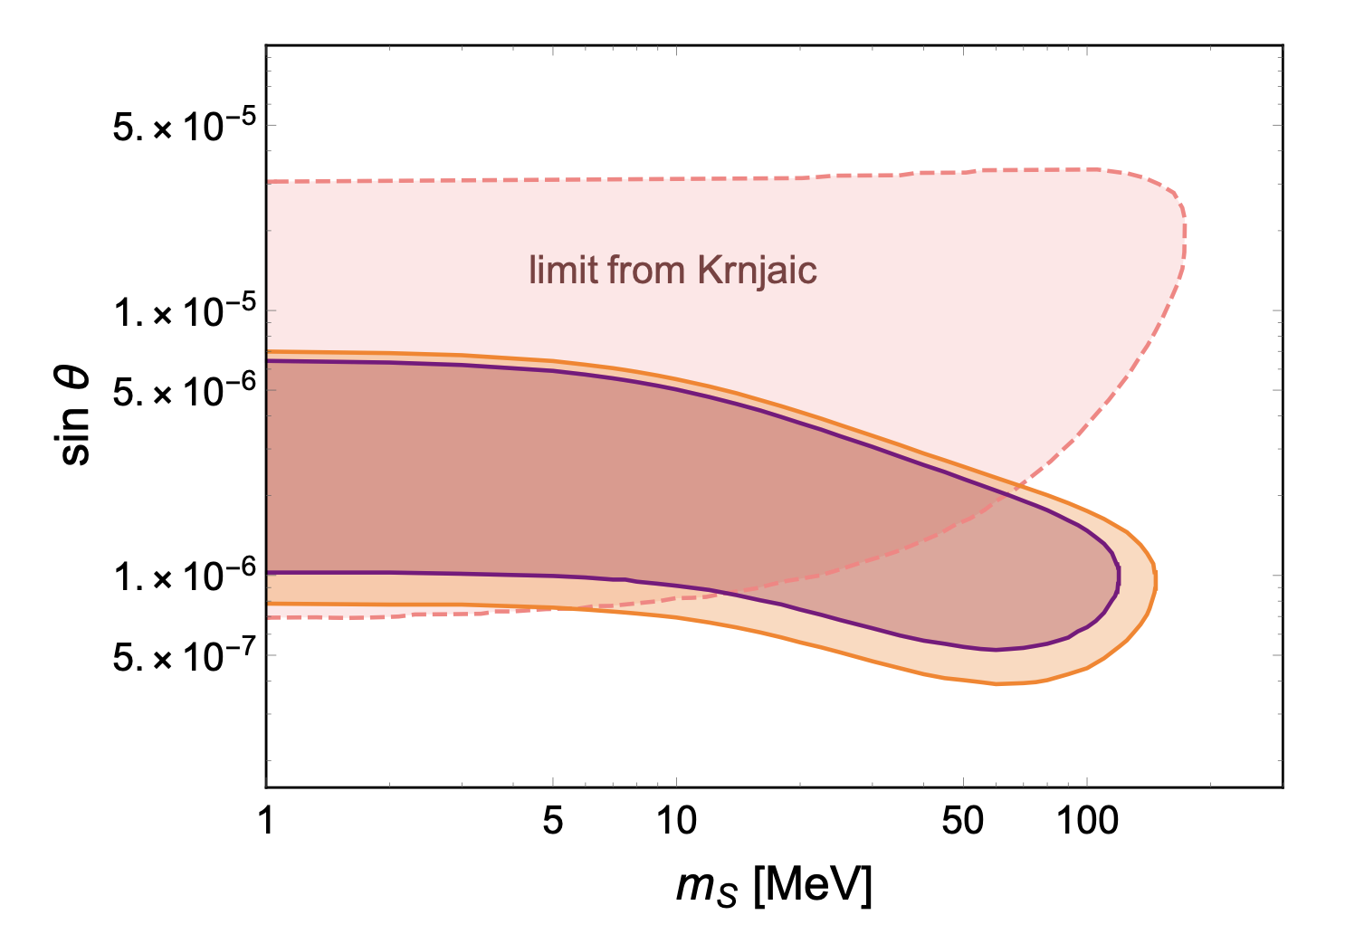
Updated SN1987A Bound on CP-even Scalar

Slide 9
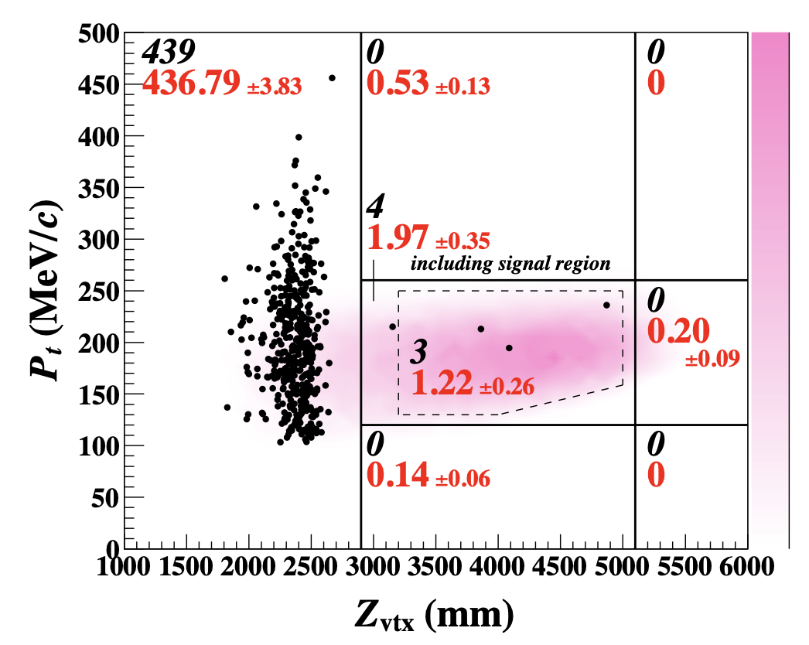
Meanwhile, KOTO Anomaly Disappeared
More background than initial estimate.
Corresponding probability of
observing 3 events is 13%.
No New Physics yet (again).
But still recalculating the supernova constraint was a useful exercise.
2012.07571 (PRL ‘21)

Slide 10
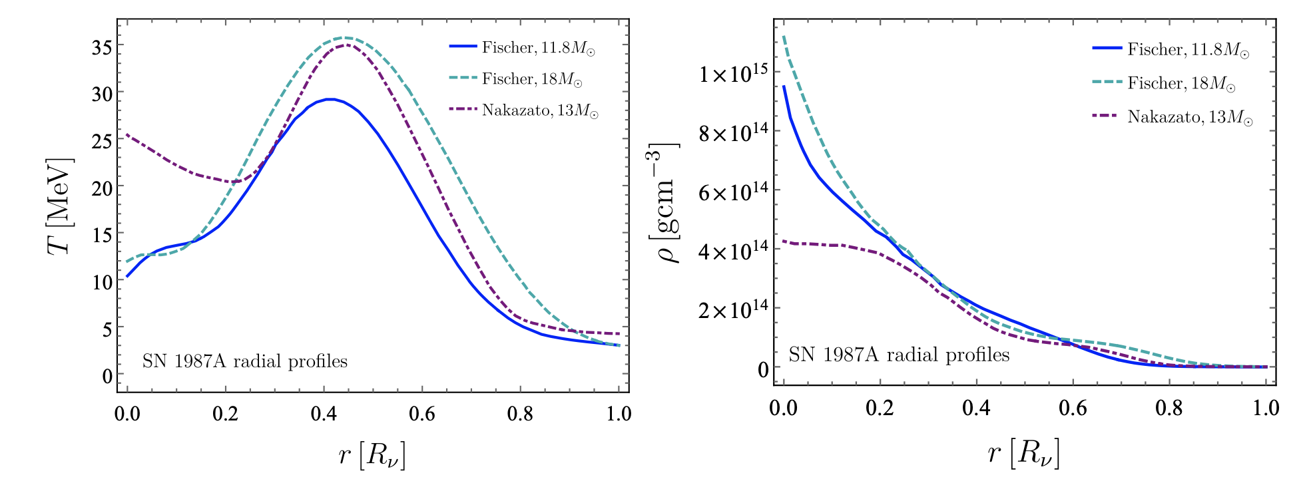
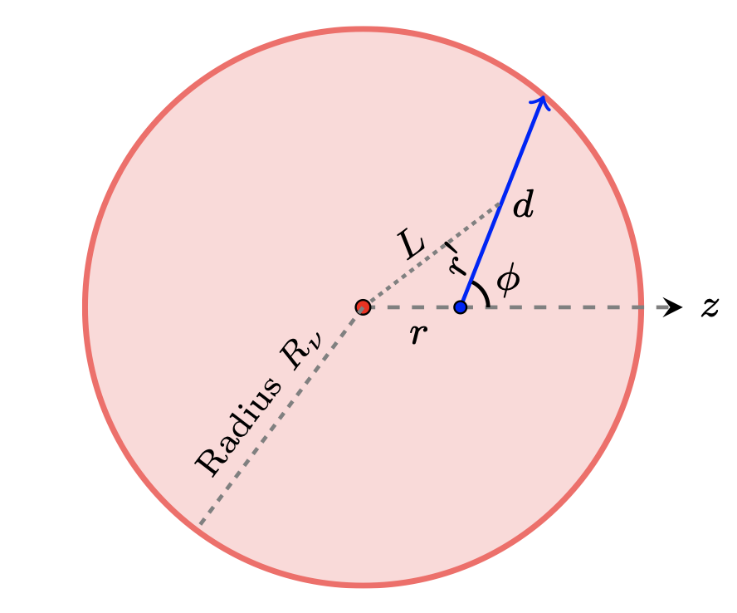
There is more to the Supernova story
Balaji, BD, Silk, Zhang, 2205.01669
Geometry effect
Include the changing temperature and density profile effects.
was not included even for axions until a week before our work: Caputo,Raffelt, Vitagliano, 2204.11862 (JCAP ‘22)
For axions, done in Chang, Essig, McDermott, 1611.03864 (JHEP ‘17)

Slide 11
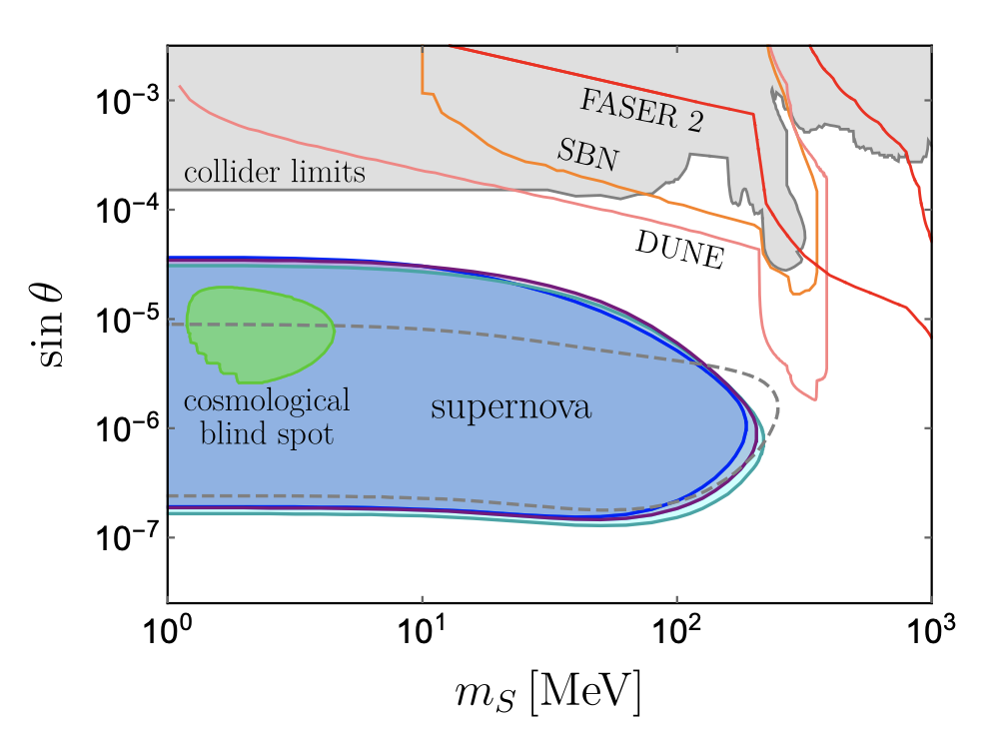
Reupdated SN1987A Bound

Slide 12
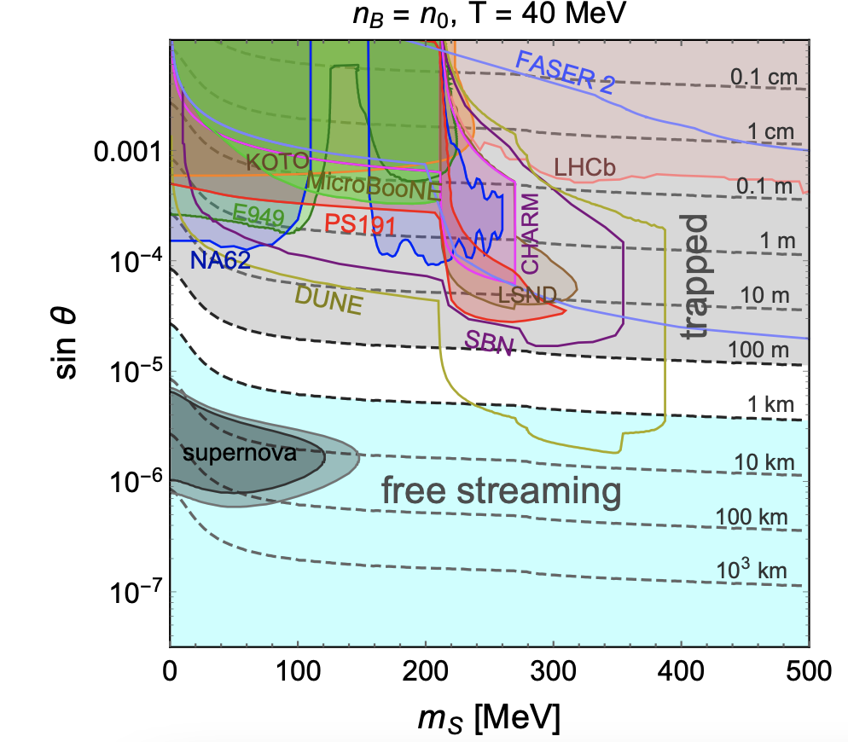
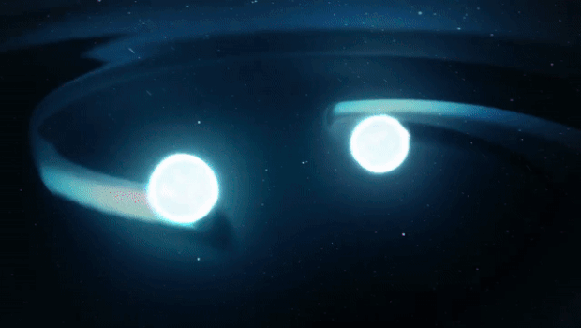
NS Mergers
From CBSNews
A New Multimesseger Window to BSM Physics
Axion: Harris, Fortin, Sinha, Alford, 2003.09768 (JCAP ‘21)
BD, Harris, Fortin, Sinha, Zhang, 2111.05852 (JCAP ‘22)
Dark photon: Diamond, Marques-Tavares, 2106.03879 (PRL ‘22)

Slide 13
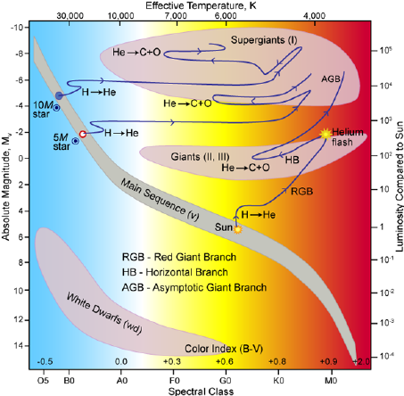
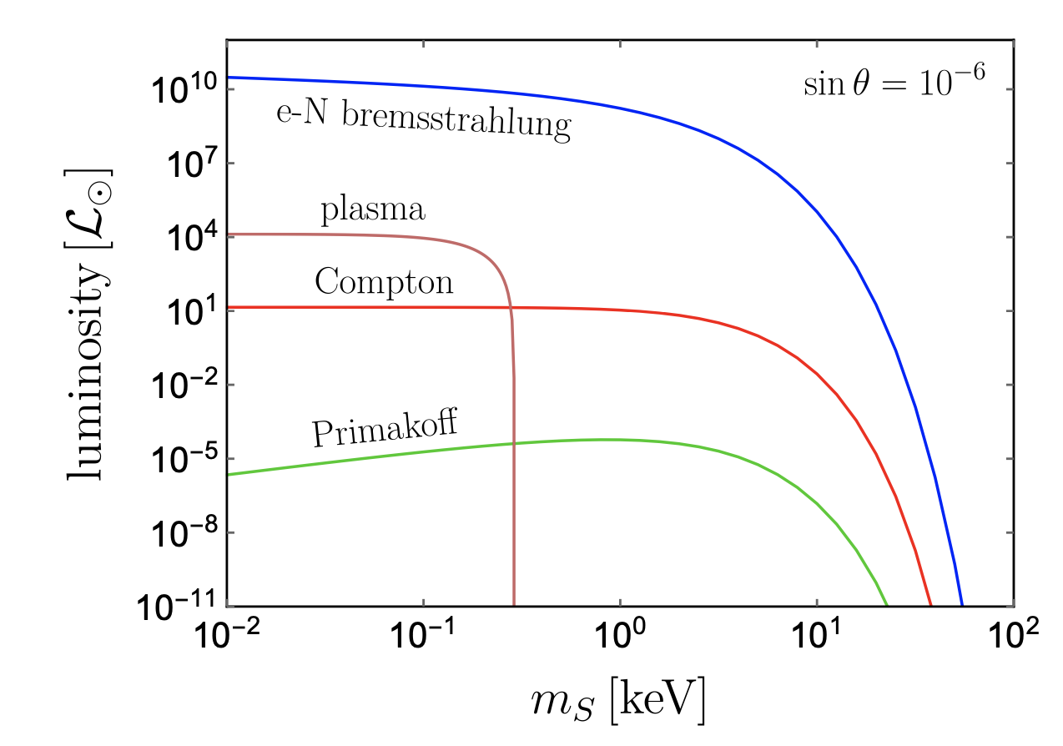
How about other stellar structures?
BD, Mohapatra, Zhang, 2010.01124 (JCAP ‘21);
Balaji, BD, Silk, Zhang, 2205.01669
Figure from Robert Hollow

Slide 14
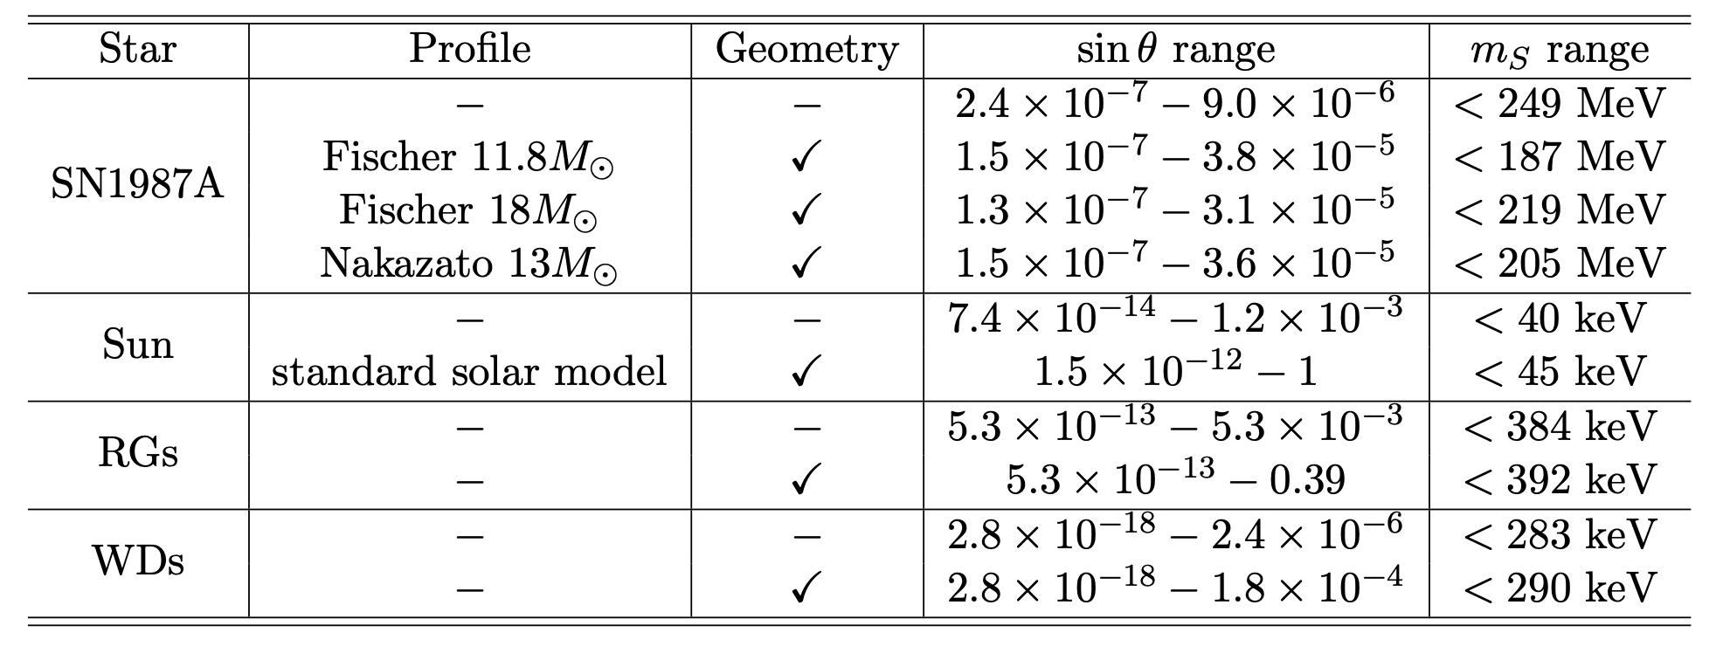
Updated Stellar Limits
BD and HB stars to be included (ongoing)

Slide 15
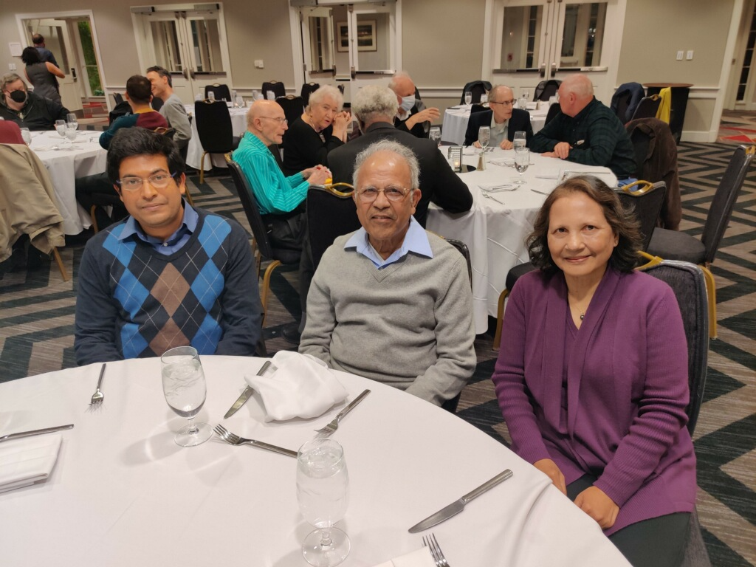
Conclusion
To quote Jim Gates, “If we had more people like Rabi, the world would have been a much better place”.
Rabi is the best physicist, mentor, guide and collaborator I have interacted with so far.
Looking forward to many more years of productive research with Rabi.
Wish a very happy retirement life to Rabi and Manju Apa.
Photo Courtesy: Deepak Sathyan
Thank you.

