Slide 1

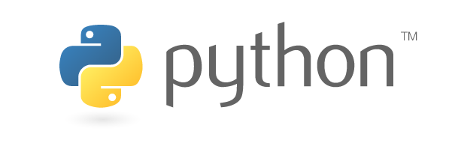
Python and PyMinuit
Physics 584
Bhupal Dev
March 8, 2018

Slide 2
Overview
Python is a high-level, interpreted, interactive and object-oriented scripting language. Python is designed to be highly readable. It uses English keywords frequently where as other languages use punctuation, and it has fewer syntactical constructions than other languages.
Python is Interpreted − Python is processed at runtime by the interpreter. You do not need to compile your program before executing it. This is similar to PERL and PHP.
Python is Interactive − You can actually sit at a Python prompt and interact with the interpreter directly to write your programs.
Python is Object-Oriented − Python supports Object-Oriented style or technique of programming that encapsulates code within objects.
Python is a Beginner's Language − Python is a great language for the beginner-level programmers and supports the development of a wide range of applications from simple text processing to WWW browsers to games.

Slide 3
Features
Easy-to-learn − Python has few keywords, simple structure, and a clearly defined syntax. This allows the student to pick up the language quickly.
Easy-to-read − Python code is more clearly defined and visible to the eyes.
Easy-to-maintain − Python's source code is fairly easy-to-maintain.
A broad standard library − Python's bulk of the library is very portable and cross-platform compatible on UNIX, Windows, and Macintosh.
Interactive Mode − Python has support for an interactive mode which allows interactive testing and debugging of snippets of code.
Portable − Python can run on a wide variety of hardware platforms and has the same interface on all platforms.
Extendable − You can add low-level modules to the Python interpreter. These modules enable programmers to add to or customize their tools to be more efficient.
Databases − Python provides interfaces to all major commercial databases.
GUI Programming − Python supports GUI applications that can be created and ported to many system calls, libraries and windows systems, such as Windows MFC, Macintosh, and the X Window system of Unix.
Scalable − Python provides a better structure and support for large programs than shell scripting.

Slide 4

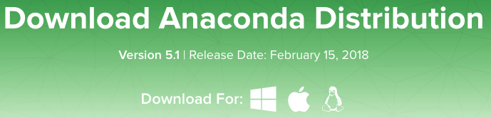
Getting Python
Open-source, free.
An easy way is to use Anaconda
After your install is complete, verify it by opening Anaconda Navigator, a program that is included with Anaconda: (for Mac) from Launchpad, select Anaconda Navigator, then qtconsole.

Slide 5
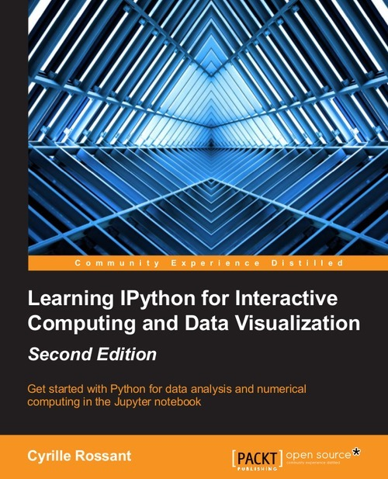
Interactive Python (IPython)
Get a free, online copy of
Learning IPython for Interactive Computing and Data Visualization
And open in Safari technical Books

Slide 6
Python Identifiers
A Python identifier is a name used to identify a variable, function, class, module or other object. An identifier starts with a letter A to Z or a to z or an underscore (_) followed by zero or more letters, underscores and digits (0 to 9).
Python does not allow punctuation characters such as @, $, and % within identifiers. Python is a case sensitive programming language. Thus, Manpower and manpower are two different identifiers in Python.
Here are naming conventions for Python identifiers −
Class names start with an uppercase letter. All other identifiers start with a lowercase letter.
Starting an identifier with a single leading underscore indicates that the identifier is private.
Starting an identifier with two leading underscores indicates a strongly private identifier.
If the identifier also ends with two trailing underscores, the identifier is a language-defined special name.

Slide 7
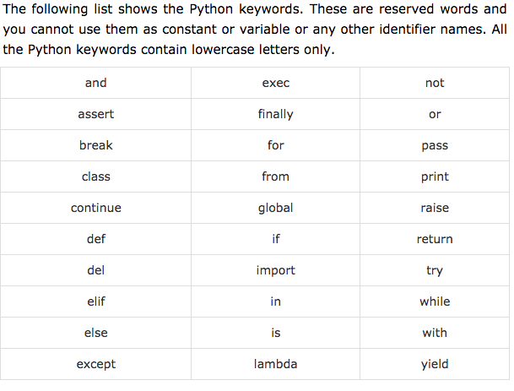
Reserved Words

Slide 8
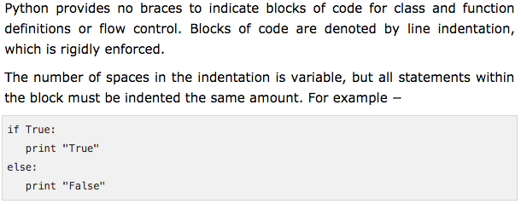
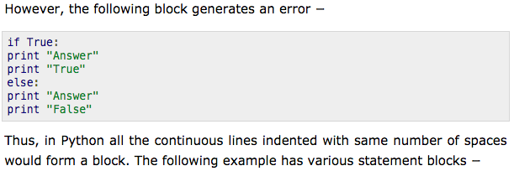
Lines and Indentations

Slide 9
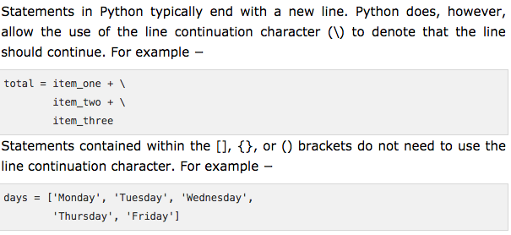
Multi-line Statements
Or write to a file filename.ipy and at command line execute run filename.ipy

Slide 10
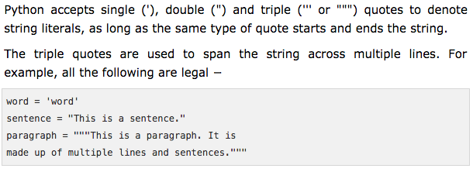
Quotations

Slide 11
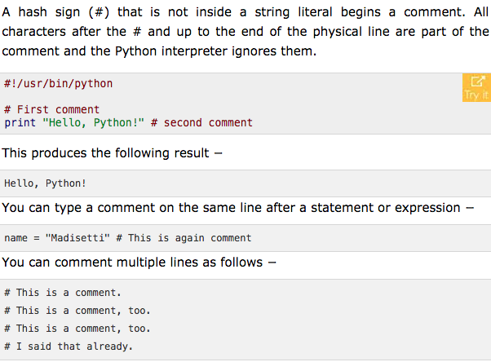
Comments

Slide 12
Using Blank Lines
A line containing only whitespace, possibly with a comment, is known as a blank line and Python totally ignores it.
In an interactive interpreter session, you must enter an empty physical line to terminate a multiline statement.
The semicolon ( ; ) allows multiple statements on the single line given that neither statement starts a new code block. Here is a sample snip using the semicolon −
Here, ”\n" is used to create a new line before displaying the actual line.

Slide 13
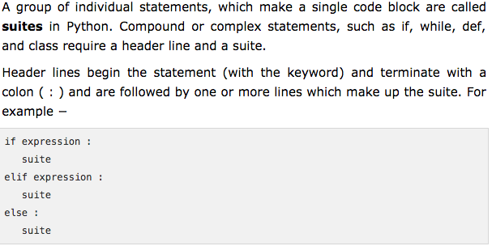
Suites

Slide 14
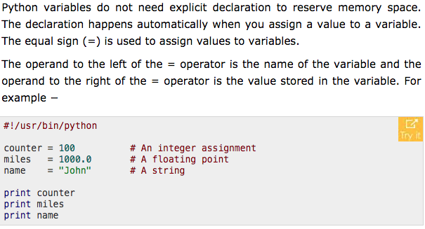
Assigning Values to Variables
In IPython, type print(…)

Slide 15
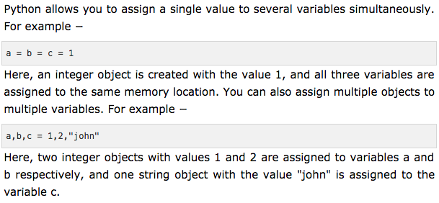
Multiple Assignment

Slide 16
Standard Data Types
Python has five standard data types:
Number
String
List
Tuple
Dictionary

Slide 17
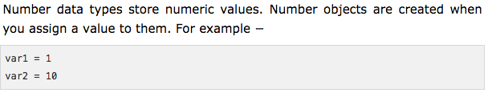
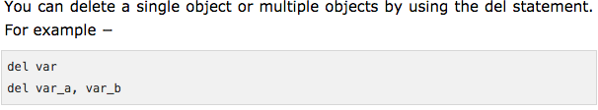
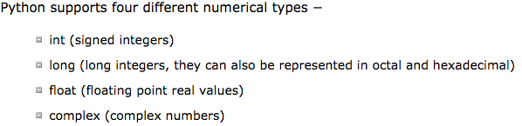
Numbers

Slide 18
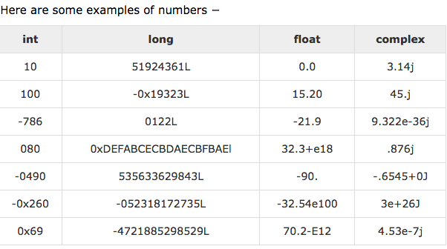
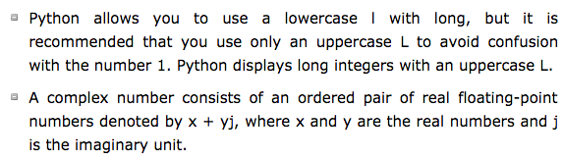
Numbers

Slide 19
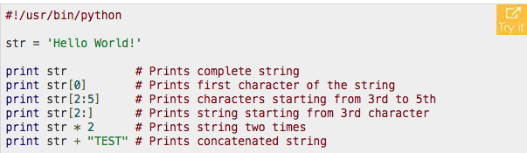
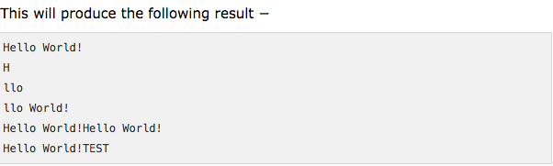
Strings
Strings in Python are identified as a contiguous set of characters represented in the quotation marks. Python allows for either pairs of single or double quotes. Subsets of strings can be taken using the slice operator ([ ] and [:] ) with indexes starting at 0 in the beginning of the string and working their way from -1 at the end.
The plus (+) sign is the string concatenation operator and the asterisk (*) is the repetition operator.

Slide 20
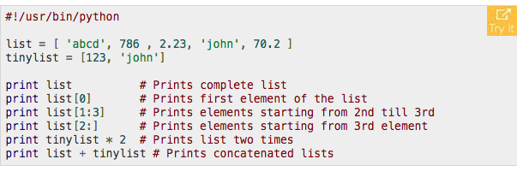
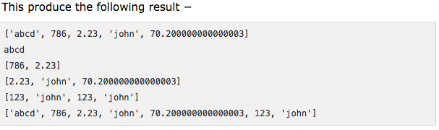
Lists
Lists are the most versatile of Python's compound data types. A list contains items separated by commas and enclosed within square brackets ([]). To some extent, lists are similar to arrays in C. One difference between them is that all the items belonging to a list can be of different data type.
The values stored in a list can be accessed using the slice operator ([ ] and [:]) with indexes starting at 0 in the beginning of the list and working their way to end -1. The plus (+) sign is the list concatenation operator, and the asterisk (*) is the repetition operator.

Slide 21
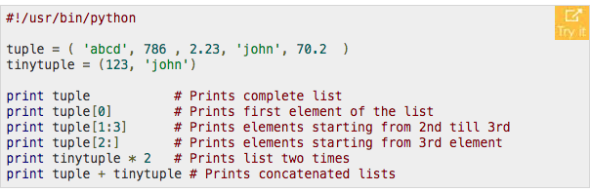
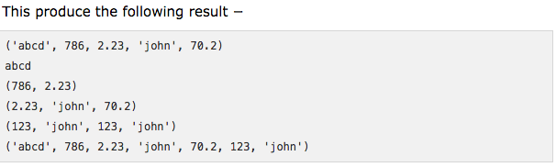
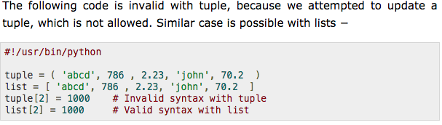
Tuples
A tuple is another sequence data type that is similar to the list. A tuple consists of a number of values separated by commas. Unlike lists, however, tuples are enclosed within parentheses.
The main differences between lists and tuples are: Lists are enclosed in brackets ( [ ] ) and their elements and size can be changed, while tuples are enclosed in parentheses ( ( ) ) and cannot be updated. Tuples can be thought of as read-only lists.

Slide 22
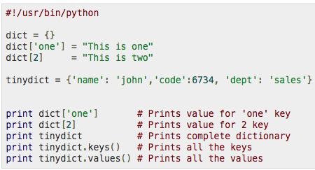
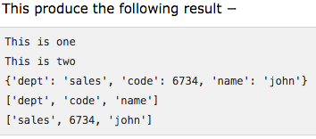
Dictionary
Python's dictionaries are kind of hash table type. They work like associative arrays or hashes found in Perl and consist of key-value pairs. A dictionary key can be almost any Python type, but are usually numbers or strings. Values, on the other hand, can be any arbitrary Python object.
Dictionaries are enclosed by curly braces ({ }) and values can be assigned and accessed using square braces ([]).
Dictionaries have no concept of order among elements. It is incorrect to say that the elements are "out of order"; they are simply unordered.

Slide 23
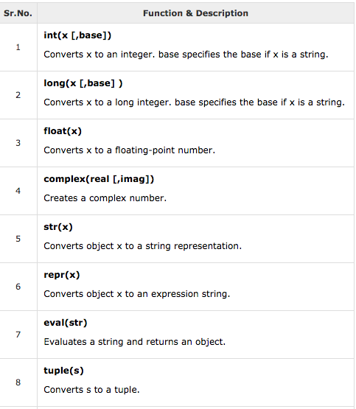
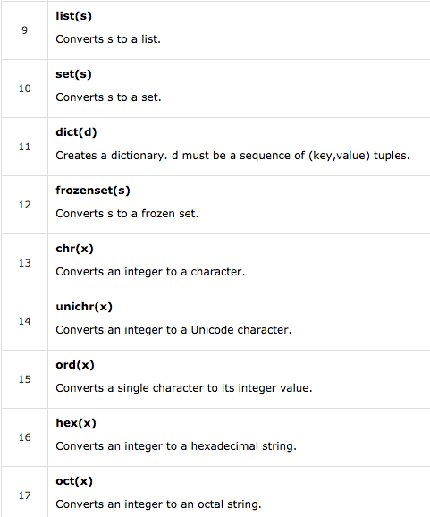
Data Type Conversion

Slide 24
Basic Operators
Python language supports the following types of operators.
Arithmetic Operators
Comparison (Relational) Operators
Assignment Operators
Logical Operators
Bitwise Operators
Membership Operators
Identity Operators

Slide 25
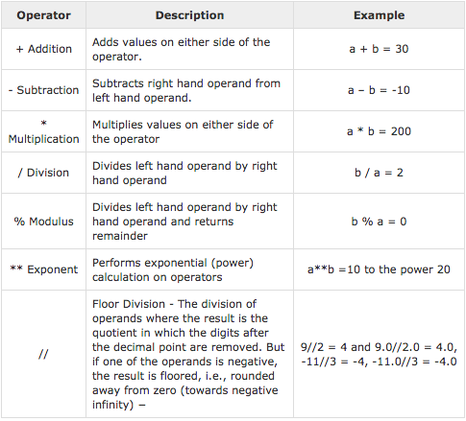
Arithmetic Operators
a,b = 10, 20

Slide 26
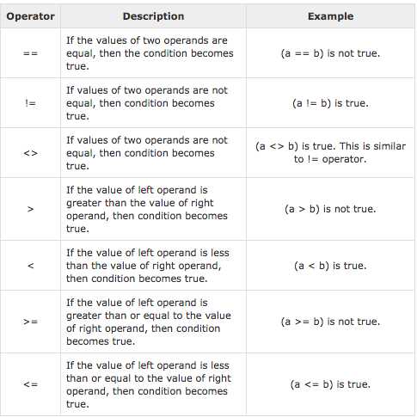
Comparison Operators
a,b = 10, 20

Slide 27
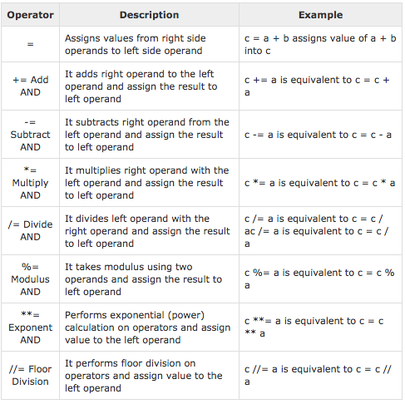
Assignment Operators

Slide 28

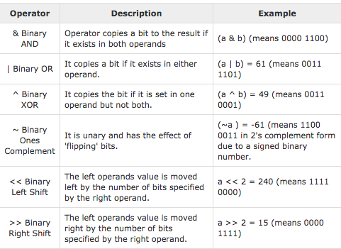
Bitwise Operators

Slide 29
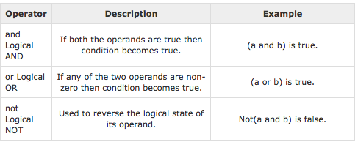
Logical Operator
a,b = 10, 20

Slide 30
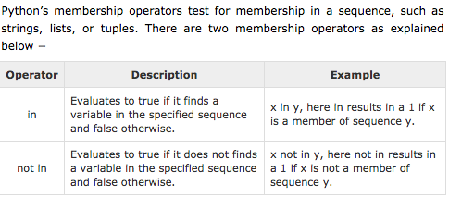
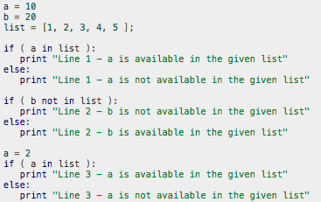

Membership Operator

Slide 31
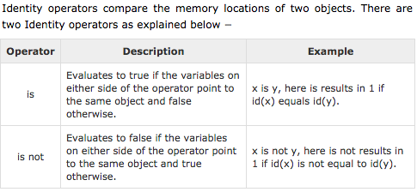
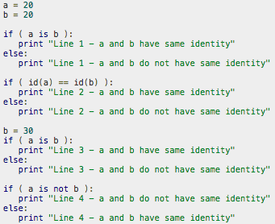

Identity Operator

Slide 32
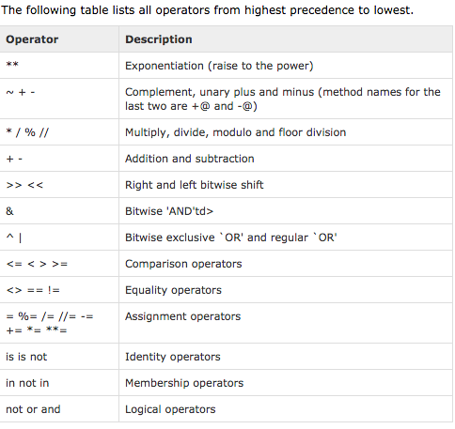

Operator Precedence

Slide 33
Decision Making: if .. elif .. else
if expression:
statement(s)
var = 100
if var < 200:
print ("Expression value is less than 200”)
if var == 150:
print ("Which is 150”)
elif var == 100:
print ("Which is 100”)
elif var == 50:
print("Which is 50”)
elif var < 50:
print( "Expression value is less than 50”)
else:
print( "Could not find true expression”)
print ("Good bye!”)
if expression1:
statement(s)
if expression2:
statement(s)
elif expression3:
statement(s)
else:
statement(s)
elif expression4:
statement(s)
else:
statement(s
if expression:
statement(s)
else:
statement(s)
if expression1:
statement(s)
elif expression2:
statement(s)
elif expression3:
statement(s)
else:
statement(s)

Slide 34
Loops
count = 0
while (count < 5):
print ('The count is:', count)
count = count + 1
for letter in 'Python':
if letter == 'h':
continue
print ('Current Letter :', letter)
for letter in 'Python':
print ('Current Letter :', letter)
for letter in 'Python':
if letter == 'h':
pass
print 'This is pass block'
print 'Current Letter :', letter
for letter in 'Python':
if letter == 'h':
break
print ('Current Letter :', letter)

Slide 35
Exercise 1
Find the prime numbers between 2 and 100
Using for loop (prime1.ipy)
Using while loop (prime2.ipy)

Slide 36
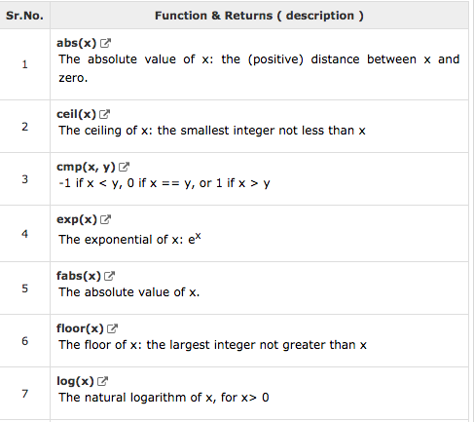
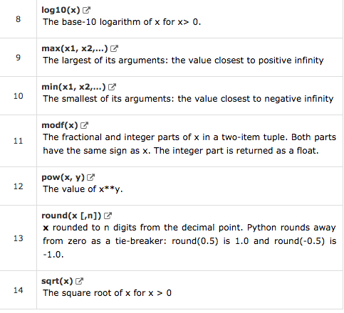
Mathematical Functions

Slide 37
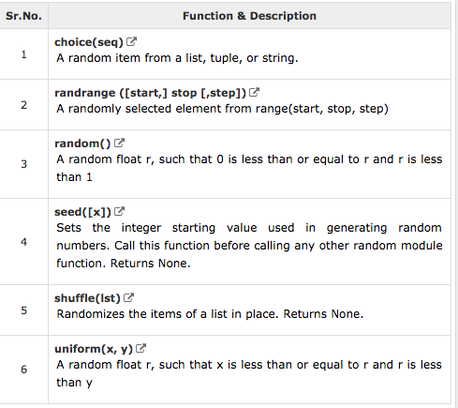
Random Number Functions
rand()
randn()

Slide 38
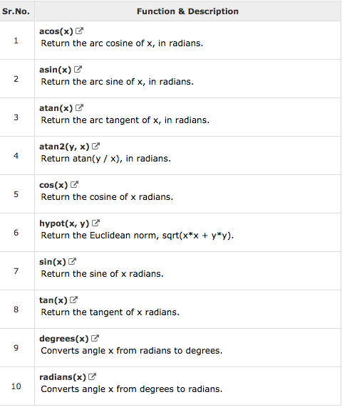
Trigonometric Functions

Slide 39
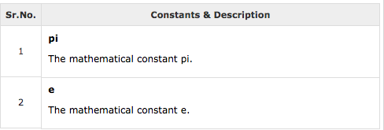
Constants

Slide 40
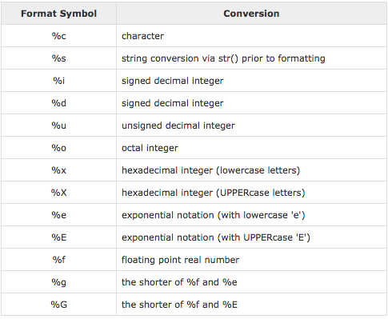
String Formatting Operator

Slide 41
Graphics
Use pylab (already included in ipython).
Load it at command line as %pylab (optional) inline
Includes both numpy (mathematical facilities) and matplotlib (graphs).
Can do all kinds of plots: line, scatter, density, contour, polar, pie chart, histograms, and more (see matplotlib.org for details).
Commands similar to Matlab.

Slide 42
Some Basic Examples
1-variable:
y = [ 1.0, 2.4, 1.7, 0.3, 0.6, 1.8 ]
^{plot(y)}
close(“all”) closes the figure pop-up window.
Random Numbers:
plot(rand(1000))
plot(rand(1000,2))
2-variable:
x = [ 0.5, 1.0, 2.0, 4.0, 7.0, 10.0 ]
y = [ 1.0, 2.4, 1.7, 0.3, 0.6, 1.8 ]
^{plot(x,y)}
^{x = linspace(0,10,100)}
^{y = sin(x)}
^{plot(x,y)}

Slide 43
Read from Data file
data = loadtxt("values.txt",float)
x = data[:,0]
y = data[:,1]
plot(x,y)
or
^{plot(data[:,0],data[:,1])}
Example: HR Diagram-- Magnitude vs surface temperature of stars

Slide 44
Customizing Plots
^{x = linspace(0,10,100)}
^{y = sin(x)}
^{plot(x,y)}
^{xlim(0,20)}
^{ylim(-2,2)}
xlabel("x axis")
ylabel("y = sin x")
plot(x,y,"g--")
[r, g, b, c, m, y, k, and w, for red, green, blue, cyan, magenta, yellow, black, and white, respectively]
[“-” for a solid line, “--” for a dashed line, “o” to mark points with a circle (but not connect them with lines), and “s” to mark points with a square.]
z = cos(x)
plot(x,y,”r-”,label=”sinus”)
plot(x,z,"k--”,label=”cosinus”)
legend()

Slide 45
Homework: Wave Interference
Suppose we drop a pebble in a pond and waves radiate out from the spot where it fell.
We could create a simple representation of the physics with a sine wave, spreading out
In a uniform circle, to represent the height of the waves at some later time.
Now suppose we drop another pebble in the pond, creating another circular set of waves
with the same wavelength and amplitude but centered on a different point.
Suppose the wavelength of the waves is 5 cm, the amplitude is 1 cm, and the centers of the
circles are 20 cm apart. Write a program to make an image of the height over a 1 m square
region of the pond. (Assume the two waves add linearly. )

Slide 46
Symbolic Math
Call:
Rational Numbers: a=Rational(1,2) means ½.
e and pi already defined. Also infinity (oo)
Declare symbolic variables explicitly:
x=Symbol(‘x’)
y=Symbol(‘y’)
from sympy import *

Slide 47
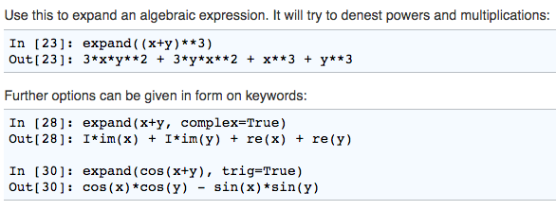
Expand

Slide 48
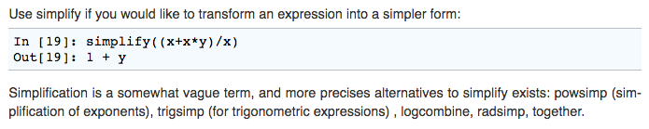
Simplify

Slide 49
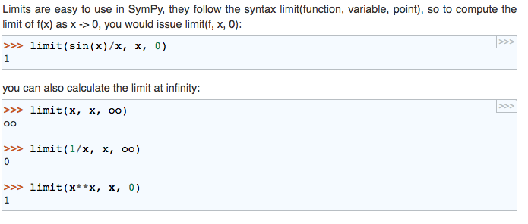
Limits

Slide 50
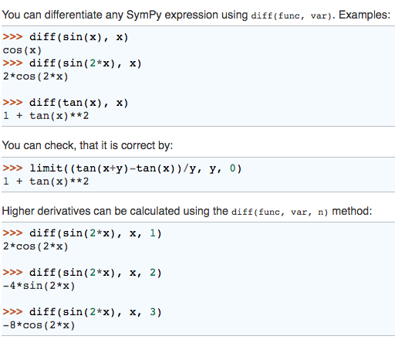
Derivatives

Slide 51
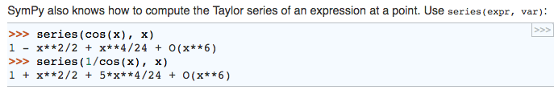
Taylor Series

Slide 52
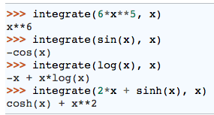



Integrals

Slide 53


Equation Solving

Slide 54

Differential Equations

Slide 55

Homework
dsolve(x*f(x).diff(x)+f(x)-f(x)**2,f(x))
Ans: Eq(f(x), -C1/(-C1 + x))
Check Solution:
C1=1
simplify(x*f(x).diff(x)+f(x)-f(x)**2)

Slide 56
Advanced Tools
Statistics and Data Analysis
Image Processing (scikit-image)
3D plotting with Mayavi
Machine Learning (scikit-learn)
For details, see http://www.scipy-lectures.org/

Slide 57


Optimization

Slide 58

Convex versus Non-Convex

Slide 59

Smooth vs Non-smooth

Slide 60

Example

