Slide 1


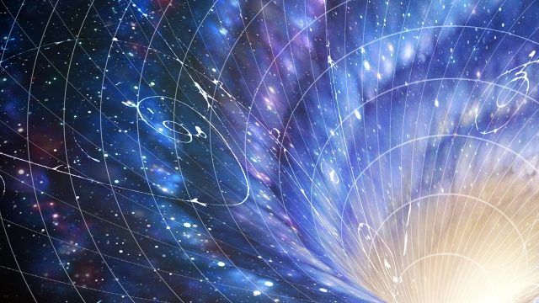
PHYSICS 197 Section 1
Review of Unit R
December 8, 2017

Slide 2
Announcements
Please submit the course evaluation online to get 1 bonus point (equivalent to 5 points on an exam).
Exam # 3: Monday, December 18 at 6 pm.
Please bring a ruler.
Your "equation sheet" for Exam #3 should contain any equation you
think would be useful, and definitions of terms in those equations
(i.e., what the letters in those equations stand for) and the units
normally associated with those terms. It may not contain any
worked-out problems. For Exam #3, you may find it useful to have an example two-observer spacetime diagram on your equation sheet. This example diagram can show axes, tick marks, and arbitrary events, but cannot specifically show solutions to a proposed question.

Slide 3
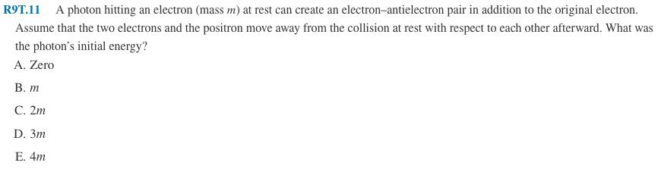
Clicker Question

Slide 4
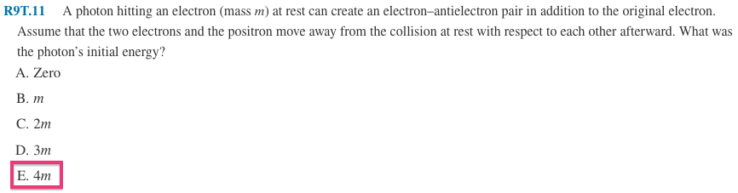
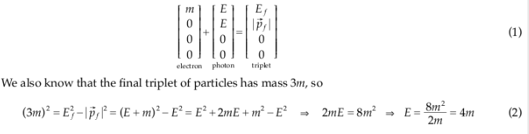
Answer

Slide 5

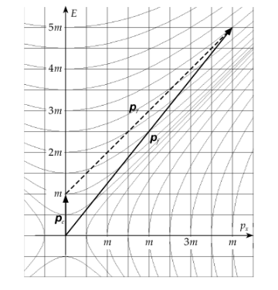
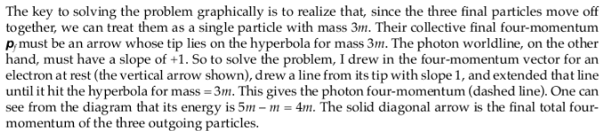
Problem R9M.2

Slide 6
2016 Exam Problem 5

Slide 7
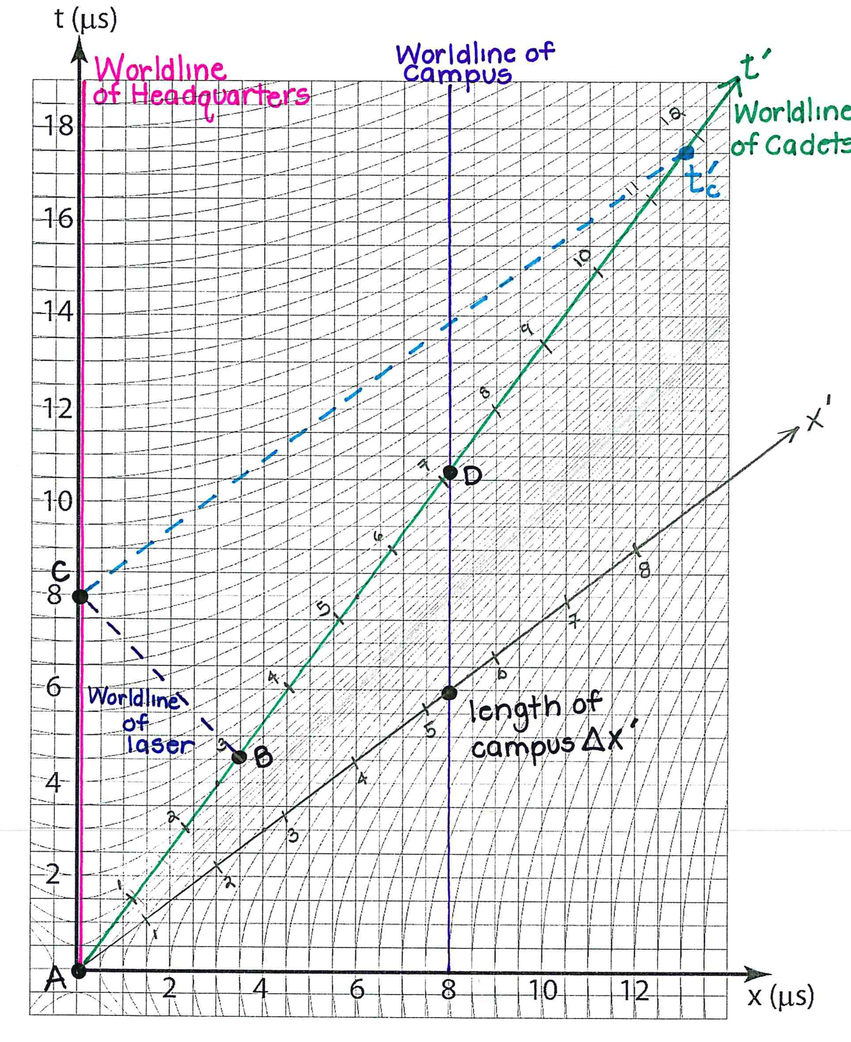

Slide 8
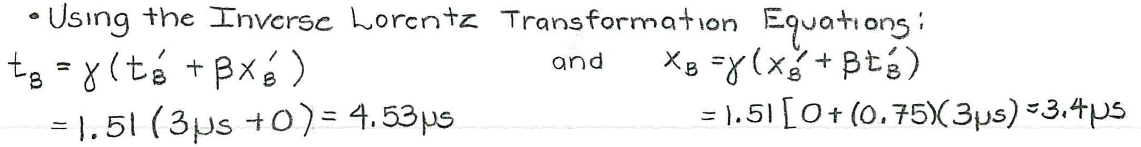
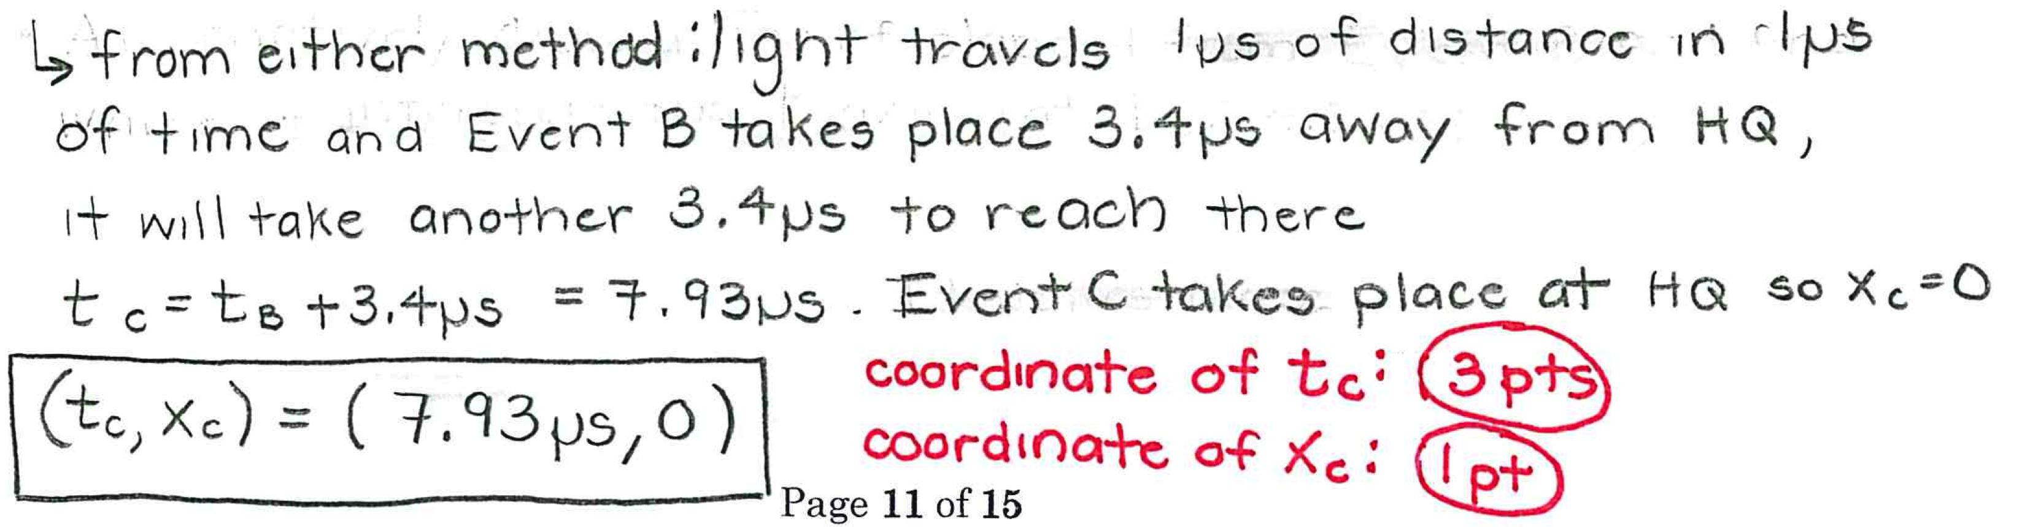

Slide 9
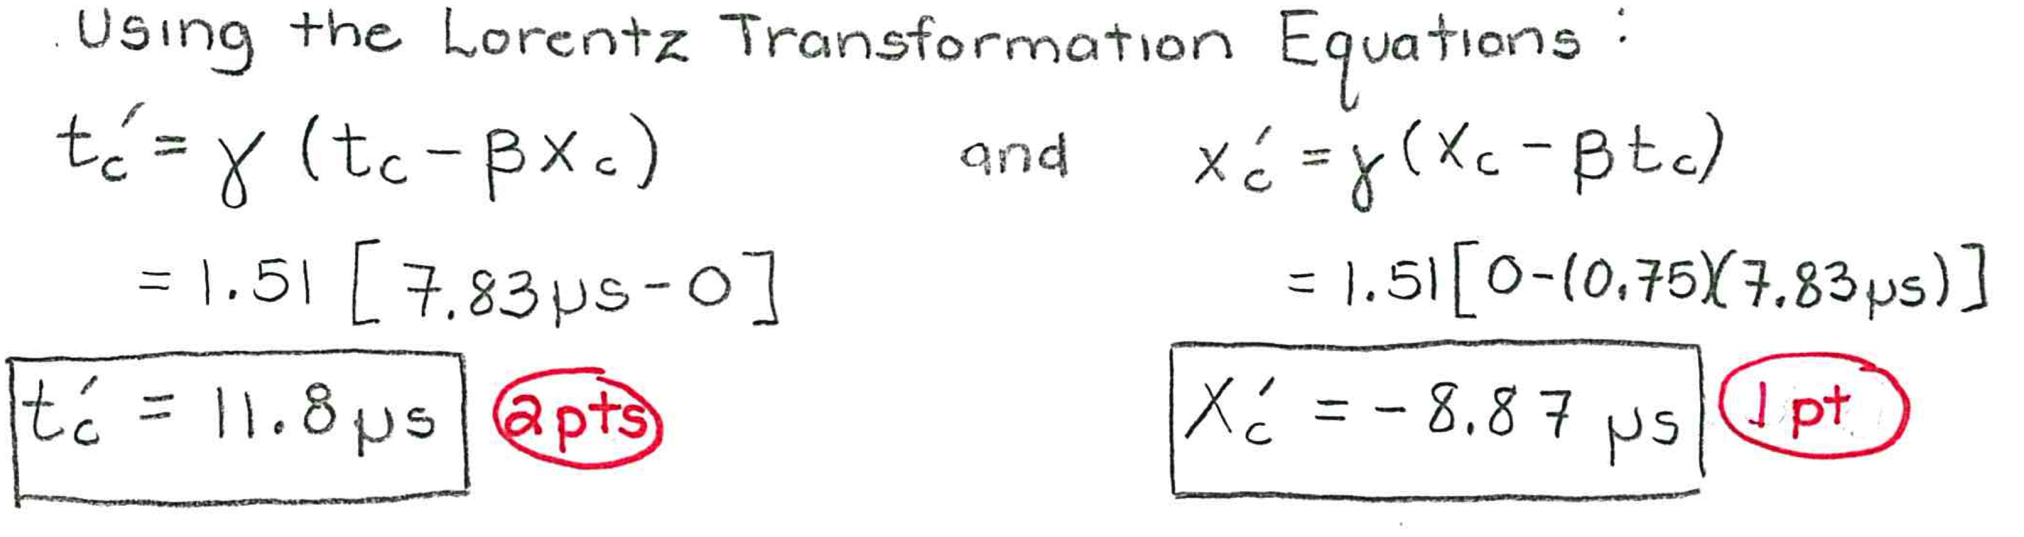
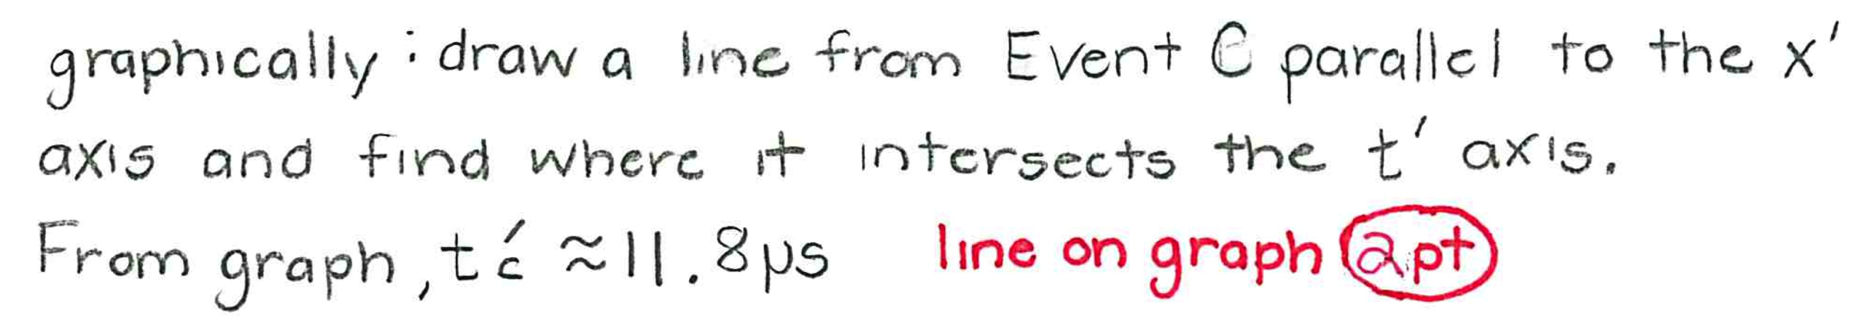

Slide 10

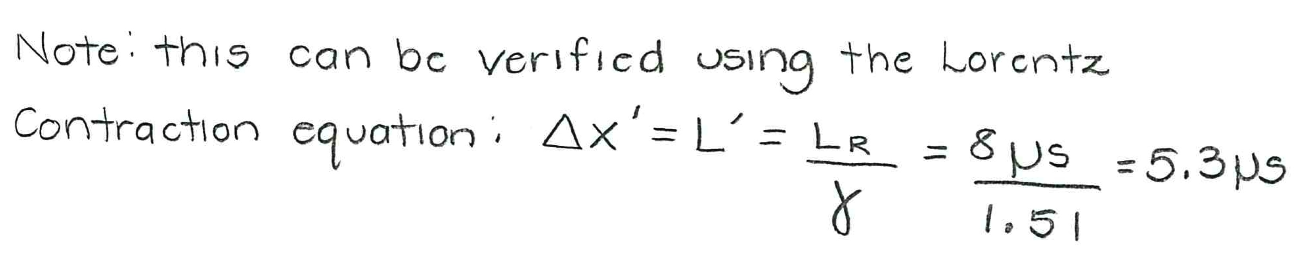

Slide 11
Clicker Question
Yes
No
Yes in the Cadets’ frame, No in the Starfleet frame
No in the Cadets’ frame, Yes in the Starfleet frame

Slide 12
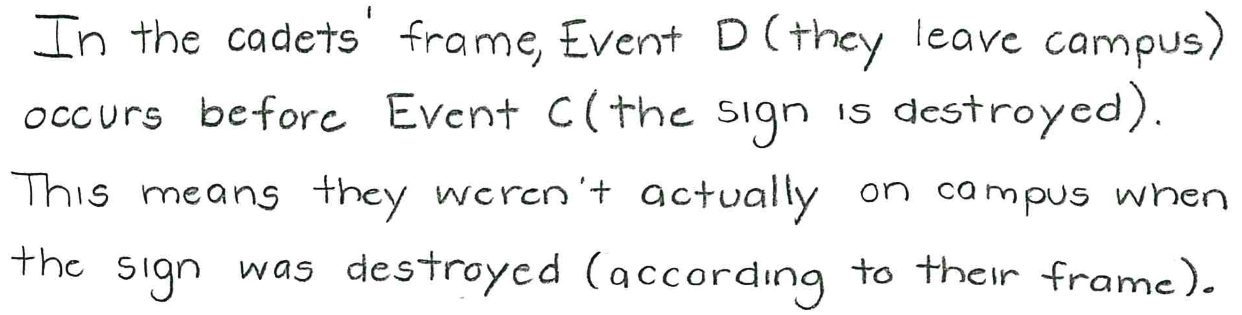
Yes
No
Yes in the Cadets’ frame, No in the Starfleet frame
No in the Cadets’ frame, Yes in the Starfleet frame

Slide 13
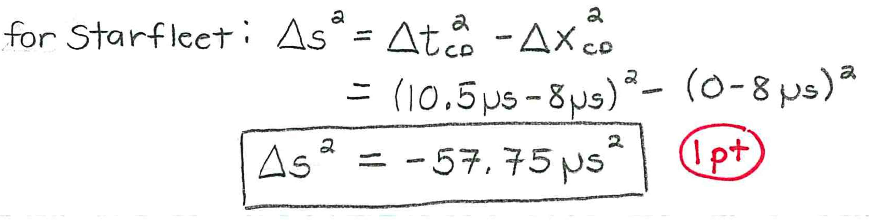
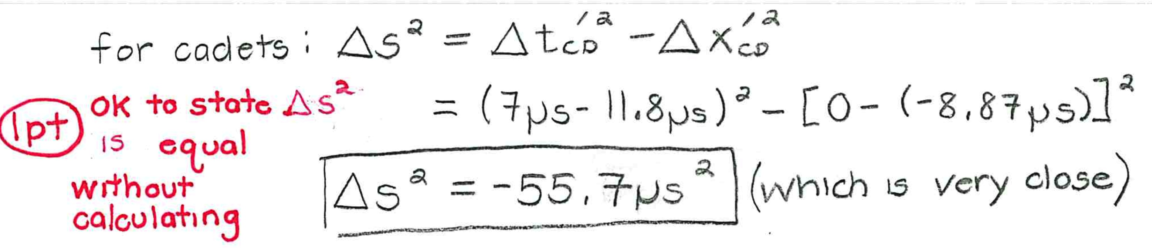
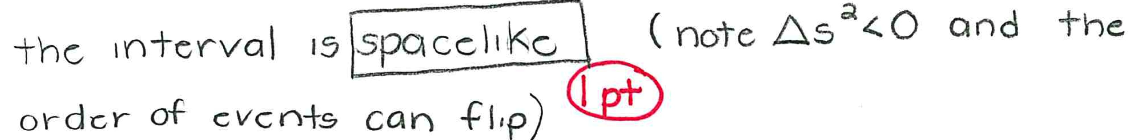

Slide 14
2016 Exam Problem 2

