Slide 1


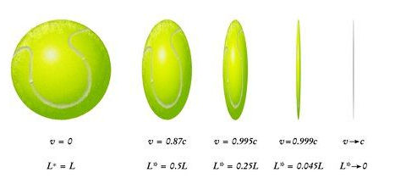
PHYSICS 197 Section 1
Chapter R6
Lorentz contraction
November 29, 2017

Slide 2
Announcements
Regrade requests for Exam #2 due Monday, December 4, BEFORE class.
Please write clearly the reason(s) why you disagree with your grade.

Slide 3
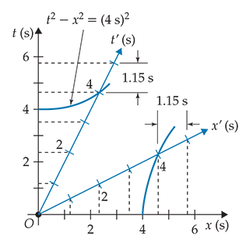
Review of Last Class (R5)
Two-observer Diagrams
Lorentz Transformation
Inverse Lorentz Transformation
Two Important Consequences:
Time Dilation (R4)
Length Contraction (R6)

Slide 4
Outline of R6
Length of a Moving Object
Two-observer Diagram
Lorentz Contraction
Barn and Pole Paradox

Slide 5
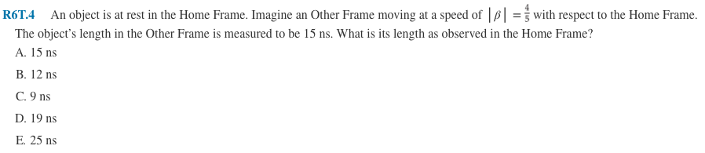
Clicker Question

Slide 6
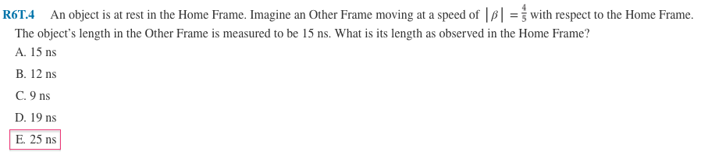
Answer
Length measured in a moving frame is shorter than the length in rest frame.
Lorentz contraction

Slide 7
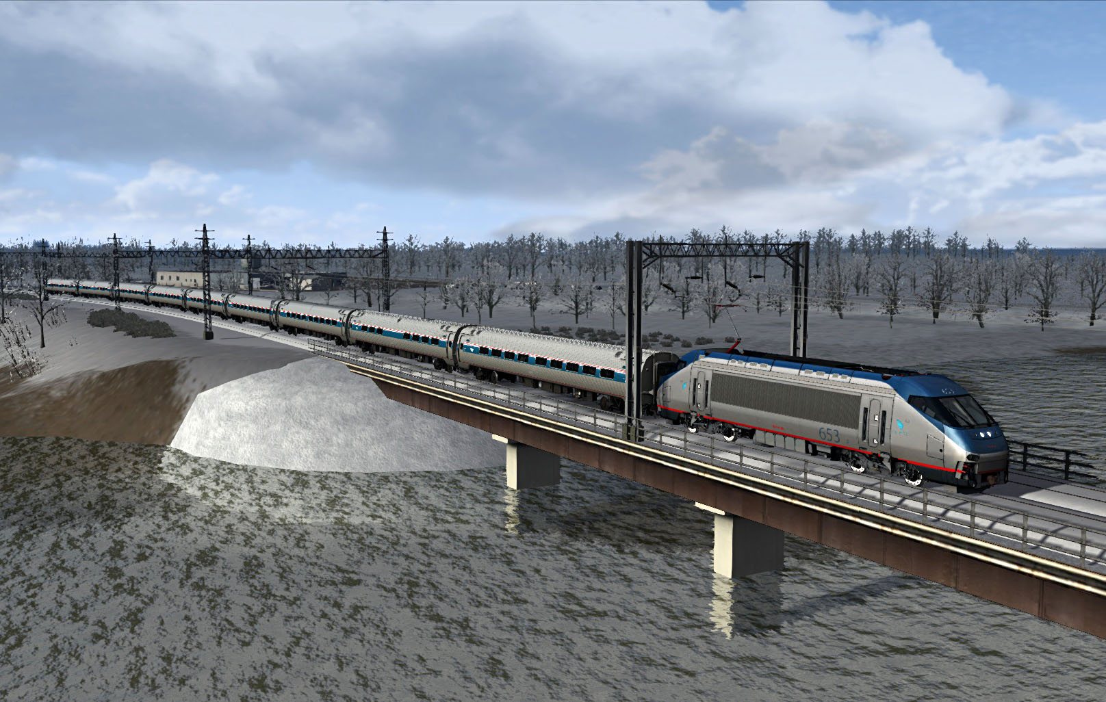
Length of a Moving Object

Slide 8
Length of a Moving Object
Another way to define length:

Slide 9
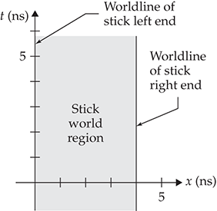
Two-Observer Diagram of a Stick

Slide 10
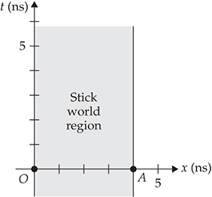
Two-Observer Diagram of a Stick

Slide 11
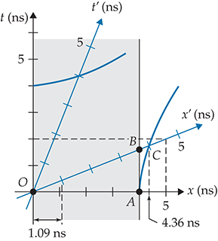
Two-Observer Diagram of a Stick
Length measured in a moving frame is shorter than the length in rest frame.

Slide 12
Length Contraction

Slide 13
What Causes Length Contraction
The physical nature of the stick does not change.
The fundamental reason for different lengths in different frames is clock synchronization.
The observers in different inertial frames disagree about which events mark the ends of the object at the same time.
Proper length: Measured in the inertial frame in which the object is at rest.
Also called rest length.

Slide 14
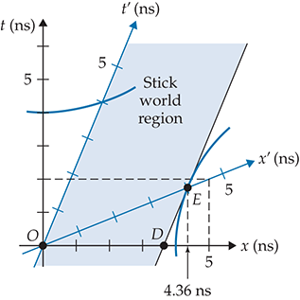
Contraction is Frame-Symmetric

Slide 15
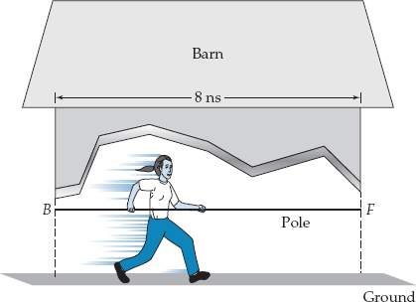
Barn and Pole Paradox

Slide 16
Barn and Pole Paradox

Slide 17
Barn and Pole Paradox

Slide 18
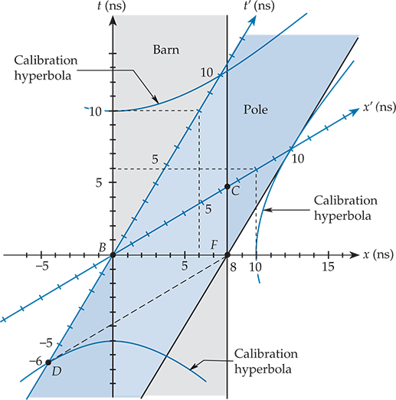
Barn and Pole Paradox

Slide 19
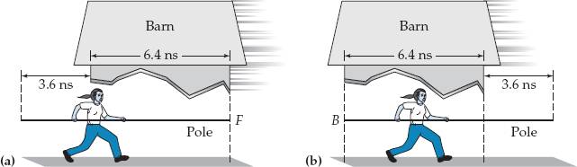
Barn and Pole Paradox

Slide 20
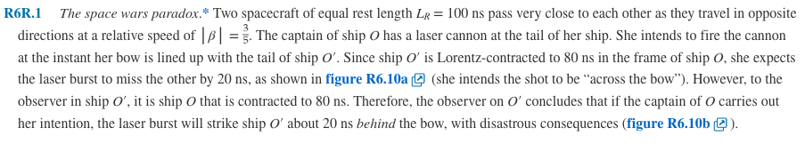
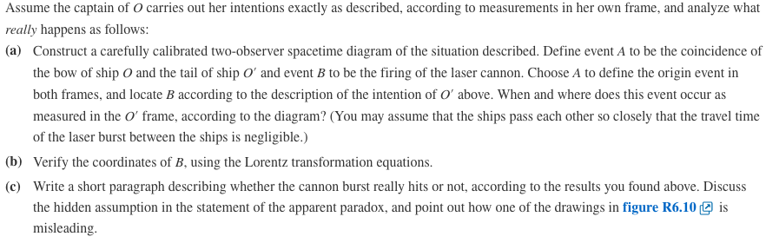
Practice Problem

Slide 21
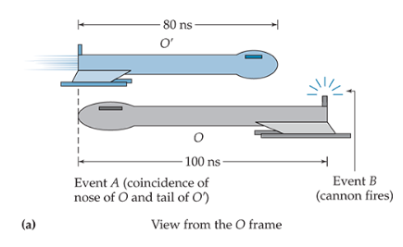
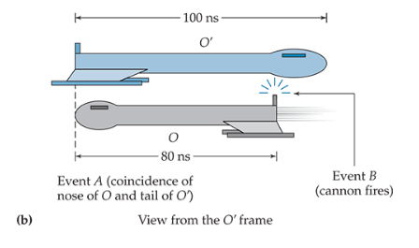
Practice Problem

Slide 22
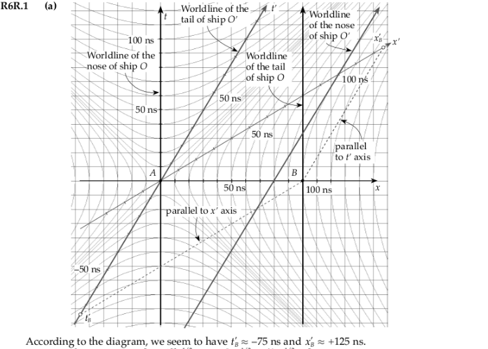
Solution

Slide 23

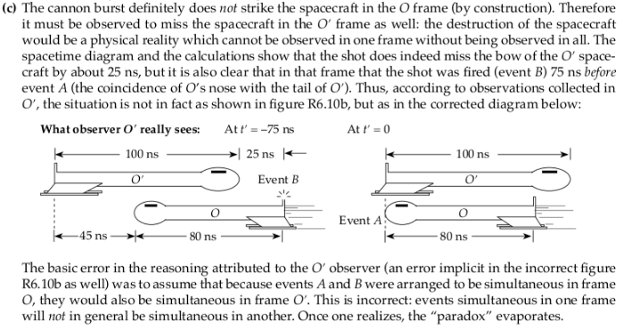
Solution

