Slide 1


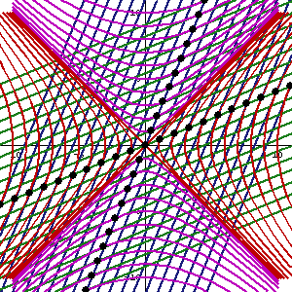
PHYSICS 197 Section 1
Chapter R5 coordinate transformations
November 27, 2017

Slide 2
Exam 2
Collect your exams from the hallway boxes.
See me for your exam if you did not sign the FERPA waiver.
Regrade requests due Monday, December 4, BEFORE class.
Please write clearly the reason(s) you disagree with your grade.
Last class: Friday, December 8.

Slide 3
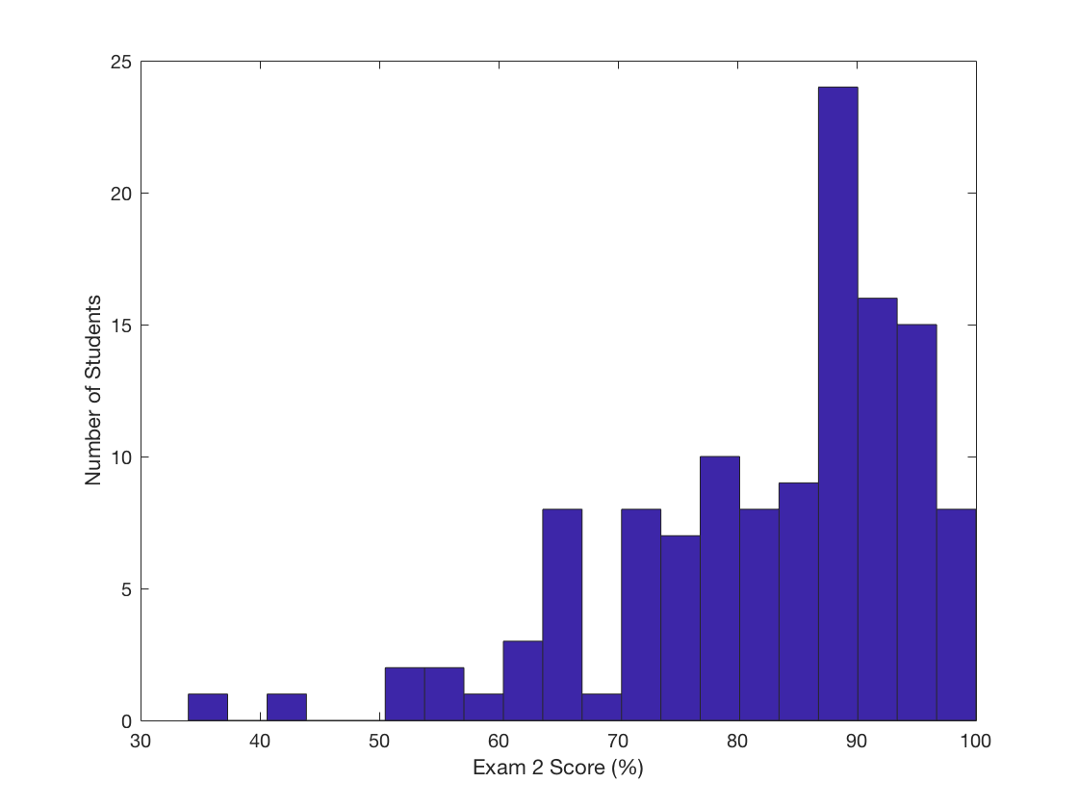
Exam 2 Statistics (Section 1)
Maximum: 100
Minimum: 34
Median: 87
Mean: 82.52

Slide 4
Outline of R5
Coordinate Transformation from (t,x,y,z) to (t’,x’,y’,z’)
Two-observer Diagrams
Diagram t’ axis
Diagram x’ axis
Reading the Spacetime Coordinates
Lorentz Transformation

Slide 5
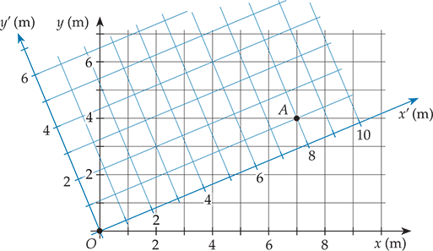
Two-Observer Diagram
(x,y) = (7m,4m)
(x’,y’) = (8m,1m)
How to draw this for spacetime diagrams in two inertial reference frames?

Slide 6
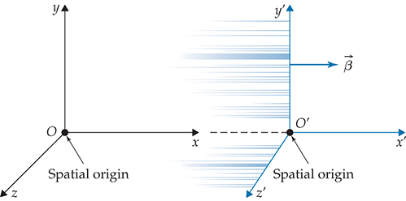
Conventions
Home Frame
Other Frame
How do their spacetime diagrams look like?

Slide 7
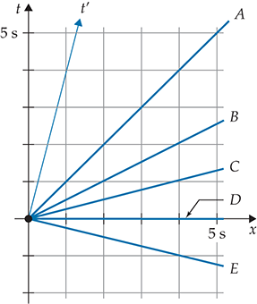
Clicker Question

Slide 8
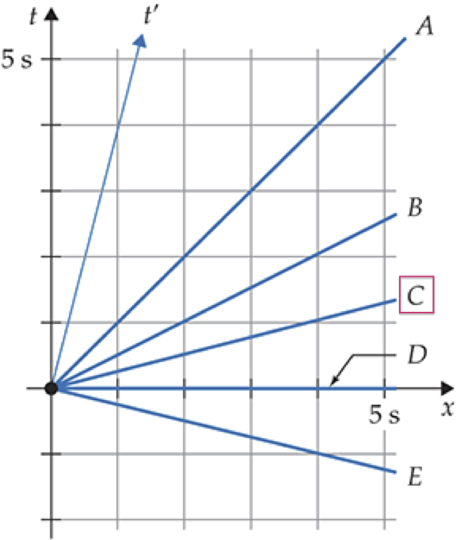
Answer
The x’ axis should make the same angle
with the x axis as the t’ axis makes
with the t axis.

Slide 9
Diagram t’ Axis

Slide 10
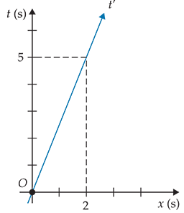
Diagram t’ Axis
Example:

Slide 11
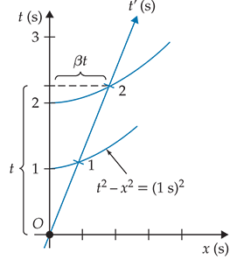
Diagram t’ Axis

Slide 12
Diagram t’ Axis
Define

Slide 13
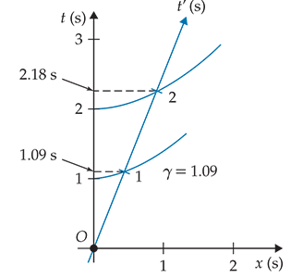
Diagram t’ Axis
Example:
Vertical separation between the marks on the t’ axis.
Not their spacing along the t’ axis, which is larger.

Slide 14
Diagram x’ Axis
Conventionally a horizontal line passing through t = 0 in the Home Frame.

Slide 15
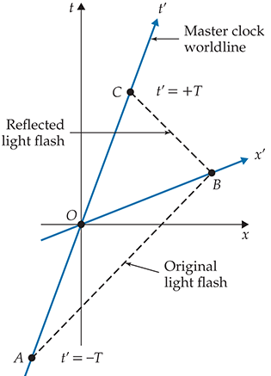
Diagram x’ Axis

Slide 16
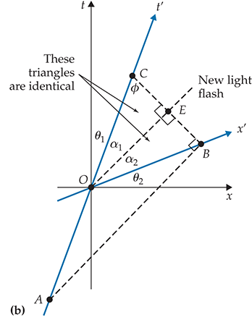
Diagram x’ Axis

Slide 17
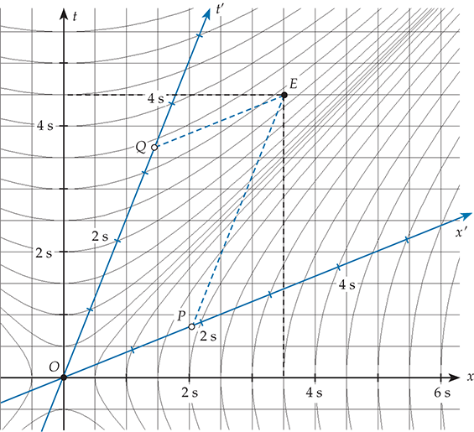
Reading the Spacetime Coordinates

Slide 18
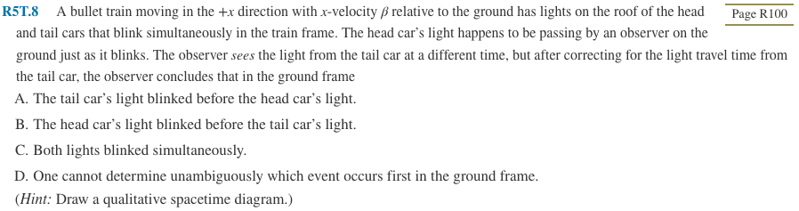
Clicker Question

Slide 19
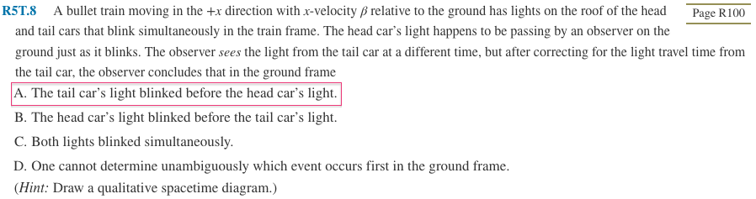
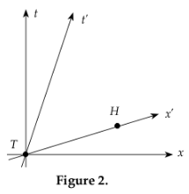
Answer

Slide 20
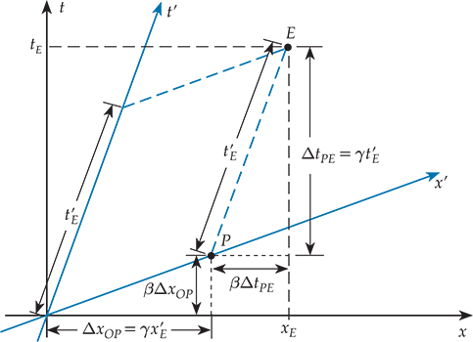
Lorentz Transformation
Recall in Galilean transformation, only the x’ component is different, but t’ is not.

Slide 21
Lorentz Transformation
Recall in Galilean transformation, only the x’ component is different, but t’ is not.

Slide 22
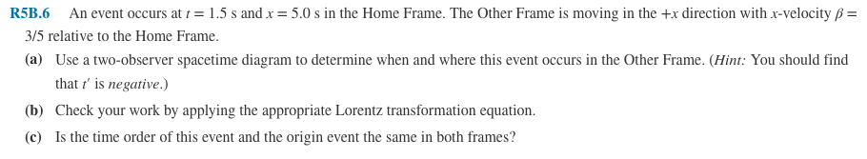
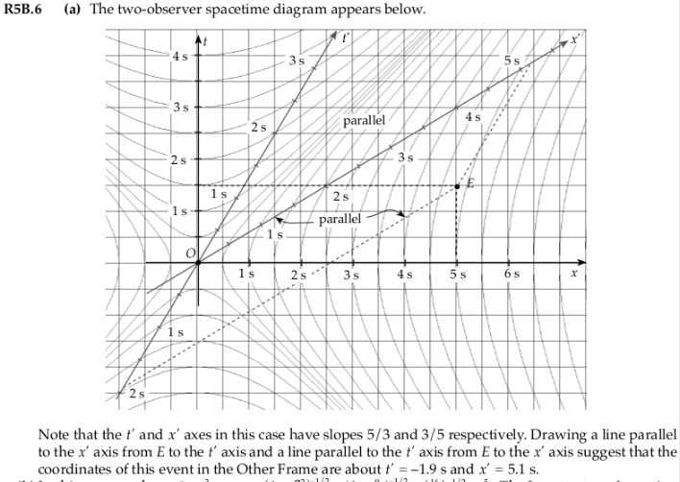
Practice Problem

Slide 23

Practice Problem

