Slide 1


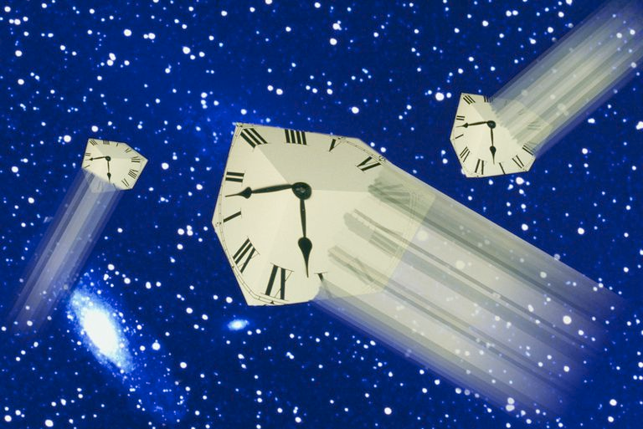
PHYSICS 197 Section 1
Chapter R4 proper time
November 20, 2017

Slide 2
Outline of R4
Proper Time vs. Coordinate Time
Binomial Approximation
Ranking the Three Kinds of Time
Experimental Evidence
The Twin Paradox

Slide 3
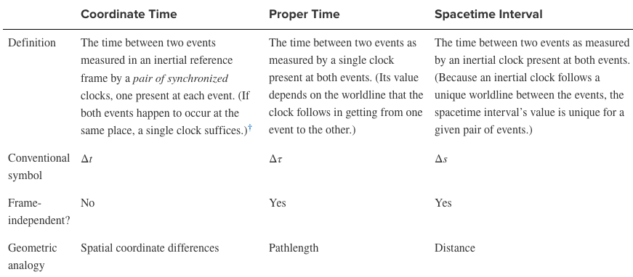
Three Kinds of Time (R3)

Slide 4
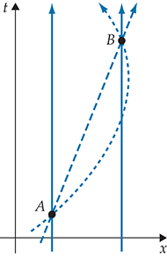
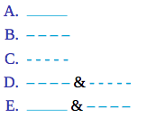
Clicker Question
R4T.1 Consider the spacetime diagram below, which shows events A and B and the worldlines of clocks that one might use to measure the time between those events.
The clock(s) following which worldline(s) measure(s) the spacetime interval between events A and B?

Slide 5
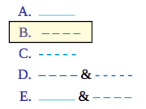
Clicker Question
R4T.1 Consider the spacetime diagram below, which shows events A and B and the worldlines of clocks that one might use to measure the time between those events.
The clock(s) following which worldline(s) measure(s) the spacetime interval between events A and B?

Slide 6
Clicker Question
R4T.1 Consider the spacetime diagram below, which shows events A and B and the worldlines of clocks that one might use to measure the time between those events.
The clock(s) following which worldline(s) measure(s) a proper time between events A and B?

Slide 7
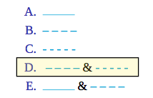
Clicker Question
R4T.1 Consider the spacetime diagram below, which shows events A and B and the worldlines of clocks that one might use to measure the time between those events.
The clock(s) following which worldline(s) measure(s) a proper time between events A and B?

Slide 8
Clicker Question
R4T.1 Consider the spacetime diagram below, which shows events A and B and the worldlines of clocks that one might use to measure the time between those events.
The clock(s) following which worldline(s) measure(s) a coordinate time between events A and B?

Slide 9
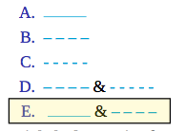
Clicker Question
R4T.1 Consider the spacetime diagram below, which shows events A and B and the worldlines of clocks that one might use to measure the time between those events.
The clock(s) following which worldline(s) measure(s) a coordinate time between events A and B?

Slide 10
Clicker Question
R4T.1 Consider the spacetime diagram below, which shows events A and B and the worldlines of clocks that one might use to measure the time between those events.
The clock(s) following which worldline(s) measure(s) the shortest time interval between events A and B?

Slide 11
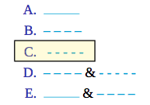
Clicker Question
R4T.1 Consider the spacetime diagram below, which shows events A and B and the worldlines of clocks that one might use to measure the time between those events.
The clock(s) following which worldline(s) measure(s) the shortest time interval between events A and B?

Slide 12
Clicker Question
R4T.1 Consider the spacetime diagram below, which shows events A and B and the worldlines of clocks that one might use to measure the time between those events.
The clock(s) following which worldline(s) measure(s) the longest time interval between events A and B?

Slide 13
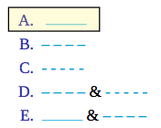
Clicker Question
R4T.1 Consider the spacetime diagram below, which shows events A and B and the worldlines of clocks that one might use to measure the time between those events.
The clock(s) following which worldline(s) measure(s) the longest time interval between events A and B?

Slide 14
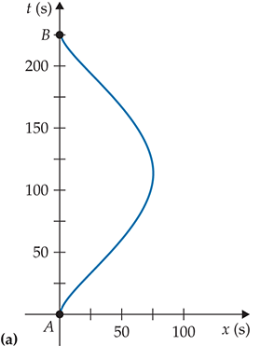
Proper Time vs.
Coordinate Time

Slide 15
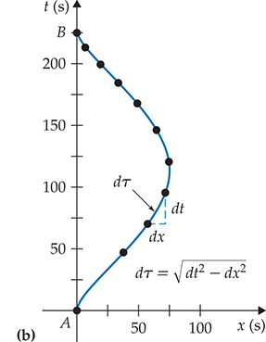



Proper Time vs.
Coordinate Time

Slide 16
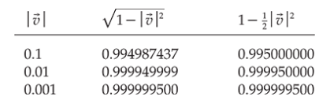
Binomial Approximation

Slide 17
Ranking of the Times
Consider two events A and B.
Suppose we measure the time between them by using two clocks that are present at both events – one in an inertial frame (at rest) and another in a noninertial frame.
Since the proper times are frame-independent, this inequality must hold for all frames.
Finally, the metric equation implies

Slide 18
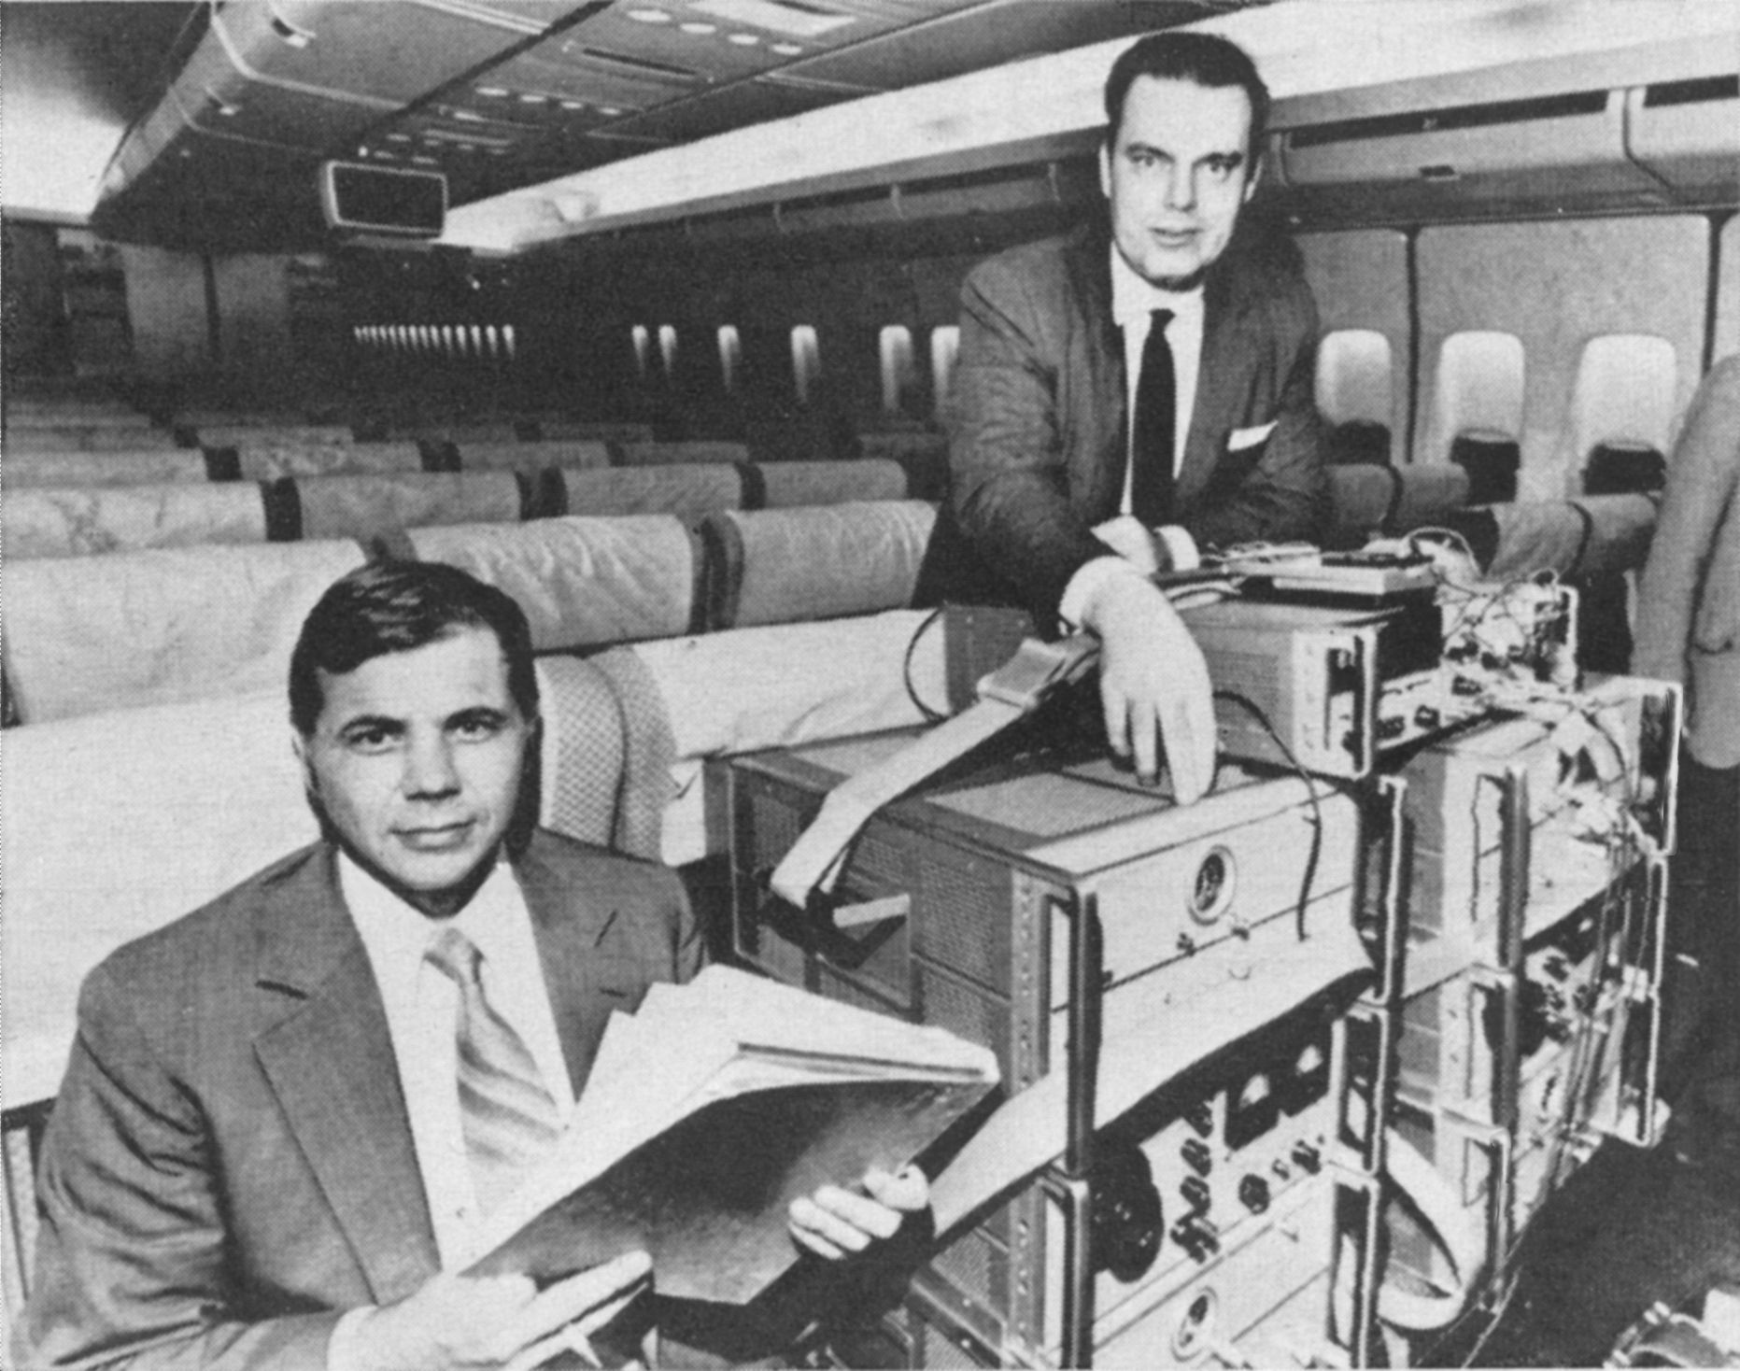
Experimental Evidence
Hafele-Keating experiment (1972).
Used three sets of very accurate Cs-beam atomic clocks.
One flew around the world westward, one flew eastward and the third remained in the lab at the US Naval Observatory.
The eastbound clock lost (59±10) ns, i.e. ran slower, while the westbound clock gained (273±7) ns, i.e. ran faster, with respect to the lab clock.
Aircraft Time Dilation

Slide 19
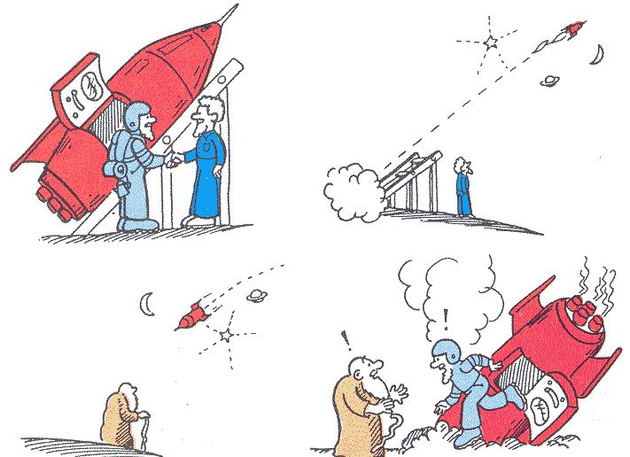
Twin Paradox

Slide 20
Twin Paradox

Slide 21
Twin Paradox

Slide 22
Twin Paradox

Slide 23
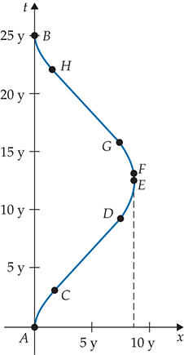
Twin Paradox

Slide 24
Twin Paradox

Slide 25
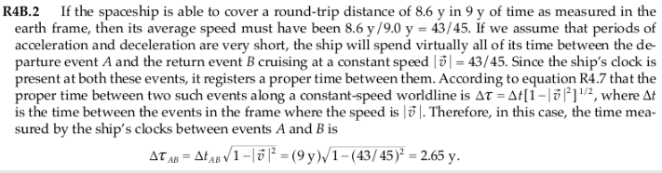
Practice Problem

