Slide 1


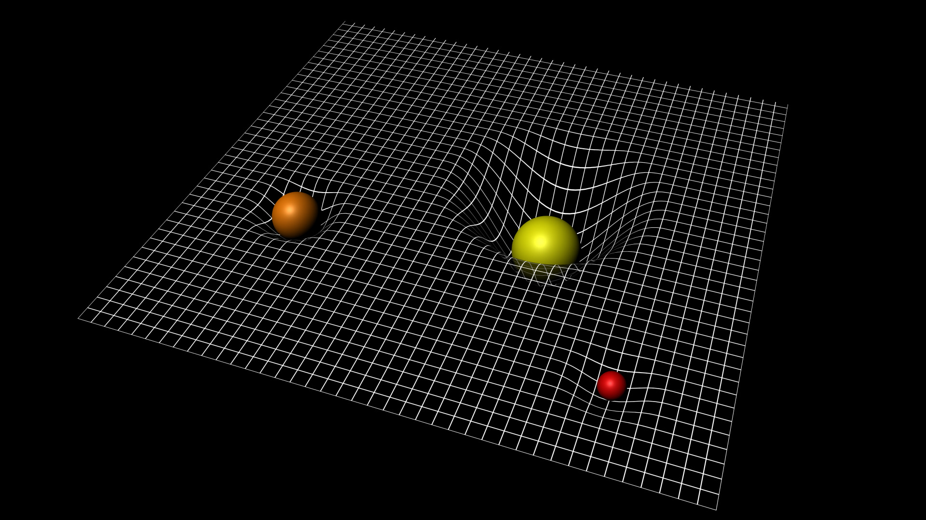
PHYSICS 197 Section 1
Chapter R3
The SPACEtime INTERVAL
November 17, 2017

Slide 2
Outline of R3
Three Kinds of Time
Metric Equation
Spacetime is Non-Euclidean
Geometric Analogy

Slide 3
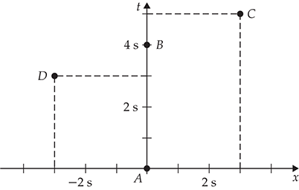
Clicker Question
R3T.6 Consider the events A, B, C, and D shown in the spacetime diagram below. What is the spacetime interval between events A and B?
0 s
3.0 s
4.0 s
5.0 s
5.8 s

Slide 4
Answer
R3T.6 Consider the events A, B, C, and D shown in the spacetime diagram below. What is the spacetime interval between events A and B?
0 s
3.0 s
4.0 s
5.0 s
5.8 s

Slide 5
Clicker Question
R3T.6 Consider the events A, B, C, and D shown in the spacetime diagram below. What is the spacetime interval between events A and C?
0 s
3.0 s
4.0 s
5.0 s
5.8 s

Slide 6
Answer
R3T.6 Consider the events A, B, C, and D shown in the spacetime diagram below. What is the spacetime interval between events A and C?
0 s
3.0 s
4.0 s
5.0 s
5.8 s

Slide 7
Clicker Question
R3T.6 Consider the events A, B, C, and D shown in the spacetime diagram below. What is the spacetime interval between events A and D?
0 s
3.0 s
4.0 s
5.0 s
5.8 s

Slide 8
Answer
R3T.6 Consider the events A, B, C, and D shown in the spacetime diagram below. What is the spacetime interval between events A and D?
0 s
3.0 s
4.0 s
5.0 s
5.8 s

Slide 9
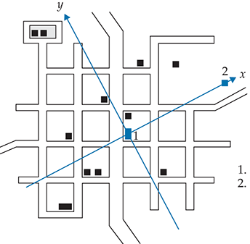
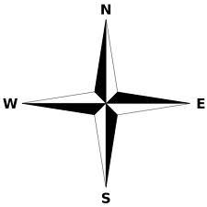
Separation between Two Points on a Plane
City Hall
Statue of Einstein

Slide 10
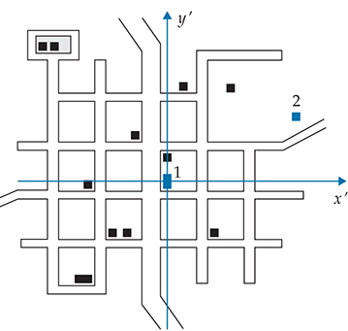
Separation between Two Points on a Plane
Coordinate separation: Depends on the coordinate system

Slide 11
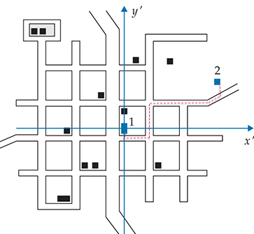
Separation between Two Points on a Plane
Pathlength: Does not depend on the coordinate system.

Slide 12
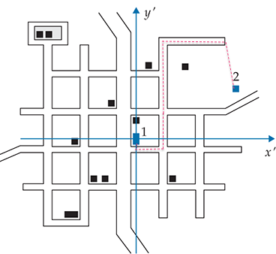
Separation between Two Points on a Plane
Pathlength: Does not depend on the coordinate system.
But not uniquely defined.

Slide 13
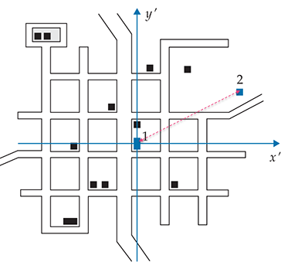
Separation between Two Points on a Plane
Distance: Does not depend on the coordinate system.
Uniquely defined.

Slide 14
Separation between Two Points on a Plane
Analogously, we can measure the time separation between
two events in spacetime in three fundamentally different ways.

Slide 15
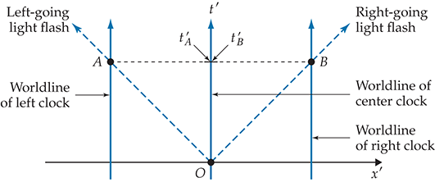
Coordinate Time
Events A and B are measured to occur at the same time.

Slide 16
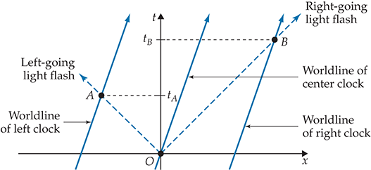
Coordinate Time
Event A is measured to occur before event B.
Δt is a frame-dependent quantity.

Slide 17
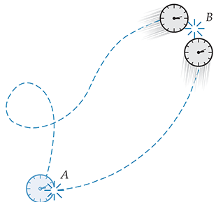
Proper Time

Slide 18
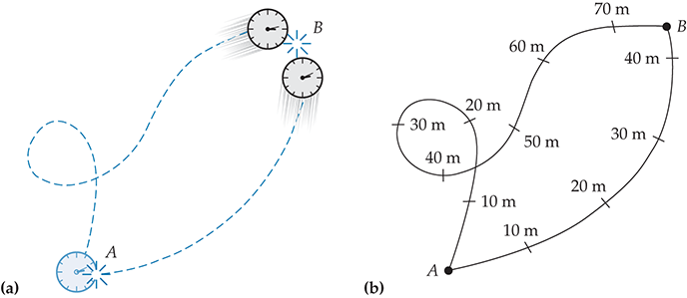
Proper Time
Analogous to pathlength.
Frame-independent, but not uniquely defined.
Depends on the worldline of the clock.

Slide 19
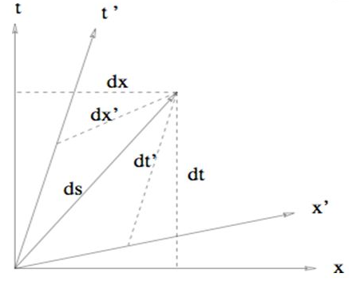
Spacetime Interval
Analogous to distance: Unique number.

Slide 20
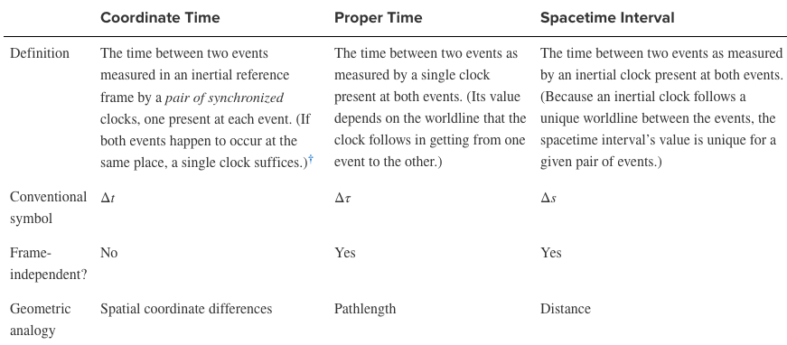
Three Kinds of Time

Slide 21
The Metric Equation
Pythagoras theorem for distance in terms of coordinate separation:
Metric equation for Euclidean geometry.

Slide 22
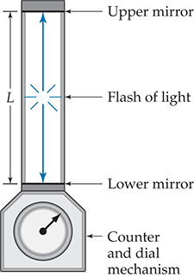
Light Clock

Slide 23
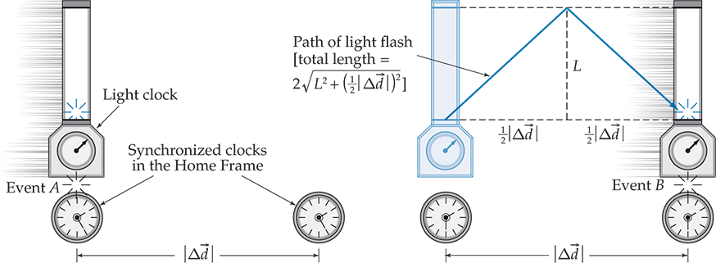
One Light Clock vs.
Two Synchronized Clocks

Slide 24
Metric Equation

Slide 25
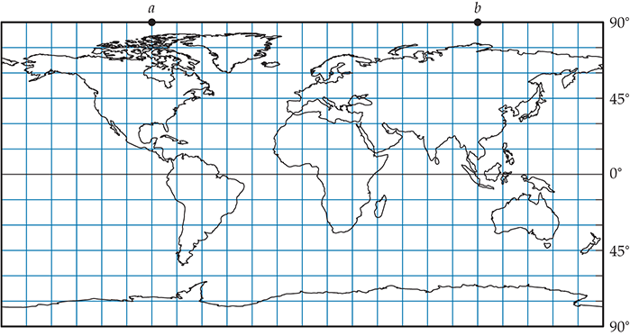
Spacetime is Not Euclidean

Slide 26
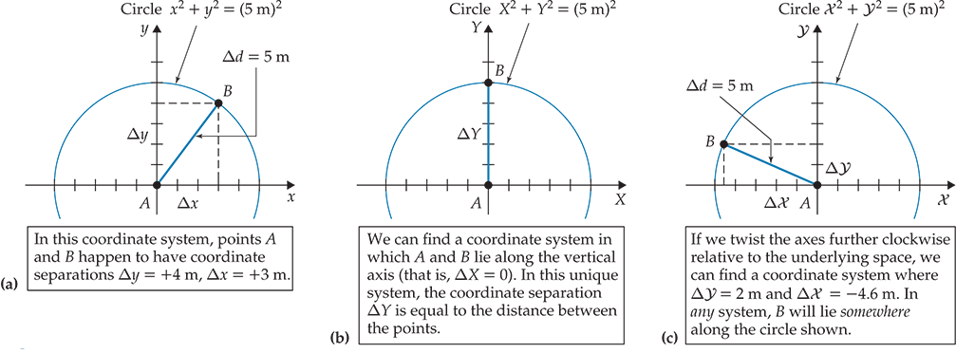
Geometric Analogy

Slide 27
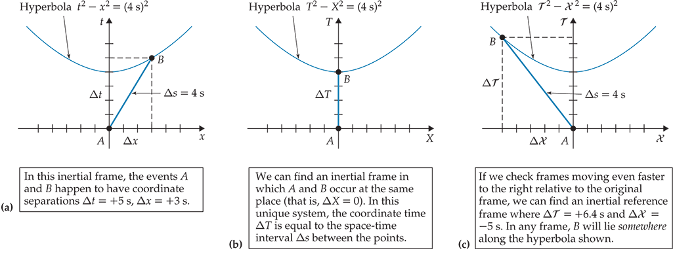
Geometric Analogy

Slide 28
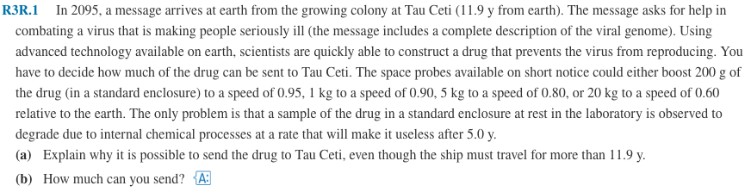
Practice Problem

Slide 29
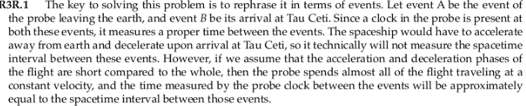
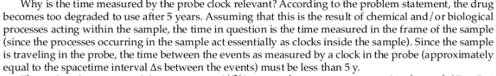
Solution

Slide 30
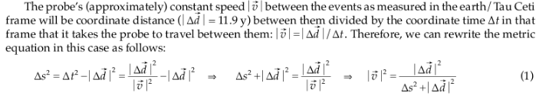


Solution

