Slide 1


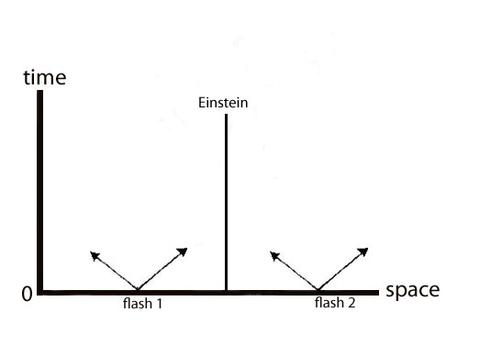
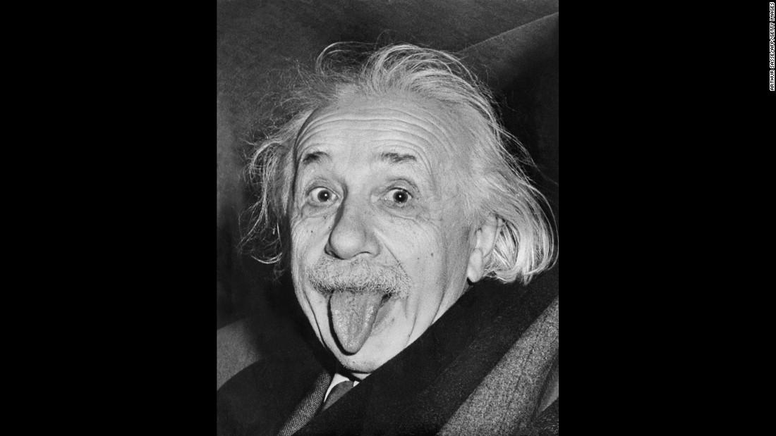
PHYSICS 197 Section 1
Chapter R2
Coordinate time
November 13, 2017

Slide 2
Announcements
Wednesday, November 15: Review of Unit N part 2.
Last chance: Please email me the problems you want to be discussed in class by 9pm Tuesday, November 14).
Last 3 years’ exams with solutions posted on Blackboard Course Home Page→ Exam Info → Exam 2.
First 3 pages of Exam paper also posted there (please go over them carefully BEFORE the exam!)
Thursday, November 16: Exam #2 (6.30 – 11 pm).
Last Names A-G: Rebstock 215
Last Names H-Z: Hillman 070

Slide 3
Overview of R2
Review of problem raised by Maxwell’s equations and Einstein’s brilliant solution.
First steps toward developing a concept of time consistent with Maxwell equations.
  Clock Synchronization
  SR Units
  Spacetime Diagram
  Radar Method
  Frame-dependence of Coordinate Time

Slide 4
Galileo, Maxwell, and Einstein
Maxwell’s electromagnetic wave equation predicts that speed of light in vacuum is a constant.
But according to Galilean velocity transformation:
According to Einstein, we must give up the concept of universal time and define it local to each inertial reference frame.
c must be the same in all inertial frames to be consistent with Maxwell.
Measuring the Speed of Light (Galilean way) (Einstein way)

Slide 5
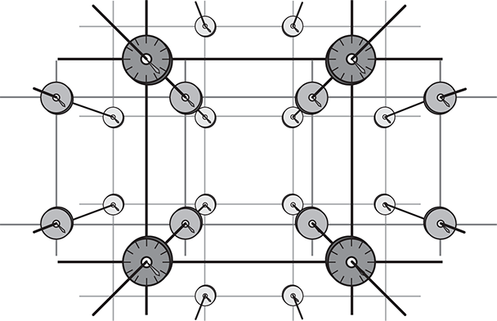
Clock Synchronization
Synchronize the clocks in a way that is consistent with
Einstein’s principle of relativity and Maxwell’s equations.

Slide 6

Clock Synchronization
Use the fact that speed of light must be the same in every inertial frame.
Start with a master clock at the spatial origin of a given inertial frame.
At t=0, send out a light flash from the clock.
A clock 1 m away will receive the flash in 1/c = 3.3 ns.
Set this clock to read t=3.3 ns as the flash passes by.
Use similar procedure to synchronize all other clocks.

Slide 7
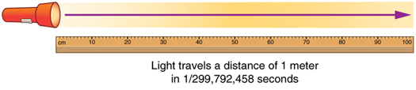
SR Unit
We can measure distance in units of light-second, i.e. distance light travels in 1 second.
1 light-second (or just sec) is equivalent to 299,792,458 m
SR unit: distance is measured in seconds.

Slide 8
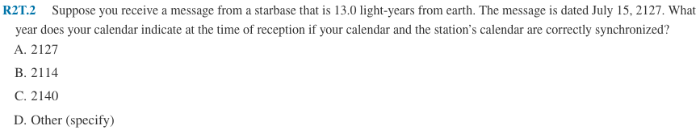
Clicker Question

Slide 9
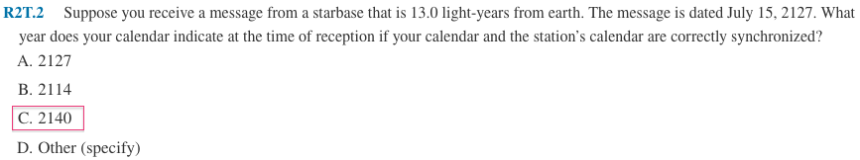
Answer

Slide 10
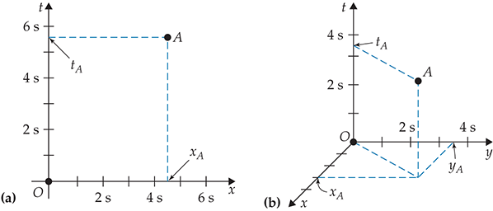
Spacetime Diagram
Depicts the spacetime coordinates of an event.
Vertical axis is time.
Horizontal axis is space, measured in SR unit of sec.

Slide 11
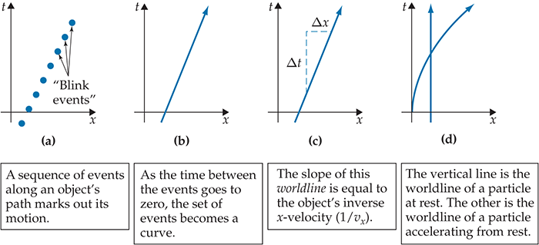
Spacetime Diagram
worldline

Slide 12
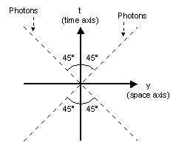
Worldline of Light
Worldline of light is a line of constant slope +1 or -1.

Slide 13
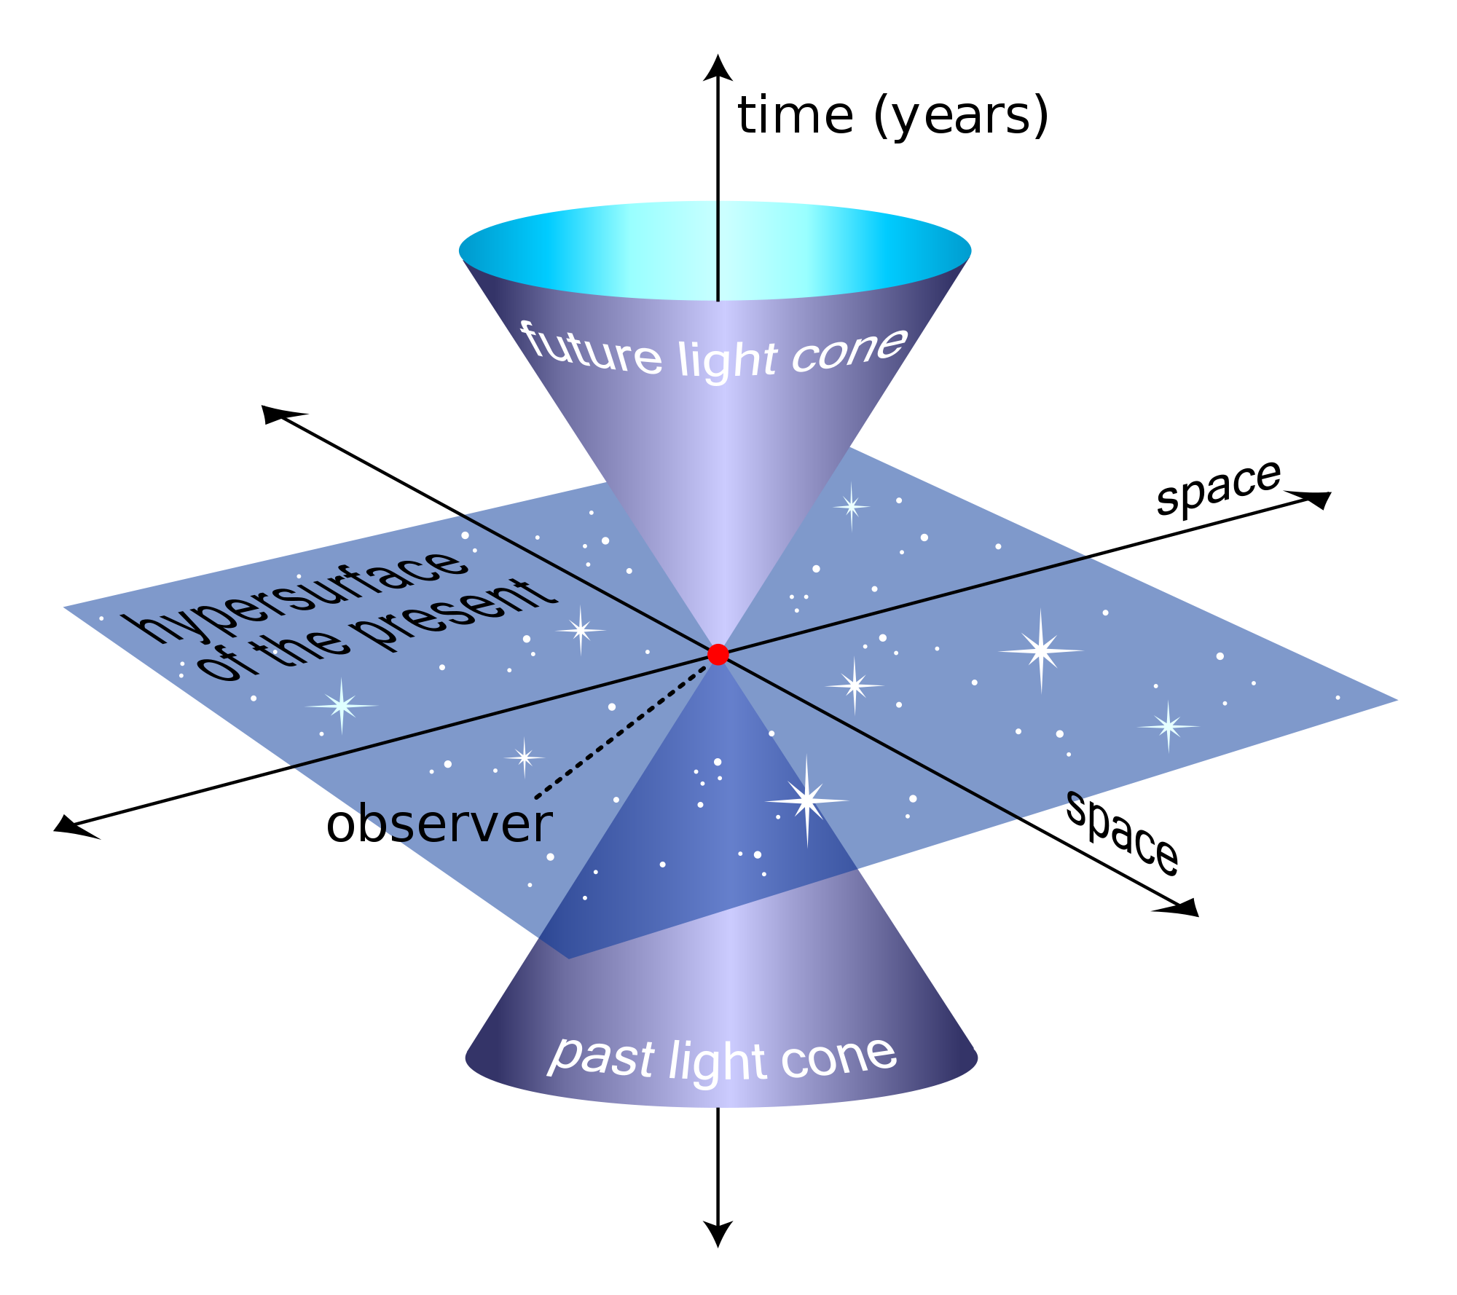
Past, Present and Future

Slide 14
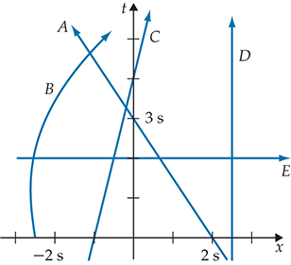
Clicker Question
Which of the worldlines shown above cannot possibly be correct?

Slide 15
Answer

Slide 16
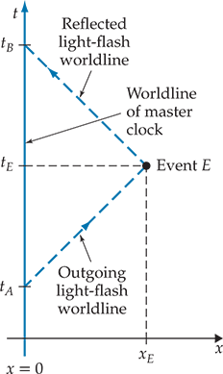
Radar Method
For 1D space, can determine the spacetime
coordinates of an event with a single master clock.

Slide 17
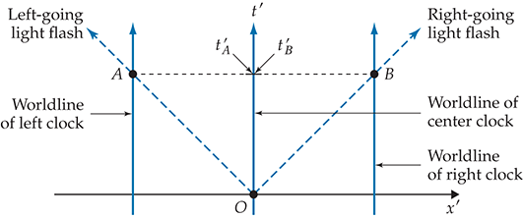
Coordinate Time is Frame-dependent
Events A and B are measured to occur at the same time.

Slide 18
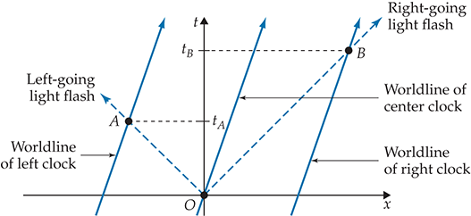
Coordinate Time is Frame-dependent
Event A is measured to occur before event B.
How to define a frame-independent time quantity? (See R3)

Slide 19
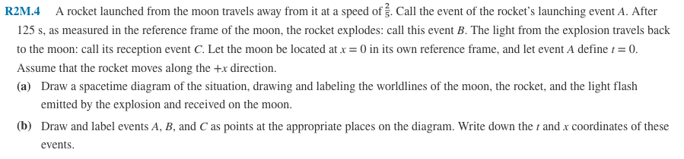
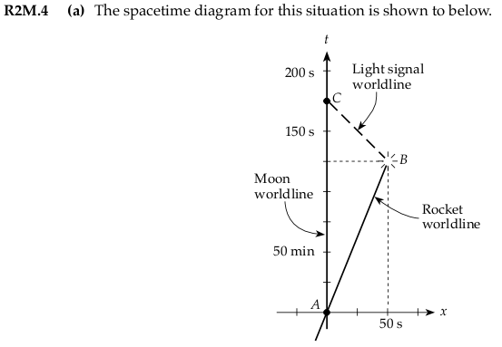
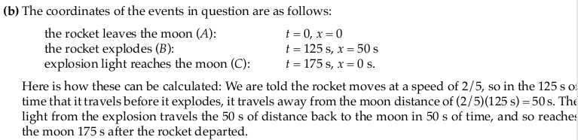
Practice Problem

