Slide 1


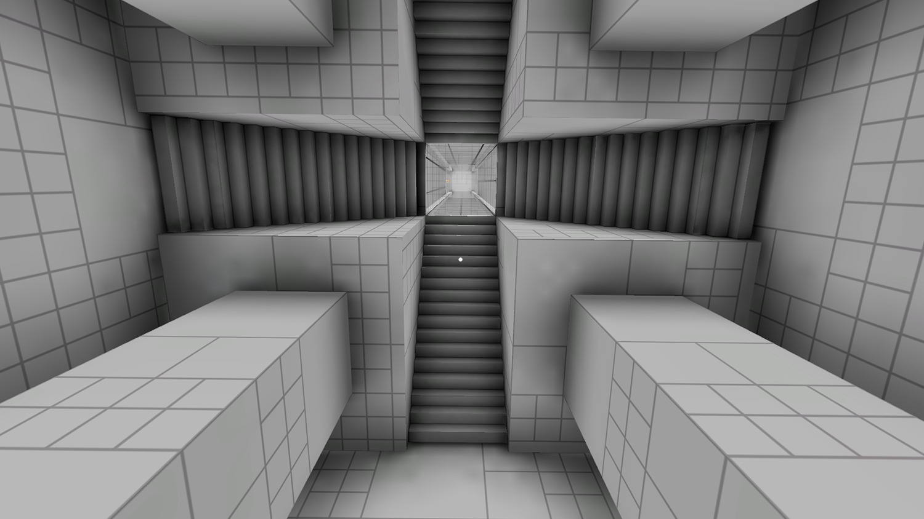
PHYSICS 197 Section 1
Chapter R1
The Principle of Relativity
November 10, 2017

Slide 2
Announcements
Wednesday, November 15: Review of Unit N part 2.
Last chance: Please email me the problems you want to be discussed in class by 9pm Tuesday, November 14).
Thursday, November 16: Exam #2 (6.30-11pm).
Covers the whole of Unit N.

Slide 3
Introduction
In Units C and N, we explored the Newtonian model of mechanics.
Unit R deals with a better model: the special theory of relativity.
Correctly explains the behavior of objects moving close to the speed of light.
Reproduces all results of Newtonian model for ordinary speeds.

Slide 4
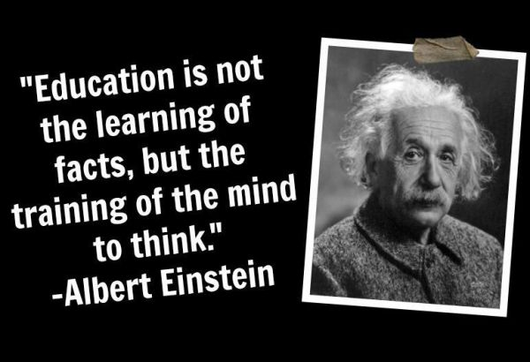
Why Special Relativity in Intro Physics?
Physical intuition can only take you so far.
When your intuition ends, you must rely on mathematical reasoning and abstract models to explain nonintuitive or even counterintuitive ideas.
Special relativity is a beautiful example of such a theory.

Slide 5

Clicker Question
12 m/s east
6 m/s east
18 m/s east
6 m/s west
12 m/s west

Slide 6
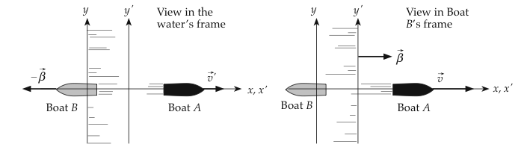
Answer
12 m/s east
6 m/s east
18 m/s east
6 m/s west
12 m/s west

Slide 7
Reference Frame

Slide 8
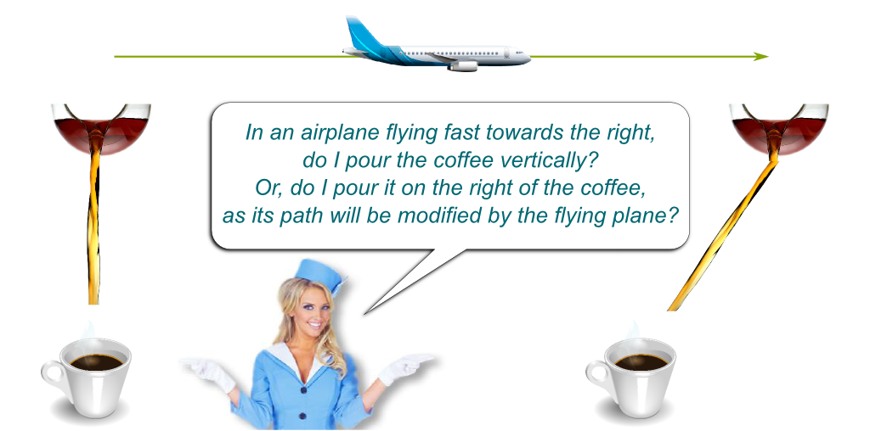
Reference Frame

Slide 9
Demo
Reference frame attached to the truck

Slide 10
Demo
Reference frame attached
to the truck
Reference frame attached to the ground

Slide 11
The Principle of Relativity
The laws of physics are the same in all inertial reference frames.

Slide 12
Question
R1T.1 Which of the following are inertial reference frames and which are not?
(Respond T if the frame is inertial, F if it is noninertial, and C if it is inertial for everyday purposes)
(a) A nonrotating frame floating in deep space
T. Archetype of an inertial frame

Slide 13
Question
R1T.1 Which of the following are inertial reference frames and which are not?
(Respond T if the frame is inertial, F if it is noninertial, and C if it is inertial for everyday purposes)
(b) A frame floating in deep space that rotates at 1 rev/h
C. Rotation rate is slow enough

Slide 14
Question
R1T.1 Which of the following are inertial reference frames and which are not?
(Respond T if the frame is inertial, F if it is noninertial, and C if it is inertial for everyday purposes)
(c) A frame attached to a roller-coaster car
F. The whole point of a roller coaster ride is to experience the
thrill of a highly noninertial frame.

Slide 15
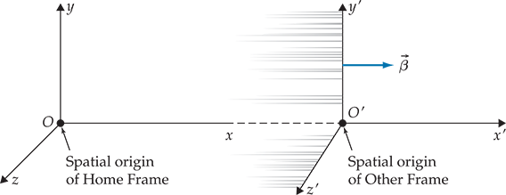
Newtonian Relativity

Slide 16
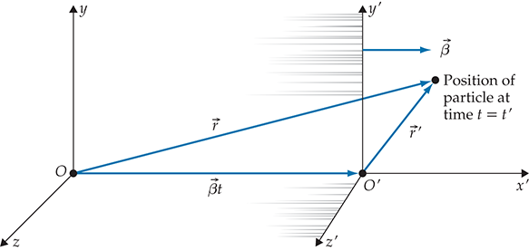
Newtonian Relativity
Spacetime coordinates: (t,x,y,z) → (t’,x’,y’,z’)

Slide 17
Galilean Transformation
Same acceleration! So same force by Newton’s 2nd law
But different speeds and position coordinates.
Different momenta and kinetic energy.

Slide 18
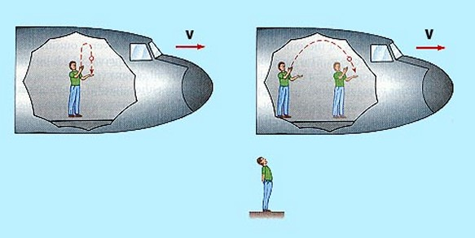
Same Acceleration
But different velocity of the ball in the two frames.

Slide 19
The Principle of Relativity
“Laws of physics are the same” (in inertial frames).
Observers in different frames may disagree about the values of various quantities (like position, velocity, momentum, kinetic energy,…).
But each observer will agree on the same equations to describe the laws of physics.
Same conservation principles will apply.

Slide 20
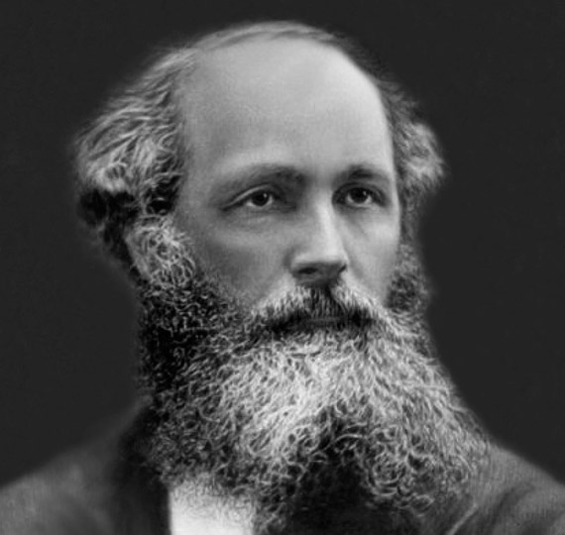
Electromagnetic Waves
Concept of Ether

Slide 21
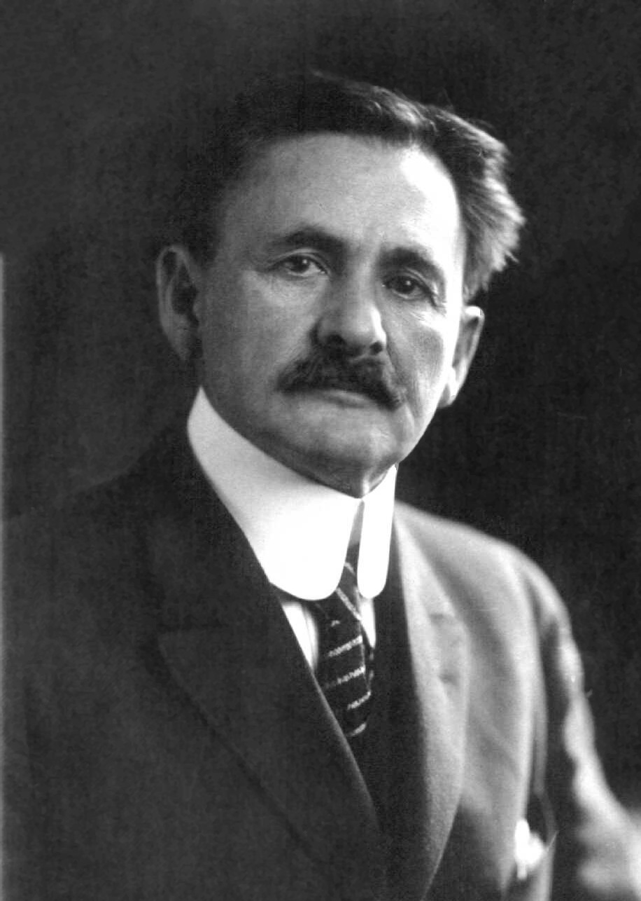
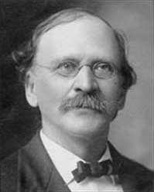
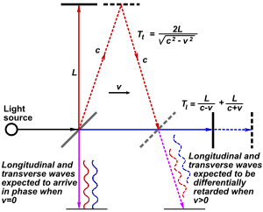
Michelson-Morley Experiment

Slide 22
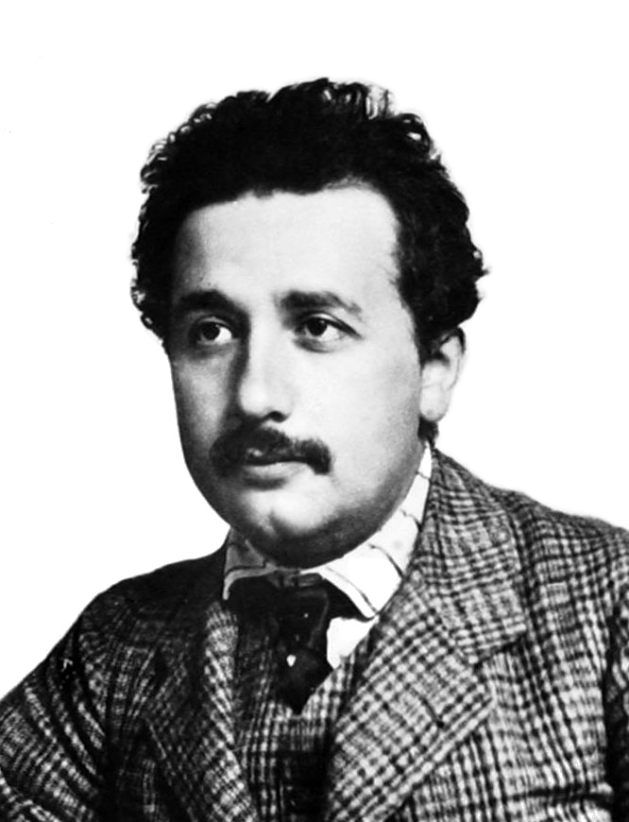
Principle of Relativity

Slide 23
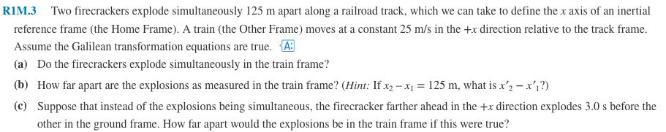
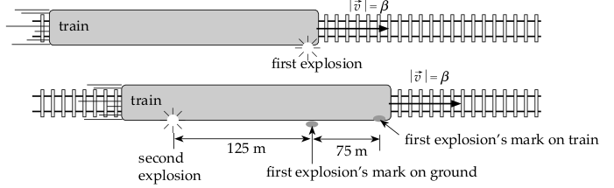
Practice Problem

Slide 24
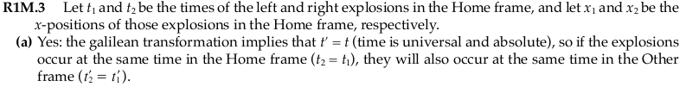

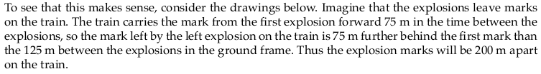
Solution

