Slide 1


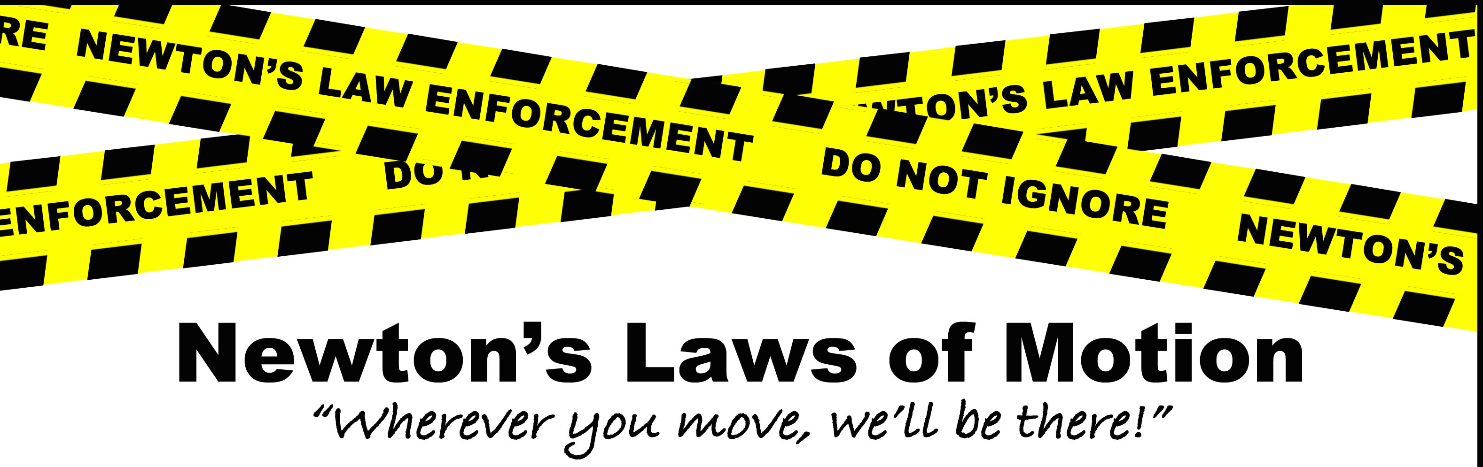
PHYSICS 197 Section 1
Unit N Review
Part 2
November 15, 2017

Slide 2
Announcements
Last 3 years’ exams with solutions posted on Blackboard Course Home Page→ Exam Info → Exam 2.
First 3 pages of Exam paper also posted there (please go over them carefully BEFORE the exam!)
Thursday, November 16: Exam #2 (6.30 – 11 pm).
Last Names A-G: Rebstock 215
Last Names H-Z: Hillman 070

Slide 3
Overview of Unit N
Statics
Linearly Constrained Motion
Coupled Objects
Circularly Constrained Motion
Noninertial Frames
Projectile Motion
Oscillatory Motion
Kepler’s Laws and Orbits

Slide 4
Review 1
Statics
Linearly Constrained Motion
Coupled Objects
Circularly Constrained Motion
Noninertial Frames
Projectile Motion
Oscillatory Motion
Kepler’s Laws and Orbits

Slide 5
Review 2
Statics
Linearly Constrained Motion
Coupled Objects
Circularly Constrained Motion
Noninertial Frames
Projectile Motion
Oscillatory Motion
Kepler’s Laws and Orbits
For other questions, come to tomorrow’s help session

Slide 6
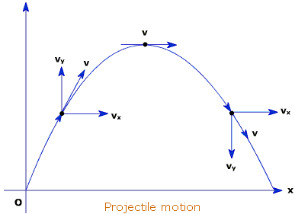
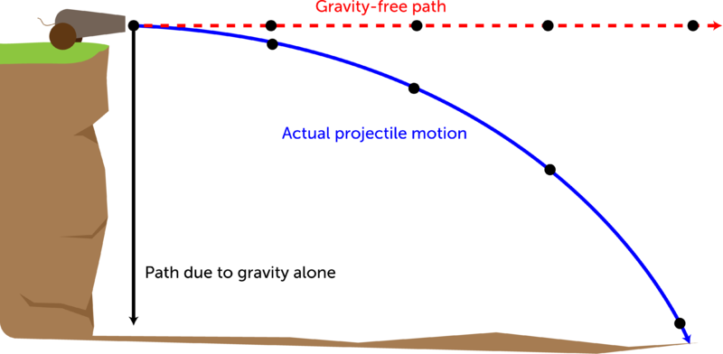
Projectile Motion (N9)
Two types of projectiles

Slide 7
Clicker Question
7.5 s
14.3 s
20.6 s
30.2 s

Slide 8
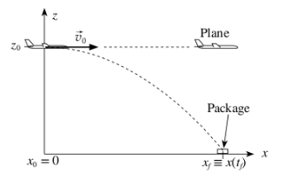
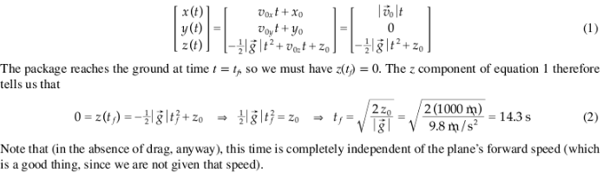
Answer
7.5 s
14.3 s
20.6 s
30.2 s

Slide 9
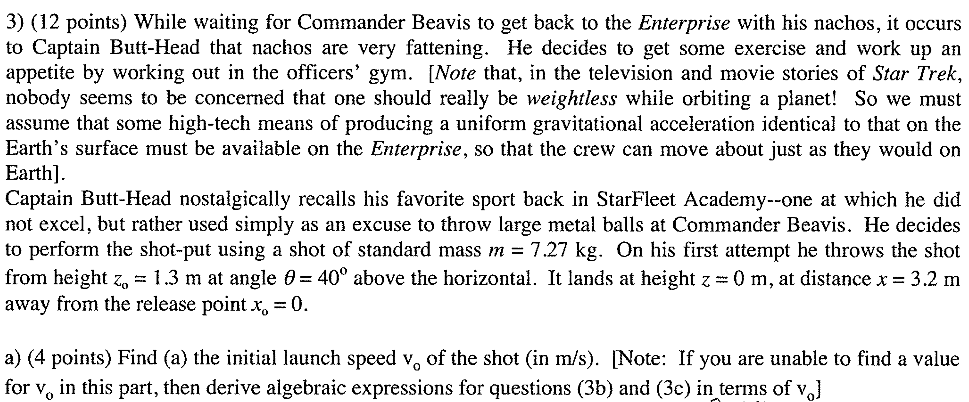
2014 Exam Problem 3

Slide 10
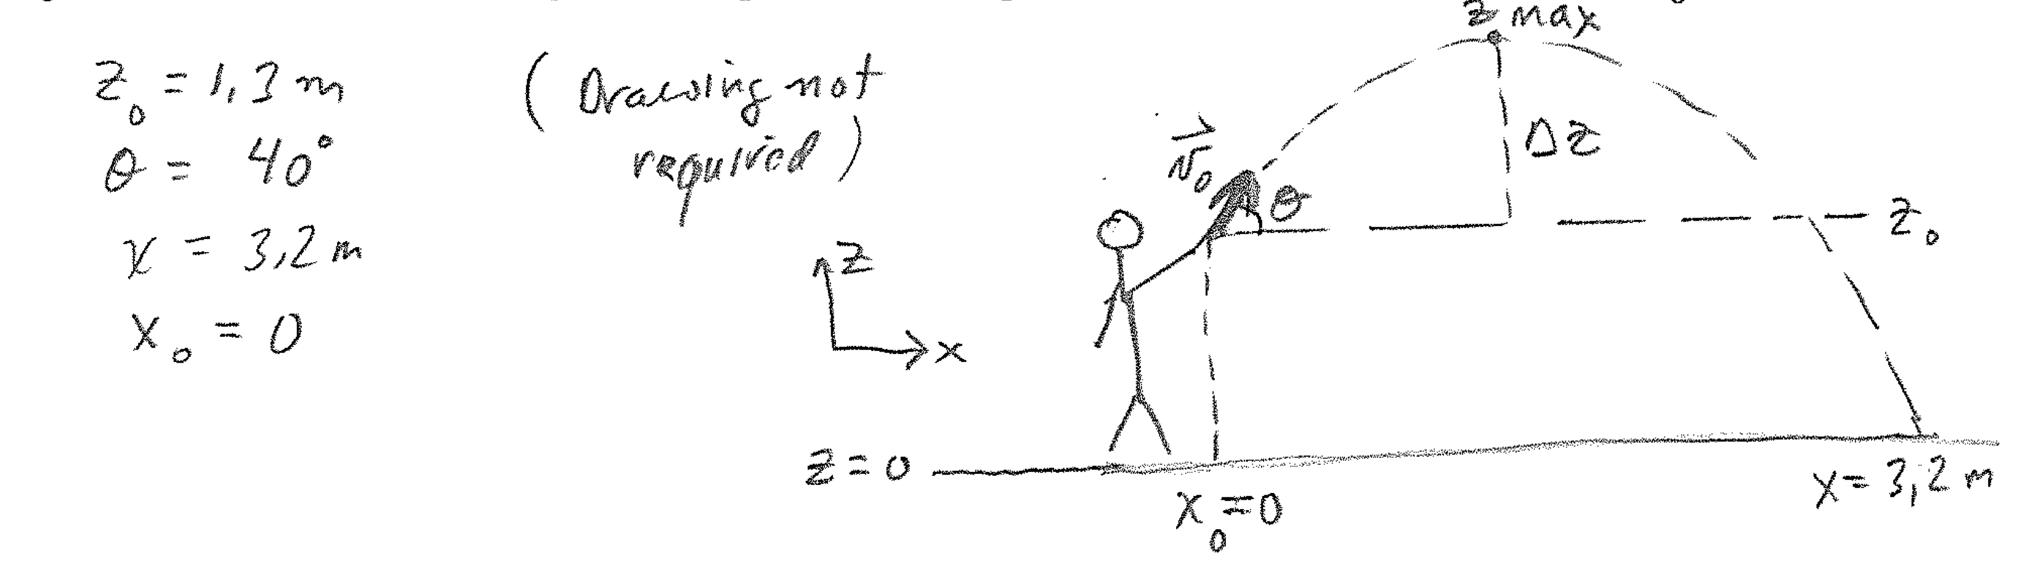
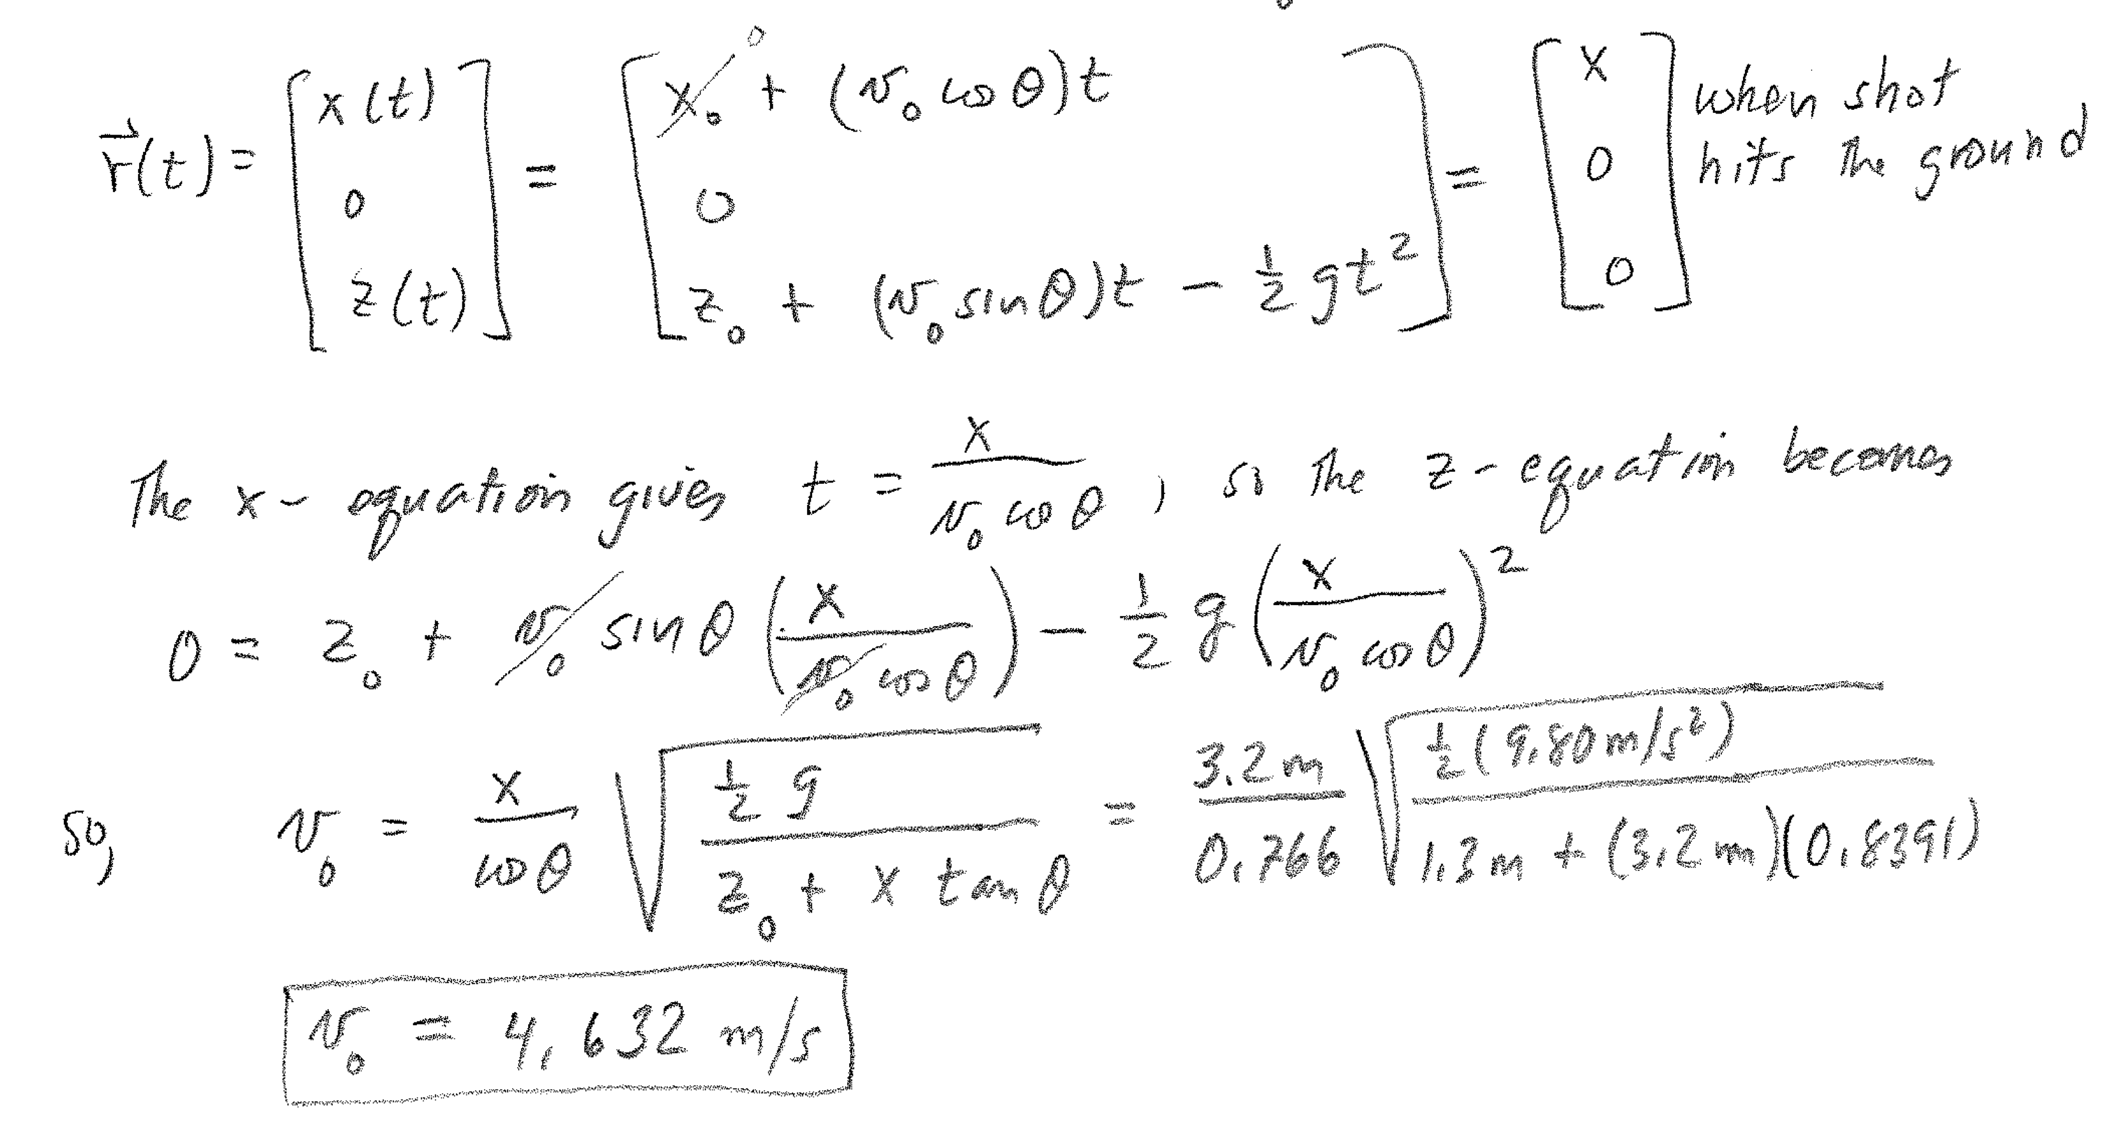
Solution (a)

Slide 11
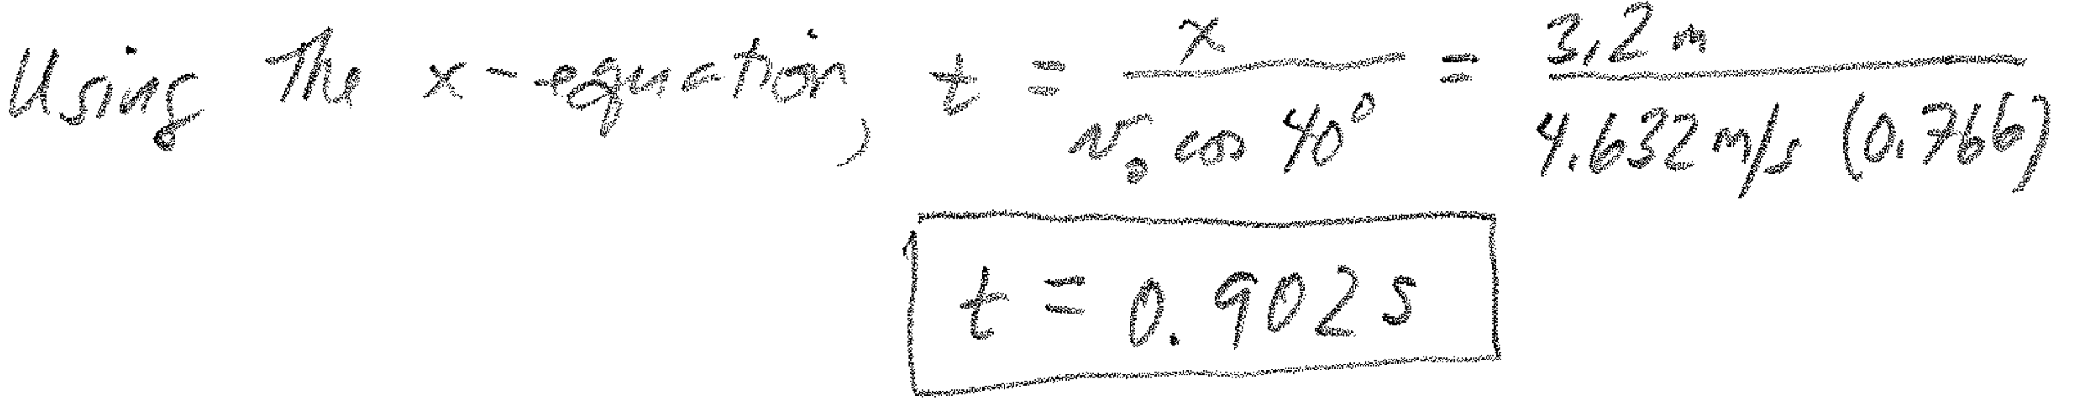
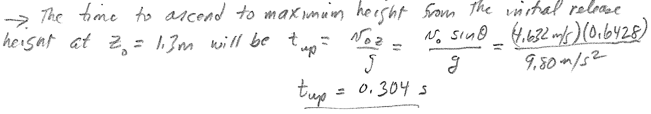
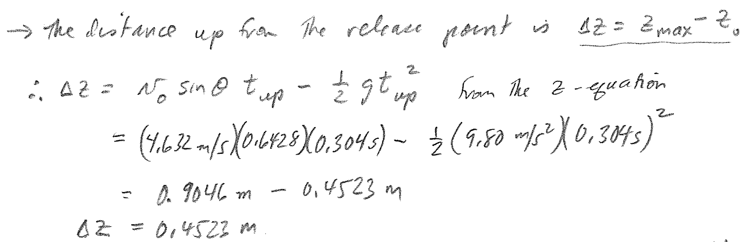
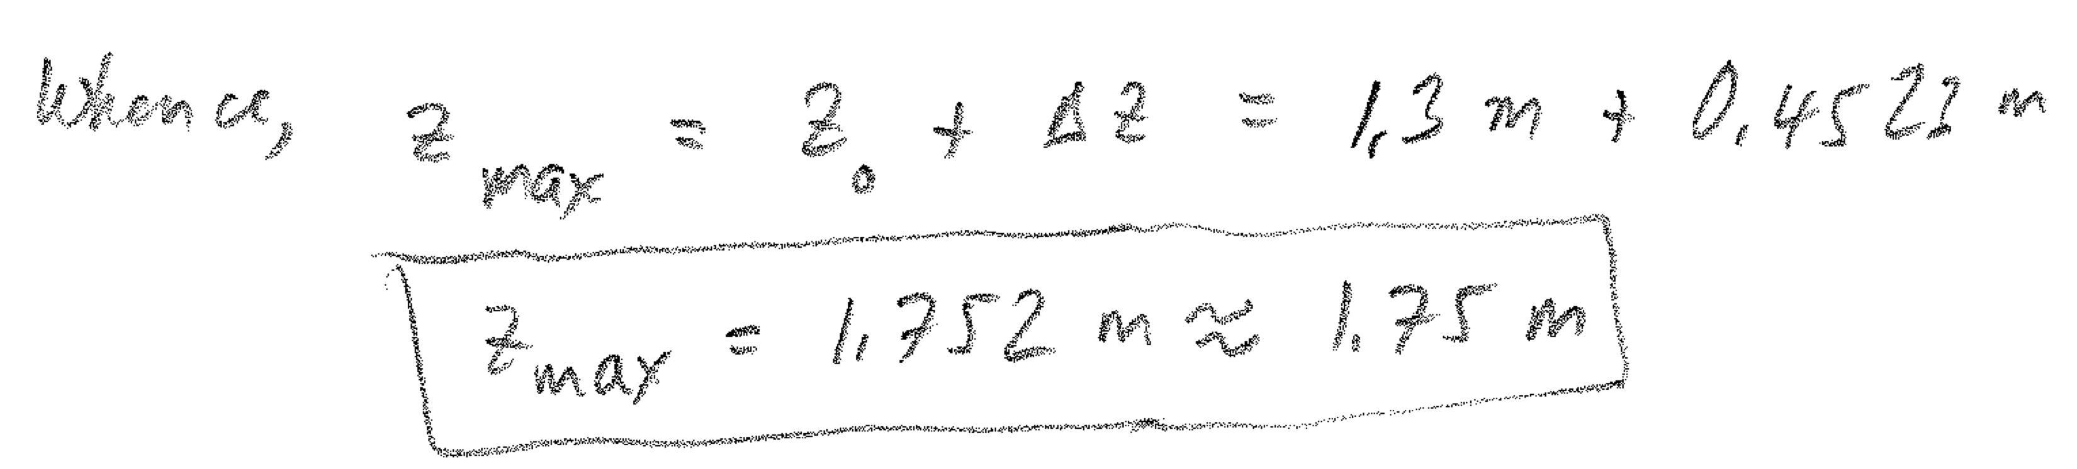
Solution (b) and (c)

Slide 12



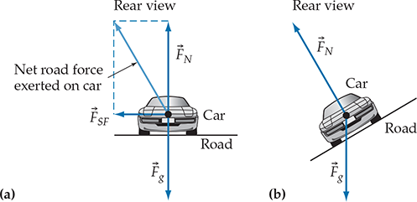
Circular Motion (N7)
Uniform circular motion:

Slide 13
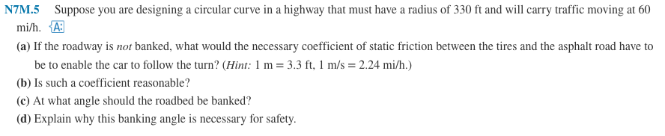
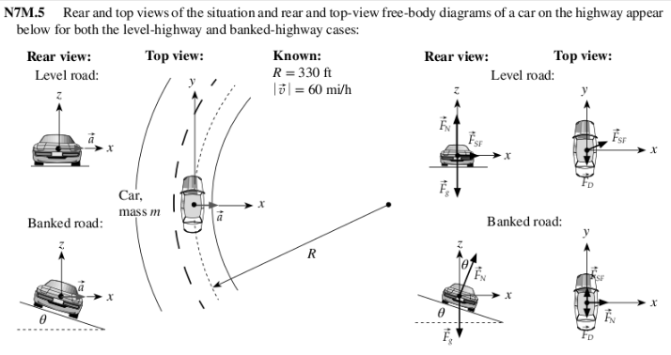
N7M.5

Slide 14
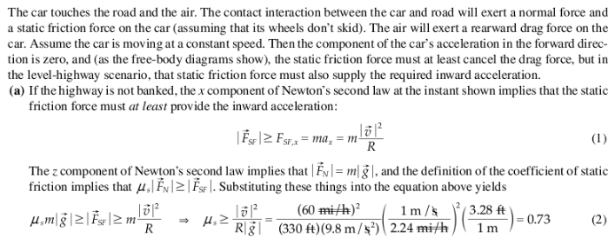
Solution

Slide 15
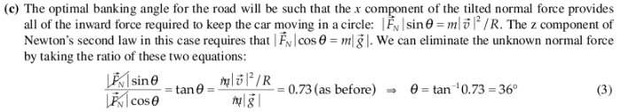

Solution

Slide 16
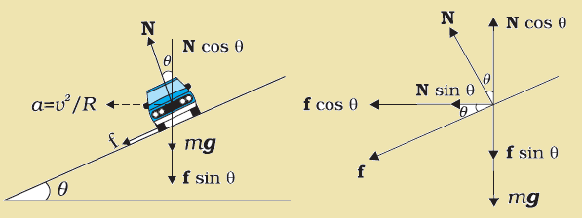
Friction and Banking
What is the maximum possible speed without sliding?

Slide 17
Statics (N4)
Balance the forces:
Balance the torques:
Choose axis of rotation in such a way that eliminates either most of the forces
or the unknown forces from the torque equation.

Slide 18
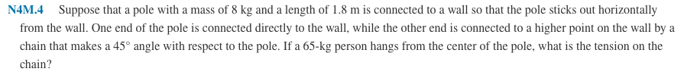
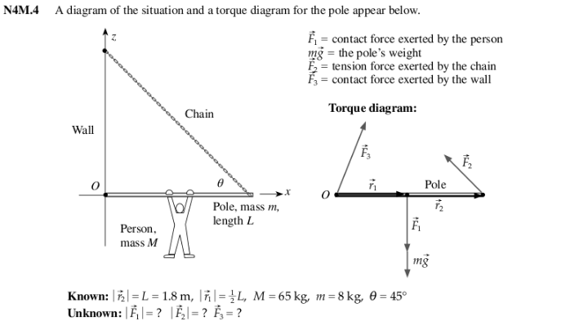
N4M.4
Need a vertical
component of F₃ to
balance the torque

Slide 19
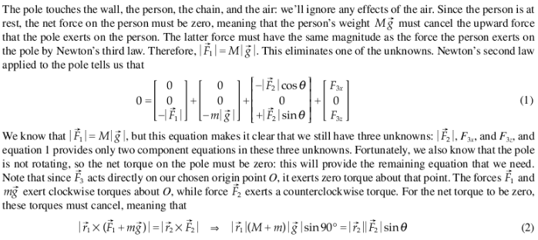
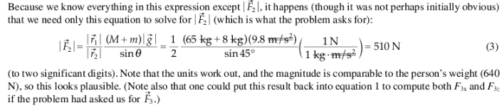
Solution

Slide 20
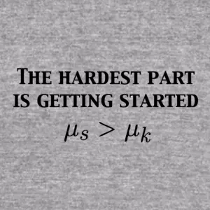
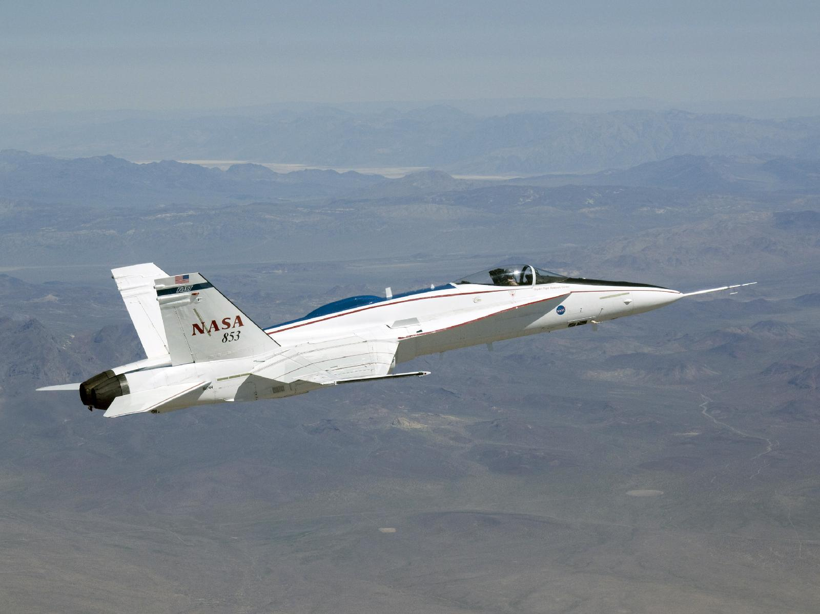
Friction (N5)

Slide 21
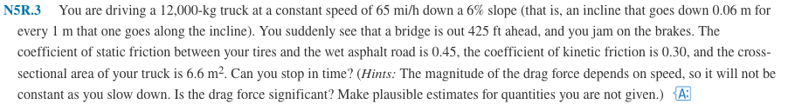
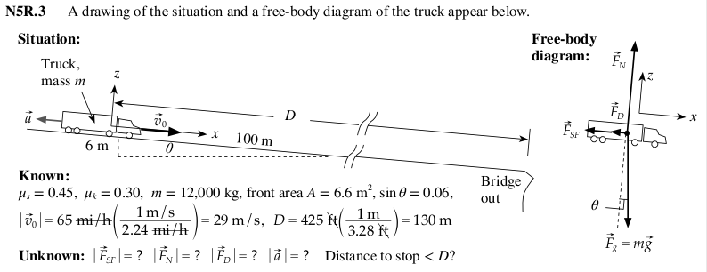
N5R.3

Slide 22

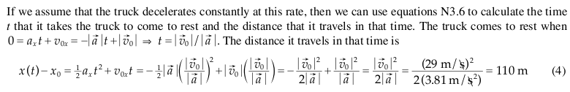

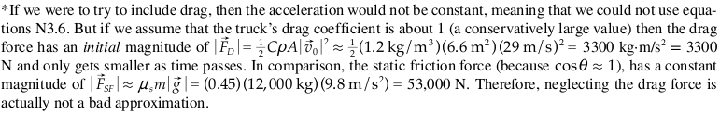
Solution

Slide 23
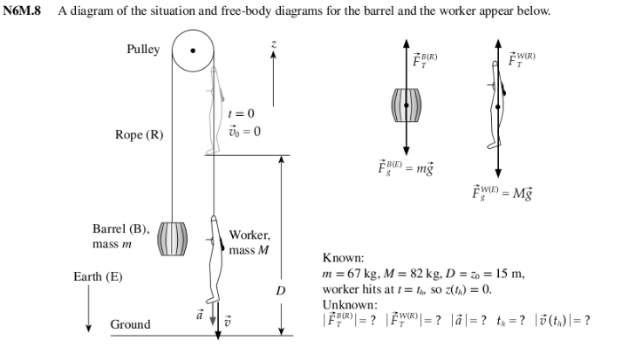
Coupled Objects (N6)

Slide 24
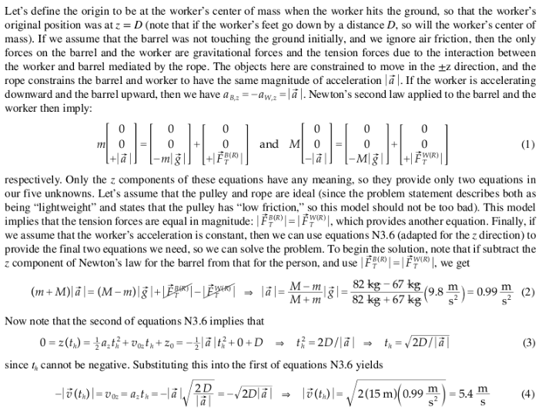
N6M.8 Solution

Slide 25
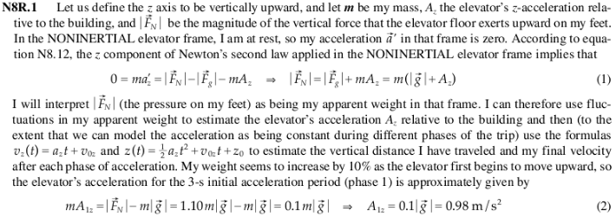
Noninertial Frames (N8)

Slide 26
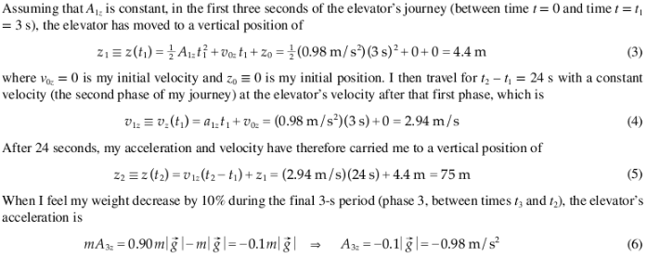
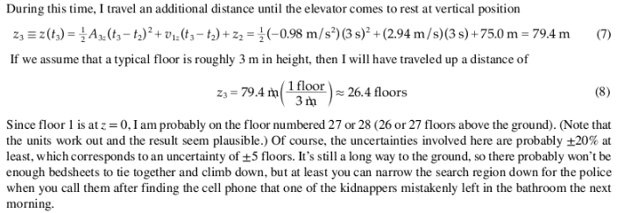
N8R.1 (continued)

