Slide 1



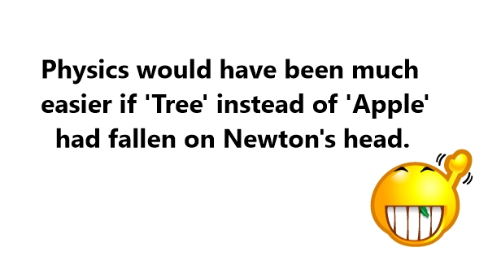
PHYSICS 197 Section 1
Unit N Review
Part 1
November 8, 2017

Slide 2
Overview
Statics
Linearly Constrained Motion
Coupled Objects
Circularly Constrained Motion
Noninertial Frames
Projectile Motion
Oscillatory Motion
Kepler’s Laws and Orbits

Slide 3
Overview
Statics
Linearly Constrained Motion
Coupled Objects
Circularly Constrained Motion
Noninertial Frames
Projectile Motion
Oscillatory Motion
Kepler’s Laws and Orbits

Slide 4
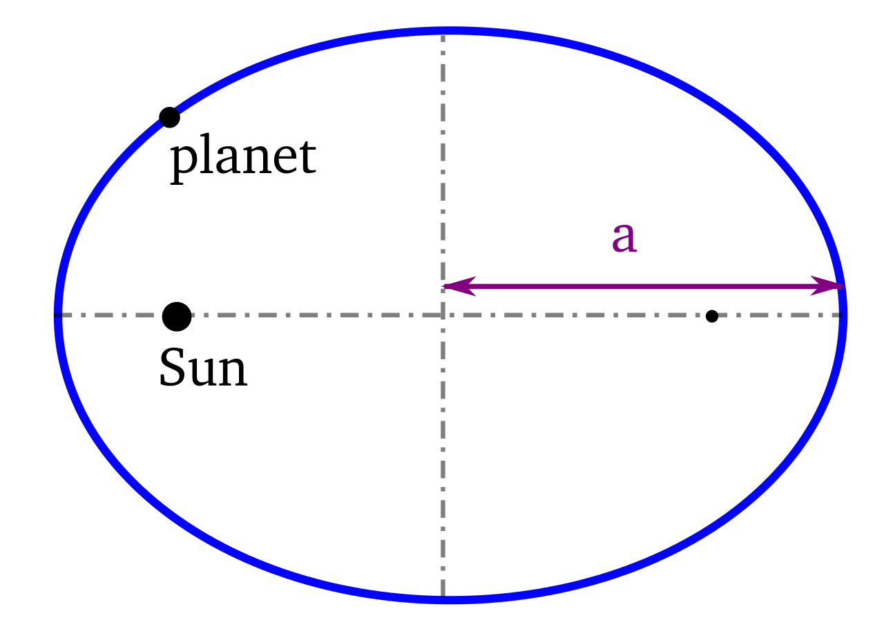
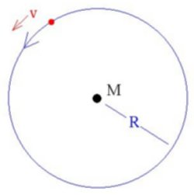



Kepler’s Laws and Orbits (N11, N12)

Slide 5
Clicker Question
1.0 M_{Earth}
10 M_{Earth}
17 M_{Earth}
23 M_{Earth}
0.1 M_{Earth}

Slide 6
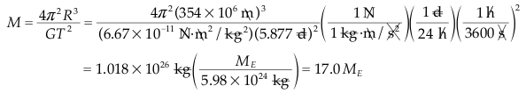
Answer
1.0 M_{Earth}
10 M_{Earth}
17 M_{Earth}
23 M_{Earth}
0.1 M_{Earth}

Slide 7
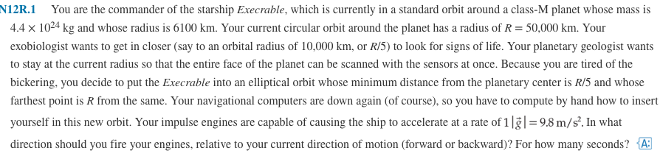
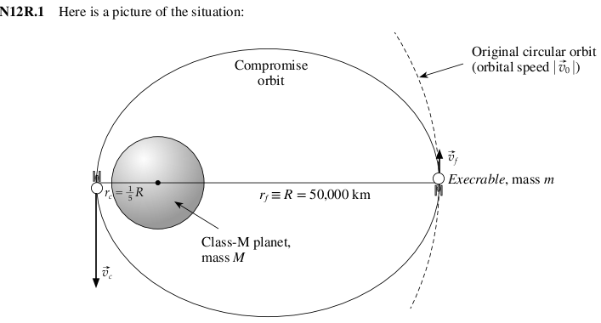
Practice Problem

Slide 8
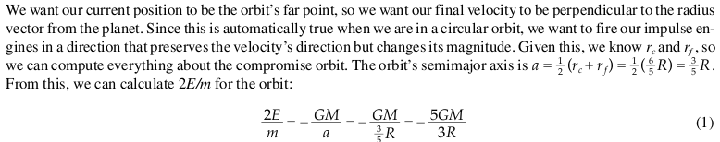
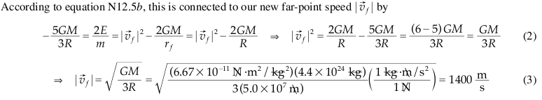

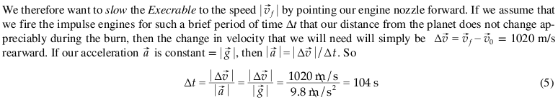
Solution

Slide 9



Oscillatory Motion (N10)
SHO equation:
General solution:
Pendulum equation:

Slide 10
Clicker Question
10 N/m
100 N/m
160 N/m
220 N/m
320 N/m

Slide 11
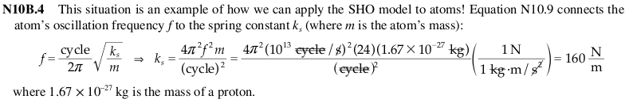
Answer
10 N/m
100 N/m
160 N/m
220 N/m
320 N/m

Slide 12

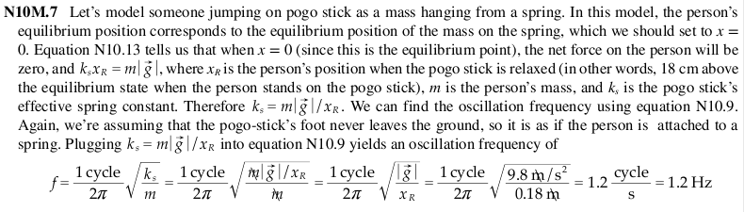
Practice Problem

Slide 13
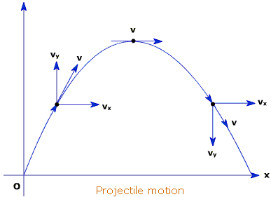
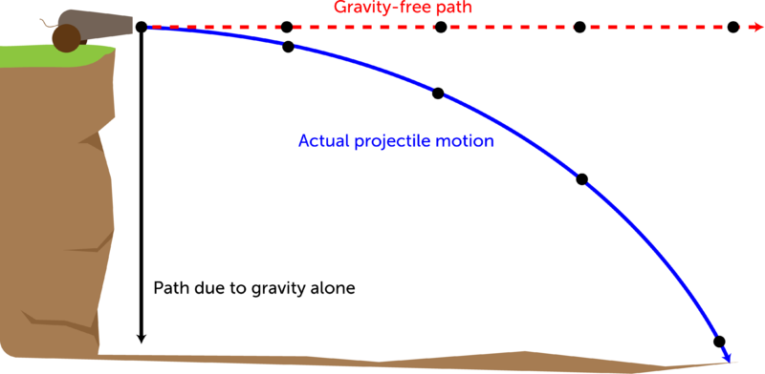
Projectile Motion (N9)
Two types of projectiles

Slide 14
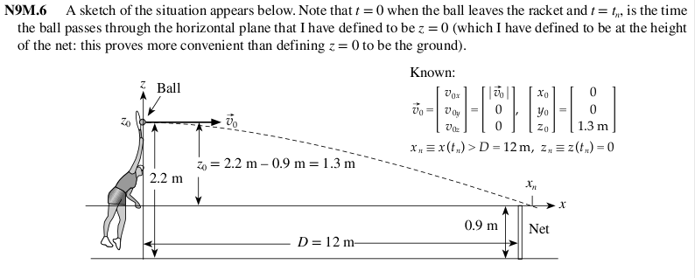
Practice Problem

Slide 15
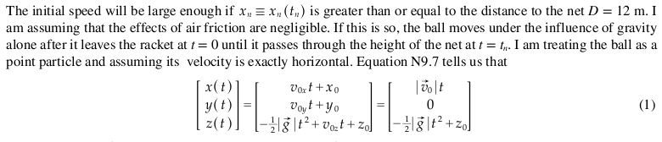
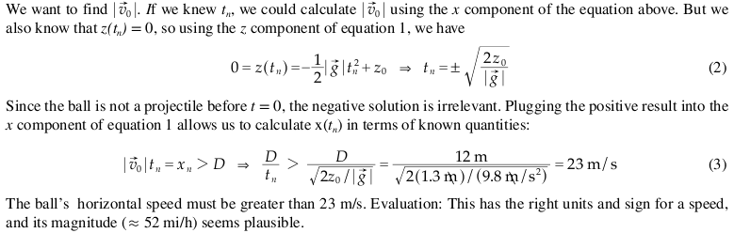
Solution

