Slide 1


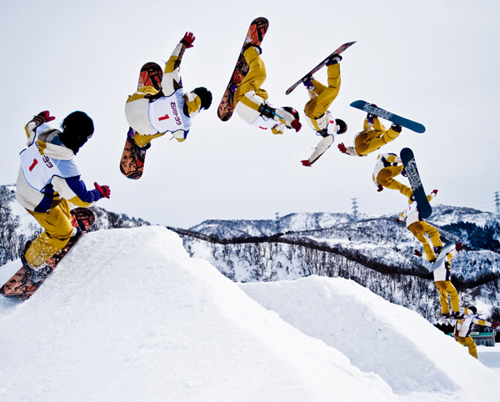
PHYSICS 197 Section 1
Chapter N9
Projectile Motion
October 30, 2017

Slide 2

Weight
An object’s weight is defined as the force that gravity exerts on it.
Near the Earth’s surface,
An object is freely falling if its weight is the only force acting on it.
From Newton’s 2nd law,
Hence, often called the acceleration due to gravity.

Slide 3
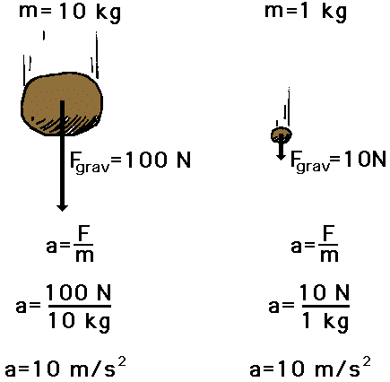
Independent of Mass

Slide 4
Projectile Motion
An object is called a projectile and its motion projectile motion if it
  remains sufficiently close to the earth’s surface (such that is valid, with a constant | |)
  has a sufficiently short trajectory (such that the direction of is constant)
  is not significantly affected by other forces (except air drag)
Simple projectile motion: when air drag is negligible.
Constant acceleration

Slide 5
Simple Projectile Motion
Integrate acceleration to find velocity:
Integrate velocity to find position:

Slide 6
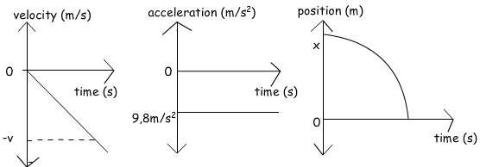
Simple Projectile Motion
Define the z axis to be vertically upward and the x and y axes to be horizontal.
In column-vector notation,

Slide 7
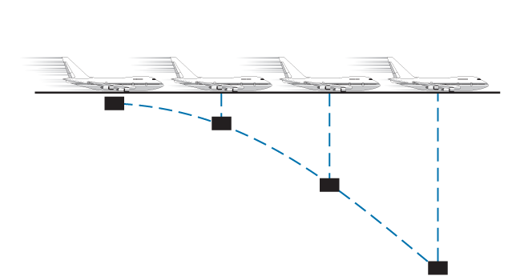
Three Basic Implications
1. Gravity affects only the z−component of the projectile’s motion.
As it falls, the projectile will maintain whatever original horizontal velocity it had.
Example: Package dropped from an airplane.

Slide 8
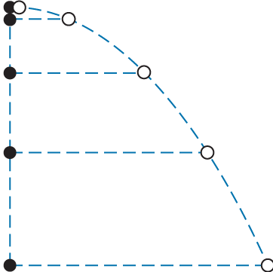
Three Basic Implications
2. The projectile’s vertical motion is completely independent of its horizontal motion.
Demo: Dropped vs. Horizontally Fired Balls
Which one reaches the ground first?
Objects fall vertically at the same rate
no matter how they are moving horizontally.

Slide 9
Three Basic Implications
3. The projection of the projectile’s motion on the horizontal (xy) plane is always a straight line.
Follows from Newton’s 1st law (since there is no non-zero component of acceleration in the xy-plane.
Generally possible to orient our reference frame so that one of the x and y axes lies in the direction of the horizontal motion.

Slide 10
Clicker Question
A clever monkey escapes from the St. Louis zoo. The zoo keeper finds him in a Forest Park tree. After failing to entice the monkey down with bananas, the zoo keeper points her tranquilizer gun directly at the monkey and shoots a dart. The clever monkey, certain he will avoid the dart and escape, lets go of the tree at the same instant the dart leaves the barrel of the gun. The dart
Misses the monkey.
Hits the monkey regardless of the initial velocity of the dart.
Hits the monkey only if the initial velocity of the dart is large enough.

Slide 11
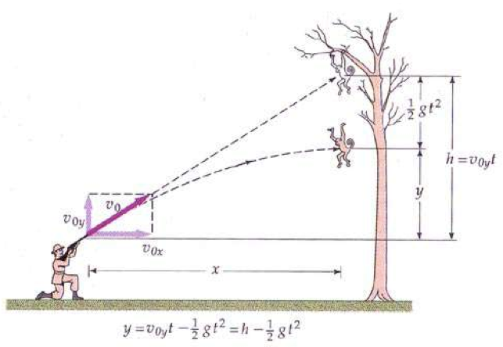
Demo: Monkey and Zoo Keeper

Slide 12
Answer to Clicker Question
A clever monkey escapes from the St. Louis zoo. The zoo keeper finds him in a Forest Park tree. After failing to entice the monkey down with bananas, the zoo keeper points her tranquilizer gun directly at the monkey and shoots a dart. The clever monkey, certain he will avoid the dart and escape, lets go of the tree at the same instant the dart leaves the barrel of the gun. The dart
Misses the monkey.
Hits the monkey regardless of the initial velocity of the dart.
Hits the monkey only if the initial velocity of the dart is large enough.

Slide 13
Answer to Clicker Question
The force of gravity accelerates the dart and the monkey equally.
So they fall the same distance in the same time.
The monkey falls from the tree, while the dart falls the same distance from the straight-line path it would have taken in the absence of gravity.
So, if the zookeeper aims at the monkey initially, the dart will always hit the monkey.
But the initial dart velocity should be large enough to overcome the horizontal separation.
If the zookeeper is very far away or the muzzle velocity is very low, the dart and the monkey will still hit the ground simultaneously, but will be separated horizontally.

Slide 14
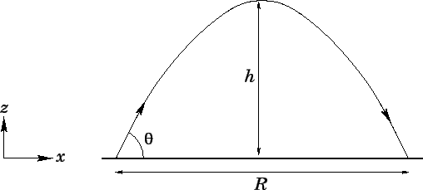
Time for Maximum Height

Slide 15
Time to Hit the Ground

Slide 16

Range of Projectile
Maximum for 45⁰

Slide 17
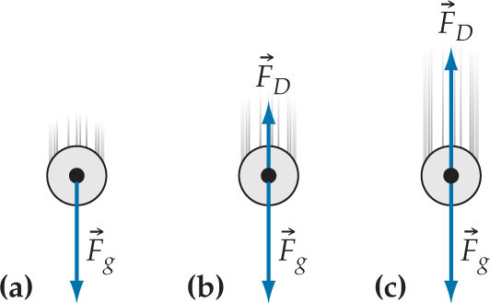
Drag Force

Slide 18
Terminal Speed

Slide 19
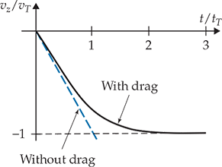


Time to Reach Terminal Speed
For a drag-free object,
In reality,

Slide 20
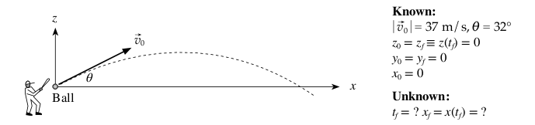

Practice Problem

