Slide 1


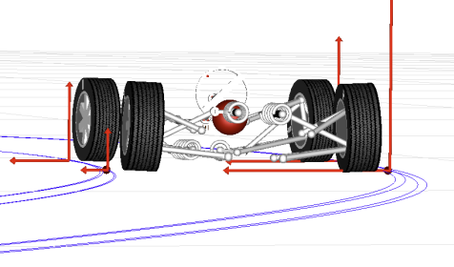
PHYSICS 197 Section 1
Chapter N6
Coupled Objects
October 23, 2017

Slide 2
Announcements
Midterm grades: Available on EGrades. Threshold for each letter grade lowered by a few points (for midterm advisory ONLY).
Daily HW Scores: Several low daily HW scores on Blackboard. If your Connect scores didn’t get transferred properly, please email me so I can fix it.
Lab Grades: Those of you not happy with your lab grades can talk to our Lab Manager, Ms. Merita Haxhia (mhaxhia@physics.wustl.edu)
Higher Final Grades: Those having low midterm grades still have a chance to get an A, if they do well in Exams 2 and 3.
Regrade Requests: Please submit by Friday, 10/27 end of class.
Next two classes (N7,N8) will be taught by Prof. Ogliore.

Slide 3
Review of N5
Linearly Constrained Motion.
Constant Velocity implies Zero Net Force.
Friction Force: Static and Kinetic.
For sliding down an incline,

Slide 4
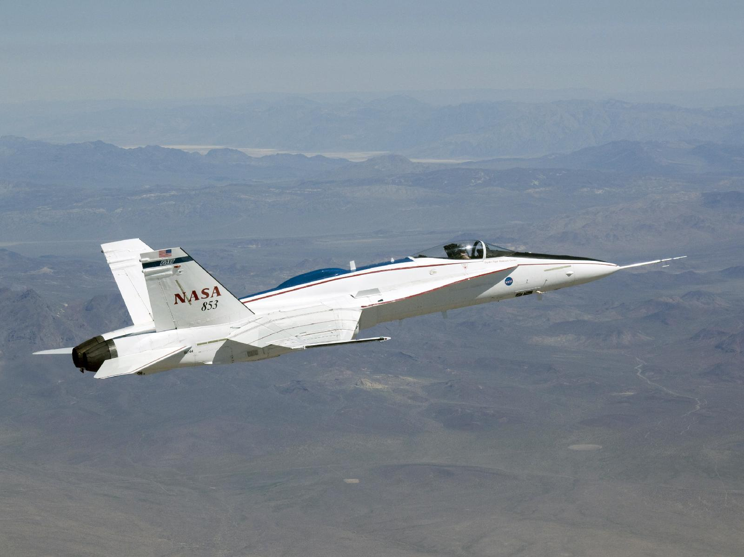
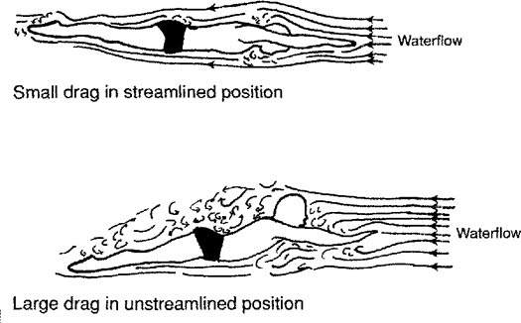
Drag Force
Friction force between an object and a fluid, when the object moves through the fluid (e.g. air, water).
Depends strongly on the object’s speed (unlike kinetic friction).
Also depends on the object’s surface area and the fluid’s density.
Video: Skillful cyclist (knows physics!)

Slide 5
Overview of N6
Continues the theme of “forces from motion.”
Motion of Coupled Objects
  (Use both Newton’s 2nd and 3rd laws)
Pushing Blocks
Strings
Pulleys

Slide 6
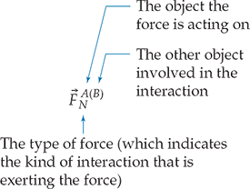
Coupled Objects
Two objects that are constrained by some kind of connection so that their motions are linked in some well-defined manner.
Use this constraint to analyze the forces acting on the individual objects in the pair.
Coupled objects are constrained to have the same acceleration.
Keeping track of all the contact forces would be a notational problem.
Convention:

Slide 7
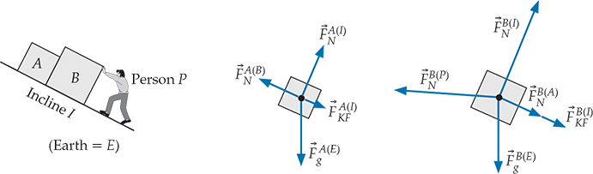
Example: Pushing Blocks

Slide 8
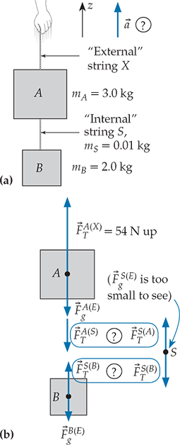
Strings
Objects do not have to be in direct contact to exert forces on each other.
Example: Two objects connected by a string.
Each end of the string exerts a tension force on the object to which it is connected.
Ideal string: Massless, inextensible, and flexible cord binding two objects together.
Same magnitude of tension force at either end of the string.

Slide 9
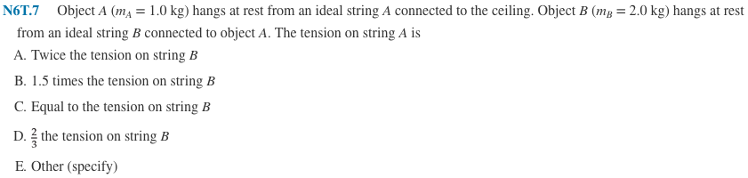
Clicker Question

Slide 10
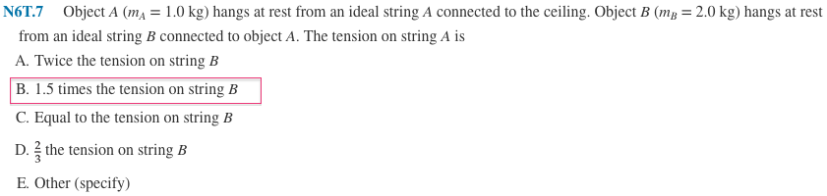

Answer

Slide 11
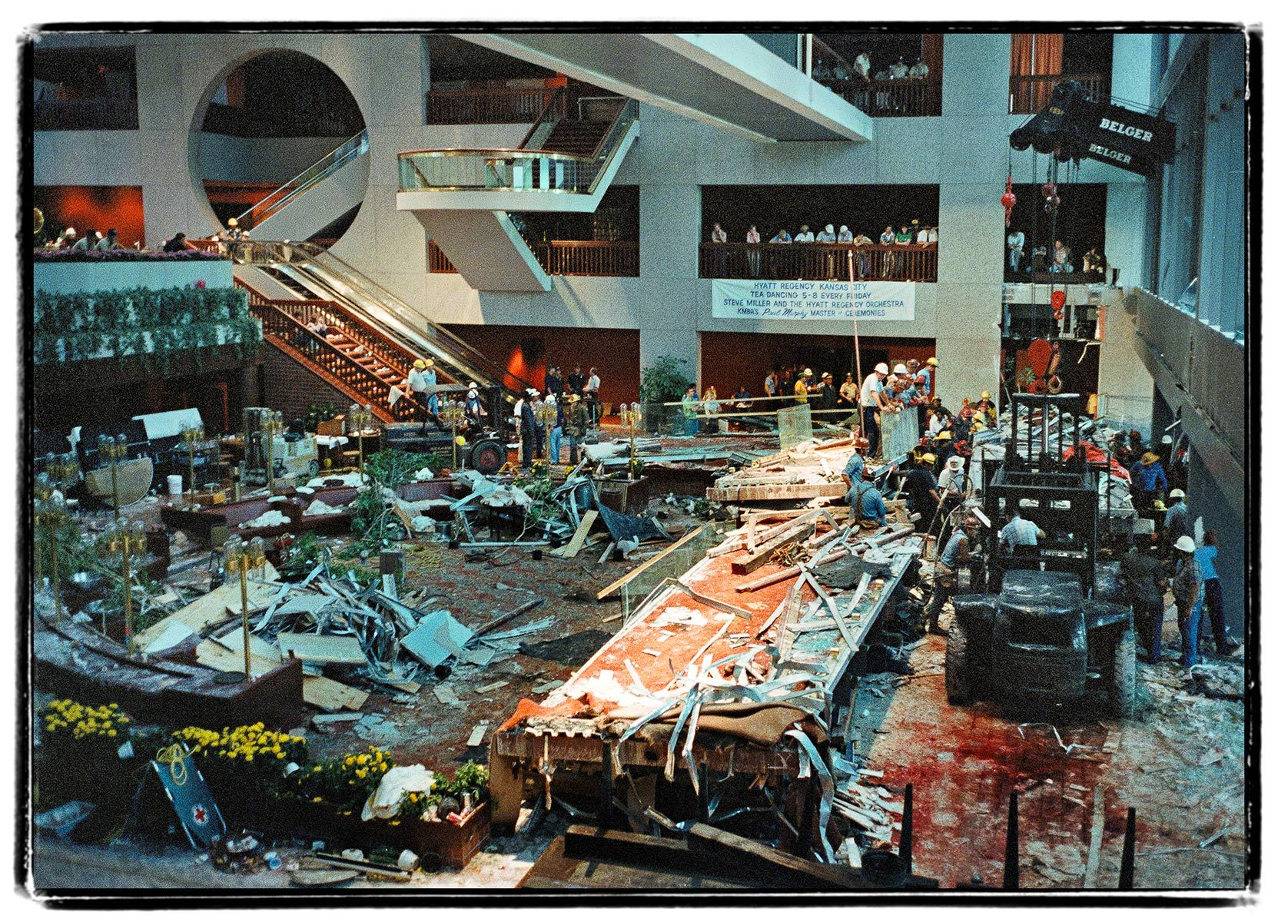
Hyatt Regency Walkway Collapse
Kansas City, MO (07/17/1981)

Slide 12
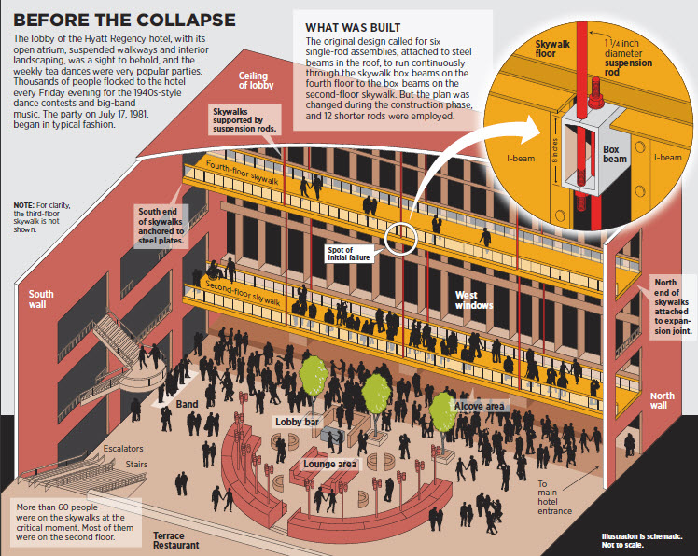

Slide 13
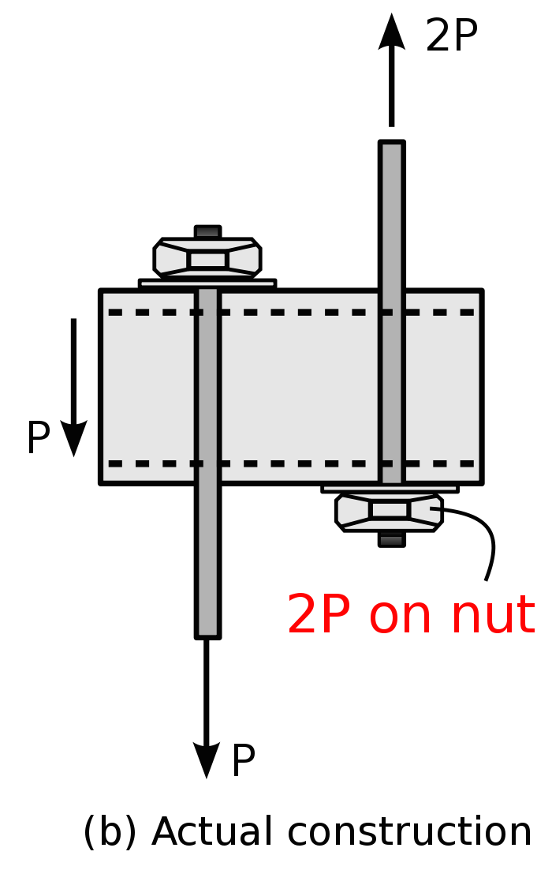
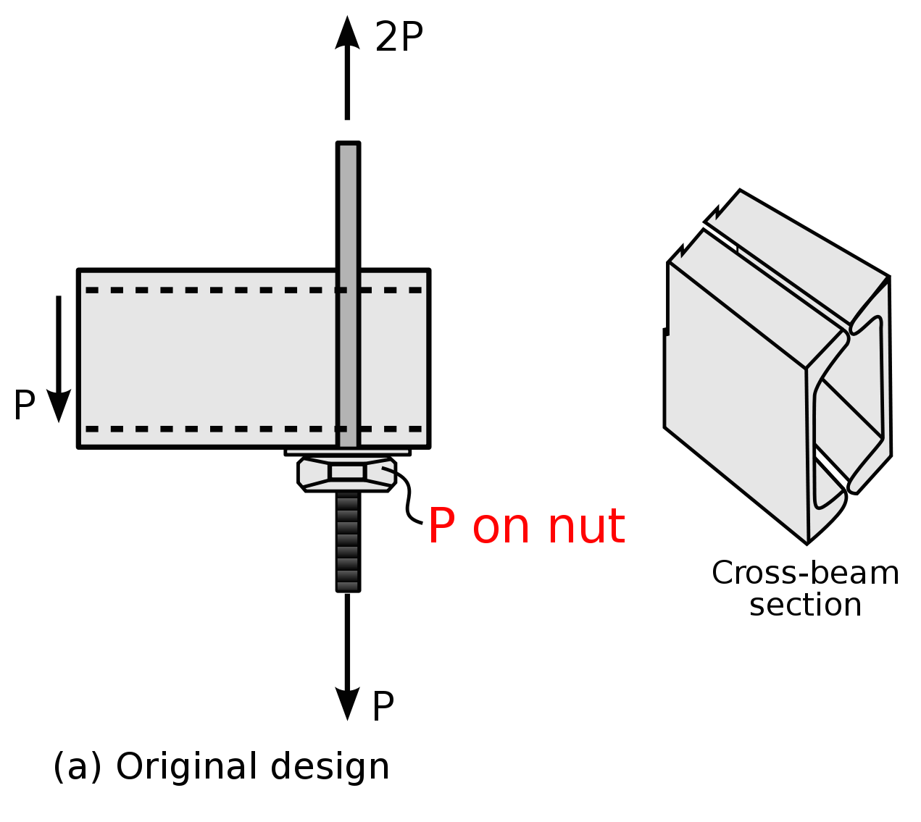
Reason of Collapse
from weight of
lower ramp
from weight of
both ramps

Slide 14
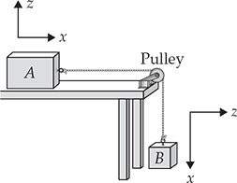
Pulleys
An ideal pulley simply redirects the string without creating any tension difference between the two sides of the string.
An ideal pulley is almost massless and has nearly frictionless bearings.
Often convenient to use separate reference frame for each object.
E.g., tension force exerted by string on object A is in +x direction, whereas that exerted by string on object B is in –x direction.

Slide 15
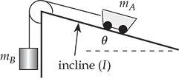
Demo: Cart and Pulley
Cart on incline with pulley and hanging mass. Under what conditions does the cart remain at rest?

Slide 16
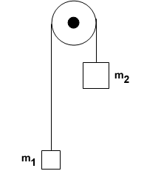
Demo: Atwood Machine
What is the acceleration of the falling mass?

Slide 17
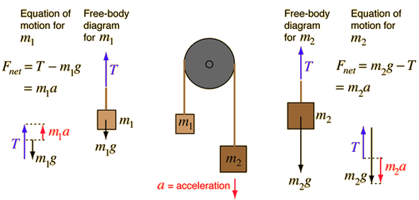

Demo: Atwood Machine

Slide 18
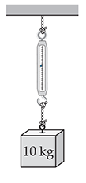
Question
N6T.9 A spring scale indicates the magnitude of the tension force exerted on its bottom hook. What will the scale read?
98 N

Slide 19
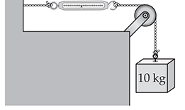
Question
N6T.9 A spring scale indicates the magnitude of the tension force exerted on its bottom hook. What will the scale read?
98 N

Slide 20
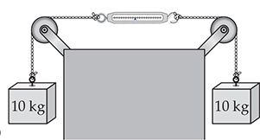
Question
N6T.9 A spring scale indicates the magnitude of the tension force exerted on its bottom hook. What will the scale read?
98 N

Slide 21
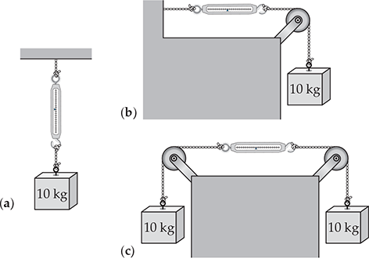
Answer

Slide 22
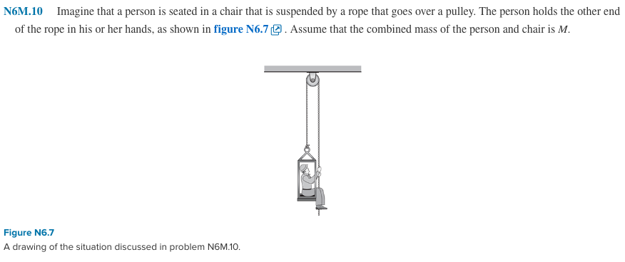
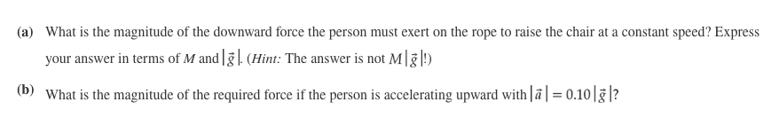
Practice Problem

Slide 23
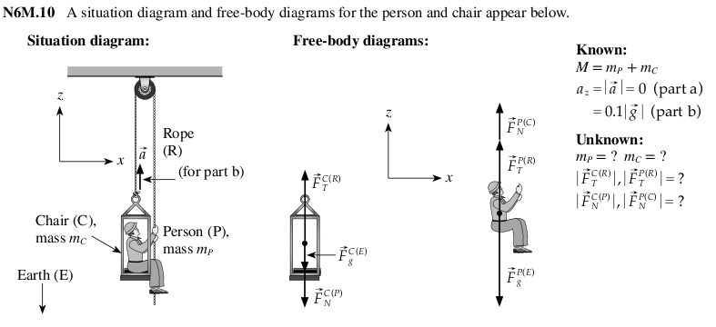
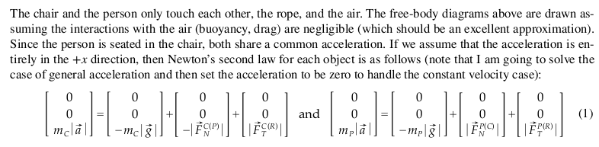
Solution

Slide 24
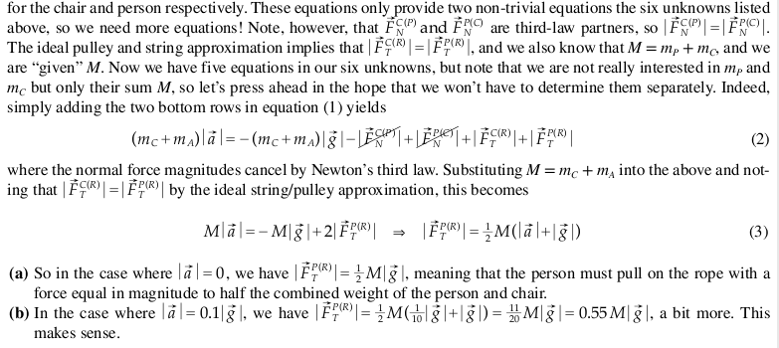
Solution

