Slide 1


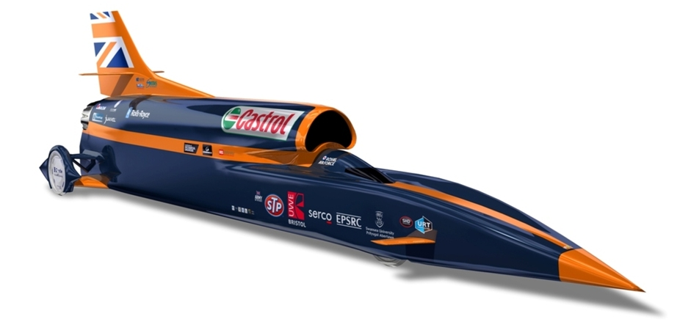
PHYSICS 197 Section 1
Chapter N5
Linearly Constrained Motion
October 20, 2017

Slide 2
Midterm Grade
Grades will be assigned according to the grading rubric on Blackboard.
Midterm grades will be posted on Blackboard by Monday, 10/23.
Regrade requests due Friday, 10/27.
Please note that the midterm grades are just to track your progress, and will NOT appear in any official documents.

Slide 3
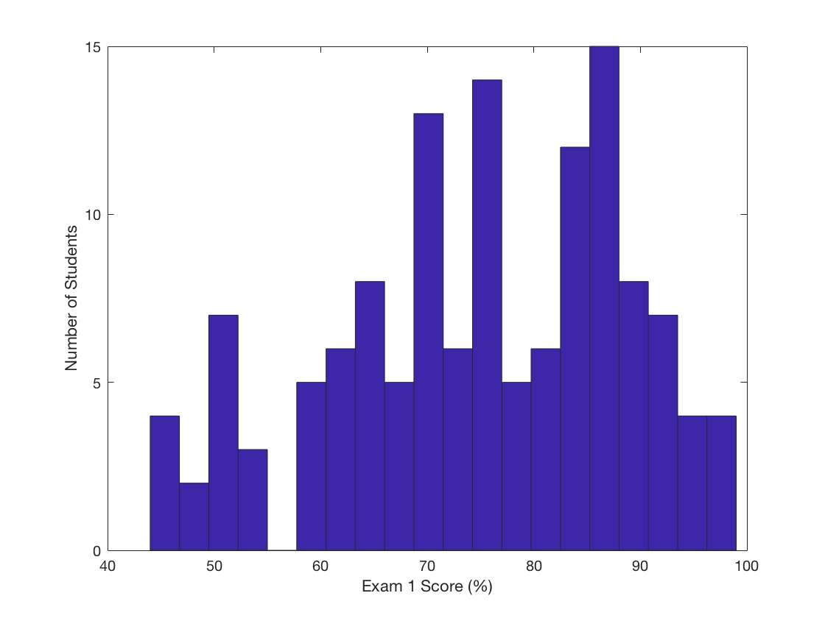
Exam 1 Results
Mean: 75.1
Median: 75.5
Standard Deviation: 13.5

Slide 4
Overview of Chapter N5
Continues the Forces from Motion theme.
In last chapter (N4), we studied the simplest case: No motion (Statics).
In this chapter, we will consider slightly more complicated cases: objects that move in straight lines (linearly constrained motion).
With either constant or nonconstant velocity.

Slide 5
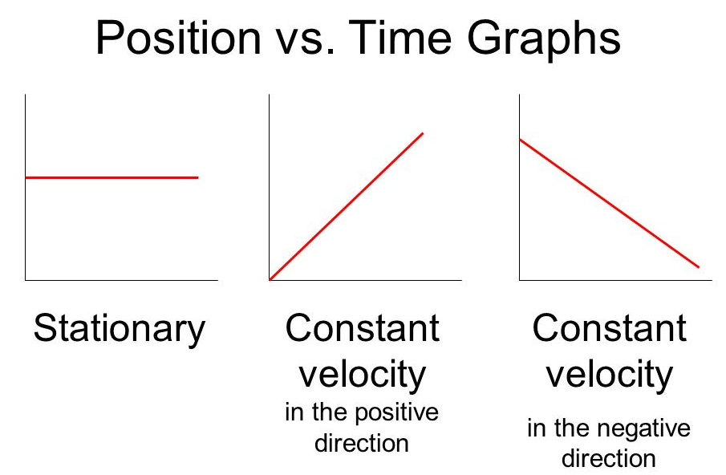
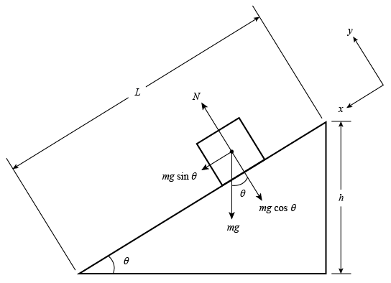
Motion at Constant Velocity
Zero acceleration.
Net force acting on the object must be zero (Newton’s 2nd law).
Similar to an object at rest.
In fact, at rest is a special case of constant-velocity motion (with velocity=0).
Convenient to choose a reference frame so that one axis is parallel to the direction of motion.
Makes as many force components as possible equal to zero.

Slide 6
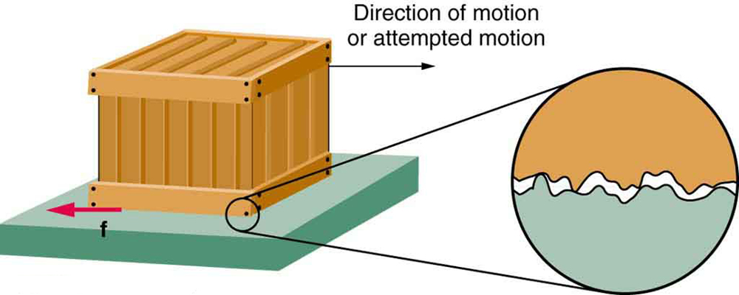
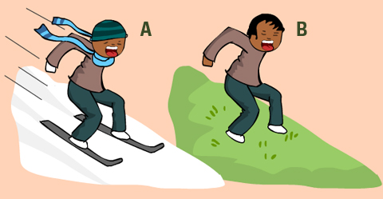
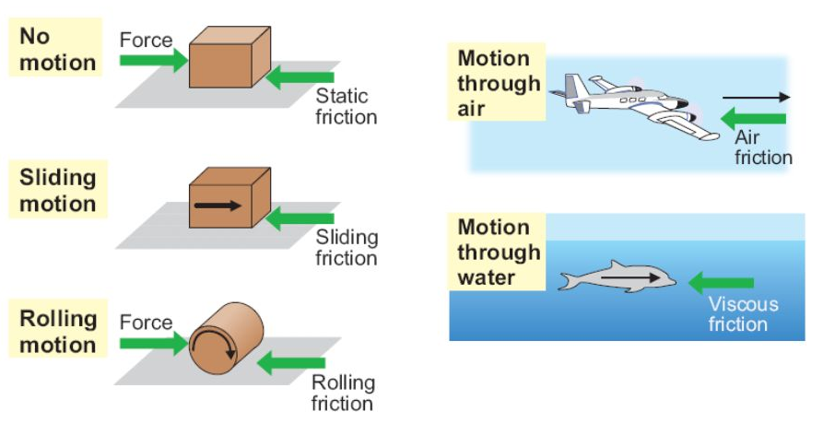
Friction Force
Occurs whenever two surfaces rub against each other.
Due to microscopic interactions between the atoms on both surfaces.
Smoother the surface, lesser the friction.
Always opposes motion and is parallel to the surfaces in contact.
Different types of friction.

Slide 7
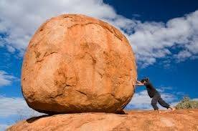
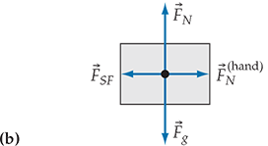
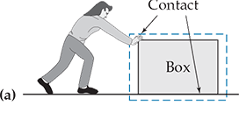
Static Friction
When the force prevents the surfaces from sliding relative to each other.
Adjusts its magnitude to exactly cancel the applied force and keeps the object at rest.
Up to a certain limit that depends on the characteristics of the surfaces and the normal force.

Slide 8

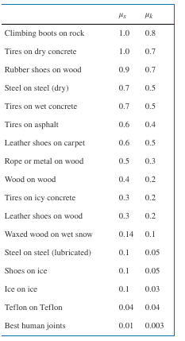
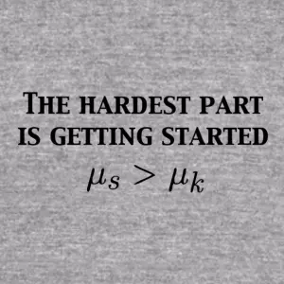
Kinetic Friction
When the surfaces are sliding relative to each other.
Fairly independent of relative speed.
Keeping the object moving requires less force than that required to start it moving:
Coefficient of static friction
is always larger than the
coefficient of kinetic friction
for two given surfaces.

Slide 9
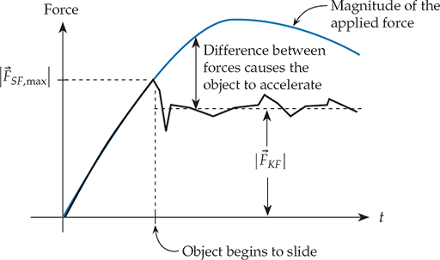
Demo:
Static and Kinetic Friction Graph

Slide 10
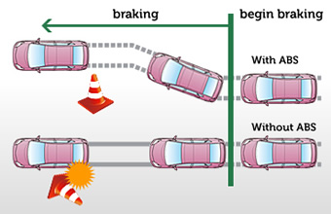
Example:
Anti-lock Braking System
Tires stay locked to the road instead of skidding.
The maximum static friction the road can exert on the tires is greater than the kinetic friction.
Helps the driver to brake the car more rapidly (and keep under better control).
If you don’t have ABS, pumping the brakes (instead of jamming on them) is more effective.

Slide 11
Demo:
Find the Critical Angle

Slide 12


Demo:
Find the Critical Angle
Independent of the block’s mass

Slide 13
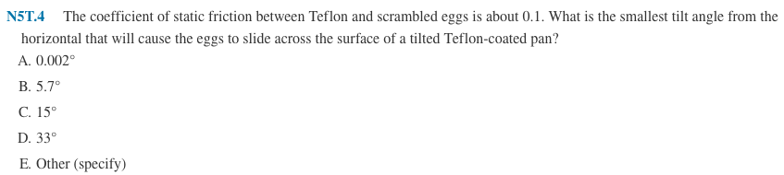

Clicker Question

Slide 14
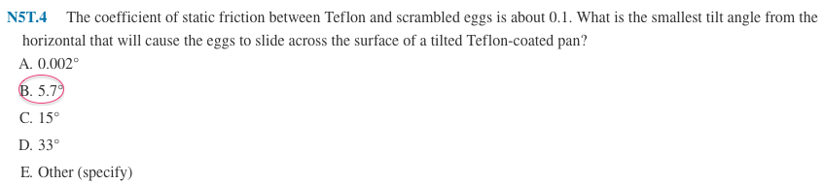
Answer

Slide 15
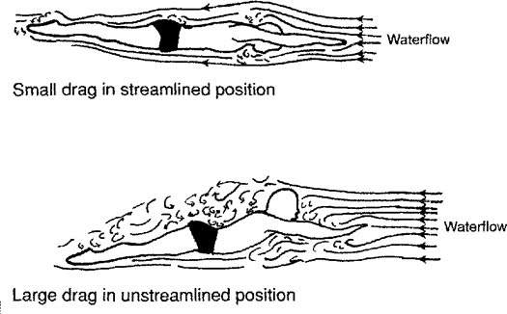
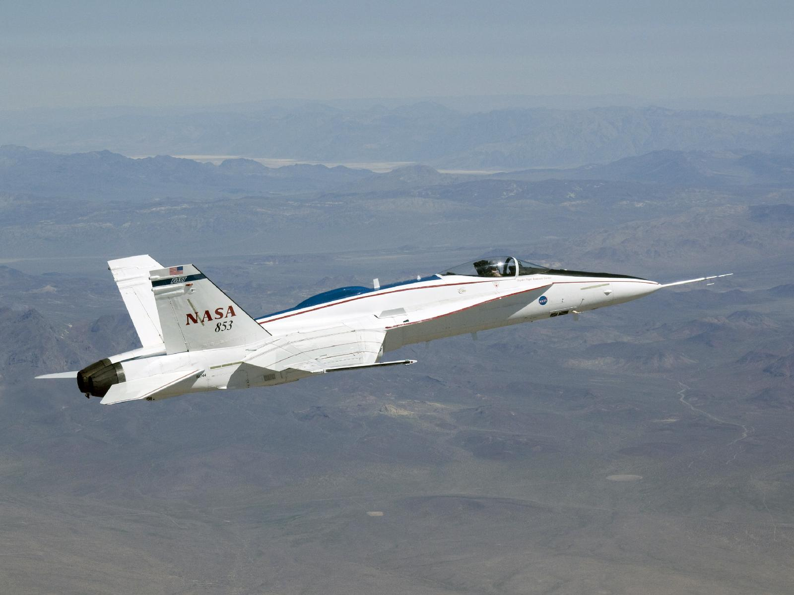
Drag Force
Friction force between an object and a fluid, when the object moves through the fluid (e.g. air, water).
Depends strongly on the object’s speed (unlike kinetic friction).
Also depends on the object’s surface area and the fluid’s density.
Skillful cyclist (knows physics!)

Slide 16
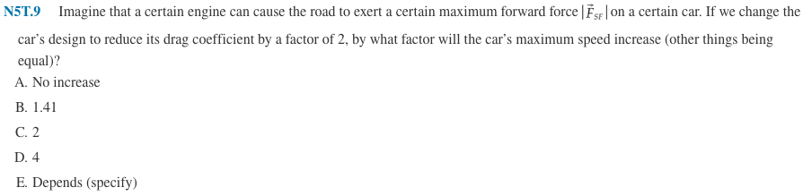
Clicker Question

Slide 17
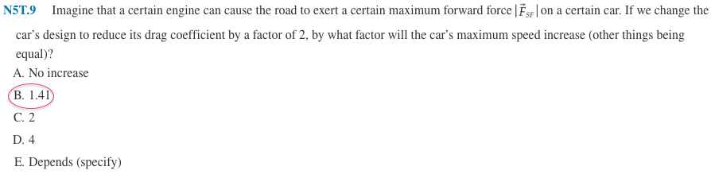

Answer

Slide 18
Linearly Accelerated Motion

Slide 19
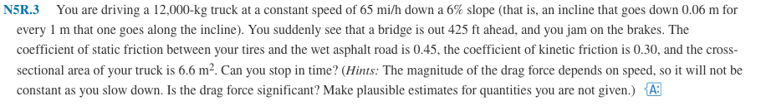
Practice Problem

Slide 20
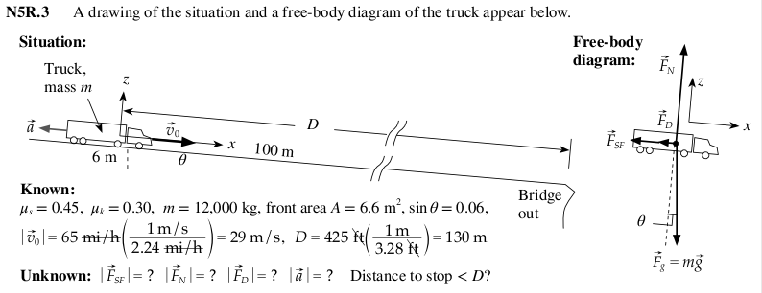
Solution

Slide 21

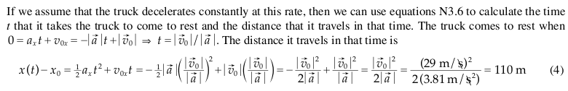

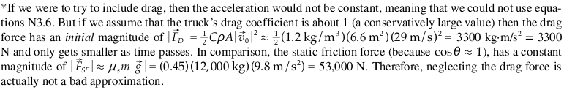
Solution

