Slide 1



PHYSICS 197 Section 1
Chapter N3
Motion from Forces
October 13, 2017

Slide 2
The Kinematic Chain
Forces from motion (last chapter):
Motion from forces (this chapter):
We will learn four different ways to calculate antiderivatives.

Slide 3
One-Dimensional Motion
Only the x-component of the position, velocity and acceleration vector relevant, which are simple signed numbers.
Sign of the number gives the direction and the absolute value gives the magnitude.
Given a graph of x(t), we can derive v(t) [by taking slope of x(t)] and a(t) [by taking the slope of v(t)]

Slide 4
Graphical Derivative
Slope above equals value below

Slide 5
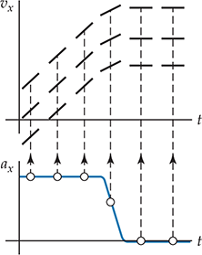
Graphical Antiderivative
Ambiguous process, because several solutions with same shape but offset vertically by a constant.
Need to choose an initial condition (generally at t=0) to resolve the ambiguity.

Slide 6
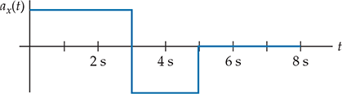
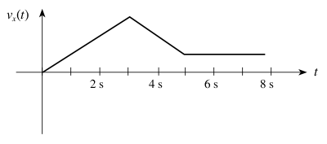
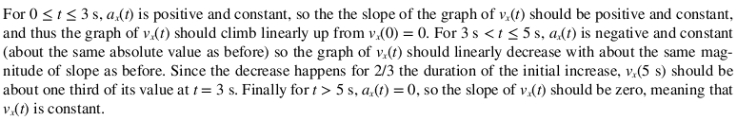
Example
N3B.1 Construct a graph of the object’s x-velocity as a function of time for an object whose x-acceleration is as given below. Assume that v_{x}(0)=0.

Slide 7
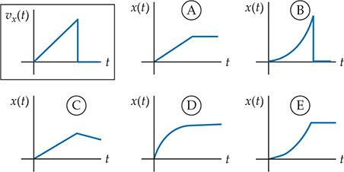
Clicker Question
N3T.1 An object’s x-velocity is shown in the boxed graph at the top left. Which of the other graphs in the set most correctly describes its x-position?

Slide 8
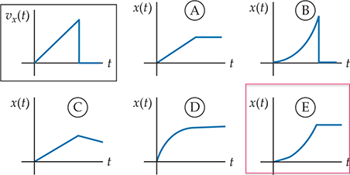
Answer
N3T.1 An object’s x-velocity is shown in the boxed graph at the top left. Which of the other graphs in the set most correctly describes its x-position?
x(t) cannot suddenly
go to zero.
Constant slope
Constant slope
Decreasing slope
Increasing slope

Slide 9
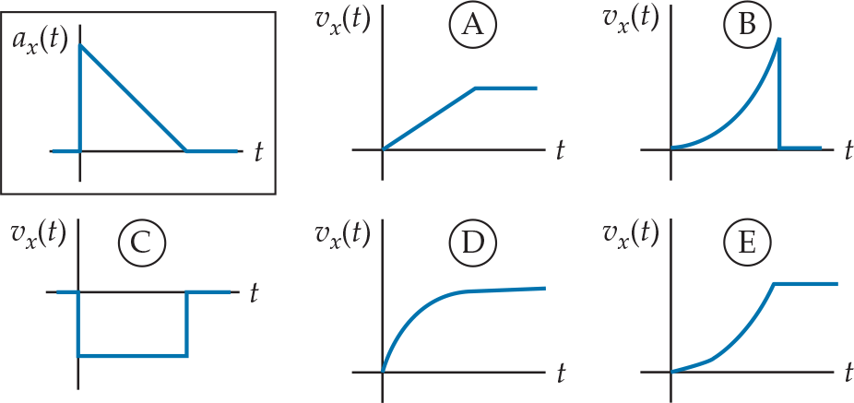
Clicker Question
N3T.2 An object’s x-acceleration a_{x}(t) is shown in the boxed graph at the top left. Which of the other graphs in the set most correctly describes its x-velocity?

Slide 10
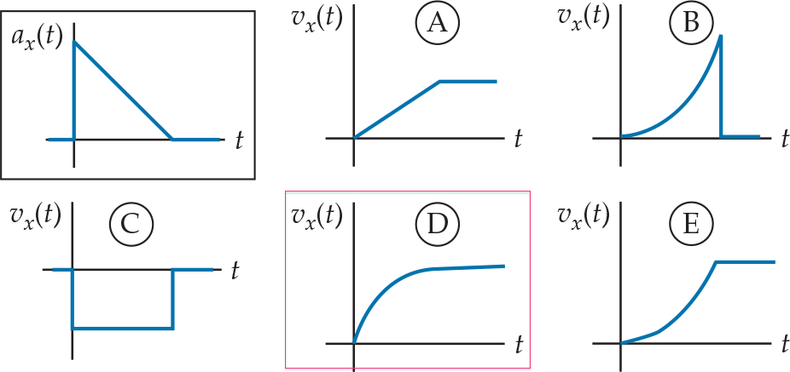
Answer
N3T.2 An object’s x-acceleration a_{x}(t) is shown in the boxed graph at the top left. Which of the other graphs in the set most correctly describes its x-velocity?

Slide 11
Another Example
N3M.2 A car starts at t=0 from rest at x=0 and accelerates at a constant rate until it reaches a cruising speed of 15 m/s. After maintaining that speed for a while, the driver, seeing that a bridge ahead is out, brakes suddenly, and the car comes to rest in a relatively short time. After remaining at rest for a few seconds, the driver then backs up at about 3 m/s. Draw qualitatively accurate graphs of the car’s x-position, velocity and acceleration as functions of time. Assume that the road is straight and the car initially travels in the positive x direction.

Slide 12
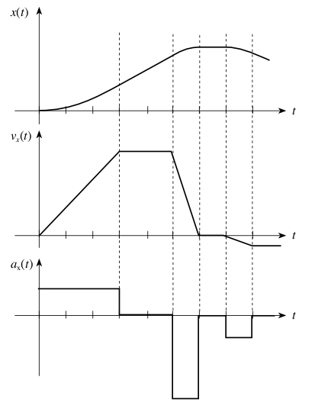
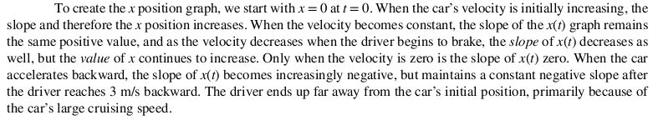


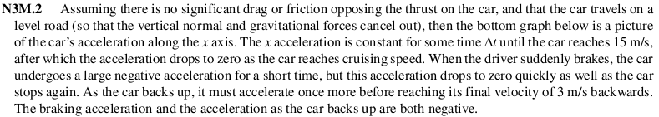
Answer

Slide 13
Integrals for One-Dimensional Motion
We can only determine a function’s antiderivative up to an overall constant.
Initial Conditions: Can determine C₁ and C₂ only if we know the object’s initial velocity v_{0x} and initial position x₀, respectively.
For constant acceleration:

Slide 14
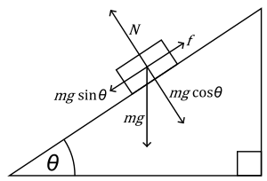
Demo
PASCO track on incline with plot of kinematics
Magnitude of acceleration while going downward is less than that while going upward.
Why?
Because friction is acting against gravity while going downward,
but with it while going upward.

Slide 15
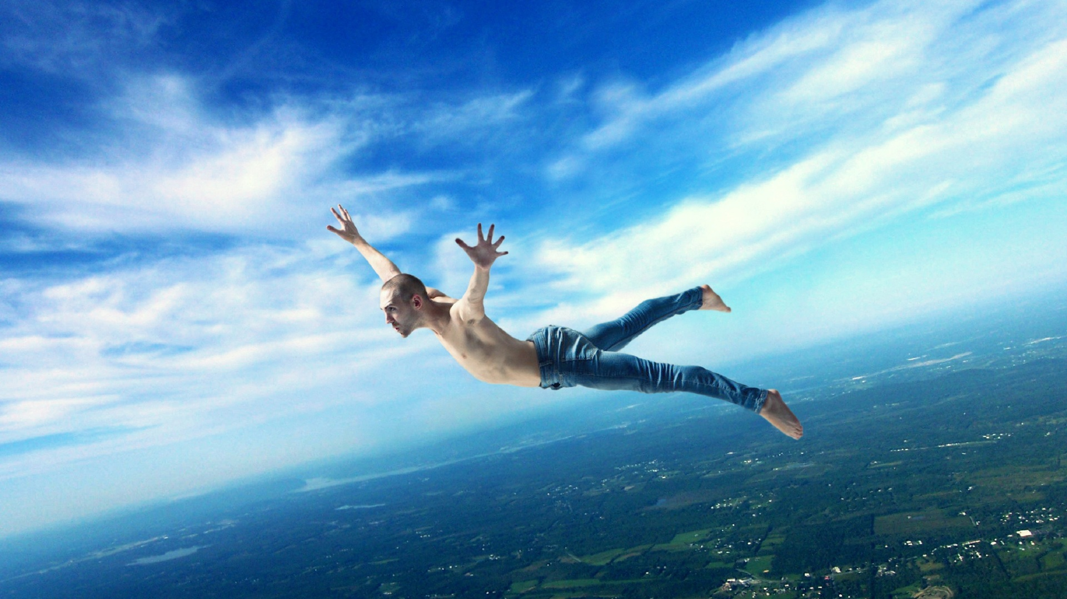

Free-fall in One Dimension
Note the typo in book’s Equation (N.3.13b)

Slide 16
General Expression
Valid in any dimension.
But could be very difficult to evaluate in many practical situations.

Slide 17
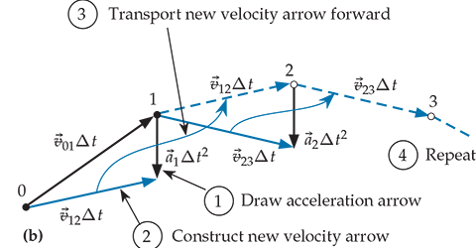
Trajectory Diagram
Follow reverse procedure of drawing a motion diagram.
Constructing by hand is often tedious.
Web app Newton (http://sixideasapps.pomona.edu/Newton/)

Slide 18
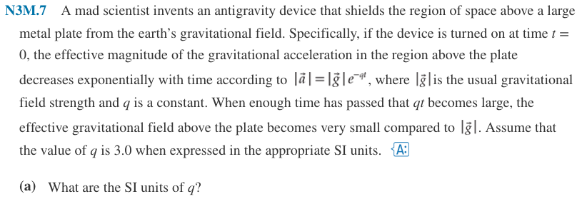
Practice Problem

Slide 19
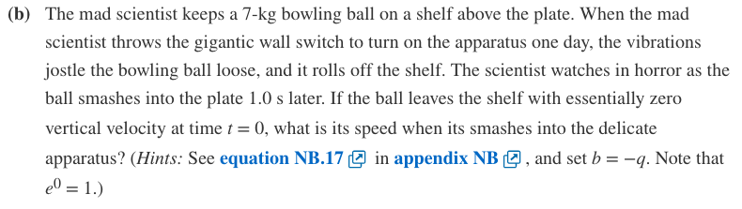
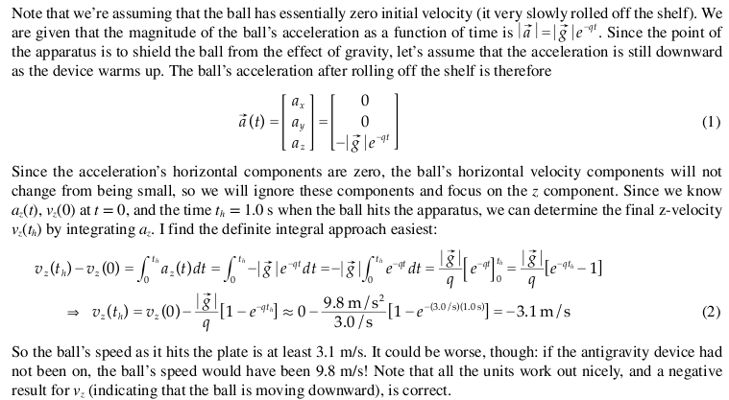
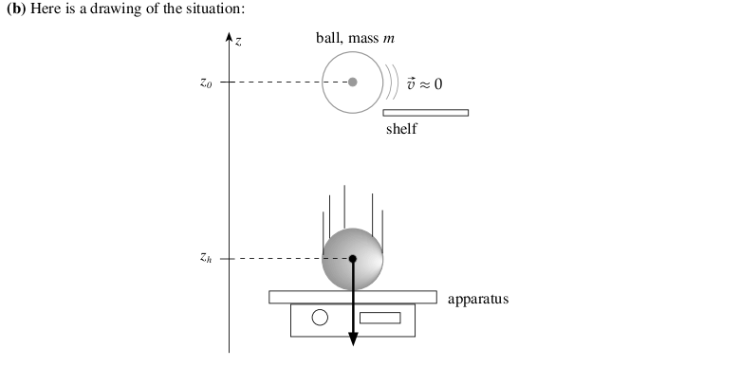
Practice Problem

Slide 20

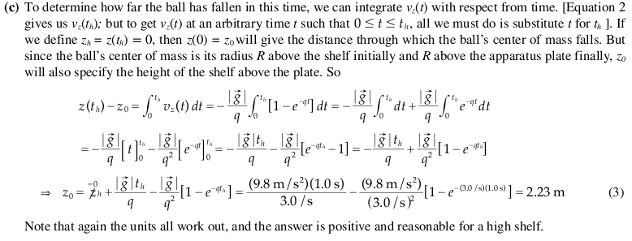
Practice Problem

