Slide 1


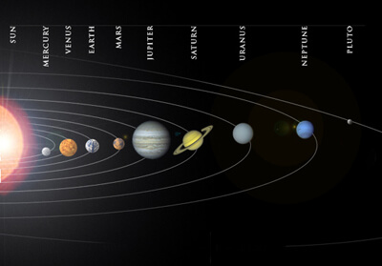
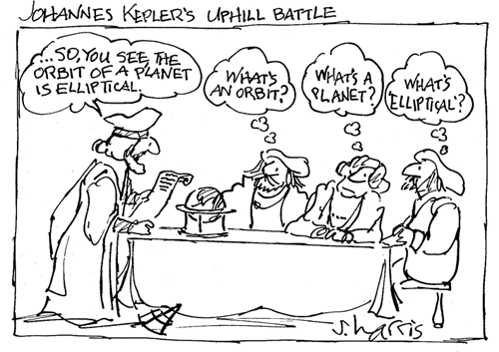
PHYSICS 197 Section 1
Chapter N11
Kepler’s Laws
November 3, 2017

Slide 2
Announcements
Wednesday, November 8: Newton’s Law Problem Solving (please email me the problems you want to be discussed in class by 9pm Tuesday, November 7).
Wednesday, November 15: Review of Unit N (more problem solving).
Thursday, November 16: Exam #2 (6.30-11pm).
Please (RE)DO the book examples, weekly HWs and practice problems by yourself (without looking at the solution or any other help) before exam.

Slide 3
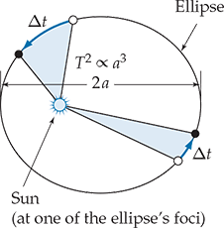
Overview
Orbital Motion: Use Newton’s gravitational force law to predict planetary orbits.
Derive Kepler’s laws as a consequence of Newtonian laws of mechanics
(planets are freely falling around the sun).
Universal model (for terrestrial and celestial mechanics).

Slide 4
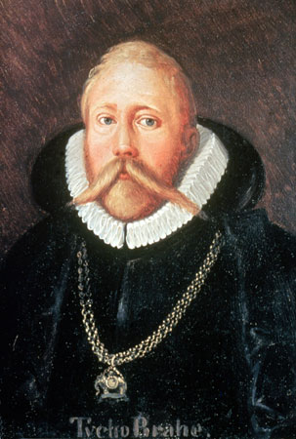
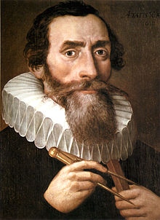

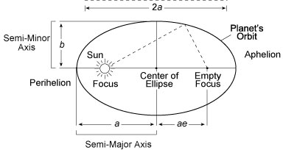
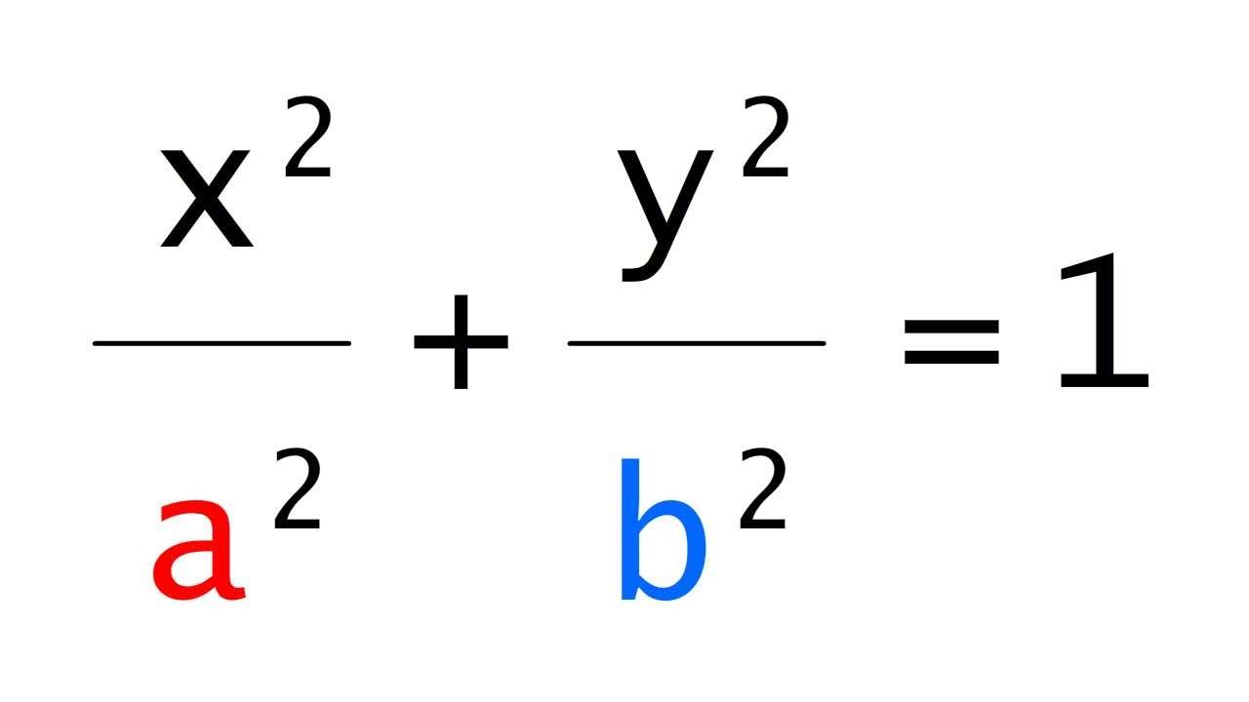
Kepler’s Laws
(derived using Brahe’s data)
1st law: The orbits of planets are ellipses, with the sun at one focus.
Sum of distances to the two focii is constant for each point on the curve.

Slide 5
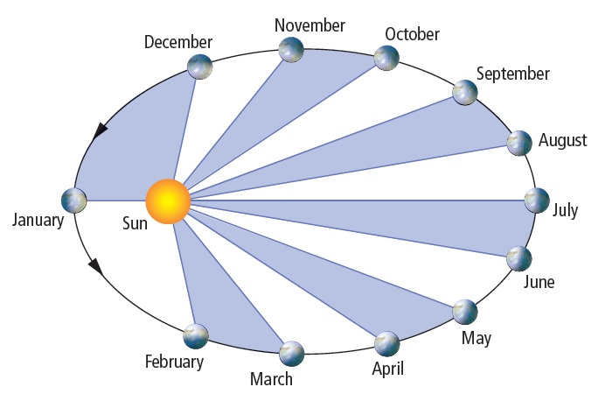
Kepler’s Laws
(derived using Brahe’s data)
2nd law: A line from the sun to the planet sweeps out equal areas in equal time.

Slide 6
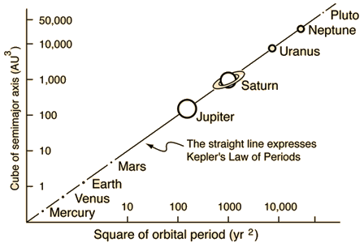
Kepler’s Laws
3rd law: The square of a planet’s period T is proportional to the cube of its orbit’s semimajor axis a.

Slide 7
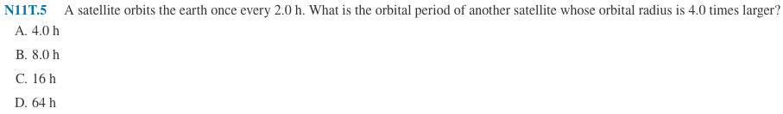
Clicker Question

Slide 8
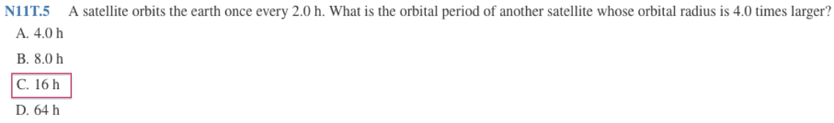
Answer

Slide 9
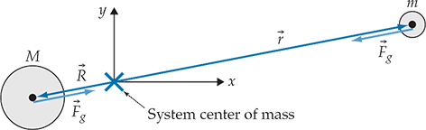
Orbits Around a Massive Primary
Consider a very massive object interacting with a much lighter object.
Choose the origin of our reference frame to be the system’s center of mass.

Slide 10

Orbits Around a Massive Primary

Slide 11
Orbits Around a Massive Primary
For M >> m,

Slide 12
Kepler’s 2nd Law
Total angular momentum of the system:
Conservation of angular momentum implies that the angular momentum of either object is conserved, along with that of the whole system.
From the definition,

Slide 13
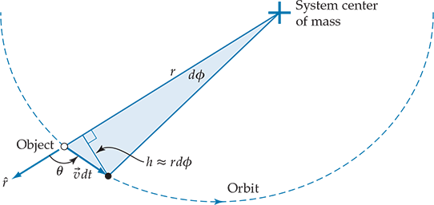


Kepler’s 2nd Law

Slide 14





Kepler’s 3rd Law
Newton’s law of universal gravitation:
If this is the only force acting on the satellite (separated by distance R from the primary),
For a uniform circular motion, the centripetal acceleration is
So we get
Time period which gives

Slide 15
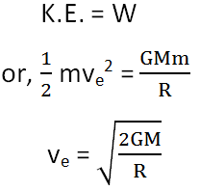
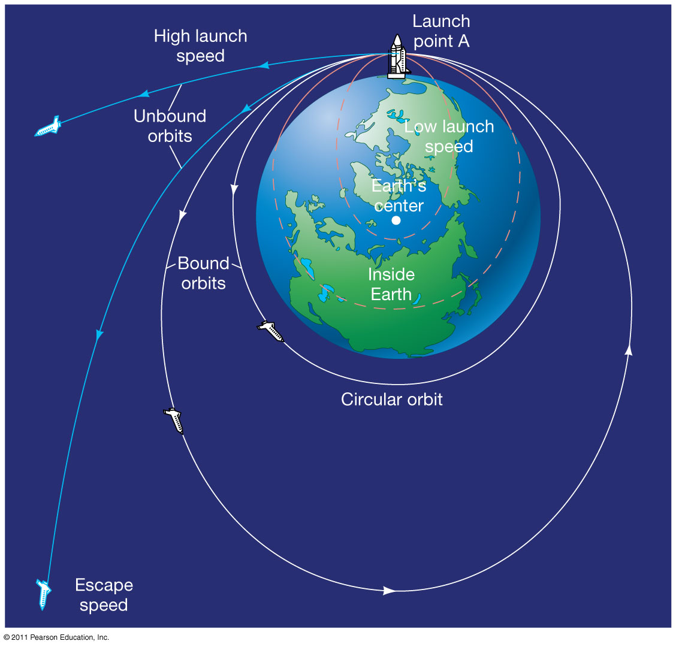
Escape Velocity
For earth, v_{e} = 11.2 km/s
For moon, v_{e} = 2.4 km/s
(Smaller than the average molecular
speed at room temperature. That’s
why no atmosphere on moon!)

Slide 16
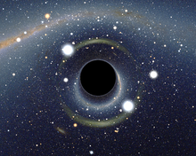
Black Hole
An object for which the escape velocity is greater than the speed of light.
So not even light can escape!
Then how do we know they exist?
Use Kepler’s 3rd law:
(if we can measure the orbit of a visible companion)
Supermassive black holes (up to a billion solar masses) found in the center of almost all known galaxies (including Milky Way).

Slide 17
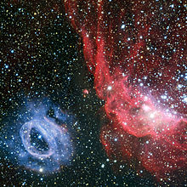
Dark Matter
The Large Magellanic Cloud is a satellite galaxy of our Milky Way, orbiting with a radius of about 170,000 light years (1.6x10²¹m) and orbital velocity of about 200 km/s.
This implies the total mass of our galaxy
Visible matter is only about 20%.
The rest is dark matter.

Slide 18
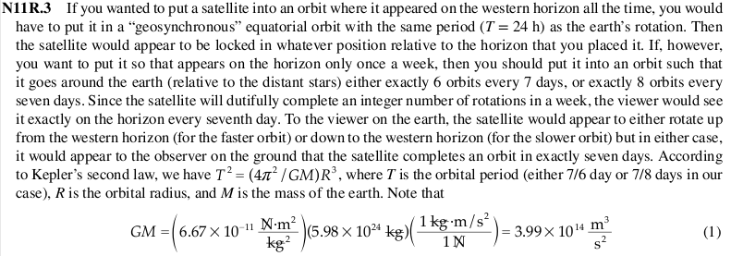
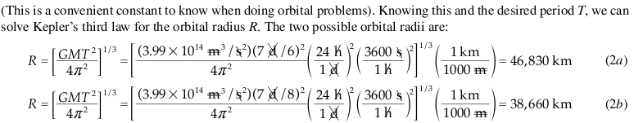
Practice Problem

