Slide 1


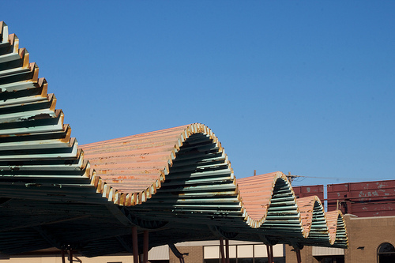
PHYSICS 197 Section 1
Chapter N10
Oscillatory Motion
November 1, 2017

Slide 2
Outline
Oscillatory Motion: An object moves in one dimension in response to a restoring force that seeks to push it back toward an equilibrium point.
Simple Harmonic Oscillator
Analogy to Circular Motion
Simple Pendulum
Other Oscillations: Damped, Forced and Chaotic

Slide 3
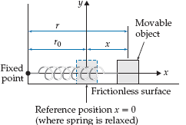
Mass on a Spring

Slide 4
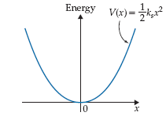
Mass on a Spring
Potential Energy Graph (C9)

Slide 5
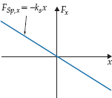
Mass on a Spring
Simple Harmonic Oscillator (SHO)
Has an equilibrium position (where the force is zero).
When displaced from equilibrium, experiences a restoring force.
This force grows in magnitude as the displacement increases.
Hooke’s law
SHO model is very useful for a wide range of real life physical systems
(from ocean waves to electrical oscillators to atomic vibrations to quantum mechanics)

Slide 6
SHO Equation
From Newton’s 2nd law,
Using we get the SHO equation:
Ordinary differential equation (ODE) of 2nd order.
Can you guess the solution?

Slide 7
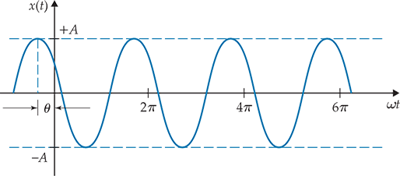
Solution to the SHO Equation
Amplitude and phase are determined by initial conditions at t=0.

Slide 8

Period and Frequency
Period T of oscillation is defined as the time it takes to complete one cycle.
Frequency f of oscillation is the number of cycles completed per unit time.

Slide 9
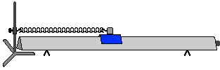
Clicker Question
N10T.4 and N10T.5 (modified)
A glider on an air track is connected by a spring to one end of the track. If it takes 0.30 sec for the glider to travel the distance of 12 cm from one turning point to the other, what are its amplitude and time period, respectively?
12 cm and 0.30 sec
6 cm and 0.15 sec
6 cm and 0.60 sec
24 cm and 0.60 sec
24 cm and 0.15 sec

Slide 10
Answer
N10T.4 and N10T.5 (modified)
A glider on an air track is connected by a spring to one end of the track. If it takes 0.30 sec for the glider to travel the distance of 12 cm from one turning point to the other, what are its amplitude and time period, respectively?
12 cm and 0.30 sec
6 cm and 0.15 sec
6 cm and 0.60 sec
24 cm and 0.60 sec
24 cm and 0.15 sec
Feedback:
Amplitude is half the distance between the oscillator’s turning points.
Period is twice the time it takes to go from one turning point to another.

Slide 11
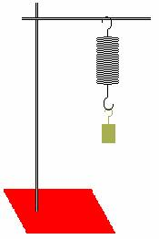
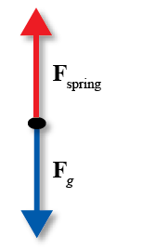
Demo:
Mass Hanging from a String
How does its oscillatory motion compare with
the horizontal arrangement we considered before?

Slide 12
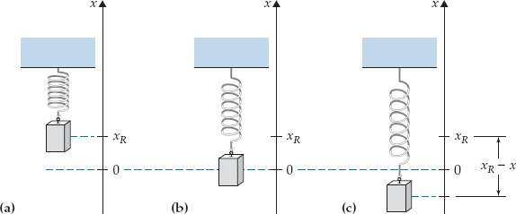
Mass Hanging from a Spring
Hanging oscillator oscillates at the same frequency it would if it were horizontal.
The gravitational force simply displaces the equilibrium point downward.

Slide 13
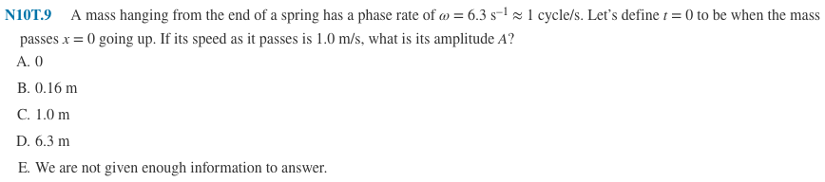
Clicker Question

Slide 14
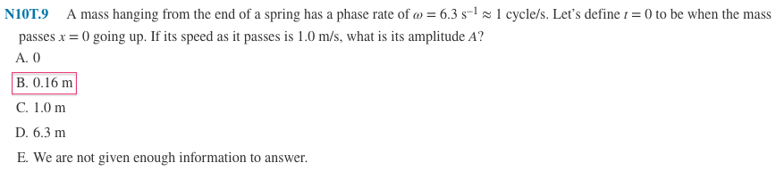

Answer

Slide 15
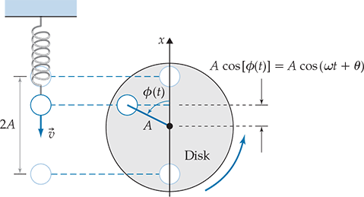
Demo:
Analogy to Circular Motion
Vertical motion of a hanging oscillator is mathematically identical to
the uniform circular motion of an object.
The rotating disk analogy provides a general way to compute the phase angle.
(clockwise vs. counterclockwise rotation determines the sign of phase)

Slide 16
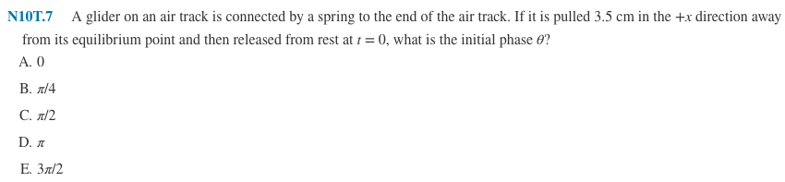
Clicker Question

Slide 17
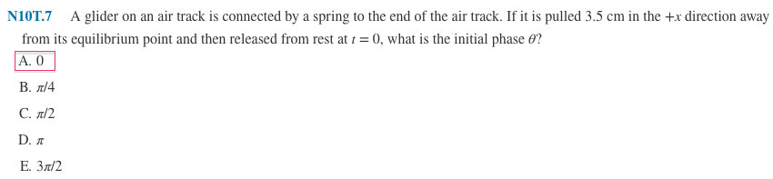
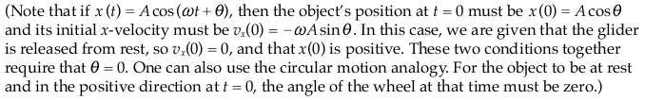
Answer

Slide 18
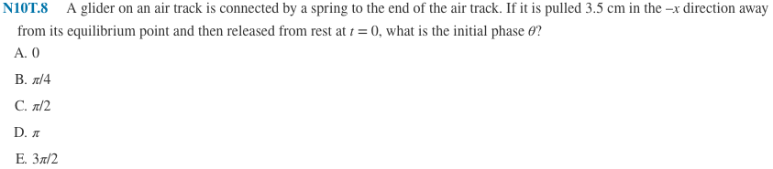
Clicker Question

Slide 19
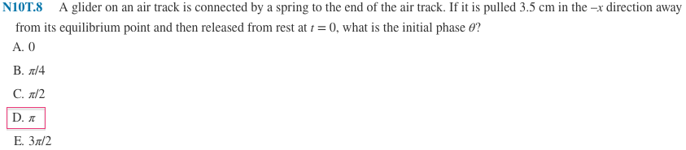
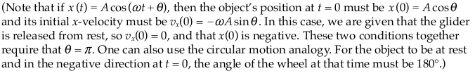
Answer

Slide 20
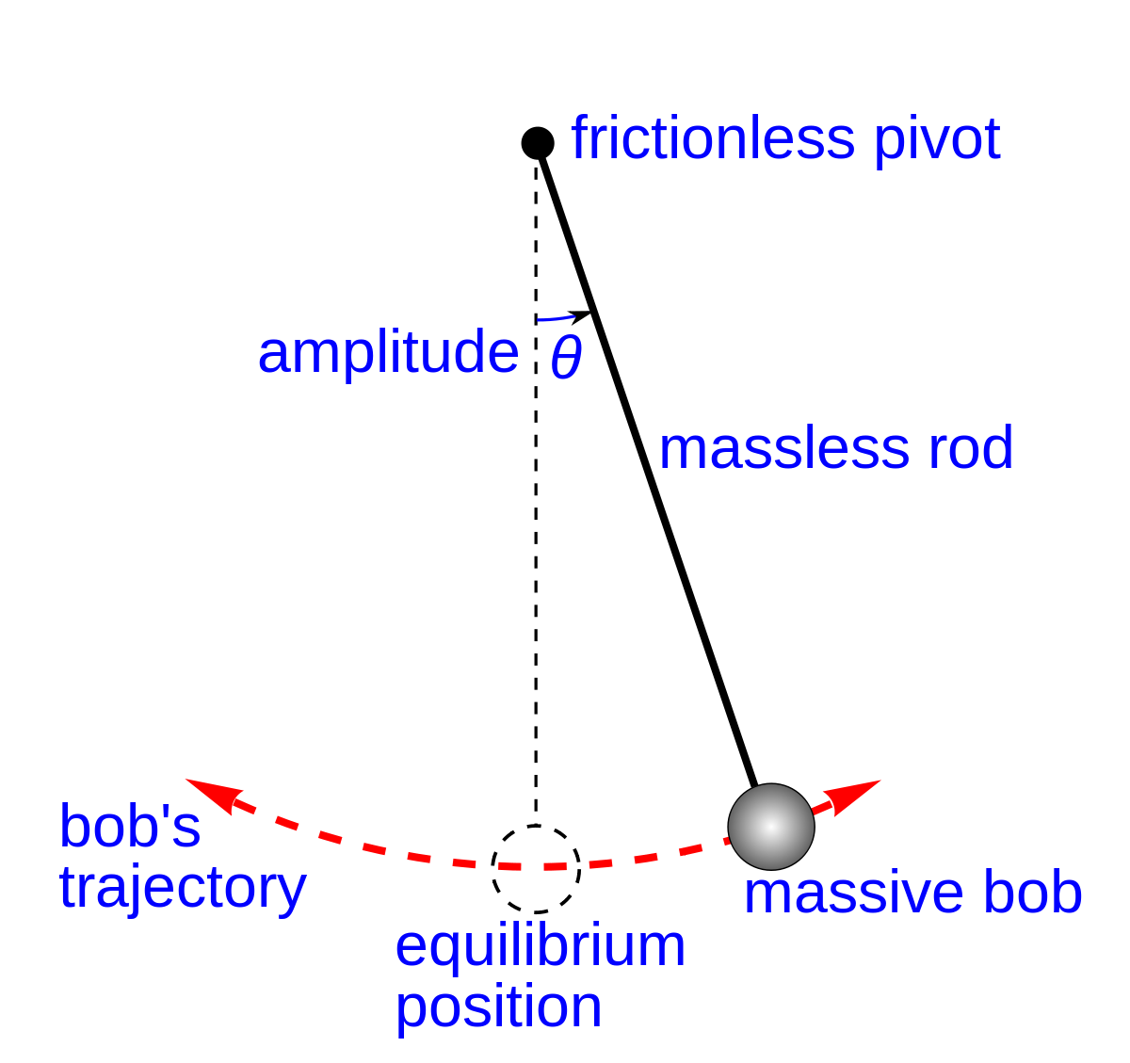
Demo:
Simple Pendulum

Slide 21
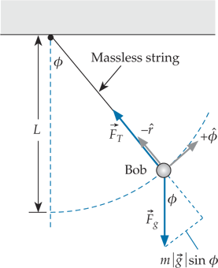



Pendulum Equation
Nonuniform circular motion (N7.3)
Gives the pendulum equation
Independent of the (small) swing angle
and bob’s mass.

Slide 22
Demo:
Damped Oscillation

Slide 23
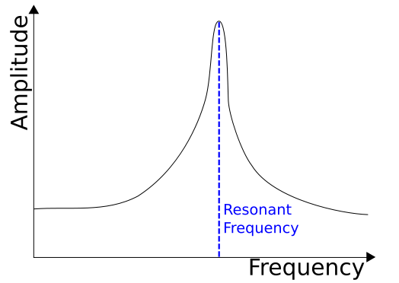
Demo:
Driven Oscillation

Slide 24
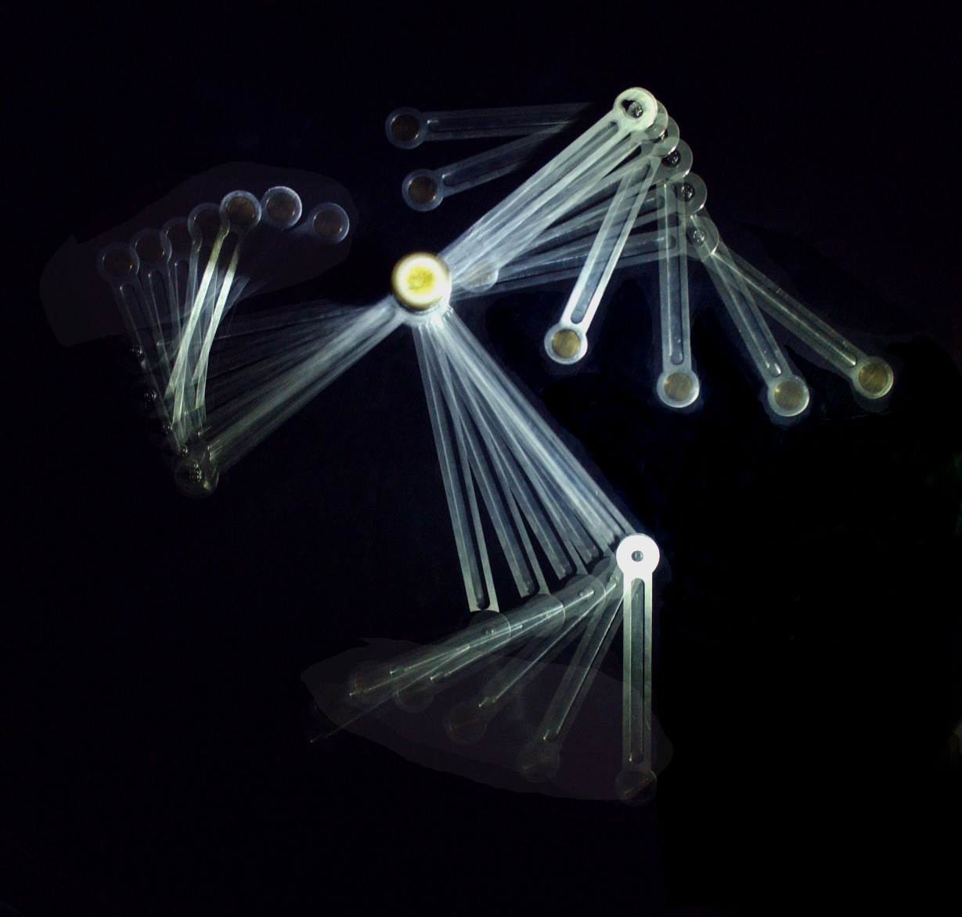
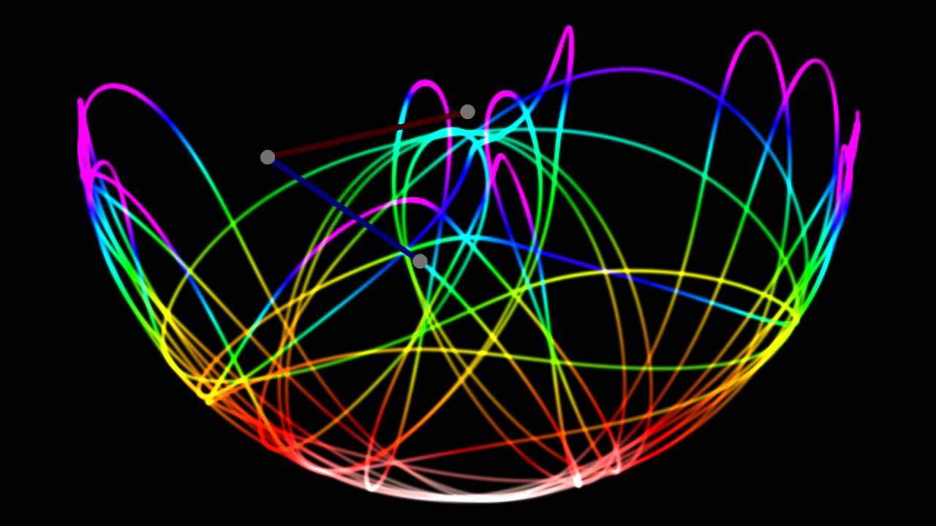
Demo:
Chaotic Oscillation

Slide 25
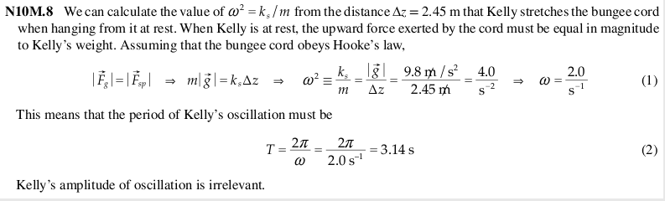
Practice Problem

