Slide 1


Physics 197 Section 1
Six Ideas that Shaped Physics
Unit C: Conservation Laws
Unit N: Newtonian Dynamics
Unit R: (Special) Relativity
Instructor: Bhupal Dev (bdev@wustl.edu)

Slide 2
Course Goal – Learn to Think Like a Physicist
Structured around problem solving
  Critical, analytical thinking
  Strengthen both quantitative and qualitative reasoning
  Become a consummate problem-solver and develop framework to approach problems in physics (and in other courses)
Hone skills to help become a scientifically literate person in your daily life
  Develop conceptual, mathematical, experimental and computational skills
  Apply physics to realistic problems to better understand everyday phenomena
  Determine if an answer makes sense
  Make realistic approximations
  Practice speaking about scientific concepts
  Enhance creativity and intuitive independence

Slide 3
Success in the Course
Intelligence is not a fixed quantity
  There’s no such thing as a “math/science person”
  There is no substitute for hard work to improve and learn new things (this is as true for Newton, Einstein, Hawking, Feynman and other greats as it is for you and me)
  We learn as much or more from mistakes and challenges as we do from being correct
EVERYONE has the potential to be good at physics if they put in the work!

Slide 4

Textbook
You will need the 3rd edition of Six
Ideas that Shaped Physics
Units C, N, and R by Thomas Moore
  The 2nd edition will not work!!!
  You will also need access to McGraw Hill
  Connect (LearnSmart)
Your options include:
  Purchase the bundled package of Units C, N, R, and Connect from the bookstore or online
  Purchase Units C, N, and R and separately purchase Connect
  Purchase only Connect, which comes with an e-text

Slide 5
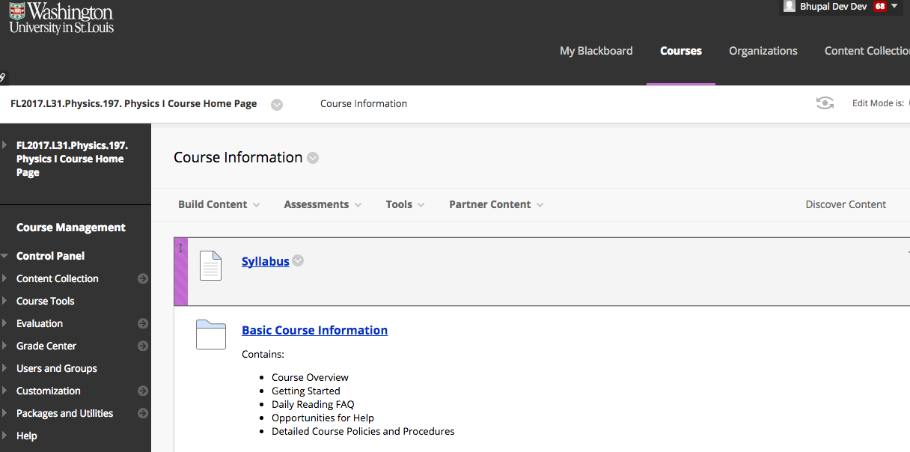
Course Information
Visit the WashU blackboard page
(https://wustl.blackboard.com) and go to FL2017.L31.Physics.197.Physics I Course Home
Integrated with McGraw Hill Connect (Learnsmart)

Slide 6
Syllabus
For next class (Wednesday, 8/30):
Read Learnsmart Chapter C1 before class
(due by 11.59pm on Tuesday, 8/29)
Weekly written homeworks
Weekly Blackboard Quizzes

Slide 7
Why Assignments Before Class?
Numerous studies indicate that people are very poor judges of how well they’re learning
[see Brown, Roediger, and McDaniel, Make It Stick: The Science of Successful Learning, Belknap Press (2014) for a great summary of these studies]
  People prefer methods that feel familiar and comfortable, even if they aren’t productive in the long run
  Trying to solve a problem before the material is taught leads to better learning, even if errors are made in the problem
  Asking you to try to solve a problem is not the same thing as asking you to understand it – that’s what class is for!
  This is not the same as teaching yourself the material!
Practical reasons
  You’ll always be on track (no need to cram)
  You’ll already have questions so we can clarify them in class
  We don’t have to waste time in class on derivations and nomenclature you can read yourself

Slide 8
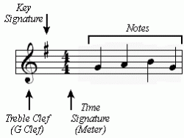



Physics is a Skill That Needs to Be Practiced
(Like Music or Sport)
Familiarize Yourself With the Material by Practicing
Learn Theory and Notes
Read Text; Daily Homework
Clarify Material; Ask Questions; Refine Techniques
Lessons
Lecture
Perfect Skills by Practicing Things That Are More Complex
Play Harder Pieces
Weekly Homework
Demonstrate What You Can Do!
Concerts
Exams

Slide 9
Get the Most Out of Class Time
Be prepared…for class
  Read the textbook
  Solve the Self-Test problems
  Work on homework alone or in a
  group, but be sure you’re an
  active participant
Be on time for class - class starts promptly at 9:10 a.m.
  Be in your seat with your homework handed in
  Homework is due no later than 9:10 a.m.

Slide 10

During Class
Class time is only effective if you actively participate
  Ask or answer a question
  Use clicker questions to talk about physics
  Write questions in the margin to ask or think about later
  Actively follow along with problems
  Talk with me before or after class
  Email me about questions, observations, or interesting things you find
For full participation credit make
sure I know your name!

Slide 11

Classroom Ground Rules
Everyone makes mistakes sometimes
  And that’s okay!
  We often learn the most from correcting
  misconceptions
Be polite! This applies whether you are the listener or the respondent
Only use your electronic devices for physics-related activities
Be on time for class and give me the full 50 minutes
  Class starts promptly at 9:10 a.m.
  Homework is due no later than 9:10 a.m.
  I promise to let you out no later than 10:00 a.m.

Slide 12
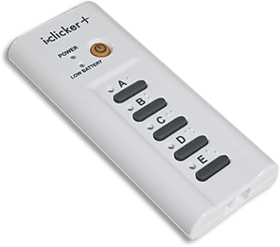
Clickers
We will be using i>Clicker+ in each class, starting Wednesday, August 30.
Free rental from Olin Library
  Pick up from Library Help Desk
  Return to library by the end of the semester
  You can use the same clicker for multiple classes
Register your clicker on this section’s Blackboard page
You may only attend this section of Physics 197

Slide 13
Grading – Daily Problems
All daily homework problems will be accessed through Connect.
The number of problems in each homework might vary depending on the chapter.
You will be graded only on if your answer is correct or incorrect, but you have unlimited tries
  It’s in your best interest to try and get them right the first time!

Slide 14
Grading – Weekly Problems
Each homework problem is worth 10 points and there are six per week
You will be graded on whether or not your solution is…
  Complete
  Clear
  Correct
  Plausible
  Initially OK
See Blackboard for and explanation of each of these categories and tips on homework

Slide 15
Grading – Weekly Problem Revisions
Check your homework on ProbViewer
  password: noether1
  Your answers may not always match ProbViewer’s!
Revisions are optional and must be done in green or purple ink
You may only do revisions if you receive
at least 2/3 points on “Complete”
It’s possible to never get a problem correct
and still earn a grade of 90% on weekly homework

Slide 16
Labs
Lab sections begin Monday, September 11
  Change your lab for any reason until Friday night
  If you can’t resolve a lab/class conflict, email Dr. Hynes (khynes@physics.wustl.edu) with your top 3 choices by September 7
For the first week of lab:
  Complete the Lab Information Quiz and the Units Quiz by noon on Monday, September 11.
  Complete the Measurement pre-lab quiz by 10 minutes before the start of your lab
  All quizzes are available on Blackboard
Additional information in the “Getting
Started” handout and the lab website

Slide 17
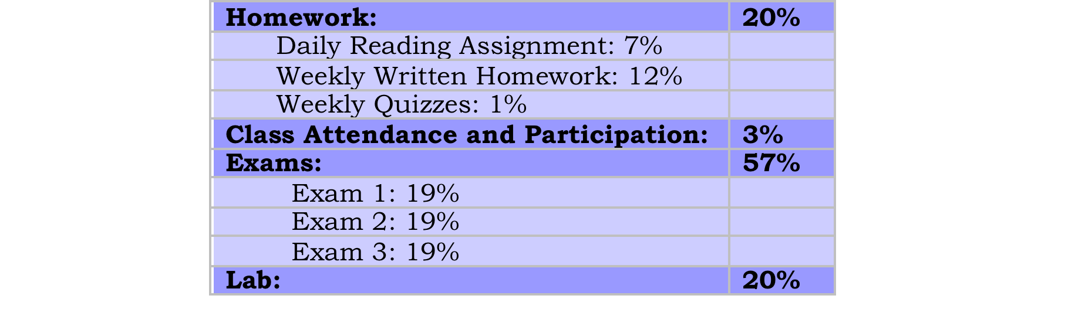
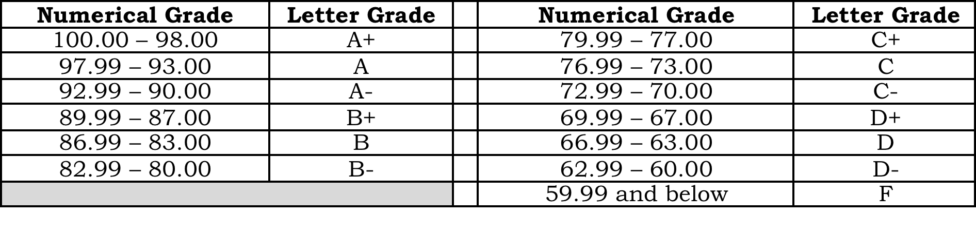
Grades
Your final course grade is based on an absolute scale.
There is no curve!
Your performance is judged strictly on how well you have
performed, not on the performance of your fellow students.

Slide 18

Help Resources
Talk to me directly after class, via email, or by appointment
Professor led help session in Compton 245
    Tuesday 1:30 – 3:00 p.m.
    Thursday 10:30 a.m. – noon
    Starting tomorrow
Assistant to Instructor (TA) office hours
  Starting Tuesday, September 5
Cornerstone
  Starting Tuesday, September 5

Slide 19
Additional Information on Blackboard
Use the Blackboard Section page to:
  Register your clicker
  Access daily homework
  Find the slides from class
  Download the course information, including the policies and procedures (this information is also on the Course Blackboard page)
  Read section-specific announcements
Use the Blackboard Course page to:
  Find general course information (this information is also on the Section page)
  Access the Cornerstone Discussion page
  Read course-wide announcements
It is your responsibility to read and understand all the course and grading policies

Slide 20

A Typical Class Demo Example
A boat carrying a large boulder is floating on a lake. The boulder is thrown overboard and sinks to the bottom of the lake. With respect to the shore, the water level in the lake
Rises
Drops
Stays the same
It depends on other things
There is not enough information given

Slide 21
A Typical Class Demo Example
When in boat, a boulder of mass m displaces a volume of water equal to V₁ = m/ρ_{water} (where ρ_{water} is the density of water).
When submerged in water, the boulder displaces a volume of water equal to the volume of the boulder, which is equal to V₂ = m/ρ_{boulder}.
Since the boulder is denser than water, ρ_{boulder} > ρ_{water}.
So V₂ < V₁, or the water level in the lake goes down.

