Slide 1


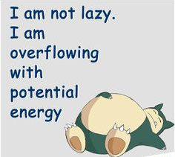
PHYSICS 197 Section 1
Chapter C9
Potential Energy Graphs
September 22, 2017

Slide 2


Review of Last Class
Conservation of total energy.
Kinetic Energy:
Potential Energy:

Slide 3

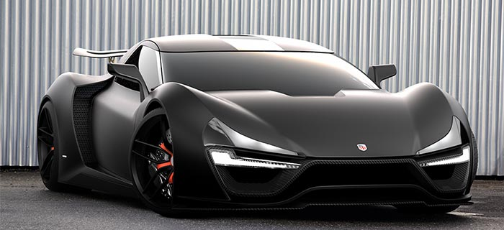
Power
Momentum | Force
Angular Momentum | Torque
Energy | Power
Unit of power: Watt = J/s.
Horsepower: 1 hp = 746 W.
200 hp
2000 hp

Slide 4

Internal Energy
Interacting macroscopic objects can store “hidden” energies, independent of kinetic and potential energies.
Example: Thermal energy
So the master equation for conservation of energy is actually
Internal energy irrelevant if it doesn’t change.

Slide 5
Interactions Between Macroscopic Objects

Slide 6
Interactions Between Macroscopic Objects

Slide 7
Interactions Between Macroscopic Objects

Slide 8
Interactions Between Macroscopic Objects

Slide 9
Interactions Between Macroscopic Objects

Slide 10
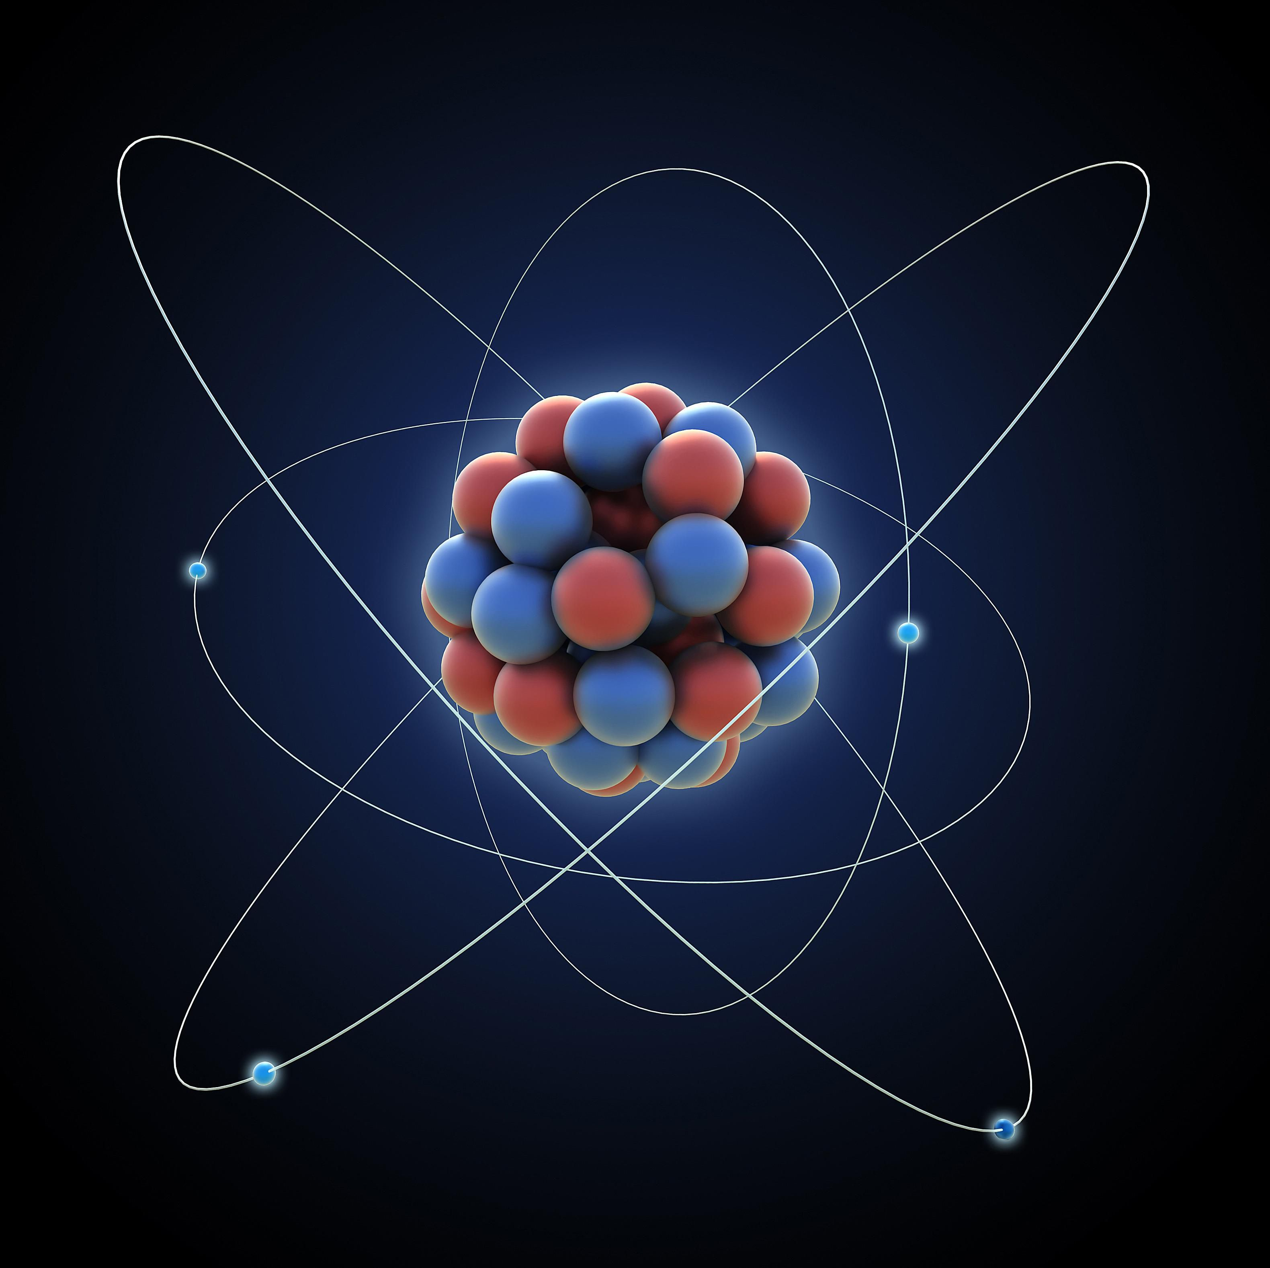
Interactions Between Two Atoms
An atom consists of many negatively charged electrons in a cloud around a positively charged nucleus.

Slide 11
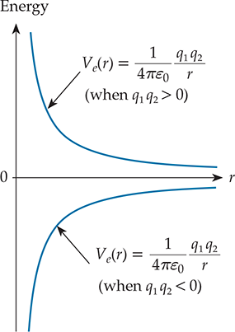
Interactions Between Two Atoms
As two atoms come closer, although the fundamental electrostatic interaction between their constituents is pretty simple:

Slide 12
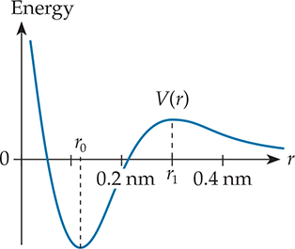

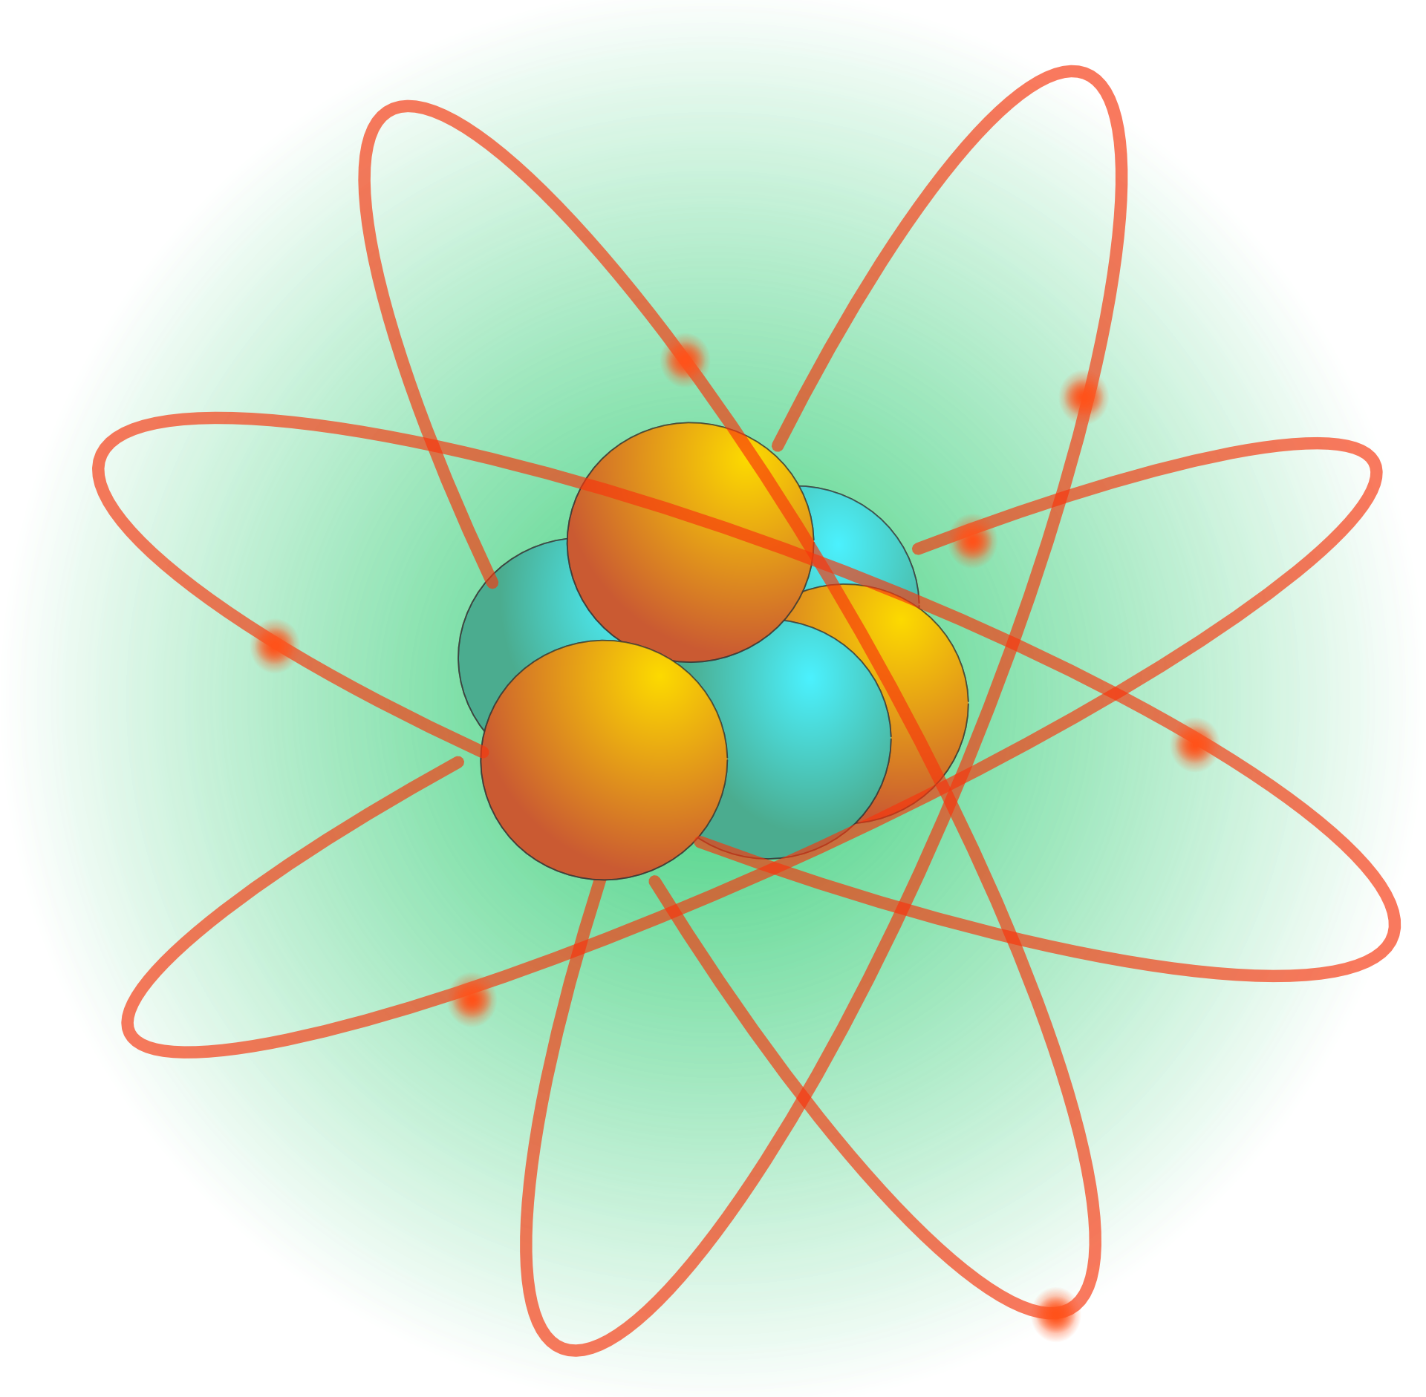
Interactions Between Two Atoms
the effective potential energy of interacting atoms can be a complicated function of their separation r:
Nuclei repel each other
Electron clouds repel each other
Settle into a new arrangement
with lower potential energy

Slide 13
Potential Energy Diagram
Simply a graph of potential energy V(r) of an interaction between two isolated objects as function of their separation r.
We will study the PE diagrams of isolated systems satisfying the following requirements:
  The objects are rigid and their internal energies do not change.
  The motion of both objects is along a line
  One object is much more massive than the other.
Can ignore the KE of the massive object.
E = K₁+U₁+K₂+U₂+V(x) = K₁+V(x)
So K₁ = E−V(x)

Slide 14
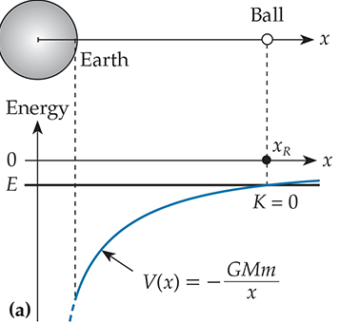
Example: Ball and Earth
E = V(x_{R})

Slide 15
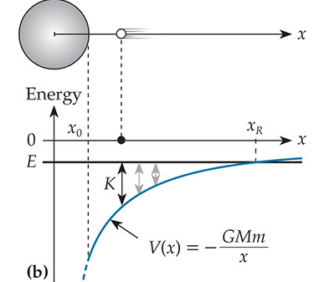
Example: Ball and Earth
Kinetic energy increases

Slide 16
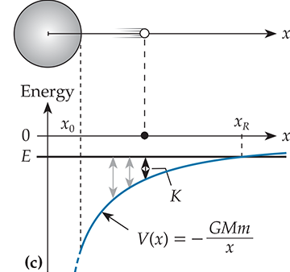
Example: Ball and Earth
Kinetic energy decreases

Slide 17
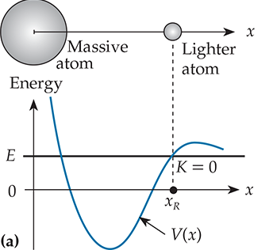
Example: Two-atom System
E = V(x_{R})

Slide 18
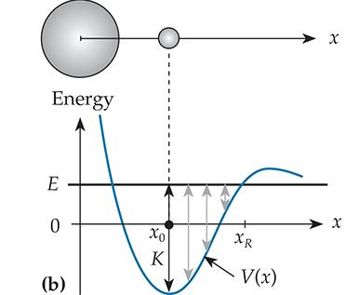
Example: Two-atom System
Kinetic energy increases

Slide 19
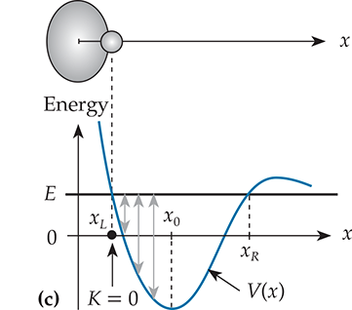
Example: Two-atom System
Kinetic energy decreases

Slide 20
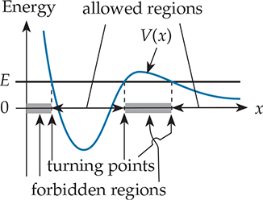
Forbidden and Allowed Regions
Notes:
Demo of V-track (allowed, forbidden regions and turning point)

Slide 21
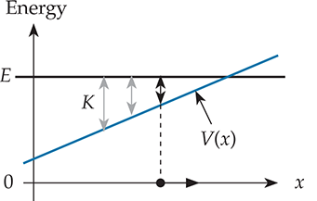
Force and Potential Energy
Positive slope implies attractive force:
KE decreases as the object moves away.

Slide 22
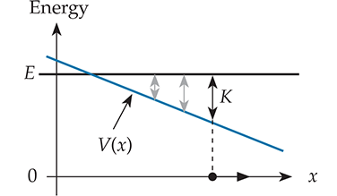
Force and Potential Energy
Negative slope implies repulsive force:
KE increases as the object moves away.

Slide 23
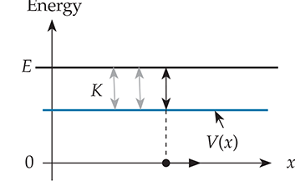
Force and Potential Energy
Zero slope implies zero force:
KE remains constant.

Slide 24
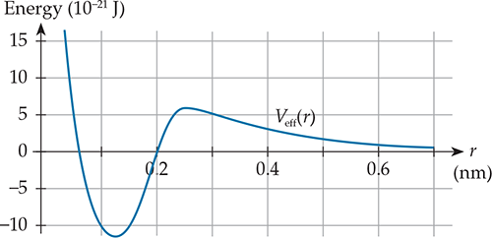
Clicker Question
C9T.4 In the hypothetical atomic interaction shown in the following figure, the force between the atoms is attractive within what range of the interatomic separation r?
For all r
For r < 0.06 nm and r > 0.2 nm
For 0.06 nm < r < 0.2 nm
For 0.12 nm < r < 0.25 nm
For r < 0.12 nm and r > 0.25 nm

Slide 25
Answer
C9T.4 In the hypothetical atomic interaction shown in the following figure, the force between the atoms is attractive within what range of the interatomic separation r?
For all r
For r < 0.06 nm and r > 0.2 nm
For 0.06 nm < r < 0.2 nm
For 0.12 nm < r < 0.25 nm
For r < 0.12 nm and r > 0.25 nm
Explanation: An attractive force corresponds to a positive slope in the V(r) graph.

Slide 26
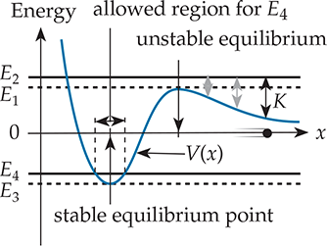
Stable and Unstable Equilibrium

Slide 27
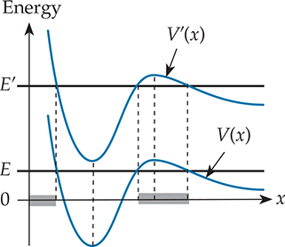
For V(x),
Only the Shape Matters, not Sign!

Slide 28
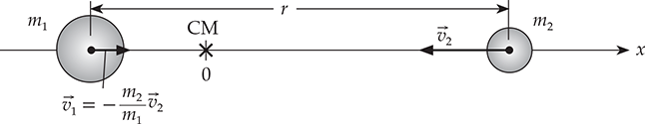

Reduced Mass
Reduced mass

Slide 29
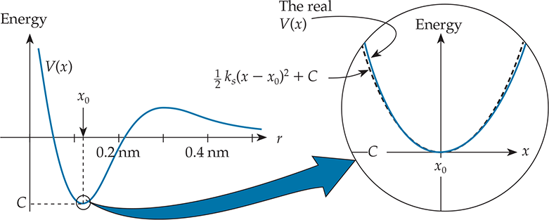
Spring Approximation
PE function near a local minimum can be approximated by the internal energy stored in a compressed/stretched spring.

Slide 30
Practice Problem
C9M.9 Suppose we hold two air-track gliders with masses of 0.25 kg and 0.50 kg together so they compress a spring with a spring constant of 100 J/m² by a distance of 2 cm. The spring is not connected to either glider, so when we release the gliders, the spring falls away. What is the gliders’ final speed relative to each other?

Slide 31
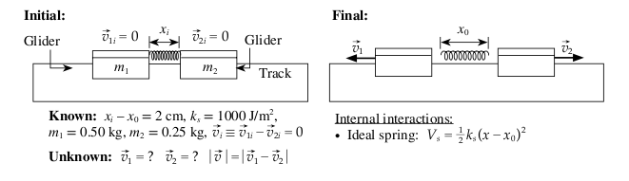
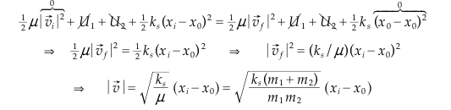

Solution

