Slide 1


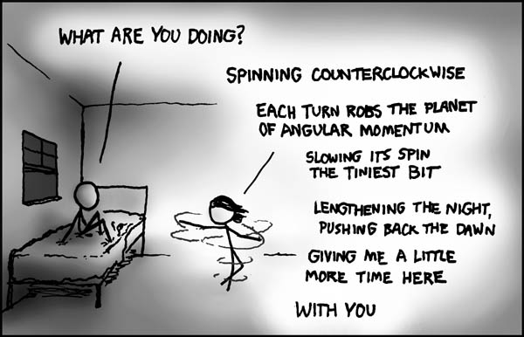
PHYSICS 197 Section 1
Chapter C7
Angular Momentum
September 18, 2017

Slide 2
Review of Last Class
Moment of Inertia
Twirl and Torque
Gyroscopic Precession
Conservation of Angular Momentum

Slide 3
Conservation of Angular Momentum
The total angular momentum of an isolated system is conserved.
Three classes of isolated systems:
  Floats in space.
  Functionally isolated (external interactions deliver no net torque).
  Involves a collision.
Two types of CAM problems:
  Where the system that consists of a single object whose moment of inertia changes between its initial and final states.
  Where parts of the system having different angular momenta interact.

Slide 4
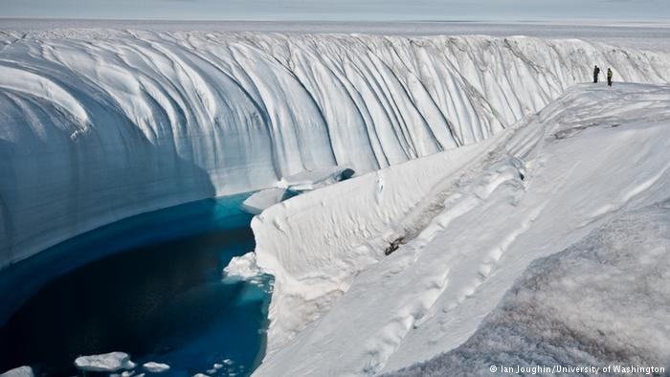
Clicker Question
C6T.8 If global warming proceeds during the next century as anticipated, the polar ice caps may melt, substantially raising the sea levels around the world. What effect will this have on the duration of the day?
It will lengthen the day slightly.
It will shorten it slightly.
It will have no effect.
I don’t believe in global warming.

Slide 5
Answer
C6T.8 If global warming proceeds during the next century as anticipated, the polar ice caps may melt, substantially raising the sea levels around the world. What effect will this have on the duration of the day?
It will lengthen the day slightly.
It will shorten it slightly.
It will have no effect.
I don’t believe in global warming.
Explanation: The melted water is free to flow from the pole toward the equator, which is farther from earth’s axis of rotation, thus increasing its moment of inertia. So by law of CAM, the rotation period should also increase.

Slide 6
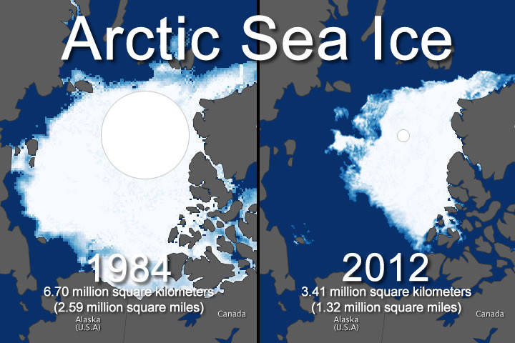
If you answered D, see this

Slide 7
Practice Problem
C6M.5 Two astronauts of equal mass are floating in space. They both hold onto a light rod 20 m long, and the whole system is rotating about the rod’s center once every 30 s.
What is the ordinary speed of each astronaut?
Now imagine that the astronauts pull themselves along the rod until they are 10 m apart. What are their ordinary speeds now?
Notes:
Ask whether the rotational speed will increase or decrease.
Demo: Turntable with dumbbells (hands stretched and then moved in)

Slide 8
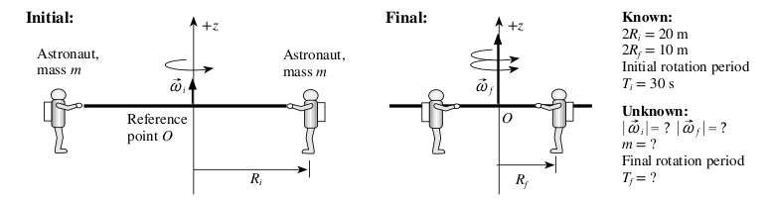





Solution

Slide 9
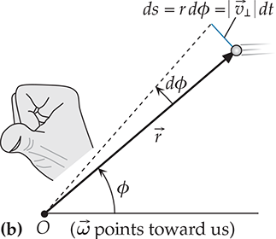
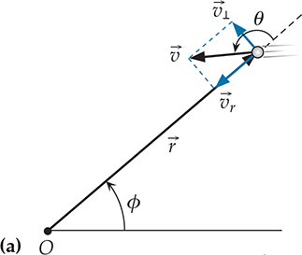

General Definition of Angular Momentum

Slide 10
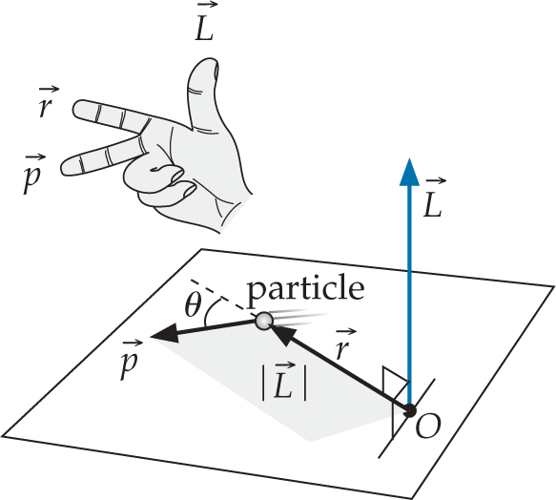
Angular Momentum and Linear Momentum

Slide 11
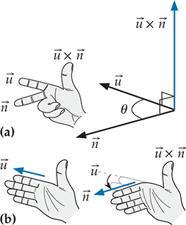
Cross Product

Slide 12
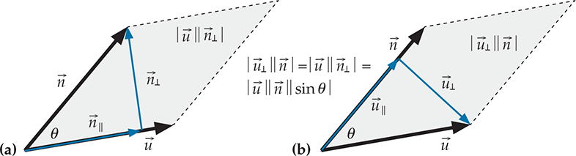
Properties
Some obvious:
Some not-so-obvious:

Slide 13

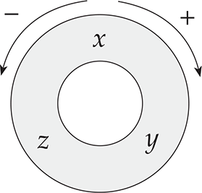
Components

Slide 14

Clicker Question
C7T.4 Suppose a jet is cruising at a constant velocity due east. At the instant the jet is above your head, what is the direction of the jet’s angular momentum around you?
East
West
North
South
Down

Slide 15
Answer
C7T.4 Suppose a jet is cruising at a constant velocity due east. At the instant the jet is above your head, what is the direction of the jet’s angular momentum around you?
East
West
North
South
Down
Explanation: The jet’s position relative to you is upward and its velocity is eastward, so its angular momentum must be perpendicular to both, and is forward by right-hand rule.

Slide 16
Clicker Question
C7T.8 Four people are sitting at the lettered positions on the rim of a merry-go-round shown below that is slowly turning clockwise. You throw a fairly massive ball horizontally to one of these people, who catches it. To which person should you throw the ball so that catching it most effectively increases the merry-go-round’s rotation rate?
Notes:
Demo with turntable and medicine ball

Slide 17
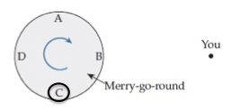
Answer
C7T.8 Four people are sitting at the lettered positions on the rim of a merry-go-round shown below that is slowly turning clockwise. You throw a fairly massive ball horizontally to one of these people, who catches it. To which person should you throw the ball so that catching it most effectively increases the merry-go-round’s rotation rate?

Slide 18
Torque and Force

Slide 19

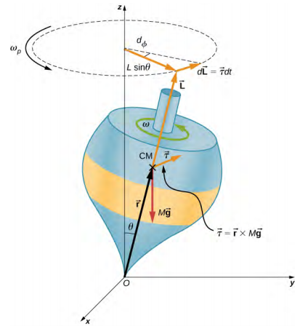
Gyroscope

Slide 20
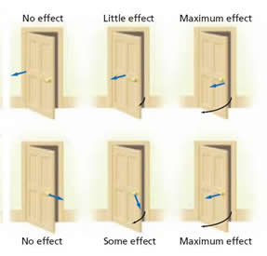
How to Maximize Torque

