Slide 1


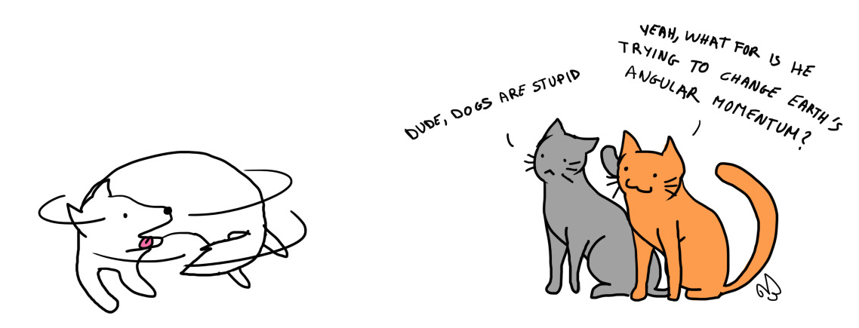
PHYSICS 197 Section 1
Chapters C6 and C7
Angular Momentum
September 15, 2017

Slide 2
Announcements
No daily HW due before next class (we’ll continue with Chapter C7 on Monday).
Revised 1st weekly HW due by next class!
Any complaints about HW grade should be made after class or by email.
Varney Prize (both class participation and good performance needed).
https://physics.wustl.edu/undergraduate/fellowships_prizes

Slide 3
Review of Last Class
Translation | Rotation
Position | Angle
Velocity | Angular Velocity
Momentum | Angular Momentum
Mass | Moment of Inertia
Impulse | Twirl
Force | Torque
Important Formulae

Slide 4
Clicker Question
C6B.9 An object consists of four small balls with mass m, connected by rods of negligible mass in a square with sides L. What is the moment of inertia for rotations about an axis going through one of the balls and its diagonal opposite?
mL²/4
mL²/2
mL²
2mL²

Slide 5
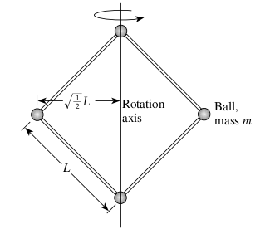
Answer
C6B.9 An object consists of four small balls with mass m, connected by rods of negligible mass in a square with sides L. What is the moment of inertia for rotations about an axis going through one of the balls and its diagonal opposite?
mL²/4
mL²/2
mL² (i.e. α=1/2)
2mL²
Q: What is the moment of inertia if the axis of rotation is going
through the center of the square perpendicular to its plane?

Slide 6

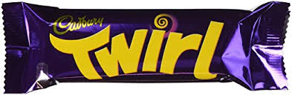
Impulse vs. Twirl

Slide 7


Force vs. Torque
Just as force is the rate of change of impulse.
Points in the same direction as the change in angular momentum
(not necessarily the angular momentum itself).
Notes:
Gyroscope demo at the end.

Slide 8
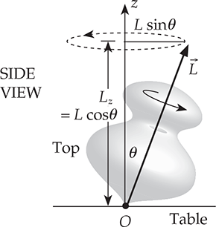
Gyroscope
Notes:
Explain with pen and notebook on the table.

Slide 9
Gyroscope

Slide 10
Gyroscope

Slide 11
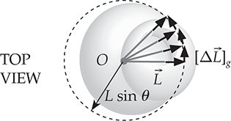
Gyroscope

Slide 12
Gyroscope

Slide 13
Gyroscopic Precession

Slide 14
Gyroscopic Precession
A spinning object exhibits
gyroscopic precession
if the only significant torque
acting on it is perpendicular
to its angular momentum
and some fixed direction.

Slide 15
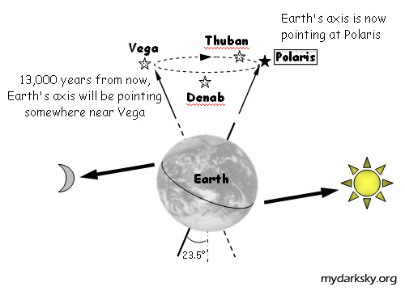
Earth’s Precession
Earth experiences gyroscopic motion (with a precession period of 26,000 years)
due to its oblate shape and tilted axis of rotation with respect to moon’s orbit.

Slide 16
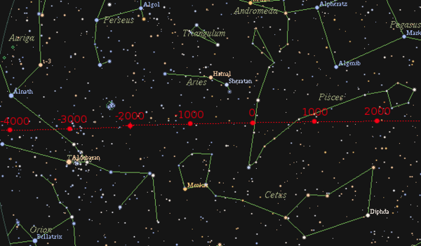
Changing the Night Sky over Millennia

Slide 17
Conservation of Angular Momentum
The total angular momentum of an isolated system is conserved.
Three classes of isolated systems:
  Floats in space.
  Functionally isolated (external interactions deliver no net torque).
  Involves a collision.
Two types of CAM problems:
  Where the system that consists of a single object whose moment of inertia changes between its initial and final states.
  Where parts of the system having different angular momenta interact.

Slide 18
Clicker Question
C6T.5 A person is sitting at rest on a stool that is free to rotate about a vertical axis. The person holds in one hand a bicycle wheel that spins rapidly counterclockwise (when viewed from above). The person then stops the wheel with the other hand. What happens as a result?
The person rotates counterclockwise (as seen from above).
The person rotates clockwise (as seen from above).
Nothing. The wheel’s angular momentum is carried away by external interactions.
Nothing. The wheel’s angular momentum is simply dissipated by the friction interaction.
Something else happens.

Slide 19
Answer
C6T.5 A person is sitting at rest on a stool that is free to rotate about a vertical axis. The person holds in one hand a bicycle wheel that spins rapidly counterclockwise (when viewed from above). The person then stops the wheel with the other hand. What happens as a result?
The person rotates counterclockwise (as seen from above).
The person rotates clockwise (as seen from above).
Nothing. The wheel’s angular momentum is carried away by external interactions.
Nothing. The wheel’s angular momentum is simply dissipated by the friction interaction.
Something else happens.
Explanation: The person+wheel system’s angular momentum about the vertical axis must be conserved.

Slide 20
Clicker Question
C6T.6 A person is sitting at rest on a stool that is free to rotate about a vertical axis. The person holds in one hand a bicycle wheel that spins rapidly counterclockwise (when viewed from above). The person then flips the wheel over. What happens as a result?
The person rotates counterclockwise (as seen from above).
The person rotates clockwise (as seen from above).
Nothing. The wheel’s angular momentum is simply dissipated in the person’s body.
Nothing. The wheel’s angular momentum remains the same before and after the flip.
The person flips over too.

Slide 21
Answer
C6T.6 A person is sitting at rest on a stool that is free to rotate about a vertical axis. The person holds in one hand a bicycle wheel that spins rapidly counterclockwise (when viewed from above). The person then flips the wheel over. What happens as a result?
The person rotates counterclockwise (as seen from above).
The person rotates clockwise (as seen from above).
Nothing. The wheel’s angular momentum is simply dissipated in the person’s body.
Nothing. The wheel’s angular momentum remains the same before and after the flip.
The person flips over too.
Explanation: Flipping the wheel over changes its angular momentum from upward to downward, so the person’s angular momentum must be upward to compensate.

Slide 22
Practice Problem
C6M.6 A certain playground merry-go-round is essentially an iron disk of radius R and mass m. Two children, whose masses are each 2m/5, are originally sitting on opposite sides of the disk near its outer edge. The merry-go-round is turning essentially without friction around a vertical axis once every 5 s. The children then clamber toward each other until each is only R/3 from the center. How long does it take the merry-go-round to complete a revolution now?
Notes:
Ask whether the rotational speed will increase or decrease.
Demo: Turntable with dumbbells (hands stretched and then moved in)

Slide 23
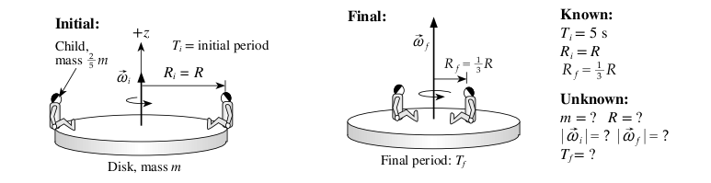




Answer
Rotational speed increases.

Slide 24
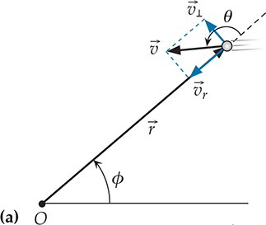
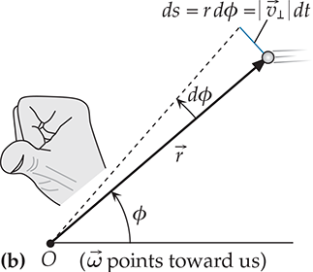
General Definition of Angular Momentum

Slide 25
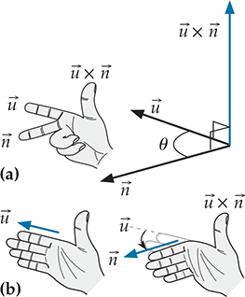
Cross Product

Slide 26
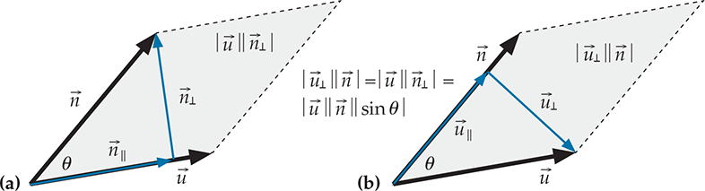
Properties
Some obvious:
Some not-so-obvious:

Slide 27

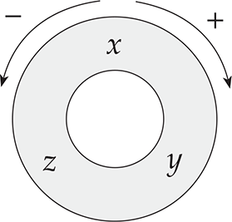
Components

Slide 28
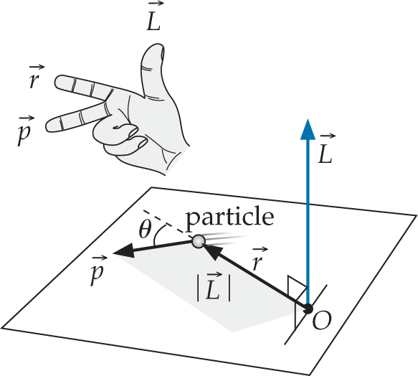
Back to Angular Momentum

