Slide 1


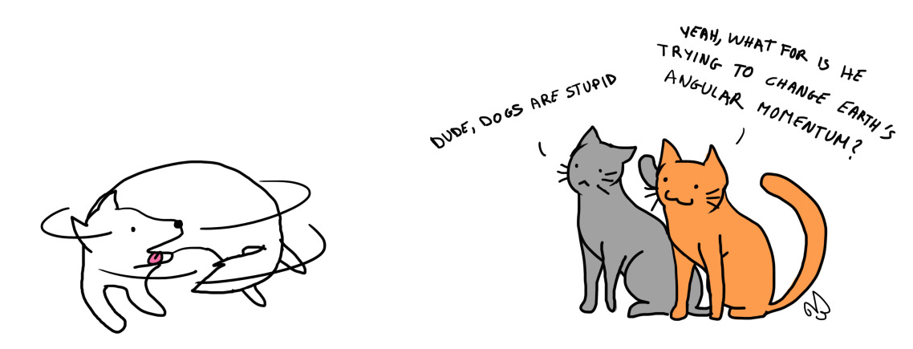
PHYSICS 197 Section 1
Chapter C6
Conservation of
Angular Momentum
September 13, 2017

Slide 2
Announcements
Please remember to turn in your 2nd weekly HW (by 9.10am).
Please remember to collect your graded 1st weekly HW from the hallway.
If you are unsatisfied with your score, please check the online solution and submit your revised work (written in blue ink) by 9.10am, Monday, Sept 18.
Those who had complained to me about their daily HW scores on Blackboard, please check the updated gradebook and let me know if you still have missing scores.

Slide 3
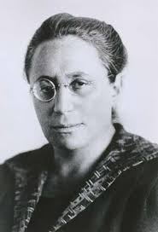
Conservation Laws
Noether’s theorem: A symmetry principle implies an associated conservation law.
Symmetry | Conservation of
Translation in time | Energy
Translation in space | Momentum
Rotation in space | Angular Momentum
Position
Orientation
Notes:
Emmy Noether, German Mathematician in the early 20th century.
Reflection is different from other symmetries listed here. Why? Because it is discrete, while others are continuous.

Slide 4
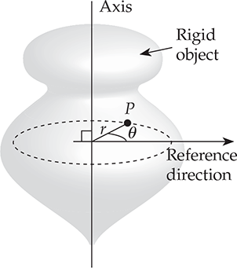
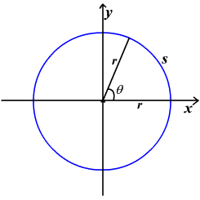
Quantifying Orientation
Angle is unitless.
By convention, always use radians (unless specified).

Slide 5
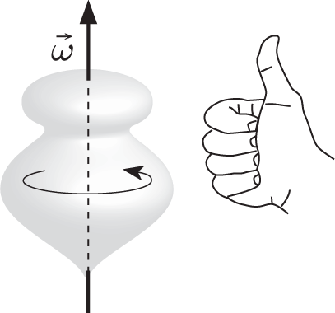
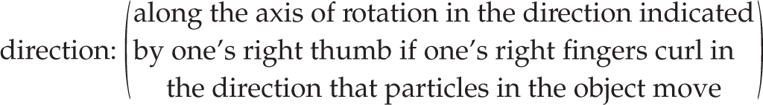
Angular Velocity

Slide 6
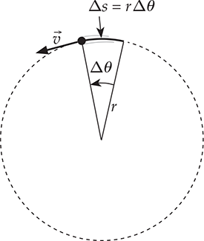
Velocity vs. Angular Velocity

Slide 7
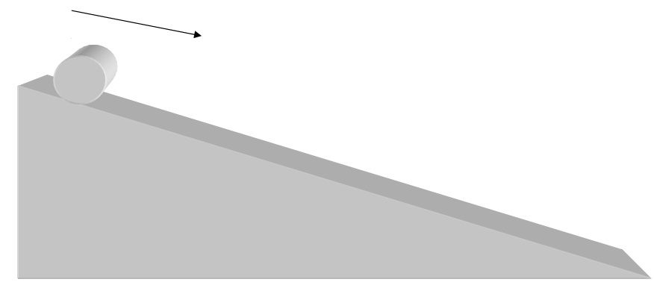
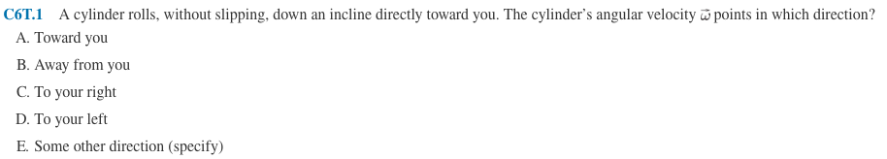
Clicker Question
C. To your right (use right hand rule).

Slide 8
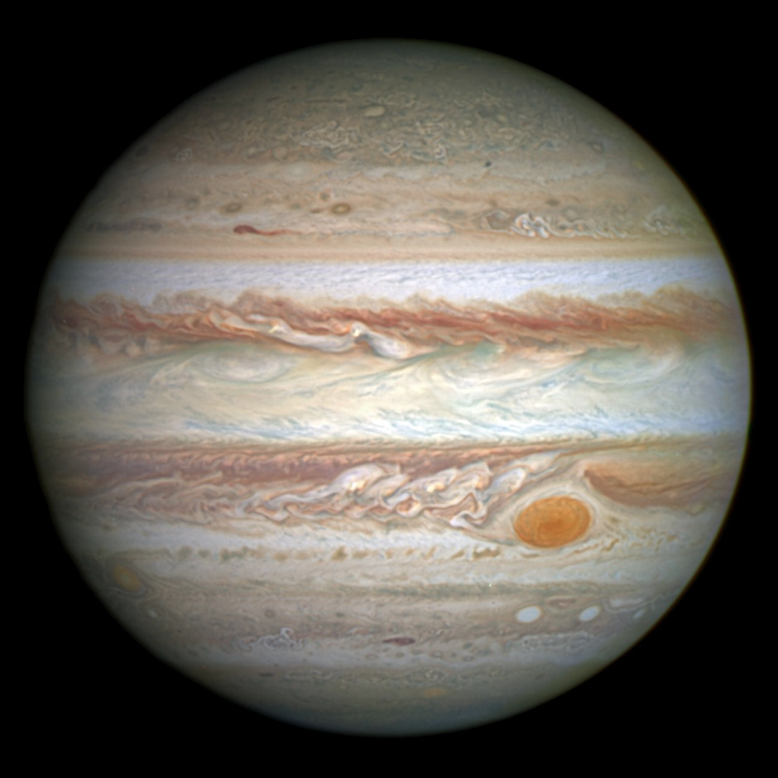
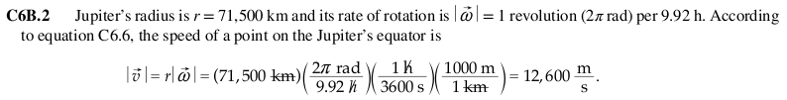
Practice Problem

Slide 9
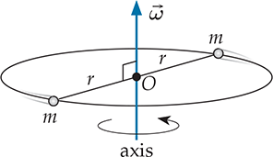
Momentum vs. Angular Momentum
Definition only valid for rigid bodies
  (with well-defined angular velocity).
Angular momentum is parallel to
  angular velocity only if an object is
  symmetric around the axis of rotation.

Slide 10
Symmetric Objects
Consider a rectangular book (e.g. your textbook). The book is symmetric for rotations around an axis that is perpendicular to its face and goes through its center of mass. T or F?
Ans: T. Every particle on one side of the axis has a corresponding particle on the other side.
The book is symmetric for rotations around an axis that goes diagonally from one corner to the other. T or F?
Ans: F. The particle at point A doesn’t have a corresponding particle at point B.

Slide 11
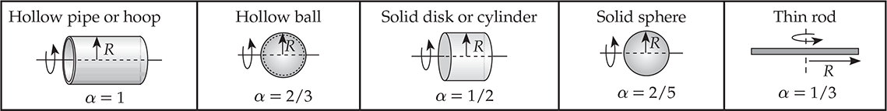
Moment of Inertia

Slide 12
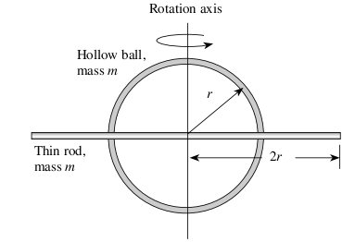
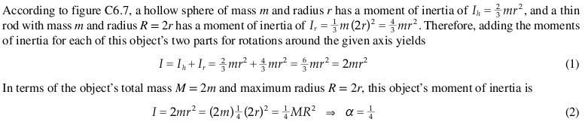
Practice Problem

Slide 13
Impulse vs. Twirl

Slide 14
Force vs. Torque

Slide 15
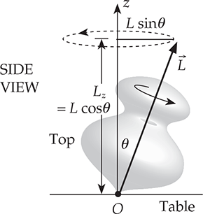
Gyroscope

Slide 16
Gyroscope

Slide 17
Gyroscope

Slide 18
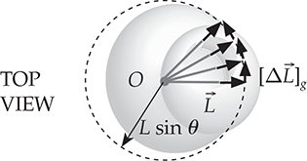
Gyroscope

Slide 19
Gyroscope

Slide 20
Gyroscopic Precession

Slide 21
Gyroscopic Precession

Slide 22
Earth’s Precession

Slide 23
Conservation of Angular Momentum
Analogous to linear momentum conservation,
The total angular momentum of an isolated system is conserved.
Three classes of isolated systems:
  Floats in space.
  Functionally isolated (external interactions deliver no net torque).
  Involves a collision.
Two types of CAM problems:
  Where the system that consists of a single object whose moment of inertia changes between its initial and final states.
  Where parts of the system having different angular momenta interact.

