Slide 1



PHYSICS 197 Section 1
Chapter C3
Vectors
September 6, 2017

Slide 2
Announcements
Please make sure you have turned in your first weekly homework.
Check solutions at the Probviewer website.
On the 197 Course Home Page, go to the left menu: Useful Websites → Six Ideas Homepage → Probviewer (password is noether3).
Graded homeworks will be returned in a week.
You can submit revisions (if you want) to earn up to 90% of the maximum possible HW grade.
Next class will be taken by Dr. Mairin Hynes.

Slide 3
Review of Chapter C2
Five Principles of Newtonian Mechanics
Speed vs. Velocity
Momentum and Impulse
Force and Weight

Slide 4
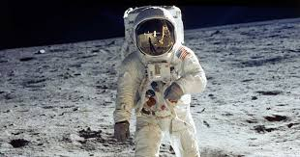
Mass vs. Weight
The gravitational field strength on the surface of Moon is about 16% of the value on the surface of Earth. Consider an astronaut whose mass is measured on Earth to be 60 kg. What are his mass and weight on the Moon?
10 kg and 94 N
10 kg and 588 N
60 kg and 94 N
60 kg and 588 N
No idea

Slide 5
Mass vs. Weight
The gravitational field strength on the surface of Moon is about 16% of the value on the surface of Earth. Consider an astronaut whose mass is measured on Earth to be 60 kg. What are his mass and weight on the Moon?
10 kg and 94 N
10 kg and 588 N
60 kg and 94 N
60 kg and 588 N
No idea

Slide 6
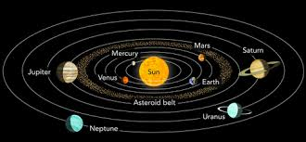
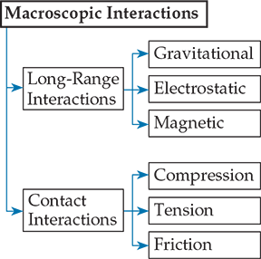
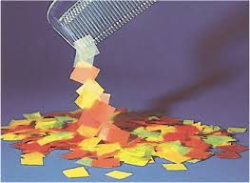
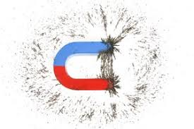
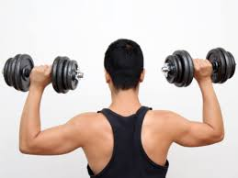
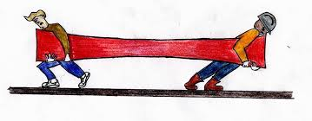
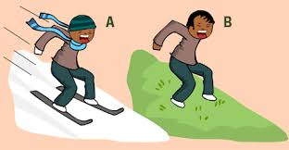

Slide 7

Momentum Transfer

Slide 8
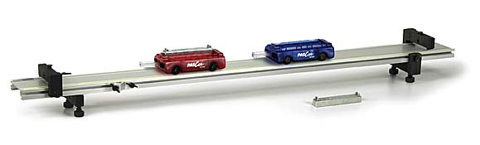
Momentum Transfer
Two carts moving on a flat frictionless surface collide head on.
One cart has mass m and the other has mass 3m.
Before the collision both carts had the same speed v (in opposite directions).
After the collision, the mass m cart is observed to be recoiling with speed 2v.
Describe the motion of the other cart after the collision.
Easy: Requires addition/subtraction of vectors in one dimension.

Slide 9
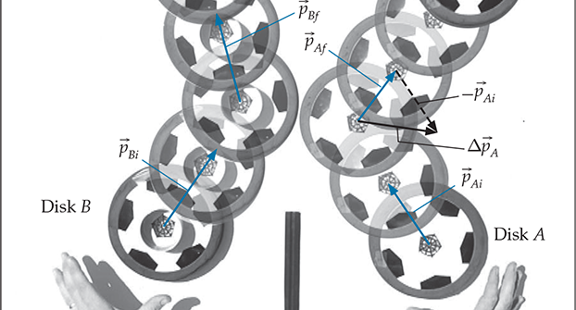
Collision in Higher Dimensions
Requires addition/subtraction of vectors in two dimensions.

Slide 10
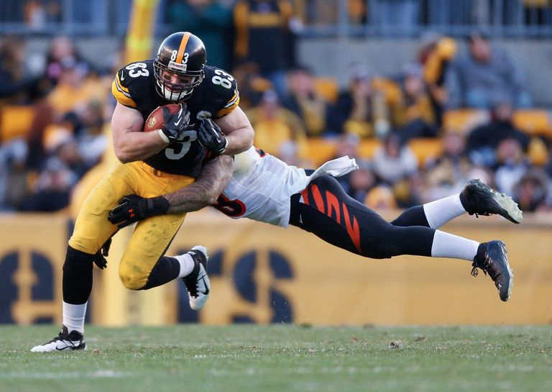
Collision in Higher Dimensions
Requires addition/subtraction of vectors in three dimensions.
Quantitative solutions to real-life problems in mechanics
require a mathematical approach to vectors.

Slide 11
Chapter C3 Overview
Reference Frame
Displacement Vector
Arbitrary Vector
Seven Rules to Remember
Vectors in Two Dimensions
Vectors in One Dimensions

Slide 12
Chapter C3 Overview
Reference Frame
Displacement Vector
Arbitrary Vector
Seven Rules to Remember
Vectors in Two Dimensions
Vectors in One Dimensions

Slide 13
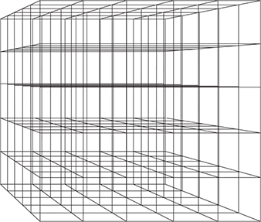
Reference Frame
The functional equivalent of a rigid cubical lattice superimposed on space.
Choose one intersection to be the origin.
The mutually perpendicular lines going through the origin are x, y, and z axes.
Choose a direction along each axis to be the “positive” direction.
Freedom in setting up reference frames.
But ….

Slide 14
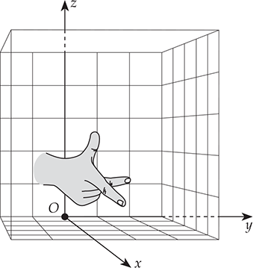
Conventions
A frame is attached to the earth’s surface.
Positive axis directions are right-handed.
Question: The x,y,z directions of a reference frame point up, west and north, respectively. Such a coordinate system is right-handed. True or False?
Standard orientation: +x=east, +y=north, +z=up

Slide 15
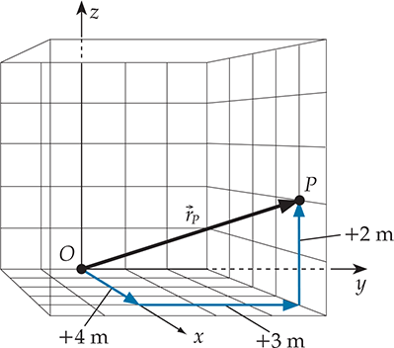
Coordinates
We can use a reference frame to quantify an object’s position.
Coordinates: An ordered list of numbers uniquely specifying a point in the chosen frame.
E.g. [x, y, z]=[+4 m, +3 m, +2 m]

Slide 16
Chapter C3 Overview
Reference Frame
Displacement Vector
Arbitrary Vector
Seven Rules to Remember
Vectors in Two Dimensions
Vectors in One Dimensions

Slide 17
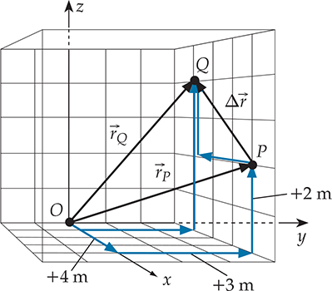
Displacement vs. Position Vector
Displacement vector: A vector that carries us from one position in space to another.
Position Vector: A vector that carries us from the reference frame’s origin to a point in space (special case of displacement vector)

Slide 18



Column-vector Representation
Check!

Slide 19
Two-minute Question
An object has an initial position
but is found a short time later at position
In a frame in standard orientation on the earth’s surface, what is the direction of the object’s displacement during this time interval?
East
West
North
South
Down

Slide 20
Two-minute Question
An object has an initial position
but is found a short time later at position
In a frame in standard orientation on the earth’s surface, what is the direction of the object’s displacement during this time interval?
East
West
North
South
Down

Slide 21

Components of a Vector
A displacement vector has components D_{x}, D_{y}, D_{z}
By the three-dimensional Pythagorean theorem,
For another displacement vector

Slide 22
Chapter C3 Overview
Reference Frame
Displacement Vector
Arbitrary Vector
Seven Rules to Remember
Vectors in Two Dimensions
Vectors in One Dimensions

Slide 23



Arbitrary Vectors
We define all other vectors by analogy to displacements.
We can multiply vectors by unitful quantities to get a new type of vector, e.g.
Displacement (vector) x 1/time (scalar) = velocity (vector)

Slide 24
Chapter C3 Overview
Reference Frame
Displacement Vector
Arbitrary Vector
Seven Rules to Remember
Vectors in Two Dimensions
Vectors in One Dimensions

Slide 25
Seven Rules
You can’t set a vector equal to an ordinary number (except zero).
Components are simple numbers (scalars, can be unitful).
Component values depend on one’s choice of reference frame.
Vectors and their components have consistent units.
Vector magnitudes are always positive.
The magnitude of a sum of vectors is not always the sum of their magnitudes.
You can’t divide by a vector (but you can multiply, though we haven’t discussed it yet).

Slide 26
Chapter C3 Overview
Reference Frame
Displacement Vector
Arbitrary Vector
Seven Rules to Remember
Vectors in Two Dimensions
Vectors in One Dimensions

Slide 27

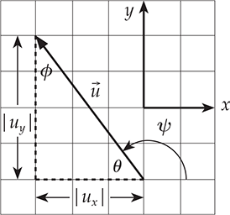

Vectors in Two Dimensions

Slide 28
Chapter C3 Overview
Reference Frame
Displacement Vector
Arbitrary Vector
Seven Rules to Remember
Vectors in Two Dimensions
Vectors in One Dimensions

Slide 29
Vectors in One Dimension
To avoid confusion, always stick to the following convention:

