Slide 1


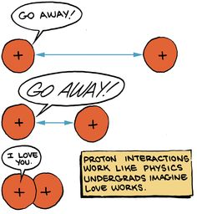
PHYSICS 197 Section 1
Chapter C2
Particles and Interactions
September 1, 2017

Slide 2
Announcements
No class Monday 9/4 (Labor day).
Read Learnsmart Chapter C3 and complete the daily homework by 11.59 pm on 9/5.
The first weekly homework is due before class (latest by 9.10 am) on Wednesday, 9/6.
Please write your name (Given, Last) and student ID on each page and staple all pages together.
Please use pencil or black ink for writing down your solutions.
Check solutions at Probviewer website (after the HW is due) – details on Blackboard.
Please make the revisions (if needed) in blue ink (do not use purple or green, as the TA is color-blind).

Slide 3
Review of Chapter C1
Unit awareness:
  Attach physical meaning to numbers.
  Cannot add or subtract quantities with different units.
  Can multiply or divide quantities with different units.
  Mathematical functions must be unitless.
Unit Conversion: Use the unit operator method to change units.
Dimensional Analysis: The units of both sides of any equation must be consistent.

Slide 4
Example
The speed v of sound waves in a gas like air might plausibly depend on the gas’s pressure P (which has units of N/m²), the gas’s density ρ(which has units of kg/m³) and its temperature T (which has units of K), and some unitless constant C. Assuming that no other quantities are relevant, which of the following formulas might possibly correctly give the speed of sound in a gas?
v = CPρT
v = CTP/ρ
v = CP/ρ
v = C√(P/ρ)
v = C√(ρ/P)
Notes:
Write v=C P^a \rho^b T^c
LHS = ms^-1; so RHS must be that

Slide 5
Example
The speed v of sound waves in a gas like air might plausibly depend on the gas’s pressure P (which has units of N/m²), the gas’s density ρ(which has units of kg/m³) and its temperature T (which has units of K), and some unitless constant C. Assuming that no other quantities are relevant, which of the following formulas might possibly correctly give the speed of sound in a gas?
v = CPρT
v = CTP/ρ
v = CP/ρ
v = C√(P/ρ)
v = C√(ρ/P)
Notes:
Write v=C P^a \rho^b T^c
LHS = ms^-1; so RHS must be that

Slide 6
Chapter C2 Overview
The Principles of Modern Mechanics
Describing an Object’s Motion
Vector operations
Momentum and Impulse
Force and Weight
Interaction Categories
Momentum Transfer

Slide 7
Chapter C2 Overview
The Principles of Modern Mechanics
Describing an Object’s Motion
Vector operations
Momentum and Impulse
Force and Weight
Interaction Categories
Momentum Transfer

Slide 8
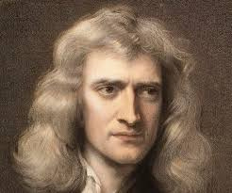
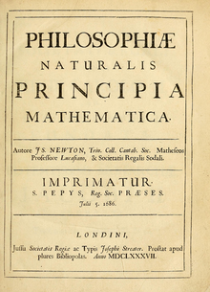
The Principles of Mechanics
Mechanics is a model of how physical interactions between objects affect their motion.
Five principles:
  We can model any object as a set of interacting point-like particles.
  A non-interacting particle moves at a constant speed in a straight line.
  An interaction is a physical relationship between exactly two particles that, in the absence of other interactions, changes the motion of each.
  Does this by transferring momentum from one particle to the other.
  A macroscopic object responds to external interactions as if it were a single particle located at its center of mass.
Notes:
The 2nd principle is sometimes called Newton’s first law.
Motion: discussed in next slide.
Momentum: mass times velocity. Will be discussed in more details later.
The 5th principle is really what makes the physics of mechanics applicable to real life.
Center of mass is a well-defined mathematical point that we can calculate (will do in C4). For a symmetrical object (like a spherical ball), it is located at the geometric center.

Slide 9
Chapter C2 Overview
The Principles of Modern Mechanics
Describing an Object’s Motion
Vector operations
Momentum and Impulse
Force and Weight
Interaction Categories
Momentum Transfer

Slide 10
Velocity vs. Speed
Speed is the rate at which the object’s center of mass is moving through space.
Question: A car moves backward 10 m in 2 s at a steady rate. The car’s speed is therefore −5 m/s. True or False?
Velocity expresses both speed and direction of motion.
An example of vector (which has both magnitude and direction).
Notes:
Triple equality means “is defined to be”.
Absolute value means speed is always positive.
We rarely need to perform the limit-taking process (\Delta t is good enough, as long as it is sufficiently short).
Car’s speedometer measures the time required for its wheel to turn once and displays a value equal to the wheel’s circumference divided by time interval.

Slide 11
2nd Principle of Mechanics
A non-interacting particle moves at a constant speed in a straight line
=
  A non-interacting particle moves at a constant velocity.
Notes:
Part of Newton’s first law.
Counterintuitive: Objects only at ‘rest’ were previously thought to be natural, not those moving at a constant velocity.

Slide 12
Chapter C2 Overview
The Principles of Modern Mechanics
Describing an Object’s Motion
Vector operations
Momentum and Impulse
Force and Weight
Interaction Categories
Momentum Transfer

Slide 13
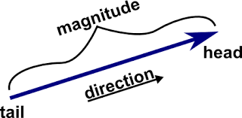
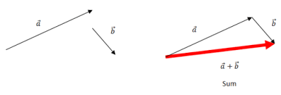
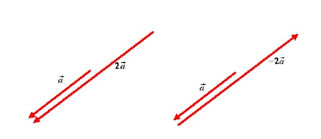
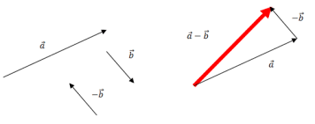
Vector
From a Latin root meaning “to carry”.
A vector carries a magnitude | | (non-negative number) and a direction.
Vector Operations (more in C3):

Slide 14
Chapter C2 Overview
The Principles of Modern Mechanics
Describing an Object’s Motion
Vector operations
Momentum and Impulse
Force and Weight
Interaction Categories
Momentum Transfer

Slide 15
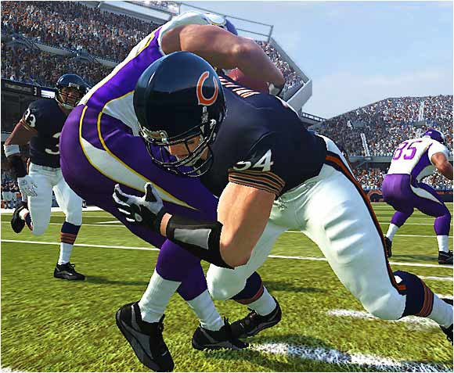
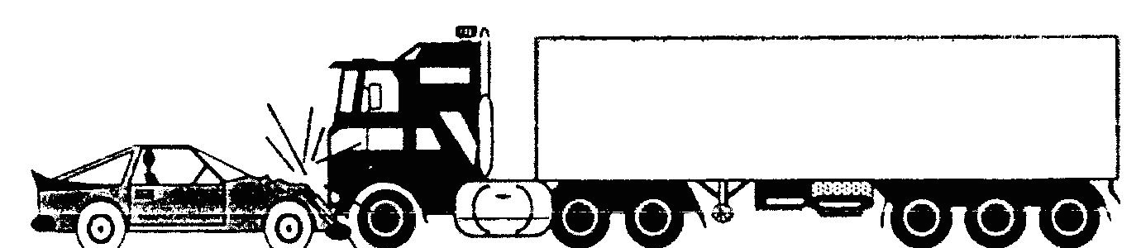
Momentum
A particle of mass m (non-negative number) and velocity has (Newtonian) momentum
Another vector quantity, which always points in the same direction as velocity.
SI unit: kg.m/s.
An object’s mass expresses how reluctant it is to change velocity when it accepts a given momentum transfer.
Notes:
Collision of

Slide 16
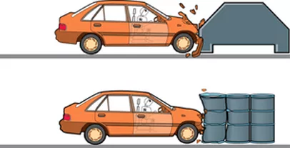

Impulse
The amount of momentum an object receives during an interaction.
represents the impulse that interaction A delivers to an object during a specified time interval.
The net change in momentum of an object (during a given time interval) is the vector sum of all impulses it has received during that interval:

Slide 17
Chapter C2 Overview
The Principles of Modern Mechanics
Describing an Object’s Motion
Vector operations
Momentum and Impulse
Force and Weight
Interaction Categories
Momentum Transfer

Slide 18
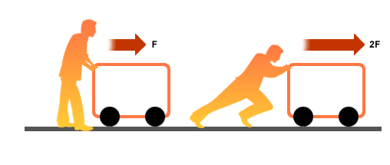
Force
The force an interaction exerts on an object is the rate at which it delivers momentum:
Has its own SI unit: Newton (N).
1 N 1 kg.m/s², that is, a 1 N force delivers 1 kg.m/s of impulse per second.
Larger the force acting on an object, more its velocity changes.

Slide 19

Weight
Objects dropped simultaneously from rest in the earth’s gravitational field always have the same speed at a given instant independent of their masses.
So in a given time interval:
So the gravitational interaction must be delivering downward momentum at a rate proportional to mass.
The gravitational force acting on an object is its weight:
is the gravitational field vector at a given point.
Near the earth’s surface, points toward its center and has a magnitude of | |= 9.8 N/kg=9.8 kg/m².

Slide 20
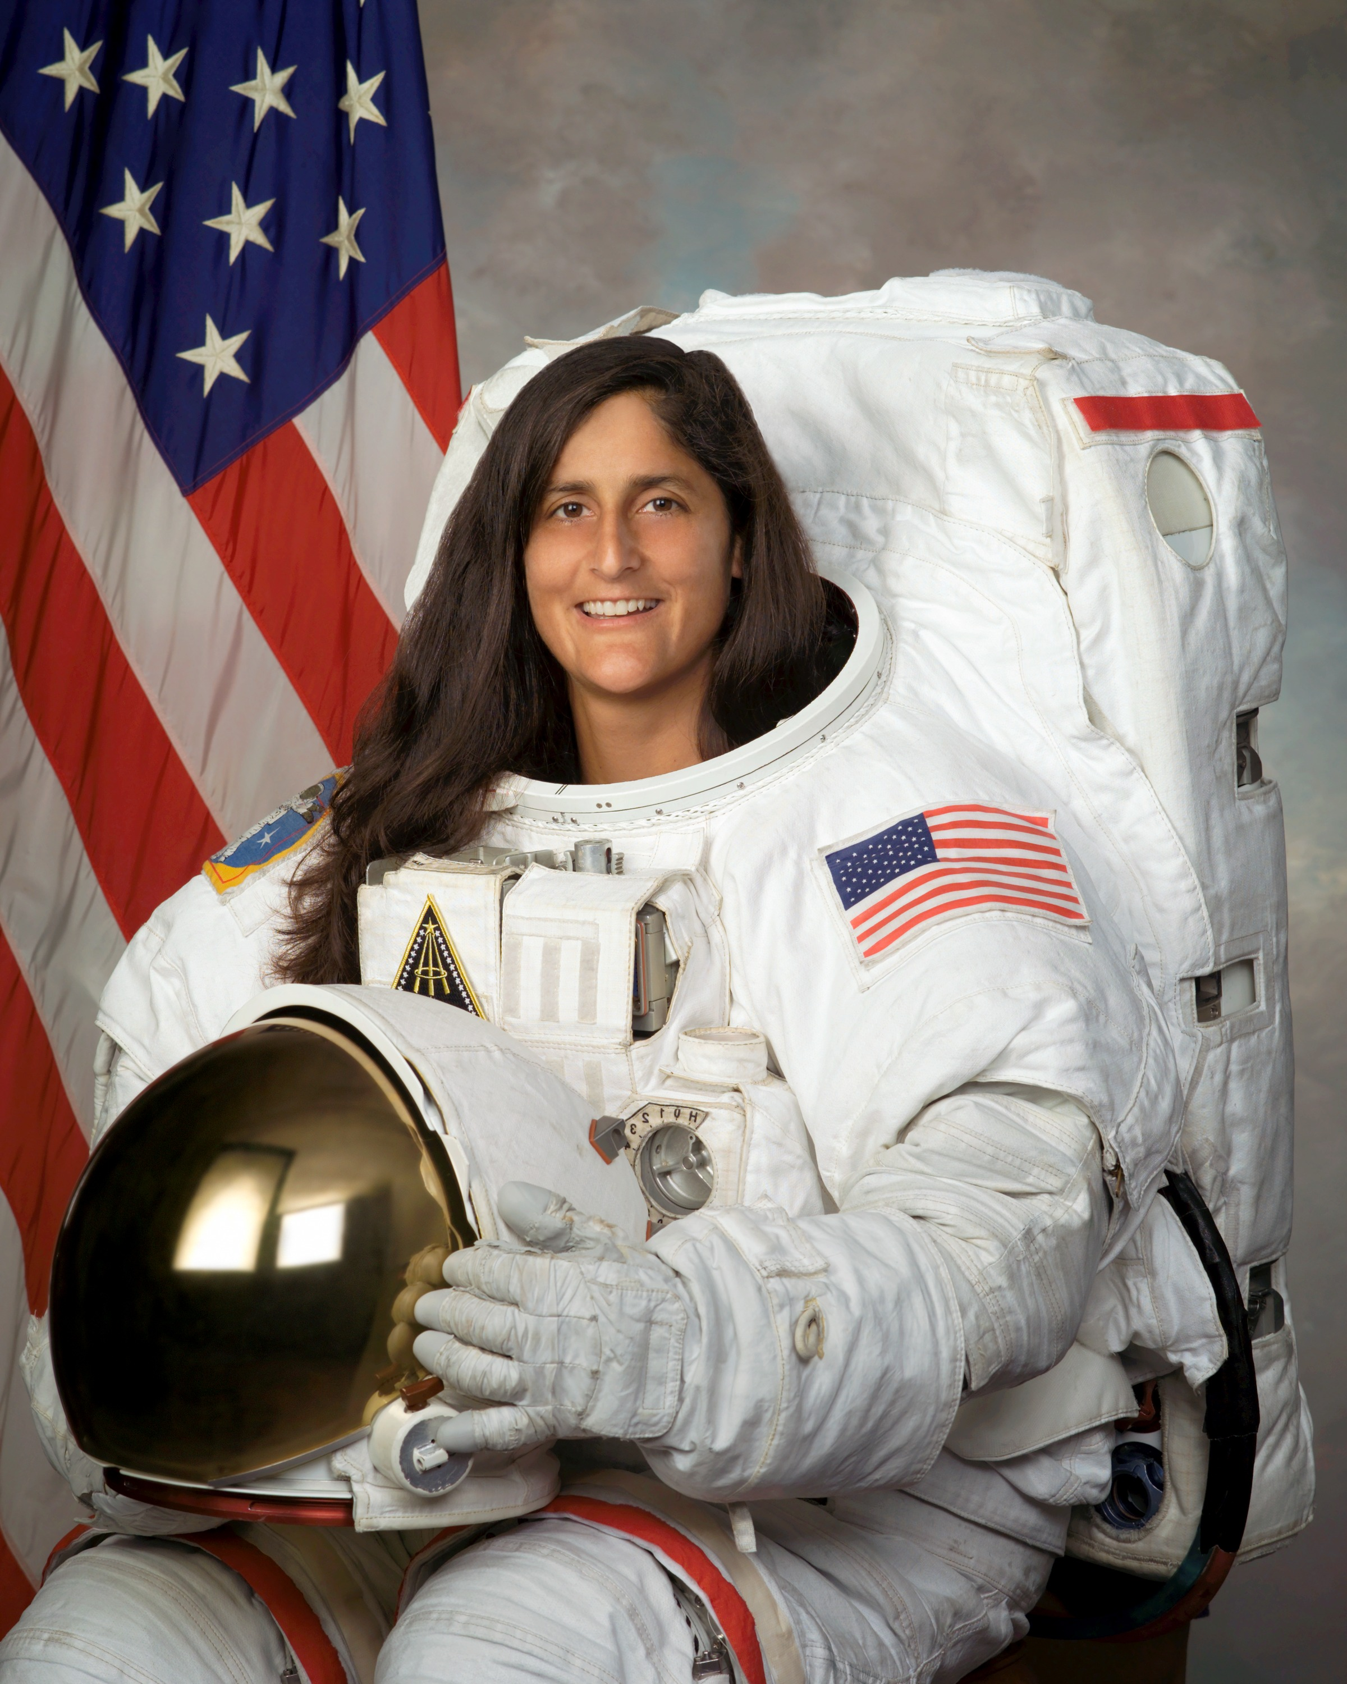
Mass vs. Weight
The gravitational field strength on the surface of Mars is about 38% of the value on the surface of Earth. Consider an astronaut whose mass is measured on Earth to be 55 kg. What is her mass on Mars?
55 kg
21 kg
76 kg
I don’t know.

Slide 21
Mass vs. Weight
The gravitational field strength on the surface of Mars is about 38% of the value on the surface of Earth. Consider an astronaut whose mass is measured on Earth to be 55 kg. What is her mass on Mars?
55 kg
21 kg
76 kg
I don’t know.

Slide 22
Mass vs. Weight
The gravitational field strength on the surface of Mars is about 38% of the value on the surface of Earth. Consider an astronaut whose mass is measured on Earth to be 55 kg. What is the magnitude of her weight on Earth? And on Mars?
539 N and 539 N
205 N and 744 N
539 N and 205 N
205 N and 539 N

Slide 23
Mass vs. Weight
The gravitational field strength on the surface of Mars is about 38% of the value on the surface of Earth. Consider an astronaut whose mass is measured on Earth to be 55 kg. What is the magnitude of her weight on Earth? And on Mars?
539 N and 539 N
205 N and 744 N
539 N and 205 N
205 N and 539 N
Remember: Weight is a vector. Its direction on Earth/Mars is always pointed to the center of Earth/Mars.

Slide 24
Chapter C2 Overview
The Principles of Modern Mechanics
Describing an Object’s Motion
Vector operations
Momentum and Impulse
Force and Weight
Interaction Categories
Momentum Transfer

Slide 25
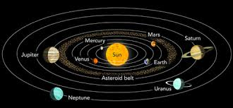

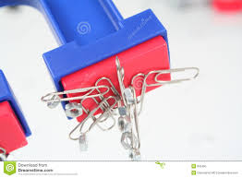
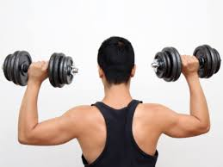
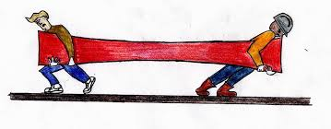
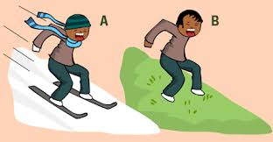

Slide 26
Chapter C2 Overview
The Principles of Modern Mechanics
Describing an Object’s Motion
Vector operations
Momentum and Impulse
Force and Weight
Interaction Categories
Momentum Transfer

Slide 27

Momentum Transfer

