Slide 1


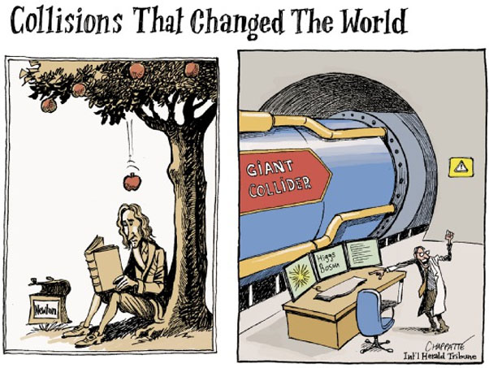
PHYSICS 197 Section 1
Chapter C14
Collisions
October 4, 2017

Slide 2
Review of Last Class
Specific Heat: change in thermal energy per unit mass per unit temperature
Latent Heat: energy absorbed/released per kg (during a phase transition)

Slide 3
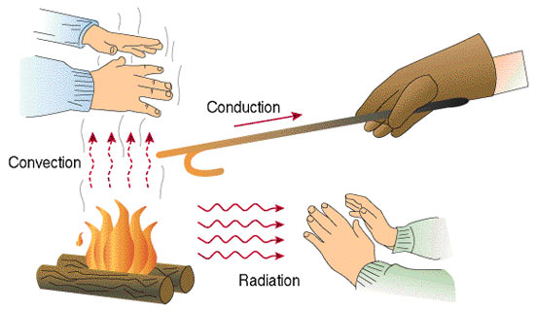
Heat Transfer
Three ways:
Conduction (across a boundary between objects in contact)
Convection (where some medium carries energy away)
Radiation (through the emission of light)
Notes:
Demo on conduction (ask students to touch various objects and feel the difference), convection (hair dryer), radiation (infrared lamp)

Slide 4
Power Emitted by a Radiating Object
Stefan-Boltzmann Law:
Wien’s Law:

Slide 5
Outline of C14
Types of Collisions
One-dimensional Collision
Two-dimensional Collision
The Slingshot Effect (collision without touching)
Using All Conservation Laws

Slide 6
Collision
A brief internal interaction far stronger than any external interactions acting on the system.
Momentary Isolation: Analyze the system just before and after the collision.
Can apply momentum and energy conservation laws.
Collisions transfer some kinetic energy of the colliding objects to internal energy (usually thermal energy).
Different types of collisions, depending on the degree of transfer of KE.

Slide 7
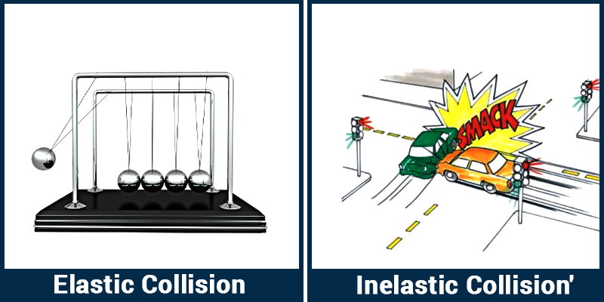
Types of Collisions
Elastic: Conserves total KE.
Inelastic: Converts some KE to internal energy.
Completely Inelastic: Objects remain stuck together. Maximum transfer of KE to IE.
Super-elastic: Some internal energy is converted to KE (e.g. an explosion).

Slide 8
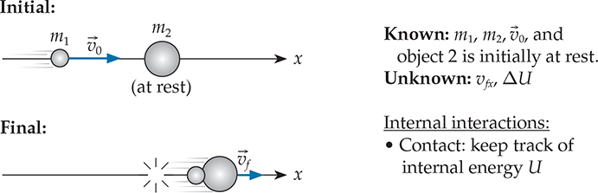
One-Dimensional Collision
Inelastic Case
Conservation of Momentum:
Conservation of Energy:
Fraction of retained KE:

Slide 9
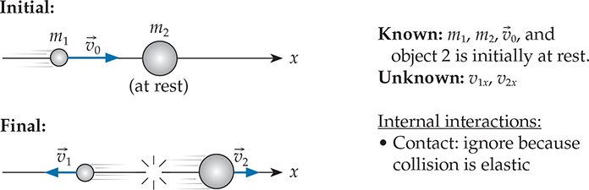
One-Dimensional Collision
Elastic Case
Conservation of Momentum:
Conservation of Energy:
Solution:
Notes:
v_{1x} > 0 if m_1 > m_2, otherwise negative. So we keep it general in the first equation
V_{2x} always positive.

Slide 10
Clicker Question
C14T.3 Suppose you have a small 100-g cart at rest. You have two different objects that you might throw at the cart to get it moving: a 50-g tennis ball and a 50-g lump of sticky clay. Other things being equal, which should you throw at the cart to maximize the cart’s final speed?
The tennis ball
The clay
Both will have the same effect
Need more information.

Slide 11
Answer
C14T.3 Suppose you have a small 100-g cart at rest. You have two different objects that you might throw at the cart to get it moving: a 50-g tennis ball and a 50-g lump of sticky clay. Other things being equal, which should you throw at the cart to maximize the cart’s final speed?
The tennis ball
The clay
Both will have the same effect
Need more information.
Explanation: Because the tennis ball will rebound from the cart, it will deliver greater impulse. You can also check that the final speed of the cart for an elastic collision will be twice as much as in the case of inelastic collision.

Slide 12
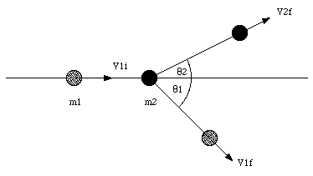
Two-Dimensional Collision
The velocities after collision define a plane in space.
Since the final momentum has no component perpendicular to this plane, the initial velocity must also have no perpendicular component.
So the initial velocity must lie in the same plane.
Any collision between a moving object and a stationary target (in arbitrary 3D) can always be reduced to a 2D problem.

Slide 13
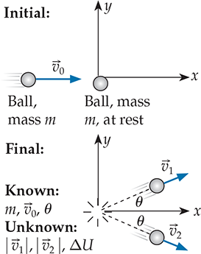
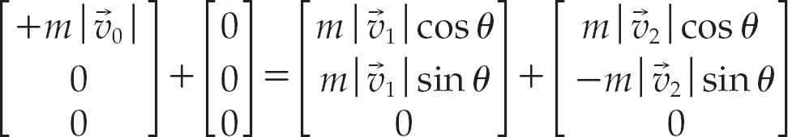

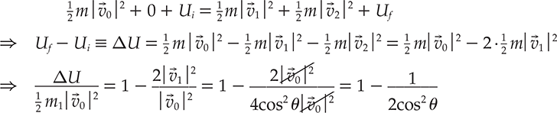
Two-Dimensional Collision
Conservation of Momentum:
Conservation of Energy:
Completely inelastic: θ→0 and fraction → ½.
Elastic Limit: θ→45⁰ and fraction →0.

Slide 14
Example: Ballistic Pendulum
Notes:
Demo

Slide 15
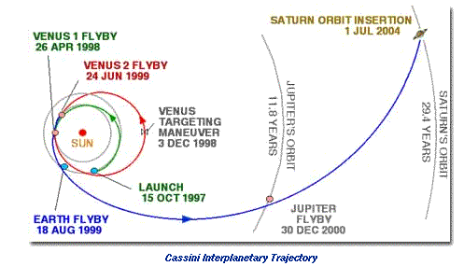
Slingshot Effect

Slide 16
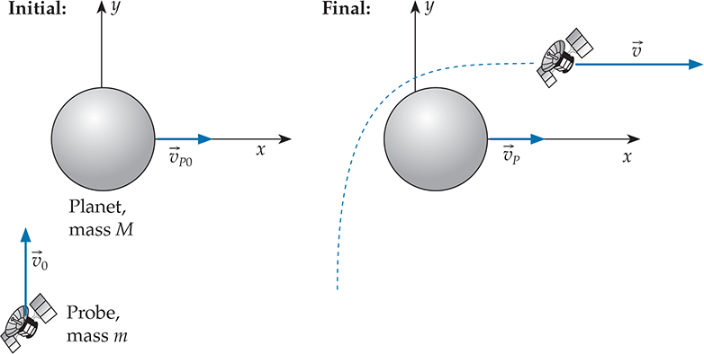
Slingshot Effect

Slide 17
Slingshot Effect

Slide 18
Using All Three Conservation Laws
Clicker Question C14T.10

Slide 19
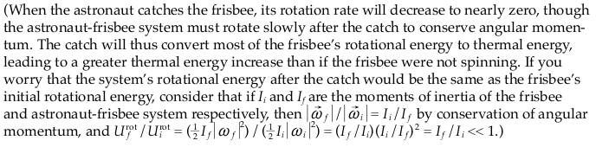
Answer

Slide 20
Practice Problem
C14M.3 A 7.2-kg bowling ball moving at 3.5 m/s collides elastically with a 1.2-kg bowling pin at rest. After the collision, the pin moves an angle 30⁰ with respect to the bowling ball’s original direction of motion. What are the final speeds of both the ball and the pin after the collision?

Slide 21
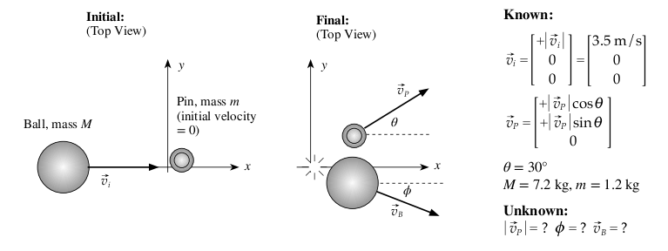
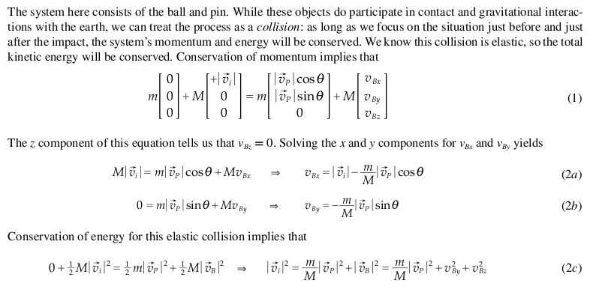
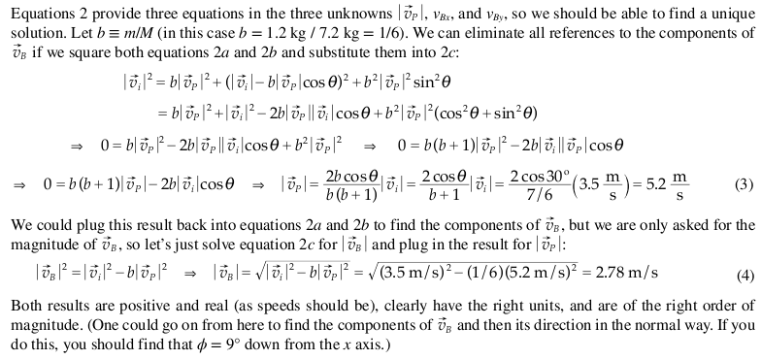
Solution

