Slide 1


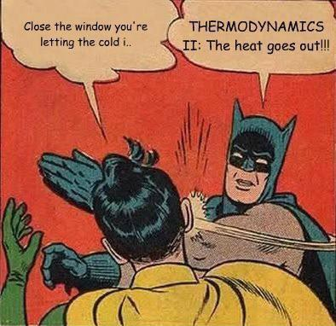
PHYSICS 197 Section 1
Chapter C12
Thermal Energy
September 29, 2017

Slide 2
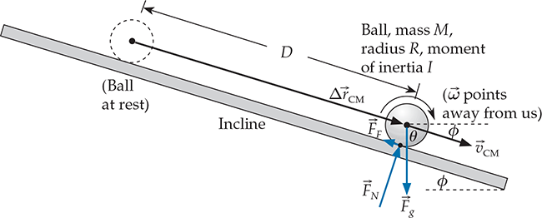
Review of Last Class
Rotational Energy:
Rolling down an incline:
Center-of-mass velocity independent of mass and radius.

Slide 3
Outline of C12
Truly “Hidden” Energy
Caloric
Microscopic Understanding
Friction and Thermal Energy
Heat, Work and Energy Transfer
Specific Heat

Slide 4
Question
C12T.1 A moving railroad car collides with a similar car at rest. The cars lock together. Such a process must convert a significant fraction of the originally moving car’s kinetic energy to thermal energy. True or False?

Slide 5
Answer
C12T.1 A moving railroad car collides with a similar car at rest. The cars lock together. Such a process must convert a significant fraction of the originally moving car’s kinetic energy to thermal energy. True or False?
True. In fact, the collision converts half of the original car’s KE to thermal energy (see the next slide).

Slide 6
Disappearing Energy
Inelastic Collision Example
We lost half of the KE. Where did it go?

Slide 7
Disappearing Energy
Sliding Block Example
So dK is negative, or friction drains the kinetic energy.
Potential energy does not change. So where does the change in KE go?

Slide 8
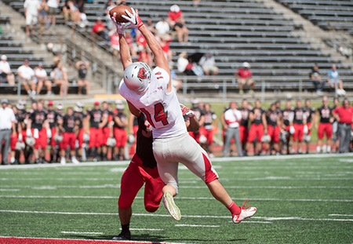
Disappearing Energy
Catching a Ball Example
The ball’s KE simply seems to disappear in the player’s hands.

Slide 9
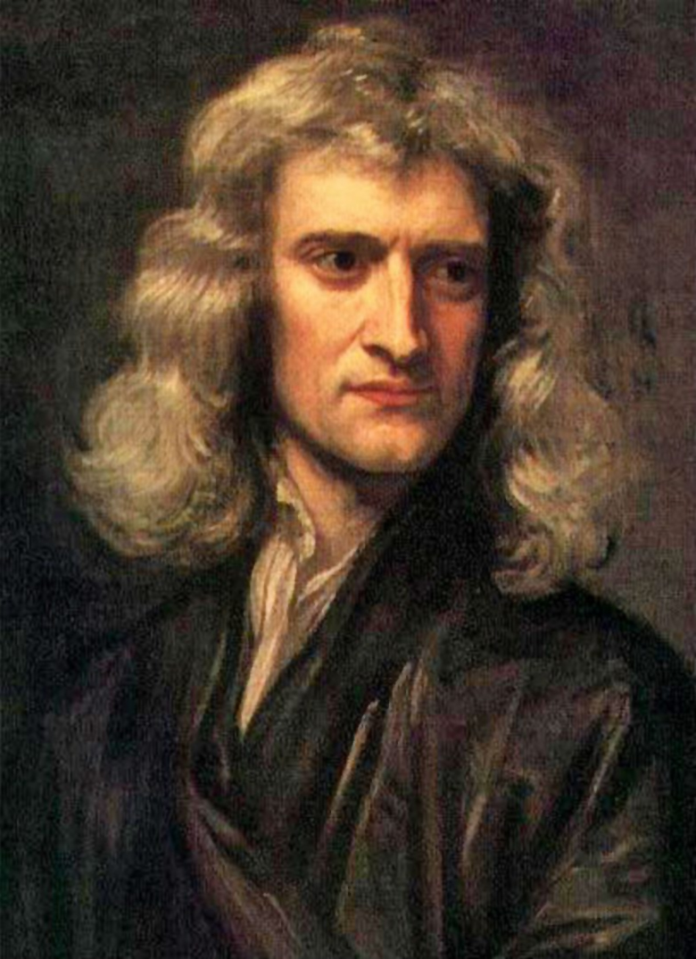
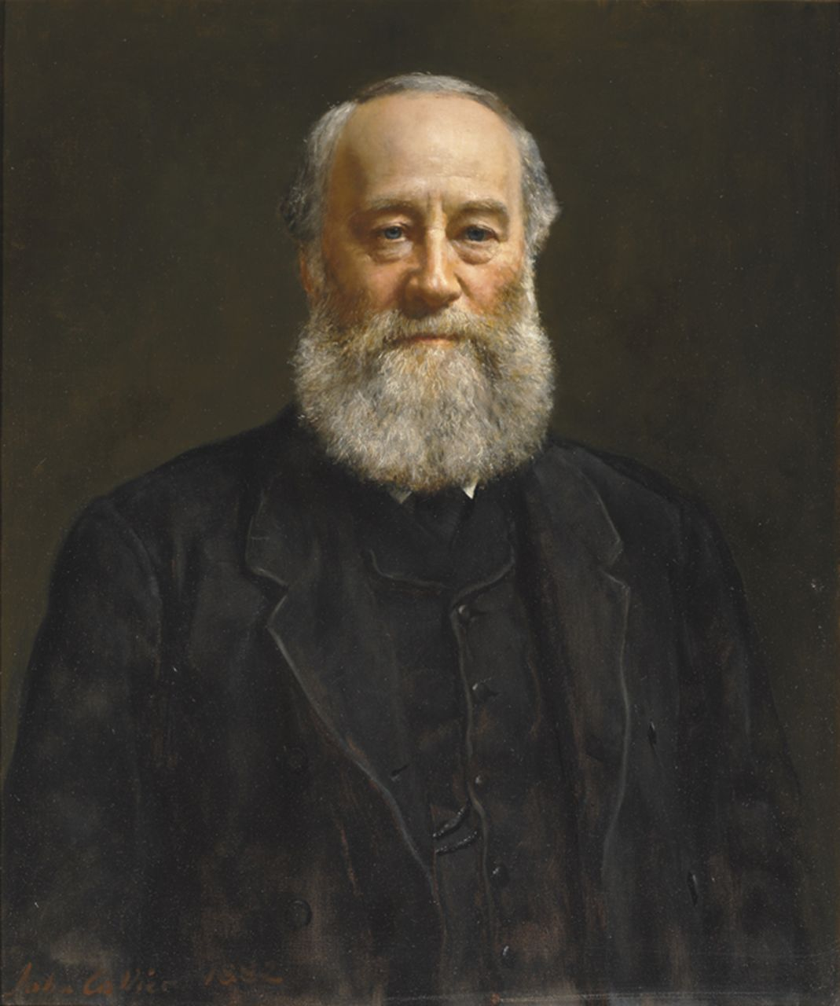
Disappearing Energy
So in our daily experience, it seems like energy is not conserved.
That’s why it took almost 150 years after Newton’s discovery of conservation of momentum for physicists (like Joule) to realize that energy was also conserved (once we include “hidden” forms of energy).
Thermal energy is just a type of internal energy.

Slide 10
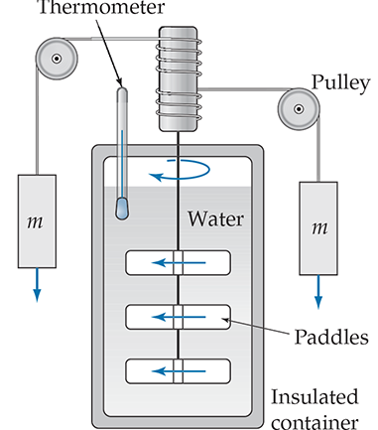
Caloric is Thermal Energy
Early concept of caloric: a fluid that flows from hot to cold objects.
Measured in calories: 1 cal is the amount of caloric required to increase the temperature of 1 g of water by 1⁰ C.
Joule’s experiment linked thermal energy to mechanical energy.
1 cal = 4.186 J
Notes:
Collide two metal balls and show that the paper burns.
Talk in C and not F, because Joule was British!

Slide 11
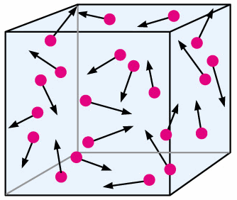

Microscopic Understanding
All objects are constructed of a huge number of small molecules.
These molecules are in ceaseless random motion.
An object’s temperature is directly proportional to the average kinetic energy per molecule:
If all molecules are at rest, T=0 K: Absolute zero (0 Kelvin = −273.15⁰C).

Slide 12
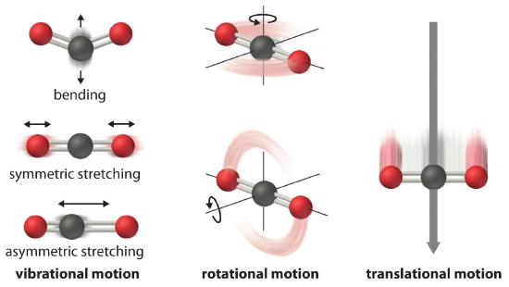
Total Thermal Energy
For an object containing N molecules, the total thermal energy is
In practice, only applicable to mono-atomic ideal gases (such as helium).
In general, thermal energy also includes rotational and vibrational energies of the molecules, in addition to their KE.

Slide 13
Thermal Energy can be Surprisingly Large
Because of the huge number of molecules contained in a macroscopic object (Avogadro’s number = 6x10²³)
The thermal energy required to increase the temperature of 1 gal of lemonade from refrigerator temperature to room temperature is about the same as the kinetic energy required to increase your car’s speed from 0 to 50 mph. (Check this!)
The heat energy released by a 1-liter bottle of water as its temperature drops by 1⁰C is equivalent to the energy required to lift that same bottle 400 m into the air. (Check this!)

Slide 14
Clicker Question
C12T.2 Suppose the average thermal speed of molecules in a gas at room temperature (22⁰C) is v₀. If we “double” the gas’s temperature (to 44⁰C), what is the average molecular speed now?
About the same
√2v₀
2v₀
4v₀
22v₀

Slide 15
Answer
C12T.2 Suppose the average thermal speed of molecules in a gas at room temperature (22⁰C) is v₀. If we “double” the gas’s temperature (to 44⁰C), what is the average molecular speed now?
About the same
√2v₀
2v₀
4v₀
22v₀
Explanation: The average KE of gas molecules is proportional to the absolute temperature, and thus increases by a factor of (273+44)K/(273+22)K. The molecules’ average speed thus increases only by a factor of √(315/295) = 1.033.

Slide 16
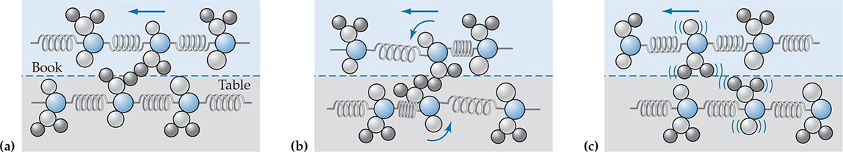
Friction and Thermal Energy
When two surfaces are in contact and one moves past the other, their surface molecules get entangled.
As the object continues to move, these molecules are pulled and twisted out of their original position.
They snap back and oscillate wildly (like masses attached to a spring).
This increases their motion, and hence, the thermal energy which accounts for the loss of KE due to friction.

Slide 17
Heat, Work and Energy Transfer
Heat (Q) is the energy that crosses the boundary between two objects because of a temperature difference between them.
Work (W) is the energy flowing across a system boundary due to external interactions that exert a force.
Heat and work both describe energy transfer across a boundary.
Different from internal energy (including thermal energy) which is inside the object’s boundary.
Both heat and work can contribute to change in internal energy.

Slide 18
Question
C12T.3 Is the specified change in the following objects’ thermal energies due to a flow of heat (Q), work (W), or some other flow of energy (E)?
Rubbing your palms together make them warmer.
Answer: W. Because of frictional work you are doing on them.

Slide 19
Question
C12T.4 Is the specified change in the following objects’ thermal energies due to a flow of heat (Q), work (W), or some other flow of energy (E)?
A hot cup of coffee on a table becomes cooler with time.
Answer: Q. The cup loses energy due to heat flow because it is hotter than its surroundings.

Slide 20
Question
C12T.4 Is the specified change in the following objects’ thermal energies due to a flow of heat (Q), work (W), or some other flow of energy (E)?
A meteorite entering the earth’s atmosphere becomes hot.
Answer: W. Because of frictional work done on it by the atmosphere.

Slide 21
Question
C12T.4 Is the specified change in the following objects’ thermal energies due to a flow of heat (Q), work (W), or some other flow of energy (E)?
Infrared laser light falling on a metal slab makes it hot.
Answer: E. This is energy transfer carried by light quanta. Not because the laser is hotter or exerts a force on the slab.

Slide 22
Conservation of Energy
Requires that a multi-object system’s total change in energy must be equal to the heat, work and other energy transfers that flow into it:
For a single object at rest, this reduces to
(also known as the first law of thermodynamics)

Slide 23
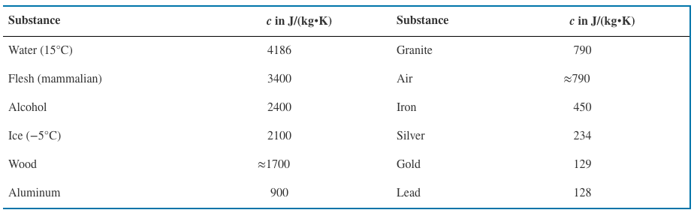
Specific Heat
Temperature and thermal energy are related, but not equivalent (like depth and volume of water in a jar).
Thermal energy in an object is in general a complicated function of the temperature.
But in a sufficiently small temperature range dT, it can be assumed to be linear:
c is the specific heat of the substance that expresses the change in thermal energy per unit mass per unit temperature.

Slide 24
Clicker Question
C12T.10 Substance A has twice the specific heat as substance B. Suppose we put 100-g blocks of these substances in direct sunlight. Assume both blocks are black and present the same surface area to the incoming sunlight. After a certain period of time, how are the temperature changes of these blocks related?

Slide 25
Answer
C12T.10 Substance A has twice the specific heat as substance B. Suppose we put 100-g blocks of these substances in direct sunlight. Assume both blocks are black and present the same surface area to the incoming sunlight. After a certain period of time, how are the temperature changes of these blocks related?
Explanation: Both blocks receive the same thermal energy, which is proportional
to the product of specific heat and temperature change. So it will cause a
greater temperature change in the object with smaller specific heat.

Slide 26
Practice Problem
C12B.13

Slide 27
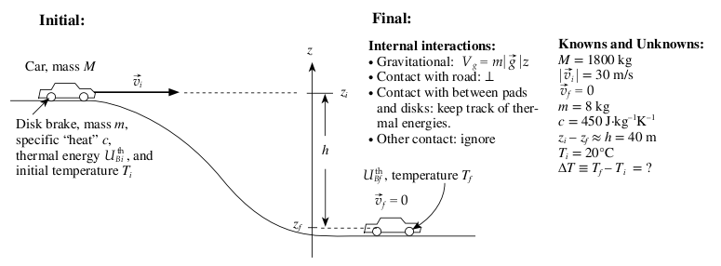


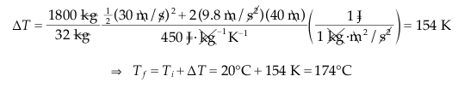
Solution

