Slide 1


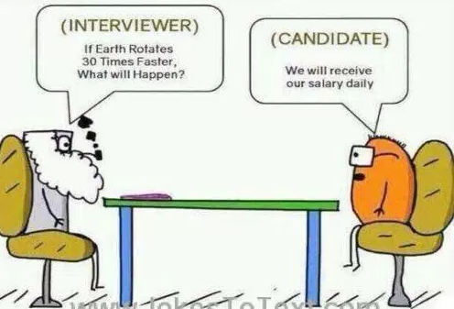
PHYSICS 197 Section 1
Chapter C11
Rotational Energy
September 27, 2017

Slide 2
Review of Last Class
Change in KE:
Work: Total energy transferred into the system:
Positive (Negative) work if the angle between force and displacement is less (greater) than 90⁰. Means energy flows into (out of) the system.
Differential Change | Quantity
Impulse | Momentum
Twirl | Angular Momentum
Work | Energy

Slide 3
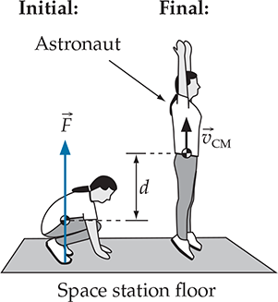
What’s the Difference?

Slide 4

Contact Interactions
Two essentially independent parts:
  Normal force (perpendicular to the interface)
  Friction force (parallel to the interface)

Slide 5
Outline of C11
Energy of a Rotating Object
Calculating Moments of Inertia
Total Energy of a Moving and Rotating Object
Rolling without Slipping

Slide 6
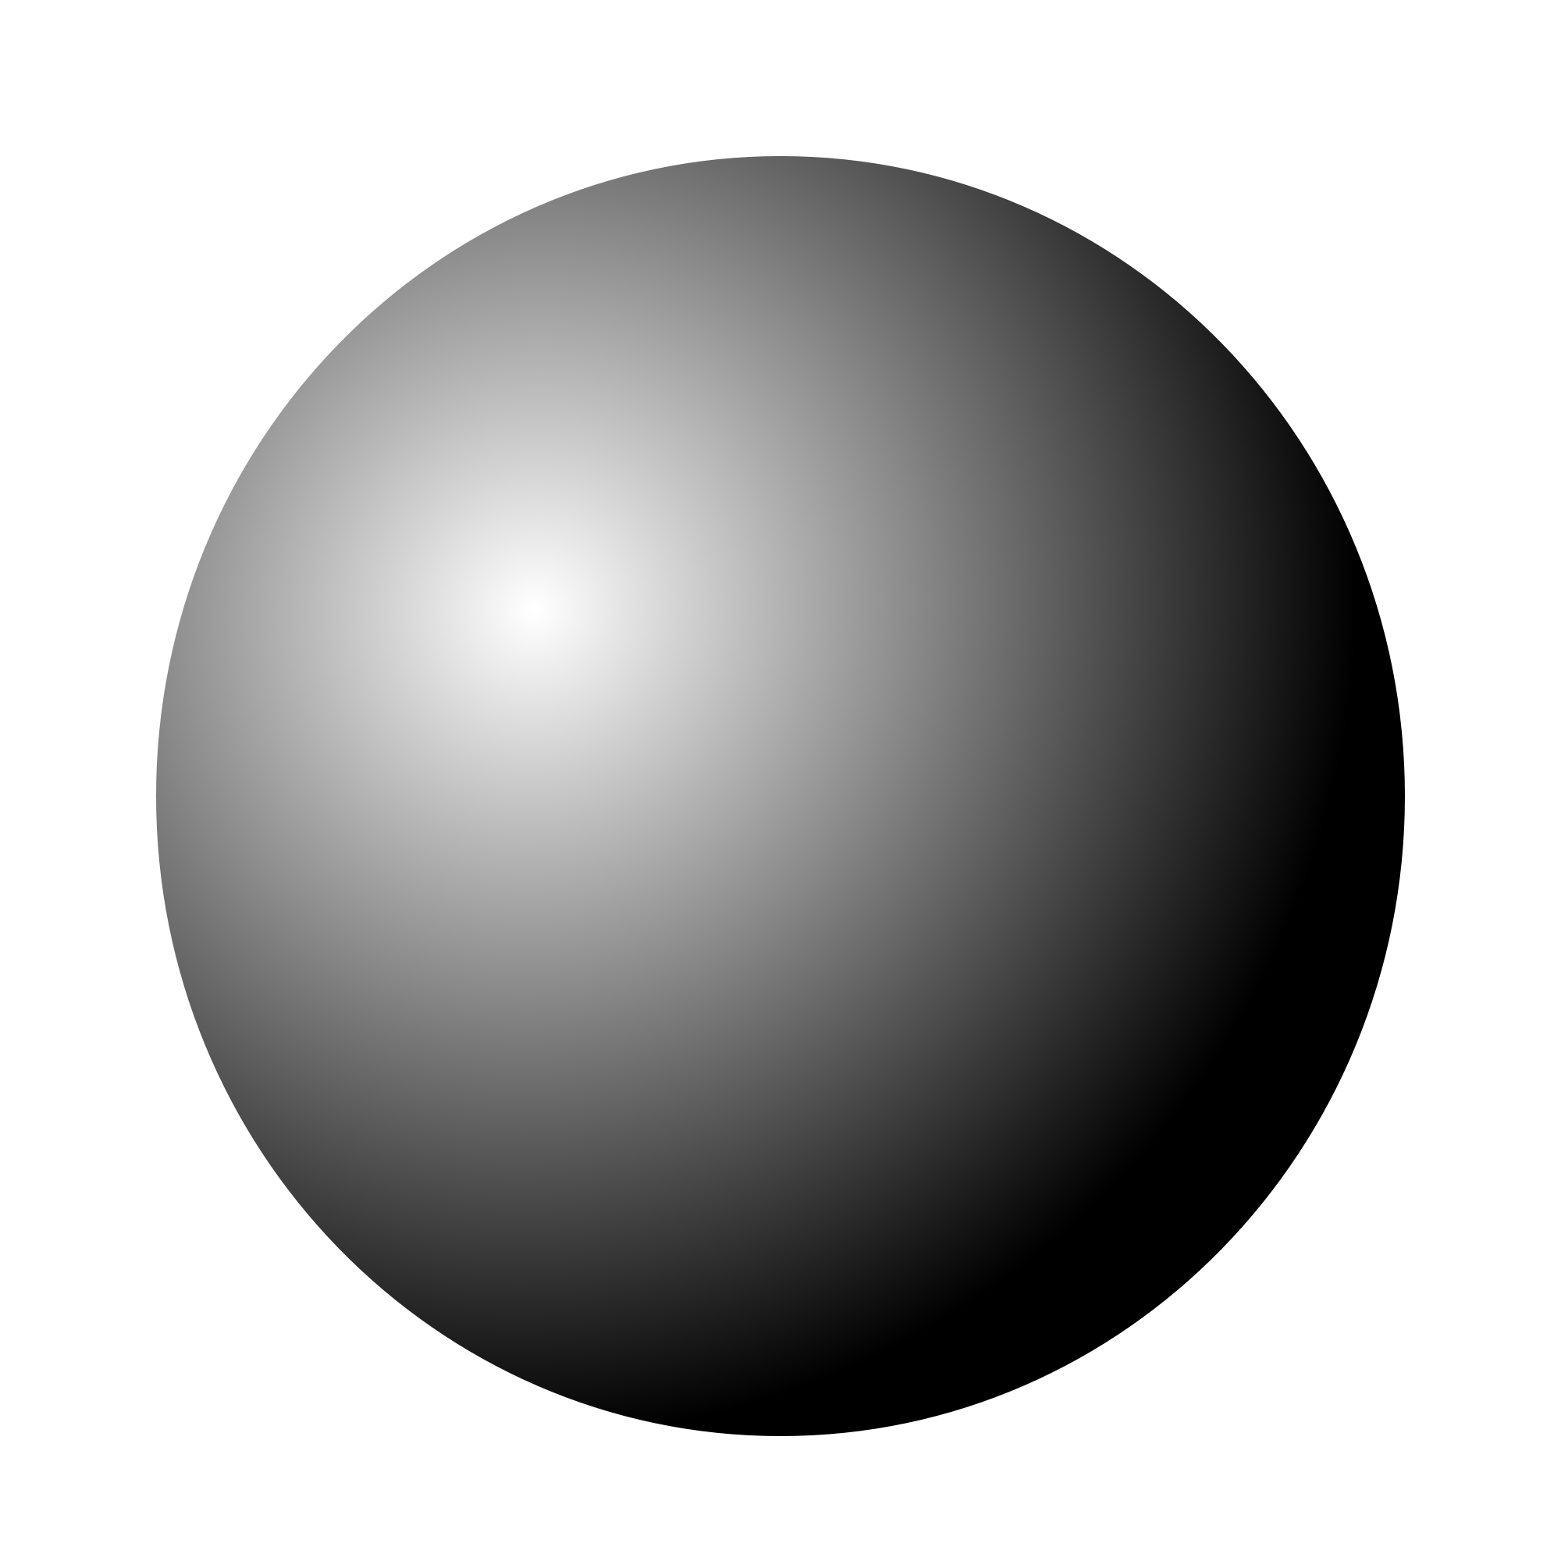
Clicker Question
E
α=0.4
D
α=0.45
C
α=0.5
B
C11T.11 Various objects are released from rest
at the same time and vertical position and roll
without slipping along an incline. The coefficients
for their moments of inertia are given below.
Which object will reach the bottom first?
0.5<α<1
A
α=1
Notes:
Demo

Slide 7
Answer
E
α=0.4
D
α=0.45
C
α=0.5
B
C11T.11 Various objects are released from rest
at the same time and vertical position and roll
without slipping along an incline. The coefficients
for their moments of inertia are given below.
Which object will reach the bottom first?
0.5<α<1
A
α=1
E. The object with smallest α wins the race, because it
  attains the maximum CM speed. We’ll see later how.
Notes:
Demo

Slide 8
Introduction to Rotational Energy
Assume that the objects in the previous question have the same mass.
Since they start from the same height, they must have the same initial gravitational potential energy.
Therefore, they should have the same kinetic energy (and thus speed) at the end, right?
Then why they do NOT reach the bottom at the same time?
Since energy must be conserved, there must be another form of (internal) energy that the potential energy is channeled into.
This is the rotational energy, which is different between the objects in previous question.

Slide 9
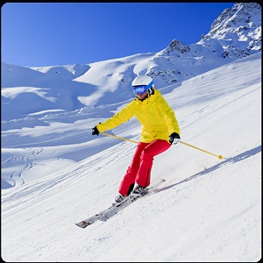
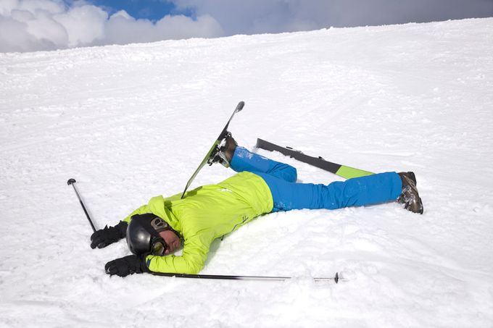
Sliding vs Rolling
Same reason why sliding down a frictionless surface is faster than rolling down.

Slide 10
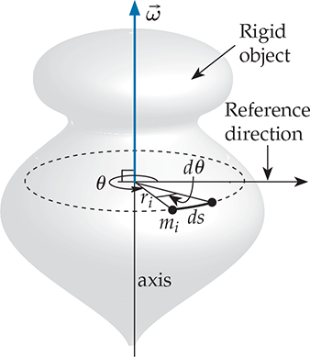
How to Calculate Rotational Energy
where

Slide 11
Question
C11T.12 An isolated star collapses so that its radius is half the original radius. Both its angular momentum and its rotational energy must be conserved. True or False?

Slide 12
Answer
C11T.12 An isolated star collapses so that its radius is half the original radius. Both its angular momentum and its rotational energy must be conserved. True or False?
False. Conserving both at the same time is impossible. The angular momentum must be conserved because the system is isolated, but the rotational energy increases at the expense of its gravitational potential energy, which gets smaller as the star shrinks.
Notes:
Analogy with momentum and KE.

Slide 13
Linear vs. Rotational Motion
Linear Motion | Rotational Motion
Mass | Moment of Inertia
Velocity | Angular Velocity
Momentum | Angular Momentum
Kinetic Energy | Rotational Energy

Slide 14
Clicker Question
C11T.3 Two wheels have the same total mass and radius. One wheel is a uniform disk. The other is like a bicycle wheel, with lightweight spokes connecting the rim to a small hub. Which has the larger moment of inertia?
The solid disk
The wheel with spokes
Moment of inertia is same for both
Need more information.

Slide 15
Answer
C11T.3 Two wheels have the same total mass and radius. One wheel is a uniform disk. The other is like a bicycle wheel, with lightweight spokes connecting the rim to a small hub. Which has the larger moment of inertia?
The solid disk
The wheel with spokes
Moment of inertia is same for both
Need more information.
Explanation: More mass is concentrated at large radii for the wheel with spokes.

Slide 16
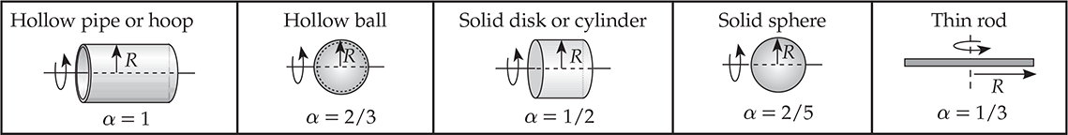
Moments of Inertia for Different Objects
Derivation requires some basic knowledge of integral calculus.

Slide 17
When an Object both Moves and Rotates
We can fortunately separate the total KE into a term (K_{CM}) that depends only on the system’s center-of-mass motion and a term (U^{rot}) that depends only on the system’s internal motions relative to the center-of-mass.

Slide 18
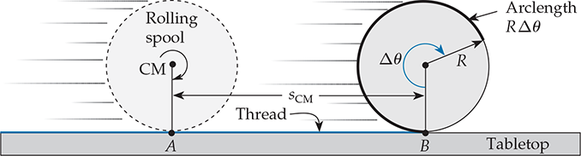

Rolling without Slipping

Slide 19
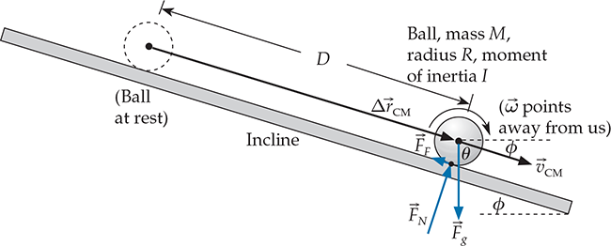
Rolling Down an Incline
The friction force acting on a rolling object only affects its rotational energy.

Slide 20

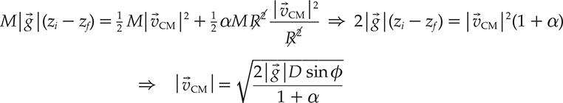
Rolling Down an Incline
For the earth-ball system, conservation of energy implies
Center-of-mass velocity independent of mass and radius.

Slide 21
Practice Problem
C11M.4 In the first scene of the movie Raiders of the Lost Ark, archeologist Indiana Jones inadvertently trips a booby trap and is chased out of a cave by a large spherical rolling stone. If the stone is rolling at 15 mi/h (about as fast as a normal human can run), what minimum vertical distance must it have rolled down before confronting Jones?

Slide 22
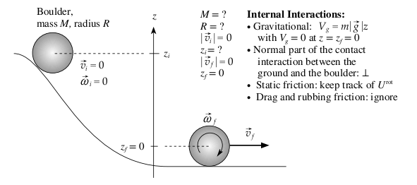

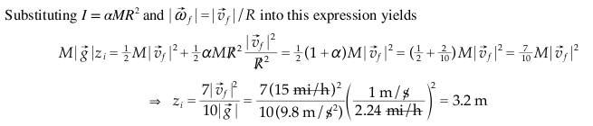
Solution

