Slide 1


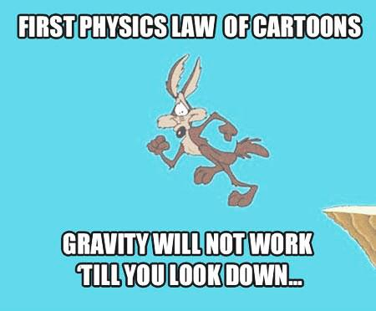
PHYSICS 197 Section 1
Chapter C10
Work
September 25, 2017

Slide 2
Announcements
Slides: Often I don’t get time to cover everything I have on the lecture slides. But please go over them after class and particularly make sure to do the practice problems.
Class Activity: Please participate in class discussions and answer questions.
Clicker Questions: The idea is to encourage in-class discussions. So please talk to your neighbors in class (on the question-related topics only!).
Weekly BB Quiz: Due TODAY 11.59 pm. Go to Course Section Page on BB → Weekly Quizzes → BB Quiz 1.

Slide 3
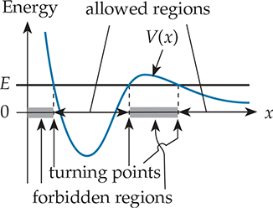
Review of Last Class
Potential energy diagram

Slide 4
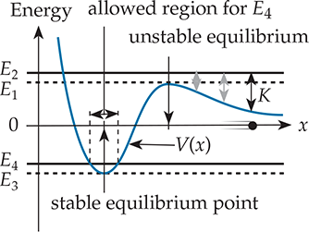
Review of Last Class

Slide 5
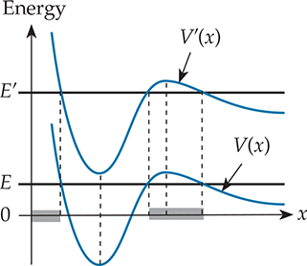
Review of Last Class

Slide 6
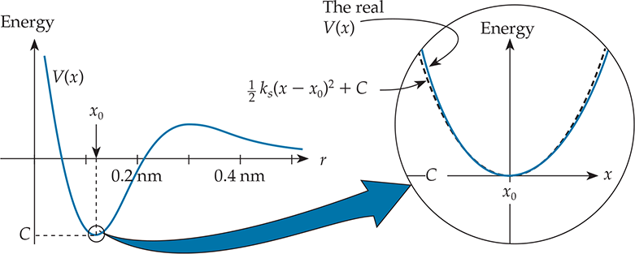
Spring Approximation
PE function near a local minimum can be approximated by the internal energy stored in a compressed/stretched spring.
Notes:
Spring Demo

Slide 7
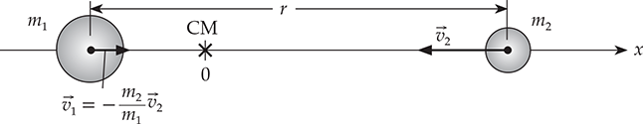

Reduced Mass
Reduced mass

Slide 8
Nose Crusher
C10T.12 A heavy ball swings at the end of a string connected to a hook in the ceiling. Suppose I pull the ball away from its equilibrium position, hold it against my nose (with the string taut), and then release the ball from rest. The ball swings away and then back toward my face. As long as I don’t move, and the ball is left alone, I can be confident that the ball will not smash my nose. True or False?

Slide 9
Answer
C10T.12 A heavy ball swings at the end of a string connected to a hook in the ceiling. Suppose I pull the ball away from its equilibrium position, hold it against my nose (with the string taut), and then release the ball from rest. The ball swings away and then back toward my face. As long as I don’t move, and the ball is left alone, I can be confident that the ball will not smash my nose. True or False?
True. The earth-ball system’s total energy must be conserved, if nothing exterior affects it. So the ball’s maximum potential energy cannot increase, meaning that it cannot go to a greater height than where it was released from rest.

Slide 10
Outline of Chapter C10
Momentum Requirement
Dot Product of Vectors
Definition of Work
Long-range Interactions
Contact Interactions

Slide 11
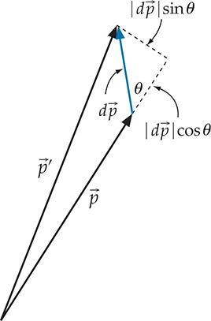
Momentum Requirement
Just follows from conservation of momentum;
nothing to do this conservation of energy.
Will see later what momentum conservation requires regarding energy transfer.

Slide 12
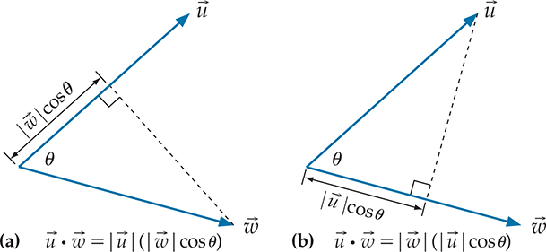
Dot Product
Magnitude of one vector multiplied by the projection of another.
If θ> 90⁰, projection (and hence, dot product) is negative.

Slide 13
Clicker Question
C10T.1 Two hockey pucks are initially at rest on a horizontal plane of frictionless ice. Puck A has twice the mass of puck B. Suppose we apply the same constant force on each puck for the same interval of time dt. How do the pucks’ kinetic energies compare at the end of the interval?

Slide 14
Answer
C10T.1 Two hockey pucks are initially at rest on a horizontal plane of frictionless ice. Puck A has twice the mass of puck B. Suppose we apply the same constant force on each puck for the same interval of time dt. How do the pucks’ kinetic energies compare at the end of the interval?
Explanation: The two pucks pick up the same
momentum transfer, so their final momenta
must be the same. Kinetic energy is p²/2m, so
The ratio of KE is inversely proportional to the
Ratio of masses.

Slide 15
Clicker Question
C10T.2 Two hockey pucks are initially at rest on a horizontal plane of frictionless ice. Puck A has twice the mass of puck B. Suppose we apply the same constant force on each puck until each puck has crossed a finish line 1 m away from its starting point. How do the pucks’ kinetic energies compare at the finish line?

Slide 16
Answer
C10T.2 Two hockey pucks are initially at rest on a horizontal plane of frictionless ice. Puck A has twice the mass of puck B. Suppose we apply the same constant force on each puck until each puck has crossed a finish line 1 m away from its starting point. How do the pucks’ kinetic energies compare at the finish line?
Explanation: In this case, the applied external force
does the same work on both pucks. So change in their
KE must be the same (assuming they are rigid and no
change in their internal energies).

Slide 17
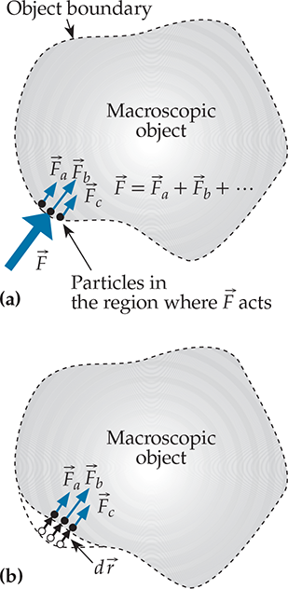

Definition of Work
Total energy transferred into the system by the external interaction:
Total work during a finite displacement:
If the force is constant during the displacement:

Slide 18
What’s the Difference?

Slide 19
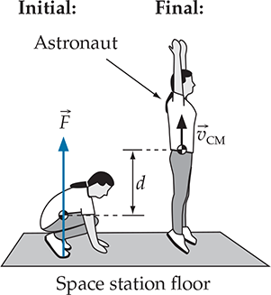
Example

Slide 20
Work
Energy that crosses a system boundary due to an external interaction that exerts a force on the system.
Same unit as energy: Joule (J).
Positive if the angle between force and displacement is less than 90⁰. Means energy flows into the system.
Negative if the angle between force and displacement is greater than 90⁰. Means energy flows out of the system.
Differential Change | Quantity
Impulse | Momentum
Twirl | Angular Momentum
Work | Energy
Notes:
Plot cosine function from 0 to pi.

Slide 21
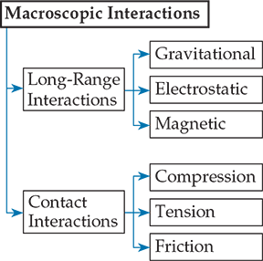
Recall from C2

Slide 22
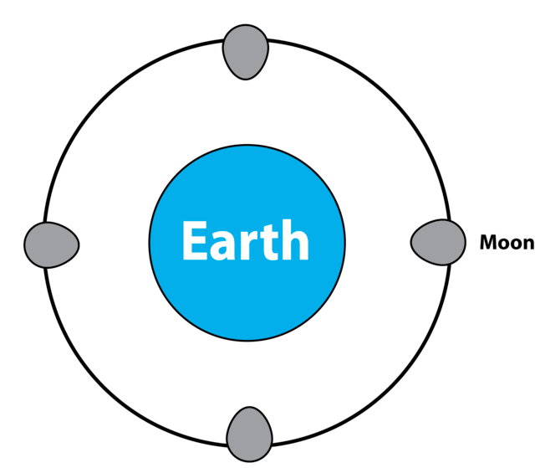
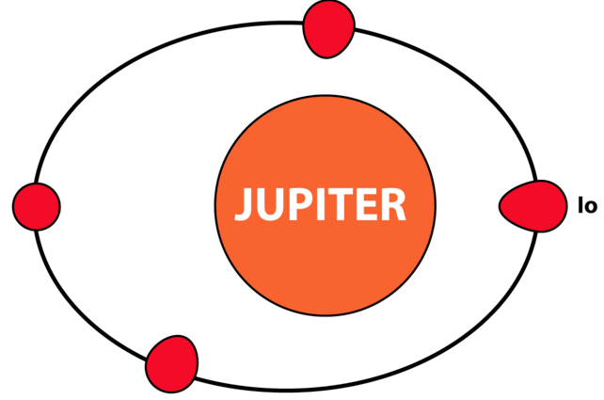
Long-range Interactions

Slide 23

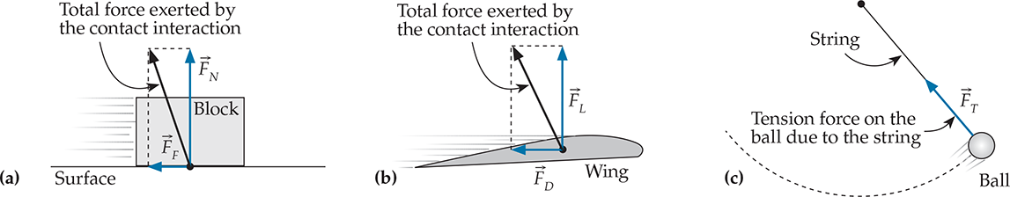
Contact Interactions
Two essentially independent parts:
  Normal force (perpendicular to the interface)
  Friction force (parallel to the interface)

Slide 24
Practice Problem
C10M.9 You are traveling along a highway at 67 mi/h. Just as you begin to climb a 100-ft-tall hill, you run out of gas. You know that there is a gas station on the other side of the hill. Is it even possible that you can coast over the hill if you put the car in neutral and simply let it roll?

Slide 25
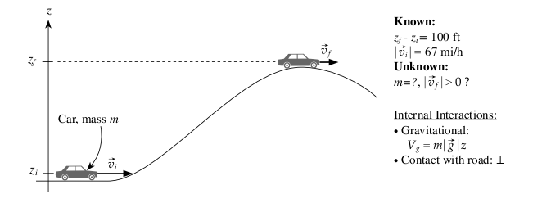
Solution
This is comfortably above zero (~39 mi/h), so you might just make it
(if friction is not significant!)

