Slide 1


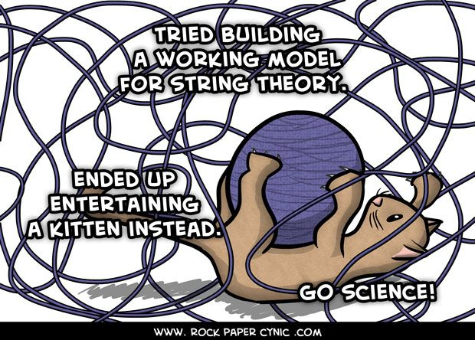
PHYSICS 197 Section 1
Chapter C1
The Art of Model Building
August 30, 2017

Slide 2

Monday’s Demo
A boat carrying a large boulder is floating on a lake. The boulder is thrown overboard and sinks to the bottom of the lake. With respect to the shore, the water level in the lake
Rises
Drops
Stays the same
It depends on other things
There is not enough information given
Notes:
----- Meeting Notes (30/08/2017 08:32) -----
Do you remember from Monday's demo what was the answer?

Slide 3
Monday’s Demo
A boat carrying a large boulder is floating on a lake. The boulder is thrown overboard and sinks to the bottom of the lake. With respect to the shore, the water level in the lake
Rises
Drops
Stays the same
It depends on other things
There is not enough information given
Notes:
----- Meeting Notes (30/08/2017 08:32) -----
The answer has to do with the basic fact that mass=volume x density

Slide 4
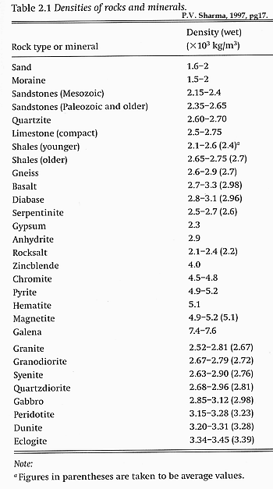
Answer
When in boat, a boulder of mass m displaces a volume of water equal to V₁ = m/ρ_{water} (where ρ_{water} is the density of water).
When submerged in water, the boulder displaces a volume of water equal to the volume of the boulder, which is equal to V₂ = m/ρ_{boulder}.
Since the boulder is denser than water (that’s why it sinks in water), ρ_{boulder} > ρ_{water}.
So V₂ < V₁, or the water level in the lake goes down.
Notes:
For fresh water, the density is 1000 kg/m^3=1x10^3 kg/m^3

Slide 5
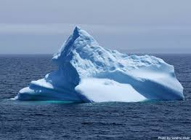
A Practical Application
Melting icebergs cause sea level to
Rise
Drop
Stay the same
No idea

Slide 6
A Practical Application
Melting icebergs cause sea level to
Rise
Drop
Stay the same
No idea

Slide 7
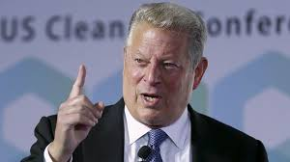
Answer
Icebergs are made of fresh water.
Salt water is denser than fresh water (ρ_{fresh} _{water} = 1 kg/liter, whereas ρ_{sea} _{water} = 1.025 kg/liter)
For example, a million kg floating iceberg in a saltwater ocean displaces a million kg of saltwater, which is not a million liters, but only 975,610 liters.
The melted iceberg adds a million liters of freshwater to the ocean.
So melting icebergs do contribute to global-warming sea-level rise.
Notes:
1000 kg/m^3 = 1 kg/liter, as 1 liter = 10^-3 m^3 (see front cover)
Who is the person here? Al Gore, a noted climate change activist and former Vice President of the US

Slide 8
Demo: Intuition
The red ball has been rolling inside the (3/4) fence.
When it reaches the gap, which path it will take?
Path A
Path B
Path C
Some other path
I don’t know.
Notes:
Clicker?
Do the demo

Slide 9
Demo: Intuition
The red ball has been rolling inside the (3/4) fence.
When it reaches the gap, which path it will take?
Path A
Path B
Path C
Some other path
I don’t know.
Notes:
Direction of Velocity is tangent to each point on the track.

Slide 10
Chapter C1 Overview
The Nature of Science
The Development and Structure of Physics
Model Building
Unit Awareness
Unit Conversions
Dimensional Analysis

Slide 11
Chapter C1 Overview
The Nature of Science
The Development and Structure of Physics
Model Building
Unit Awareness
Unit Conversions
Dimensional Analysis

Slide 12
The Nature of Science
Science is a process for building, evaluating and refining conceptual models of physical reality.
Involves four crucial elements coming together:
  A sufficiently large community of scholars, who share
  A commitment to logical consistency as an essential feature of all models
  An agreement to use reproducible experiments to test models
  A grand theory rich enough to provide a solid foundation for research
Example: Astrology is not a science, because it lacks (which of the above four elements?)
  the use of reproducible experiments to test it.
Notes:
Why astrology is not a science (one of your daily HW)? Let’s see how many did it correctly.

Slide 13
Chapter C1 Overview
The Nature of Science
The Development and Structure of Physics
Model Building
Unit Awareness
Unit Conversions
Dimensional Analysis

Slide 14

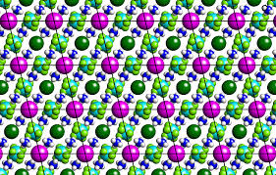
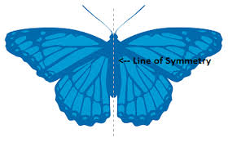
Symmetry Principles
What do we mean by symmetry of a system?
Symmetry principles have played a pivotal role in the development of modern physics.
Symmetry is an operation under which the system remains unchanged.
Reflection
Rotation
Translation
Notes:
Isn’t a symmetric structure more beautiful than asymmetric one? I am not talking about modern art, which is often random and asymmetric.

Slide 15
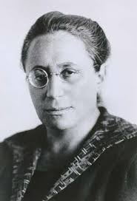
Conservation Laws
Noether’s theorem: A symmetry principle implies an associated conservation law.
So symmetry principles must be deeper than conservation laws.
Symmetry | Conservation of
Translation in time | Energy
Translation in space | Momentum
Rotation in space | Angular Momentum
Reflection | Parity
Notes:
Emmy Noether, German Mathematician in the early 20th century.
Reflection is different from other symmetries listed here. Why? Because it is discrete, while others are continuous.

Slide 16
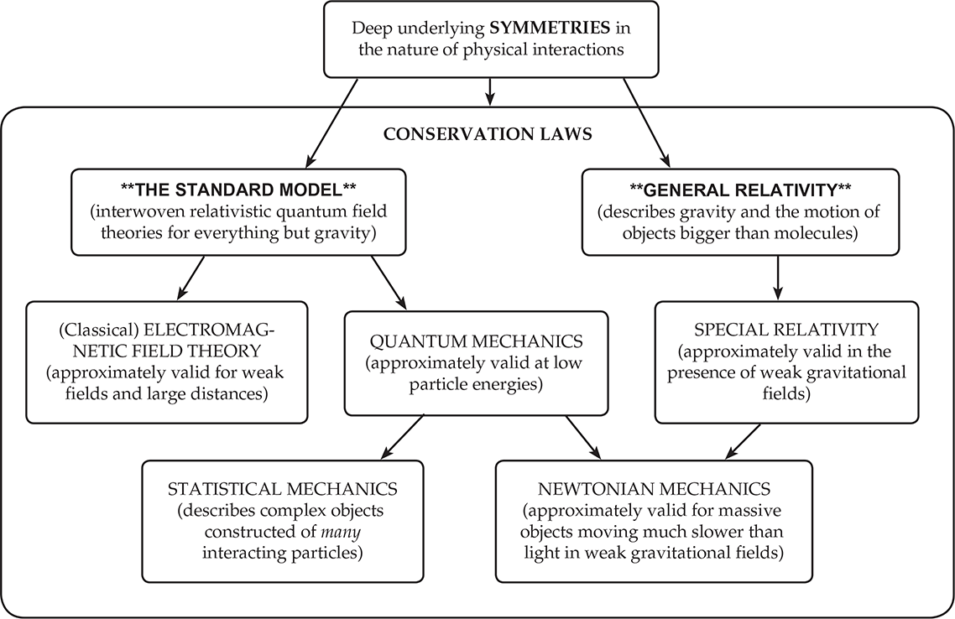
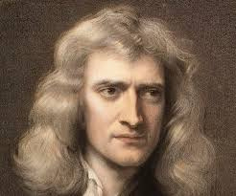
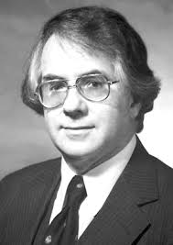
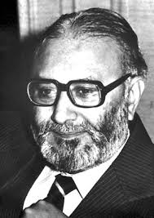
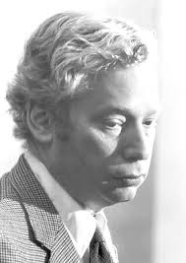
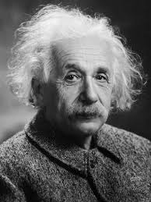
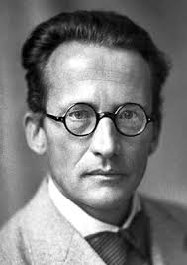
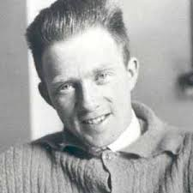
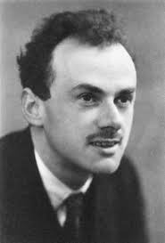
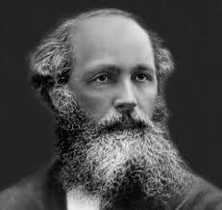

Unification of Models

Slide 17
Chapter C1 Overview
The Nature of Science
The Development and Structure of Physics
Model Building
Unit Awareness
Unit Conversions
Dimensional Analysis

Slide 18
Model Building
An art that requires knowledge, intelligence, creativity, and most importantly, practice.
Models are essential because reality is often far too complicated to analyze.
A good model captures the essence of reality while being small and simple enough to be grasped.
The trick is simplifying just enough to make the problem tractable without making the result uselessly crude.
Weakest-link Rule: Identify the most uncertain quantity in the problem and not sweat stuff smaller than this.

Slide 19
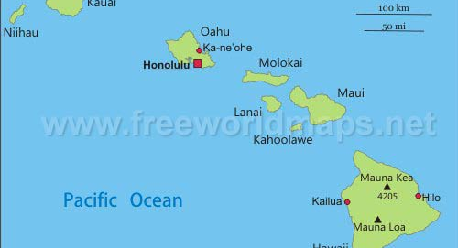
A Model Building Example
Suppose you are standing on a southeast-facing beach on the Hawaiian island Kauai on a clear day. Can you see the top of Mauna Kea on the Big Island?

Slide 20
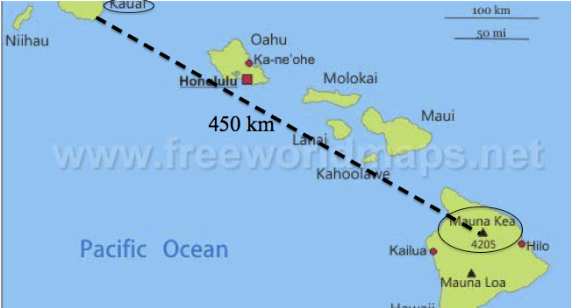
A Model Building Example
Suppose you are standing on a southeast-facing beach on the Hawaiian island Kauai on a clear day. Can you see the top of Mauna Kea on the Big Island?

Slide 21
Solution in Three Steps
Model: Draw a schematic diagram and/or discuss approximations and assumptions.
Math: Do the math implied by the model to solve for the desired result.
Check: Does the solution make sense?
Making mistakes (and then correcting them) is an honorable part of the learning process.
“An expert is who knows …. the worst errors that can be made in a subject …. and how to avoid them.” --Heisenberg

Slide 22
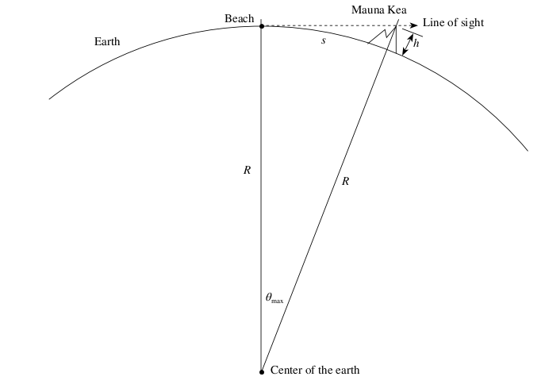
Step 1: Model

Slide 23


Step 2: Math
Height of Mauna Kea, h = 4205 m = 4.2 km
Radius of Earth, R = 6380 km

Slide 24
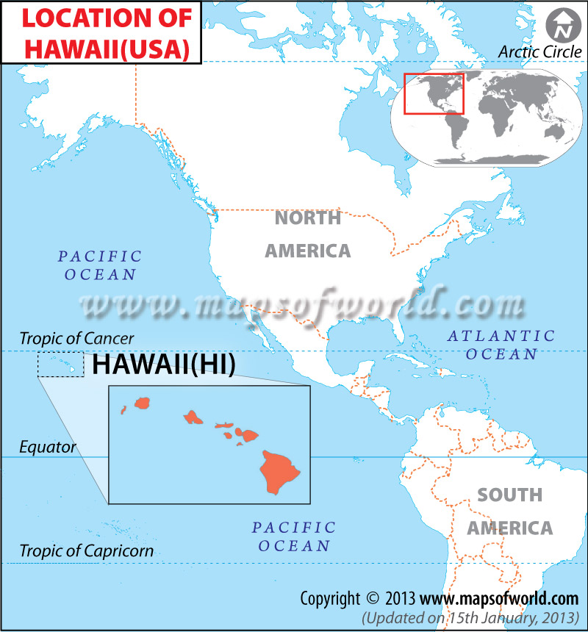
Step 3: Check
Actual distance between the southeastern part of Kauai and Mauna Kea is about 450 km.
So the peak of Mauna Kea will be below the horizon, and hence, not visible from Kauai.
How good is our assumption that the Earth is spherical?
Earth’s polar radius is smaller than its equatorial radius by only 11km.
Won’t change our conclusion at all (also Hawaii is pretty close to the equator).

Slide 25
Chapter C1 Overview
The Nature of Science
The Development and Structure of Physics
Model Building
Unit Awareness
Unit Conversions
Dimensional Analysis

Slide 26
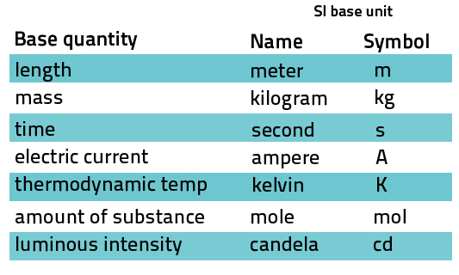
Unit Awareness
Units attach physical meaning to bare numbers.
We will mostly use SI units.
Seven base units and several derived units.

Slide 27
Unit Awareness
Be constantly vigilant of units!
You cannot add or subtract quantities with different units (e.g. 10 m + 3 kg is nonsense!)
You can multiply and divide quantities with different units, but you need to keep track of the units at the end (e.g. [length/time] = m/s)
Mathematical functions [such as sin x, e^{x}, log x] all require unitless arguments (x must be unitless) and must yield unitless results.
Angles in both degrees and radians are considered unitless, but be careful while converting one to the other.
An easy way to spot mistakes in a calculation is to check units.

Slide 28
Clicker Question
Assume that D and R have units of meters, T has units of seconds, m and M have units of kilograms, v has units of meters per second, and g has units of m/s². Which of the following equations has self-consistent units?
D = mR²
m = M(1+R²)
D = (1−m/M)gT²
g = mv²/R

Slide 29
Clicker Question
Assume that D and R have units of meters, T has units of seconds, m and M have units of kilograms, v has units of meters per second, and g has units of m/s². Which of the following equations has self-consistent units?
D = mR²
m = M(1+R²)
D = (1−m/M)gT²
g = mv²/R

Slide 30
Chapter C1 Overview
The Nature of Science
The Development and Structure of Physics
Model Building
Unit Awareness
Unit Conversions
Dimensional Analysis

Slide 31
Unit Conversions
Use the unit operator method to change units.
Rearrange factors and cancel the units that appear in both numerator and denominator.
Absolutely foolproof method as long as you make sure to cancel the unwanted units.
Example: A car is going at 60 miles per hour on I-64W. What is the speed in m/s?
1 mile = 1.609 km = 1609 m
1 hour = 60 min = 3600 s
So 60 mile/hour = 60 (mile/hour).(1609 m/1 mile).(1 hour/3600 s) = 26.8 m/s

Slide 32
Chapter C1 Overview
The Nature of Science
The Development and Structure of Physics
Model Building
Unit Awareness
Unit Conversions
Dimensional Analysis

Slide 33
Dimensional Analysis
The units of both sides of any equation must be consistent.
Just combining this fact with simple plausibility arguments, we can guess an expression for a physical quantity even if we don’t know almost anything about the underlying physics.
Often represents the simplest model one can construct.

Slide 34
Example
The speed v of sound waves in a gas like air might plausibly depend on the gas’s pressure P (which has units of N/m²), the gas’s density ρ(which has units of kg/m³) and its temperature T (which has units of K), and some unitless constant C. Assuming that no other quantities are relevant, which of the following formulas might possibly correctly give the speed of sound in a gas?
v = CPρT
v = CTP/ρ
v = CP/ρ
v = C√(P/ρ)
v = C√(ρ/P)
Notes:
Write v=C P^a \rho^b T^c
LHS = ms^-1; so RHS must be that

Slide 35
Example
The speed v of sound waves in a gas like air might plausibly depend on the gas’s pressure P (which has units of N/m²), the gas’s density ρ(which has units of kg/m³) and its temperature T (which has units of K), and some unitless constant C. Assuming that no other quantities are relevant, which of the following formulas might possibly correctly give the speed of sound in a gas?
v = CPρT
v = CTP/ρ
v = CP/ρ
v = C√(P/ρ)

Slide 36
Reminders for Next Class
Buy textbooks and Connect (or get the 14-day trial version of Connect in the meantime)
Become familiar with Connect (make sure you have adobe flash installed on your computer)
Get your clicker from Olin Library Help Desk
Read Learnsmart Chapter C2 and complete the daily homework by 11.59 pm on 8/31.

